Slide 1
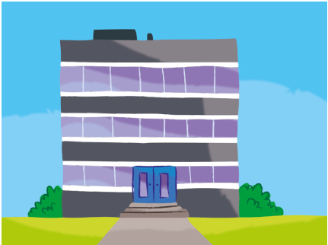
1. Dad works in the

Slide 2
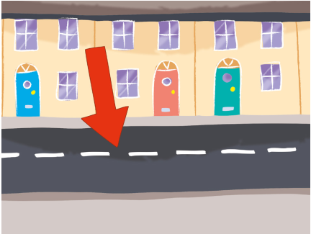
2. He lives on Green

Slide 3
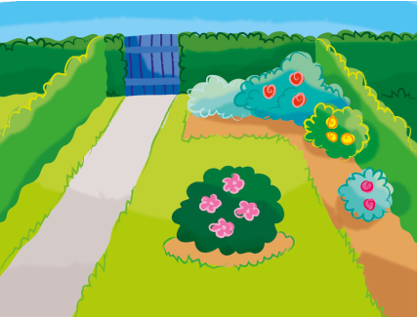
3. She plays in the

Slide 4
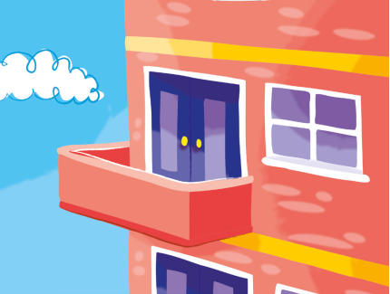
4. Sam lives in the

Slide 5
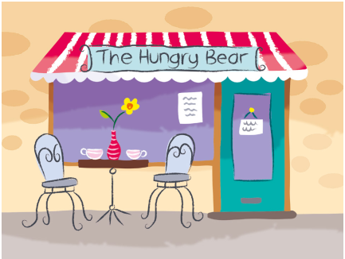
5. Kate eats ice cream in the

Slide 6
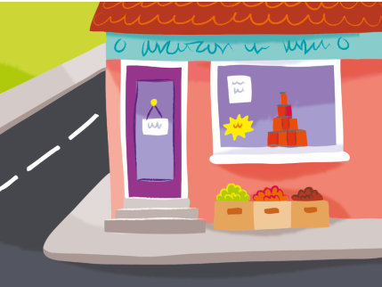
6. Mum works in the

Slide 7
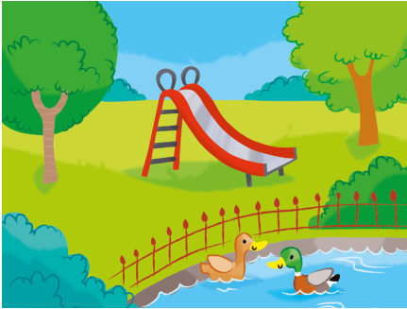
7. Bob plays in the

Slide 8
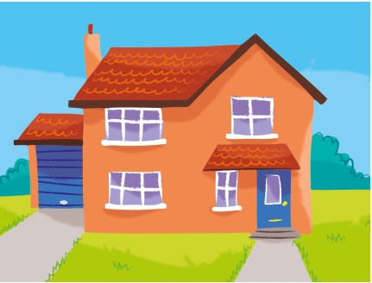
8. Sally lives in the

