Slide 1
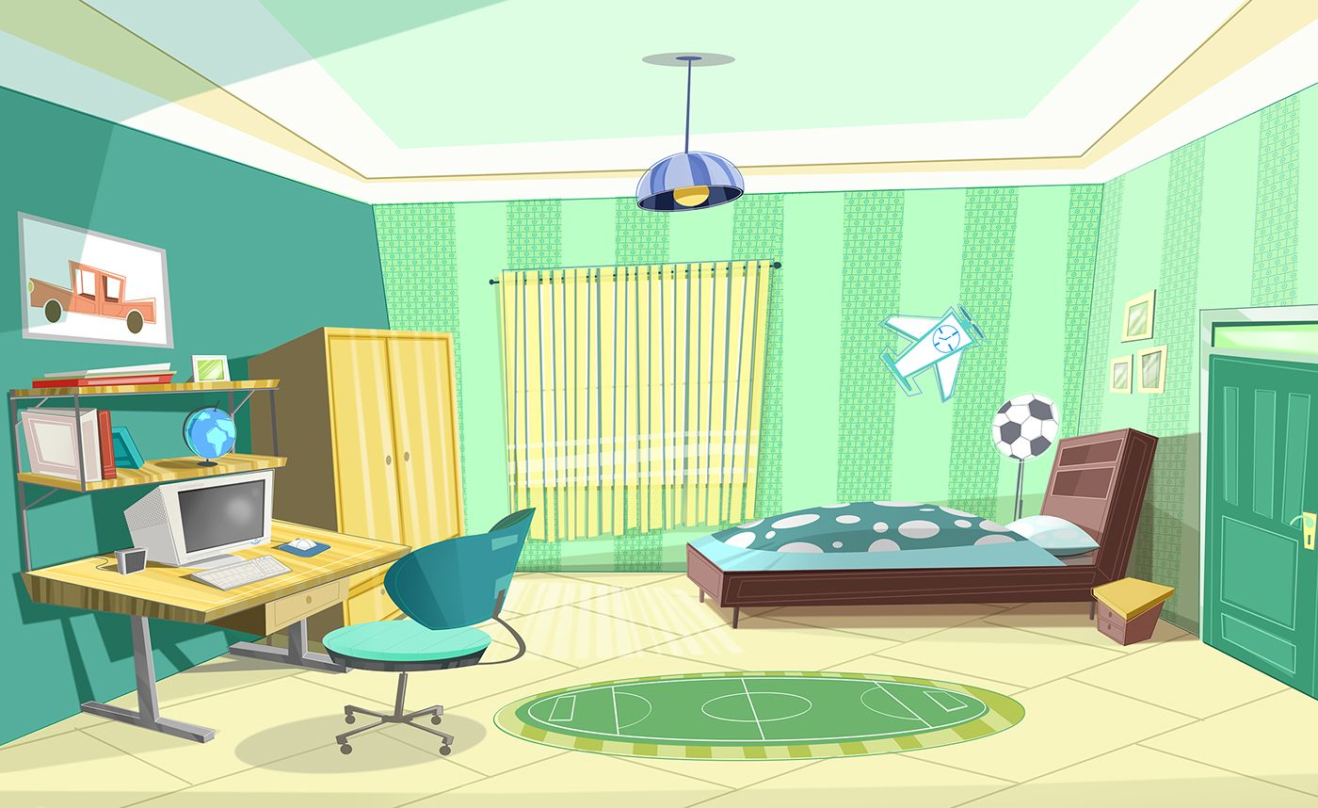




IrinaPapakhina

Slide 2
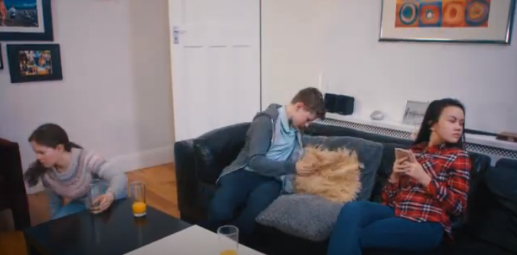
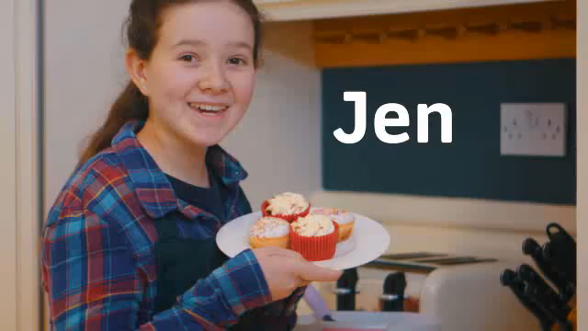
Look at the photo.
Where are the children?
What can you see in the room?
3. GUESS: What are the children looking for?
Watch the video and check your answers.
IrinaPapakhina

Slide 3
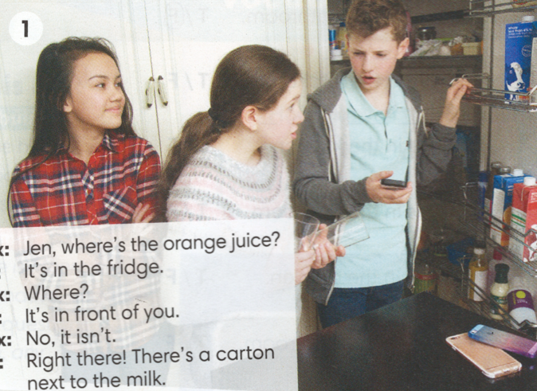

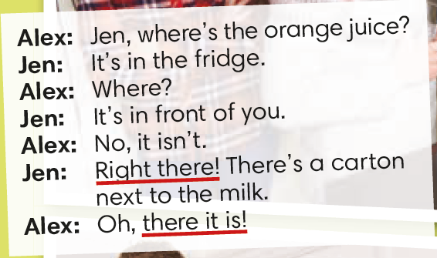
IrinaPapakhina

Slide 4
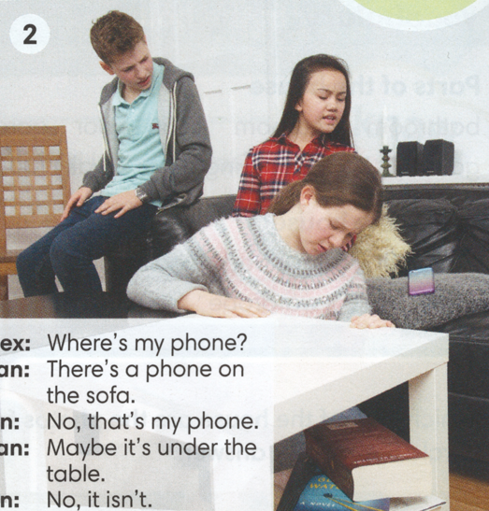

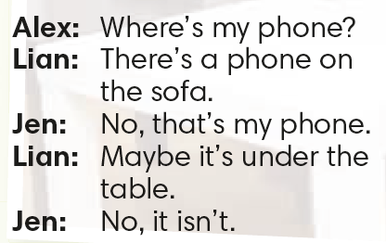
IrinaPapakhina

Slide 5
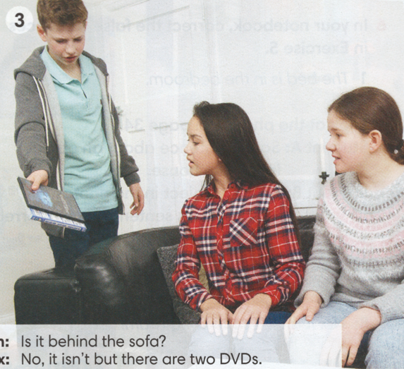

IrinaPapakhina

Slide 6
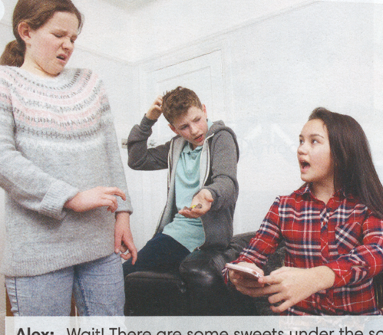
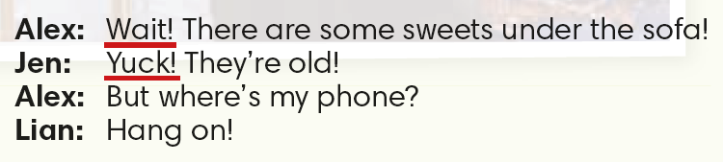
4
IrinaPapakhina

Slide 7


IrinaPapakhina

Slide 8
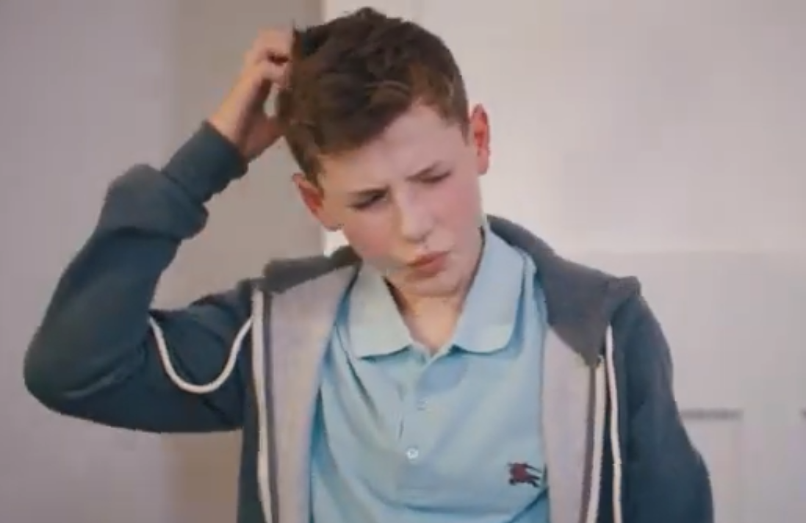

GUESS: Where is Alex’s phone?
Watch the video and check your answers.
IrinaPapakhina

Slide 9
Complete the sentences.
There’s
__________ a phone on the sofa.
No, it isn’t but __________ two DVDs.
there are
IrinaPapakhina

Slide 10
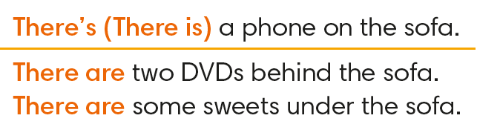
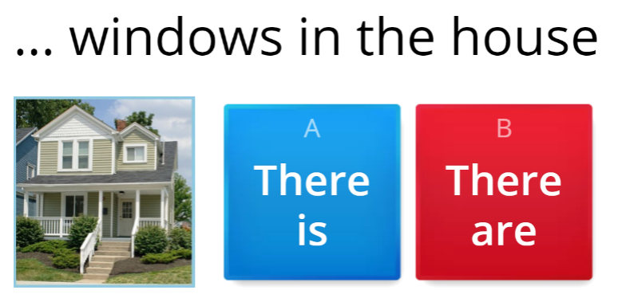
IrinaPapakhina

Slide 11
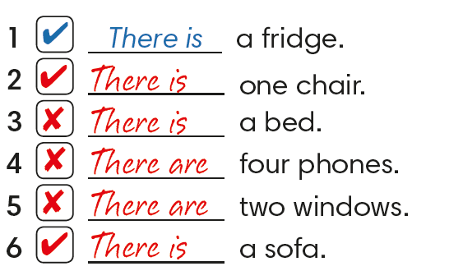
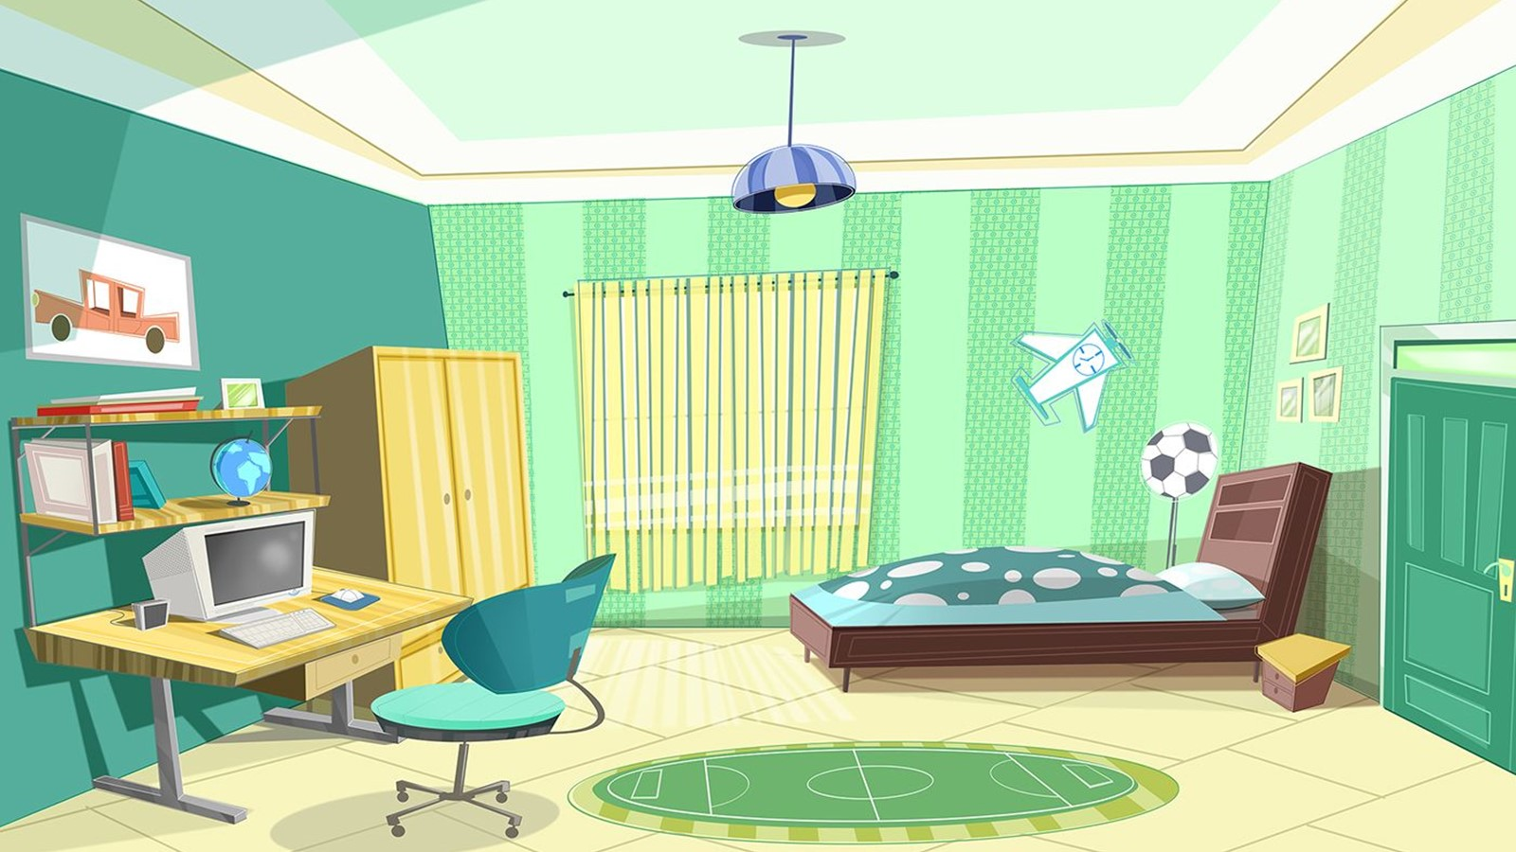
Complete the sentences with There is or There are.
Look at the photos and tick (V) the true sentences.
IrinaPapakhina

Slide 12
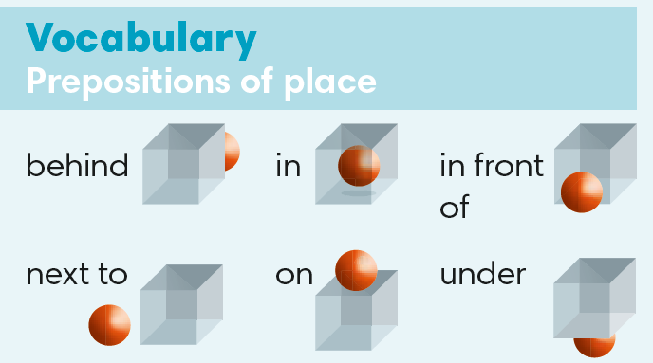
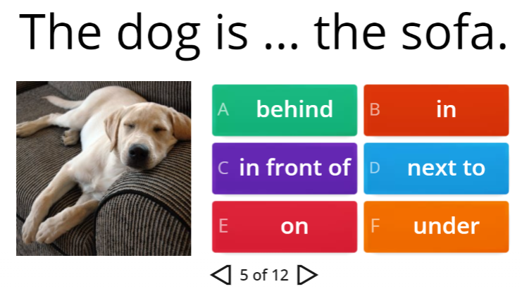
IrinaPapakhina

Slide 13
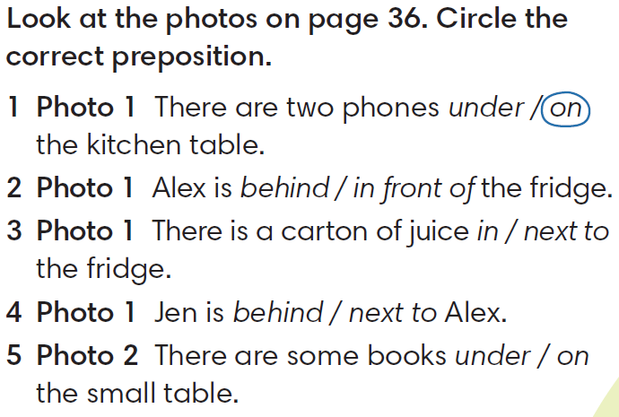
IrinaPapakhina

Slide 14
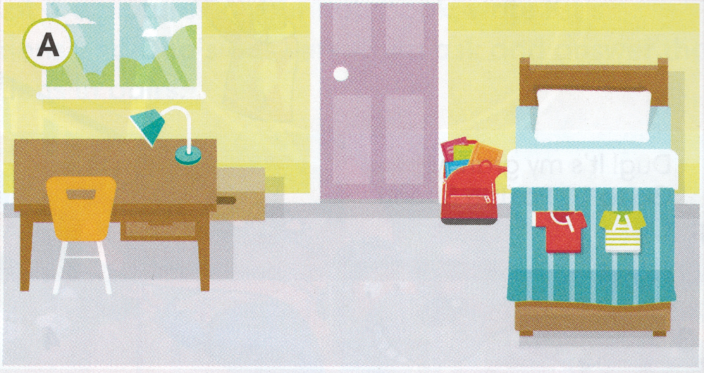
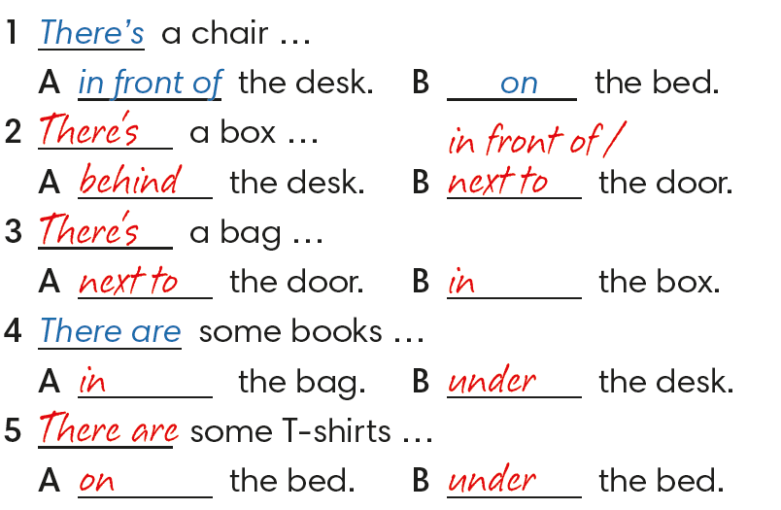
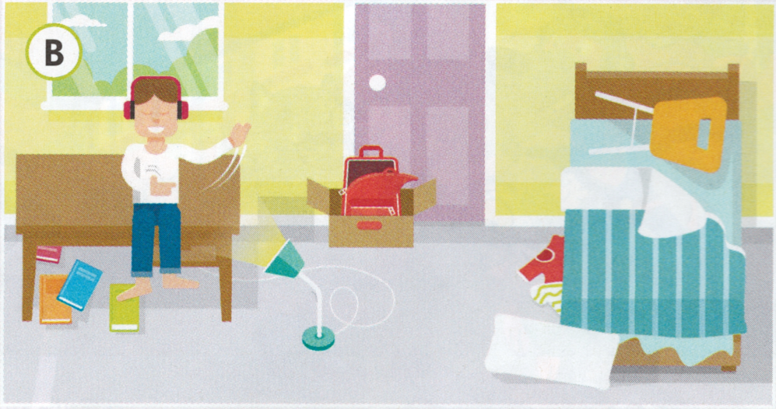
IrinaPapakhina

Slide 15
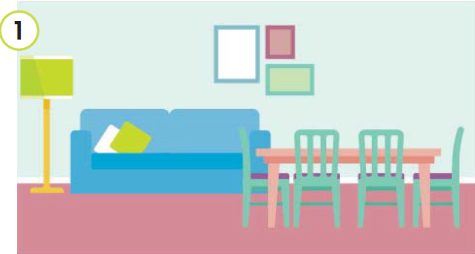
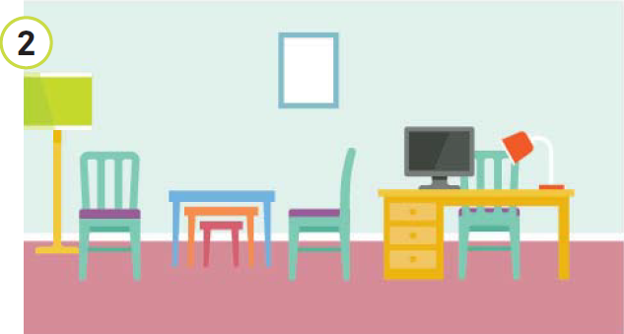
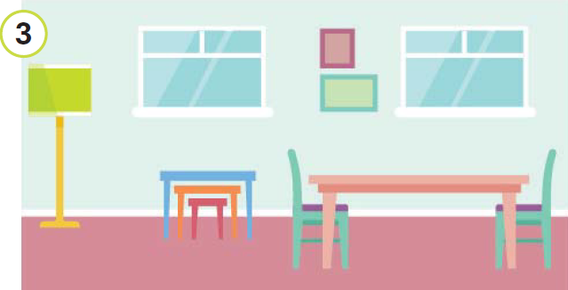
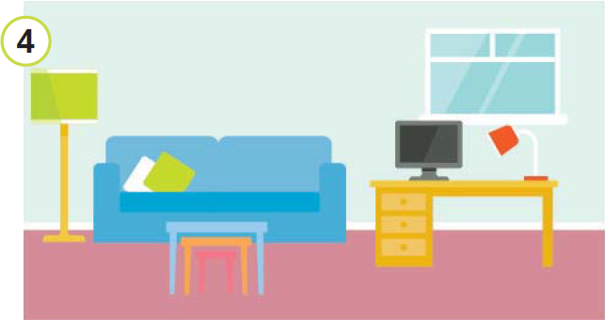
IrinaPapakhina

Slide 16
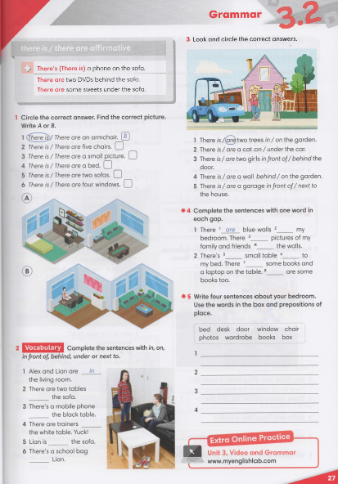


IrinaPapakhina

Slide 17
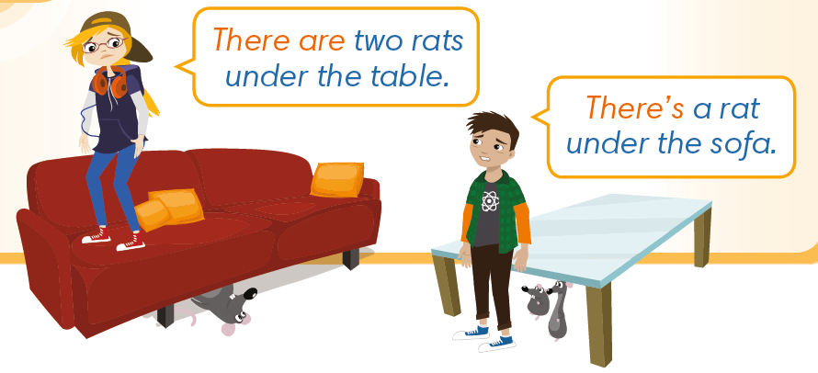

Watch the video and say how many rats
there are in the house.
How many rats are there in the picture?
IrinaPapakhina

Slide 18
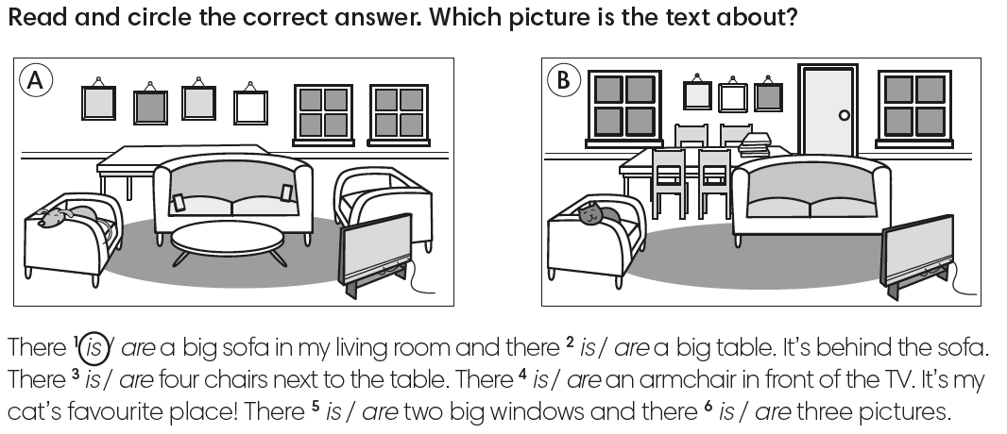
Picture A
Picture B
IrinaPapakhina

Slide 19
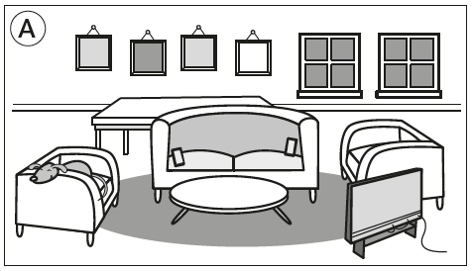
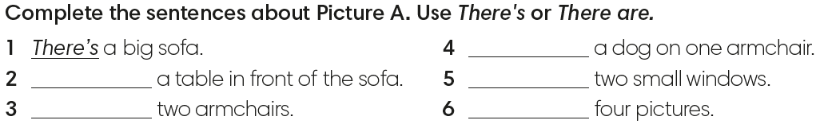
There’s
There’s
There are
There are
There are
IrinaPapakhina

Slide 20
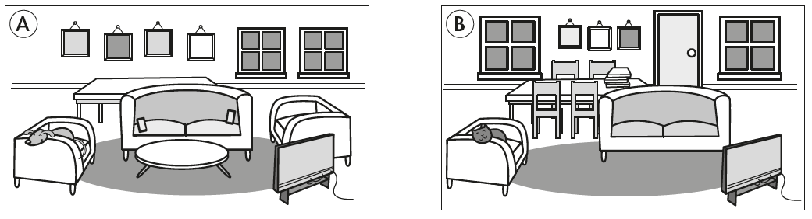
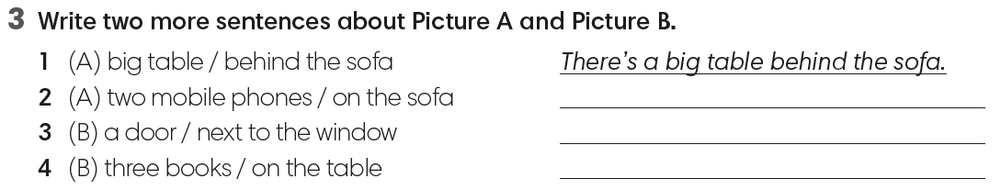
There are two mobile phones on the sofa.
There is a door next to the window.
There are three books on the table.
IrinaPapakhina

Slide 21
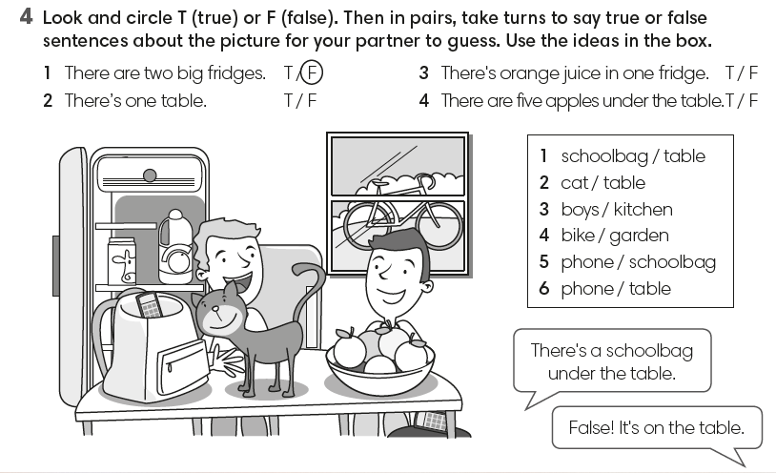
IrinaPapakhina

