Slide 1
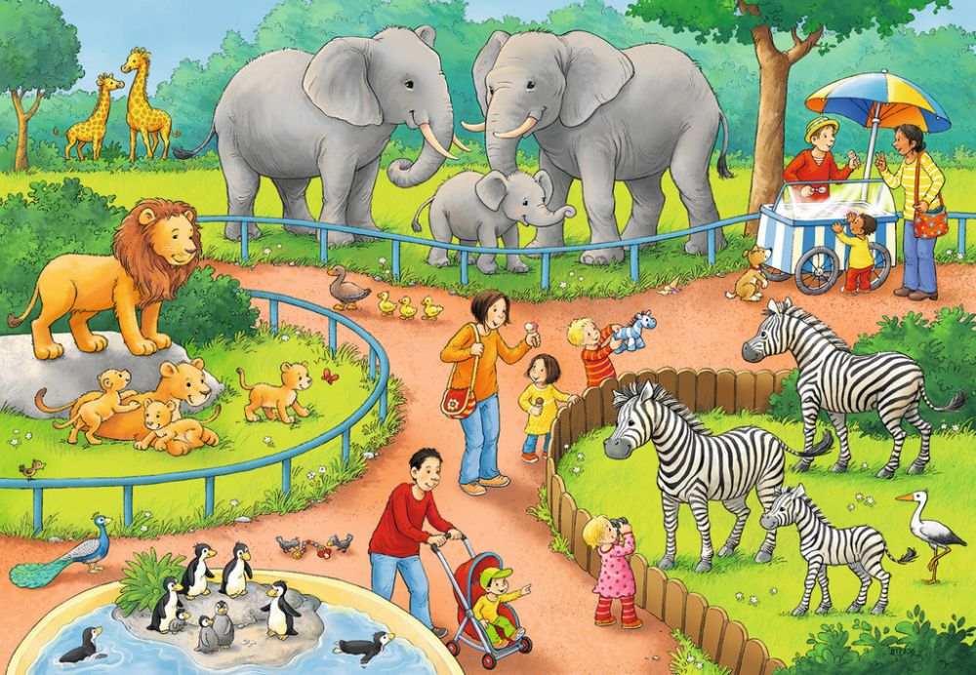
How many elephants are there?
There are …

Slide 2
How many giraffes are there?
There are …

Slide 3
How many zebras are there?
There are …

Slide 4
How many lions are there?
There are …

Slide 5
How many penguins are there?
There are …

Slide 6
How many ducklings are there?
There are …

Slide 7
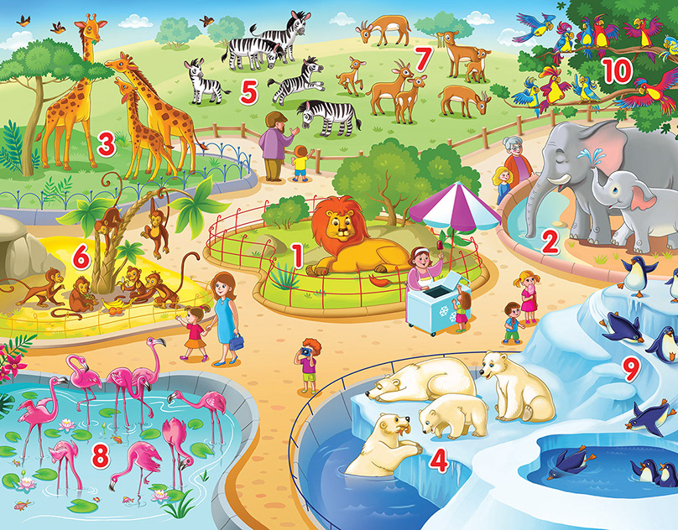
How many giraffes are there?
There are …

Slide 8
How many zebras are there?
There are …

Slide 9
How many deer are there?
There are …

Slide 10
How many parrots are there?
There are …

Slide 11
How many elephants are there?
There are …

Slide 12
How many penguins are there?
There are …

Slide 13
How many polar bears are there?
There are …

Slide 14
How many flamingos are there?
There are …

Slide 15
How many monkeys are there?
There are …

