Slide 1

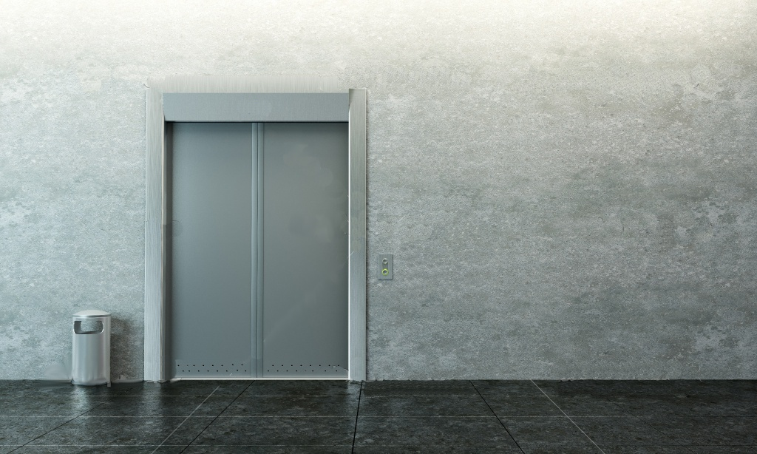
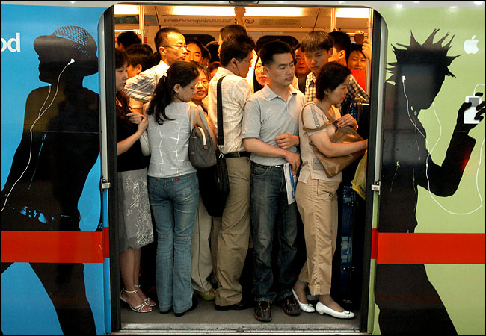
0
ORDINAL
NUMBERS
by HERBER

Slide 2
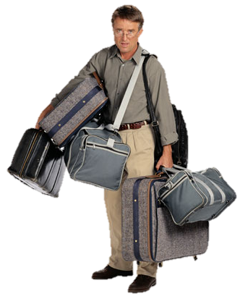
1 st
FIRST

Slide 3
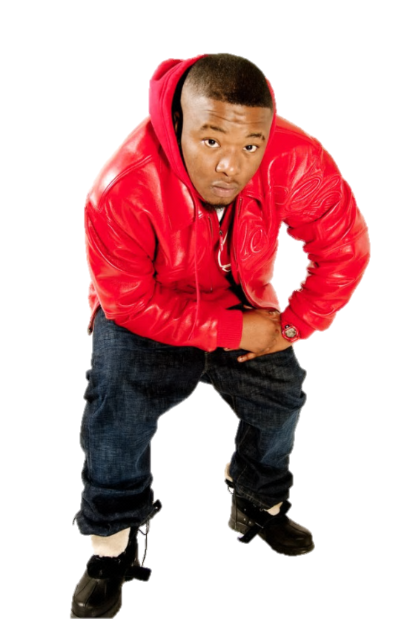
2 nd
SECOND

Slide 4

3 rd
THIRD

Slide 5

4 th
FOURTH

Slide 6

5 th
FIFTH

Slide 7

6 th
SIXTH

Slide 8

7 th
SEVENTH

Slide 9
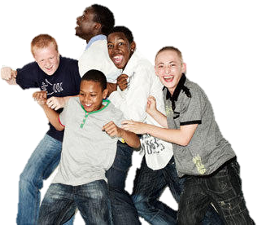
8 th
EIGHTH

Slide 10

9 th
NINTH

Slide 11

10 th
TENTH

Slide 12

11 th
ELEVENTH

Slide 13
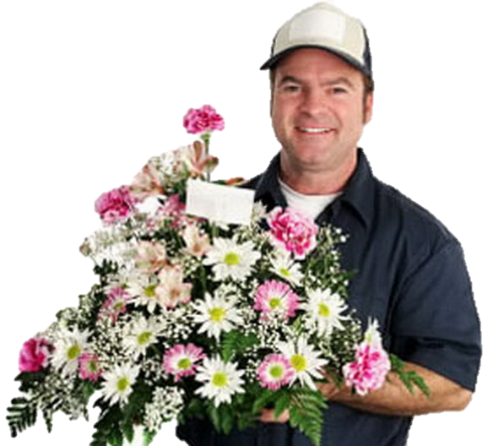
12 th
TWELFTH

Slide 14

13 th
THIRTEENTH

Slide 15
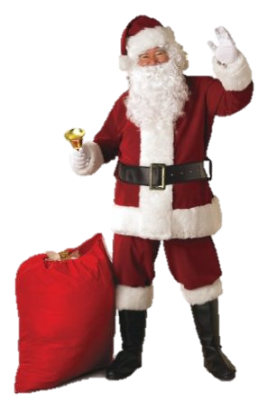
14 th
FOURTEENTH

Slide 16

15 th
FIFTEENTH

Slide 17
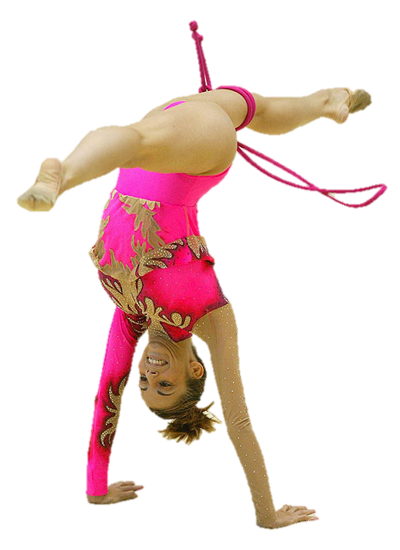
16 th
SIXTEENTH

Slide 18

17 th
SEVENTEENTH

Slide 19
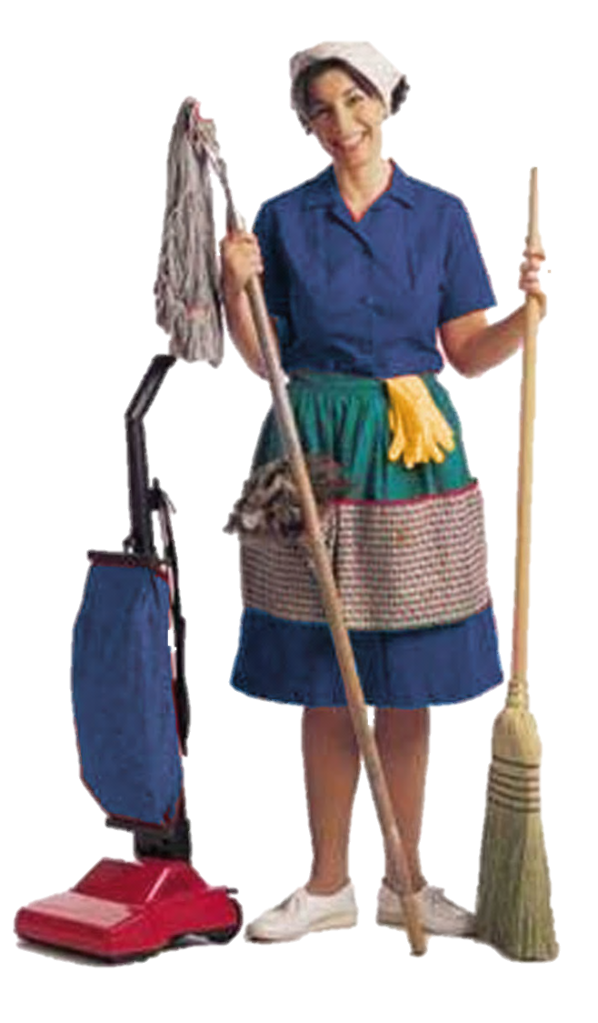
18 th
EIGHTEENTH

Slide 20
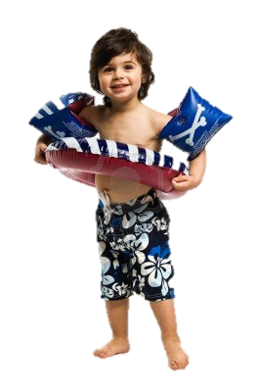
19 th
NINETEENTH

Slide 21
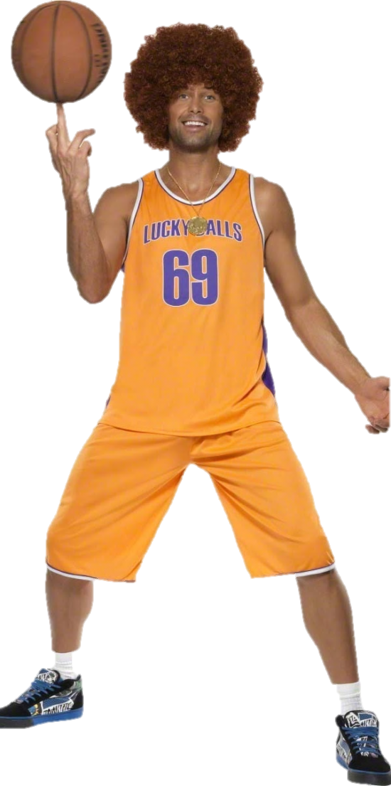
20 th
TWENTIETH

Slide 22
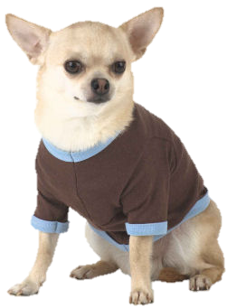
21 st
TWENTY-FIRST

Slide 23
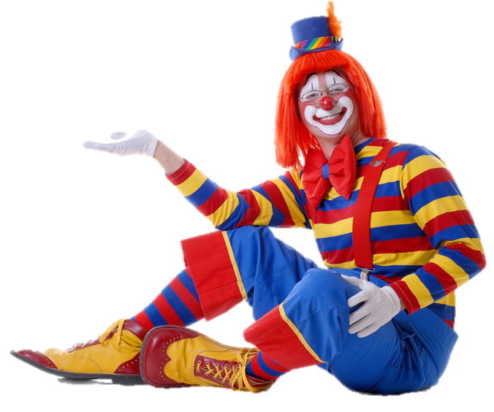
22 nd
TWENTY-SECOND

Slide 24
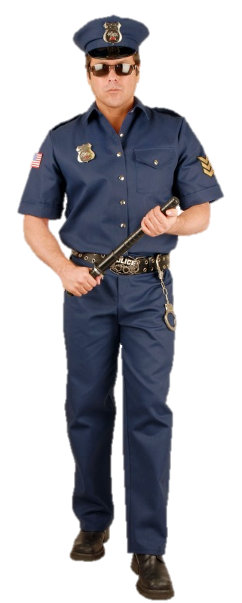
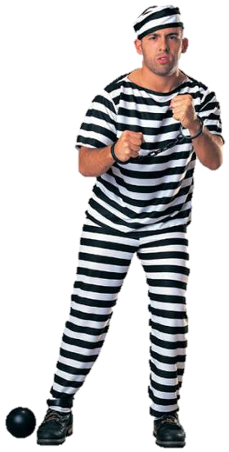
23 rd
TWENTY-THIRD

Slide 25
24 th
TWENTY-FOURTH

Slide 26
25 th
TWENTY-FIFTH

Slide 27
26 th
TWENTY-SIXTH

Slide 28
27 th
TWENTY-SEVENTH

Slide 29
28 th
TWENTY-EIGHTH

Slide 30
29 th
TWENTY-NINTH

Slide 31
30 th
THIRTIETH

Slide 32


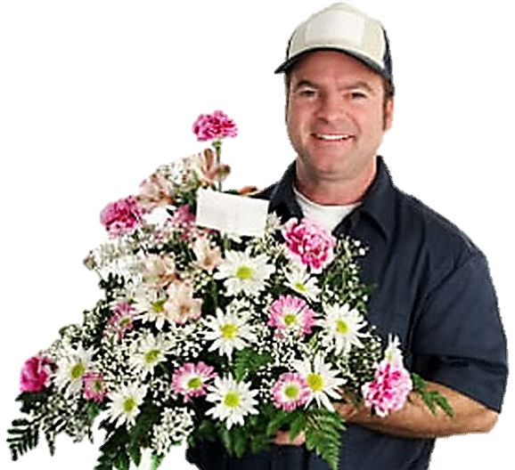
Help me, please! I’m going to the third floor
11
12
9
10
7
8
5
6
3
4
1
2

Slide 33
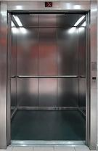
3 rd
third
Thank you!

Slide 34

I’m going to the fifth floor
11
12
9
10
7
8
5
6
3
4
1
2

Slide 35
5 th
fifth
Thank you!

Slide 36

I’m going to the ninth floor
11
12
9
10
7
8
5
6
3
4
1
2

Slide 37
9 th
ninth
Thank you!

Slide 38
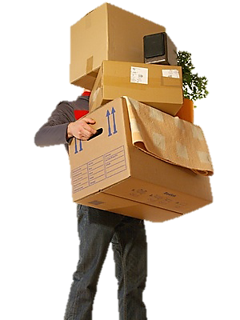
I’m going to the second floor
11
12
9
10
7
8
5
6
3
4
1
2

Slide 39
2 nd
second
Thank you!

Slide 40
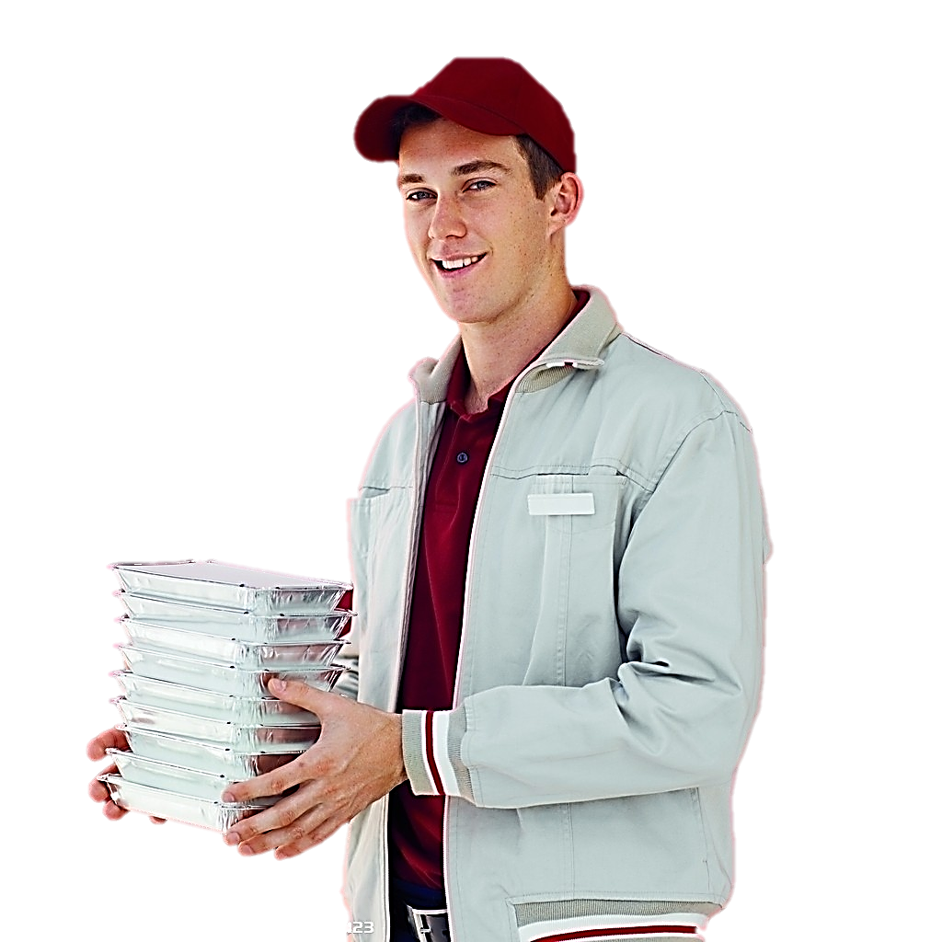
I’m going to the first floor
11
12
9
10
7
8
5
6
3
4
1
2

Slide 41
1 st
first
Thank you!

Slide 42

We’re going to the twelfth floor
11
12
9
10
7
8
5
6
3
4
1
2

Slide 43

12 th
twelfth
Thank you!

Slide 44
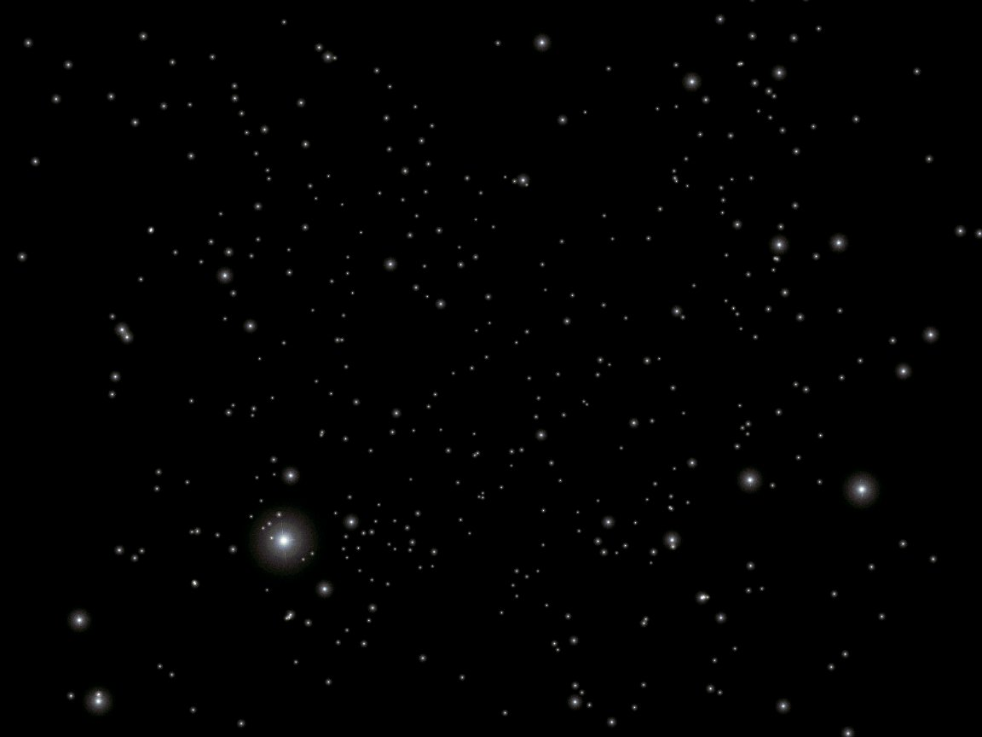
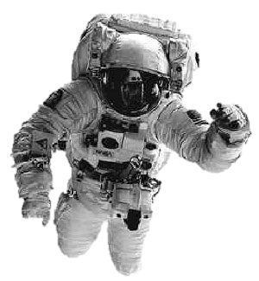
What floor are we on?
?

