Slide 1
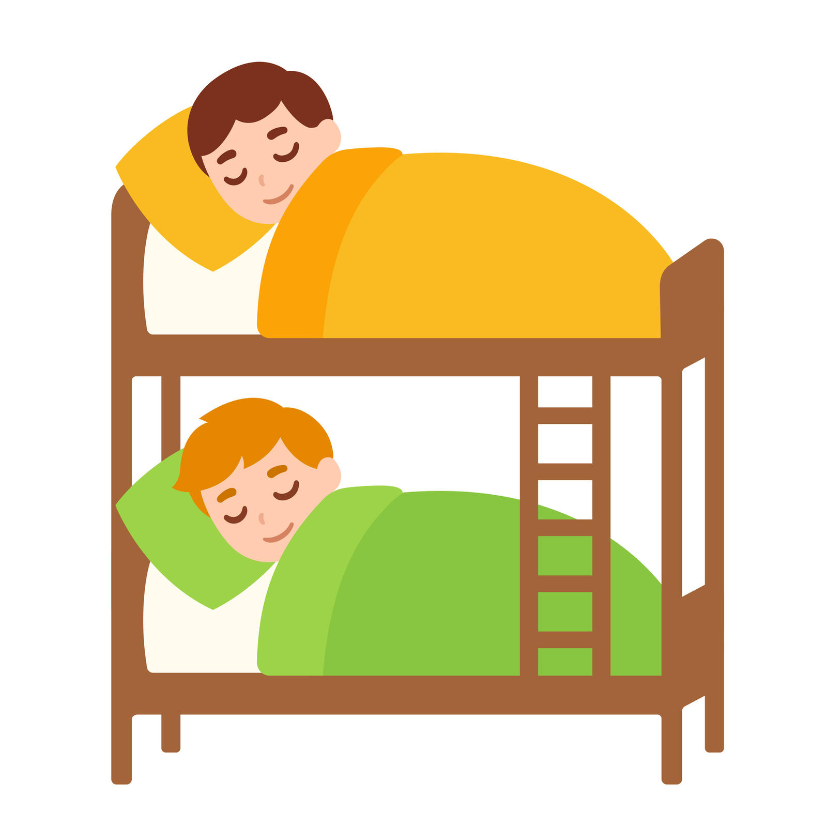
Are they sleeping?
Yes, they are. No, they aren’t.

Slide 2
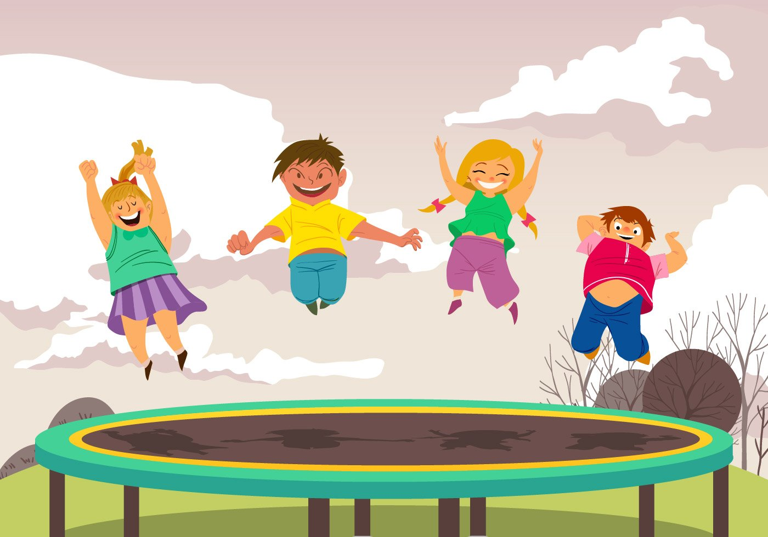
Are they having breakfast?
Yes, they are. No, they aren’t.

Slide 3
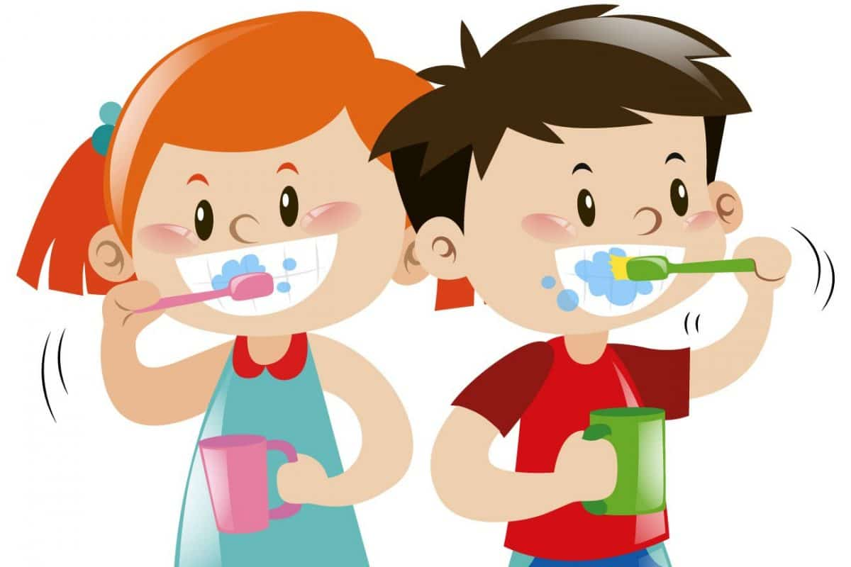
Are they brushing their teeth?
Yes, they are. No, they aren’t.

Slide 4
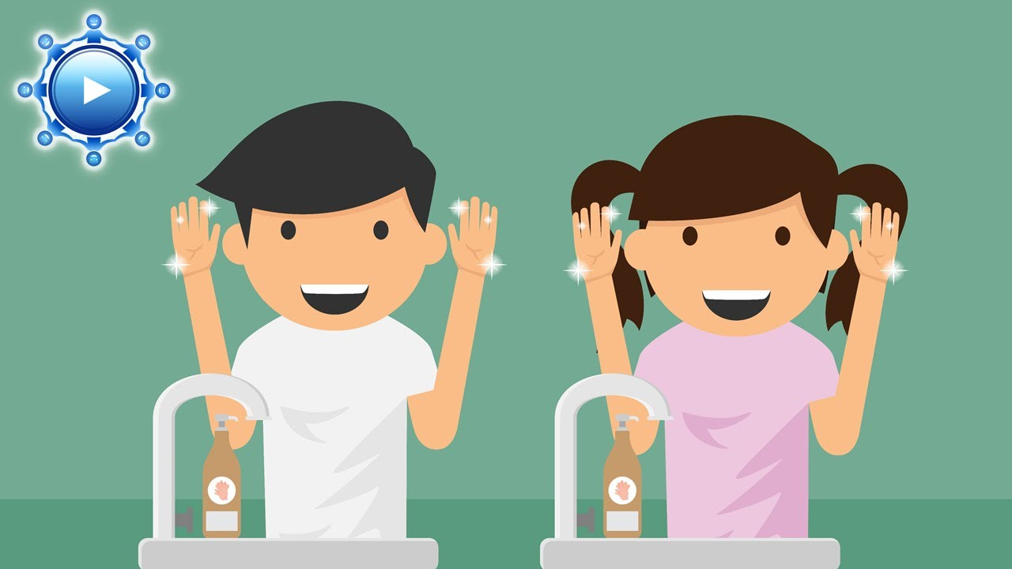
Are they washing their faces?
Yes, they are. No, they aren’t.

Slide 5
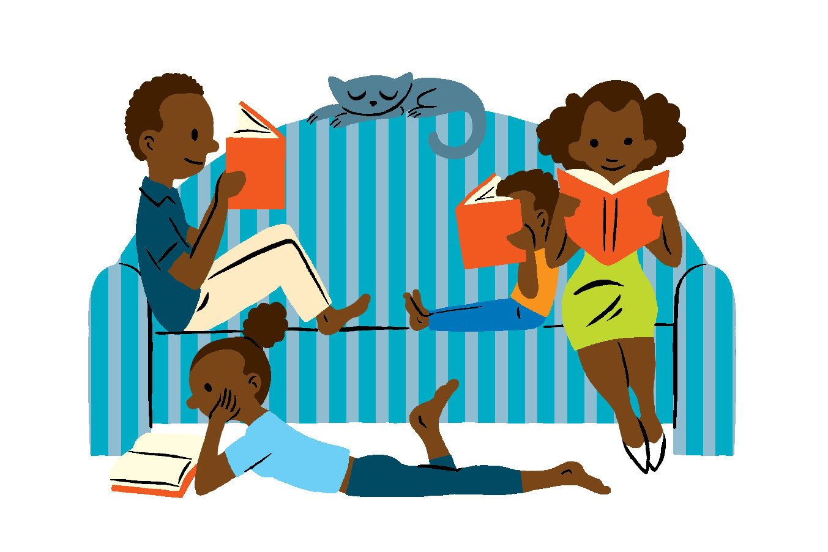
Are they reading books?
Yes, they are. No, they aren’t.

Slide 6
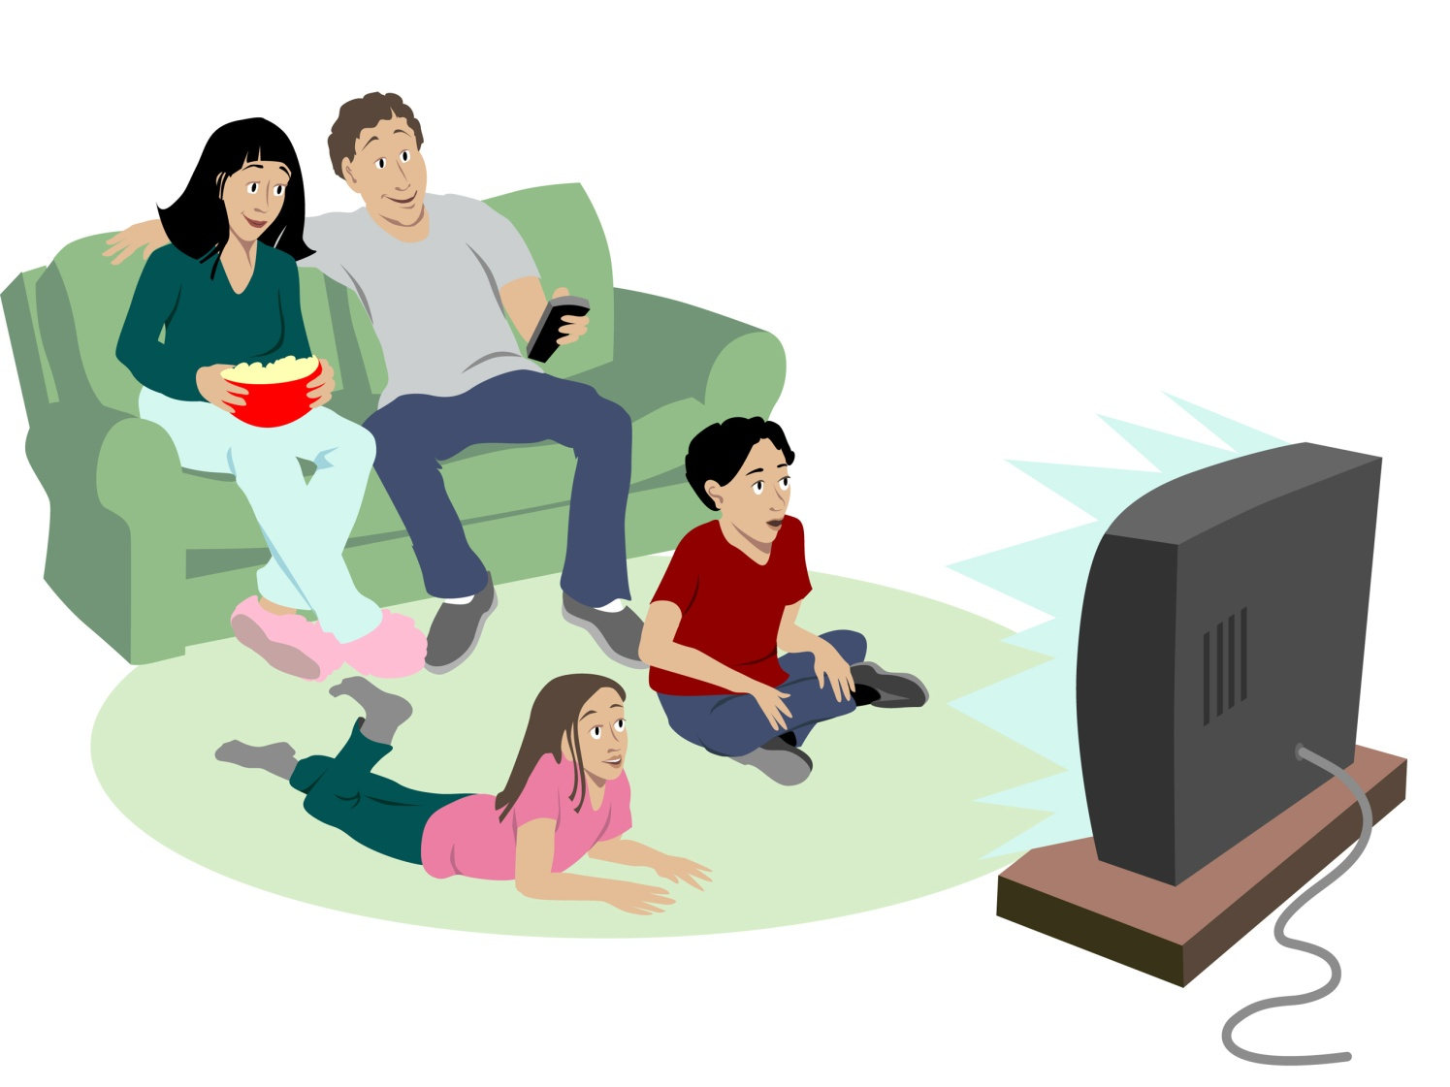
Are they watching TV?
Yes, they are. No, they aren’t.

Slide 7

Are they playing a game?
Yes, they are. No, they aren’t.

Slide 8
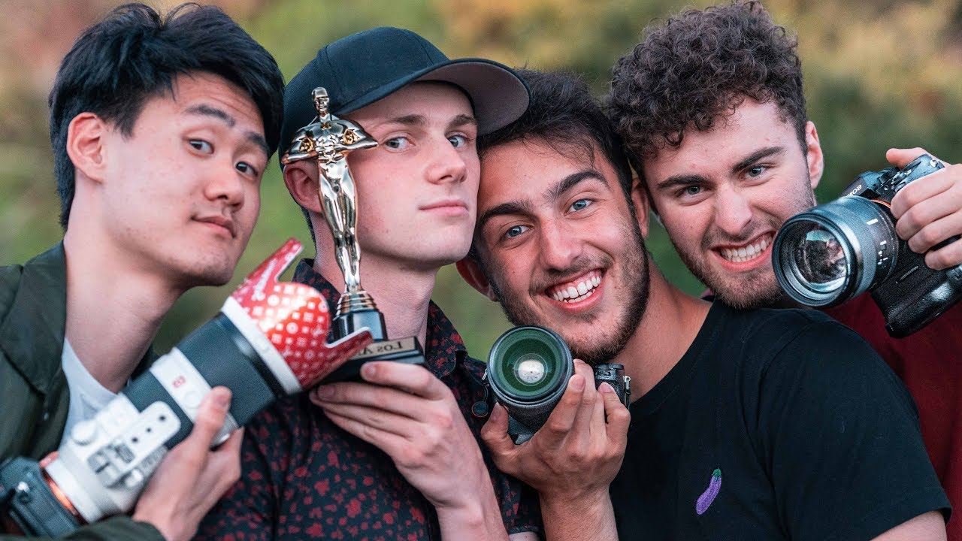
Are they taking photos?
Yes, they are. No, they aren’t.

Slide 9
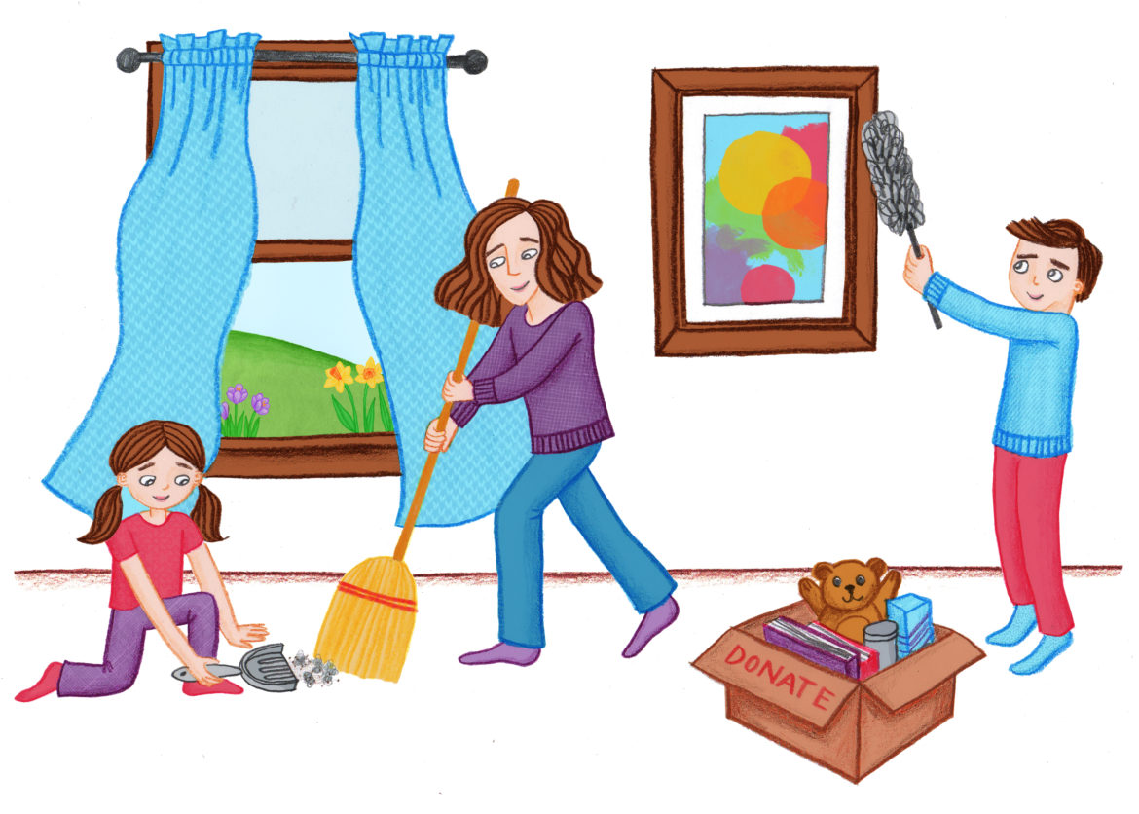
Are they tidying up?
Yes, they are. No, they aren’t.

Slide 10

Are they listening to music?
Yes, they are. No, they aren’t.

