Slide 1
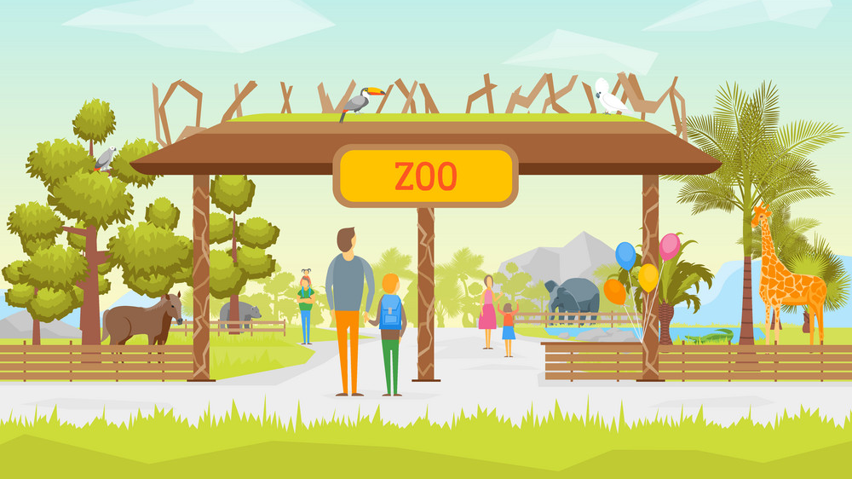


IrinaPapakhinac

Slide 2

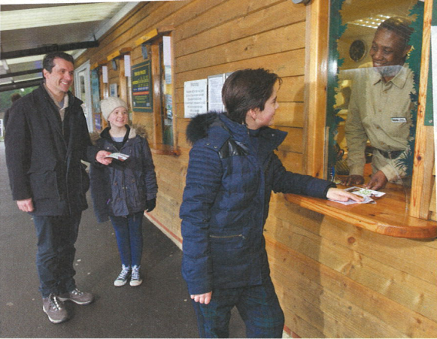
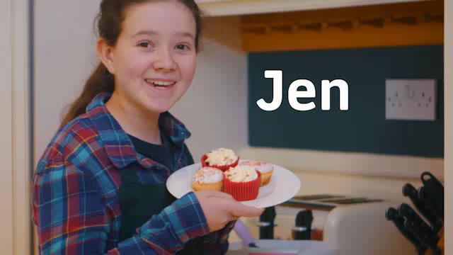
Look at the photo.
Lucas wants to buy a ticket.
GUESS
Where do they want to go?
Watch the video and check your answers.
IrinaPapakhinac

Slide 3
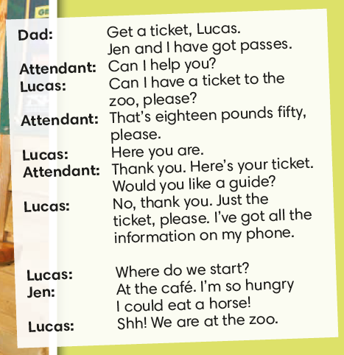
How many tickets does Lucas want to buy?
Why don’t Dad and Jen need tickets?
Why don’t they need a guide?
What does Lucas say to buy a ticket?
IrinaPapakhinac

Slide 4
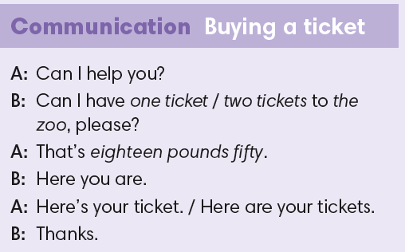

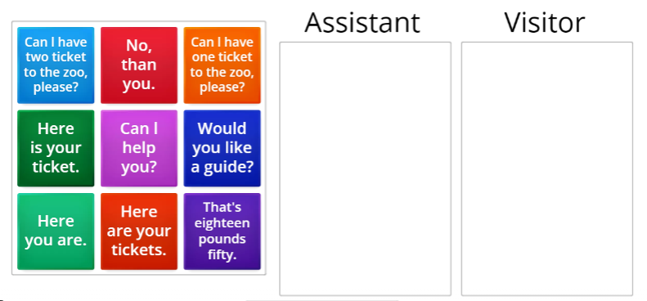
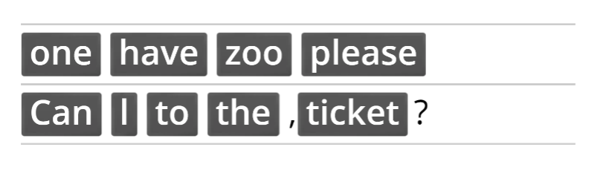
IrinaPapakhinac

Slide 5
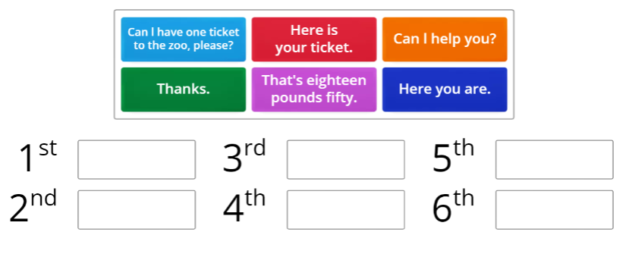
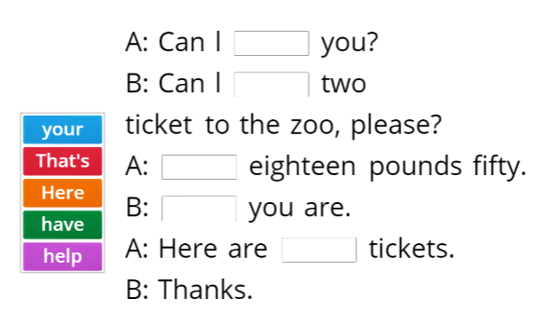
IrinaPapakhinac

Slide 6

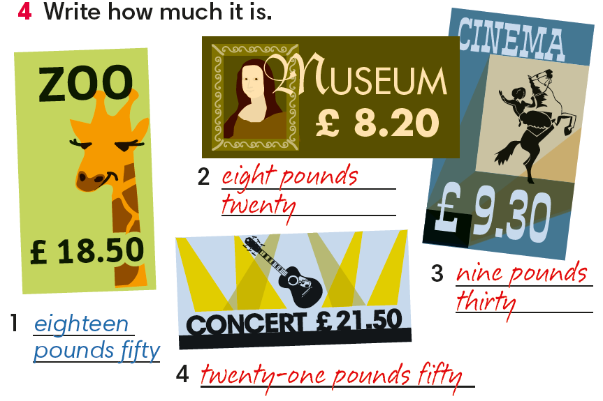
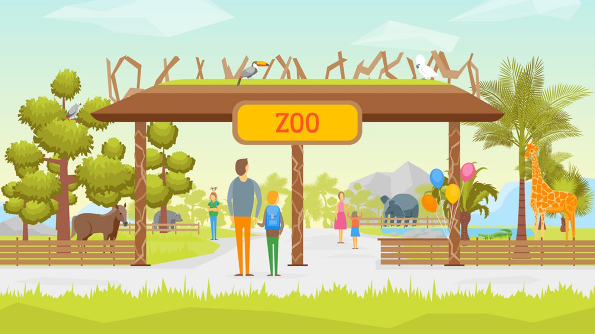
IrinaPapakhinac

Slide 7
Listen and complete the table.
number of tickets | three
place | aquarium
price | twelve pounds sixty
IrinaPapakhinac

Slide 8
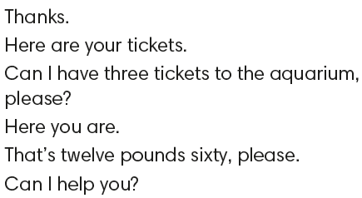
Put the sentences in the correct order.
IrinaPapakhinac

Slide 9
Roleplay buying a ticket.
IrinaPapakhinac

Slide 10


1. How often do you go to the zoo? museum? cinema? concert?
2. Can you buy a ticket yourself now?
3. What can you say to buy a ticket?

Slide 11
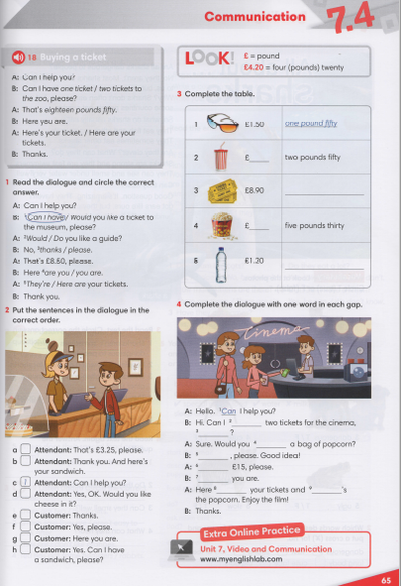


IrinaPapakhinac

Slide 12
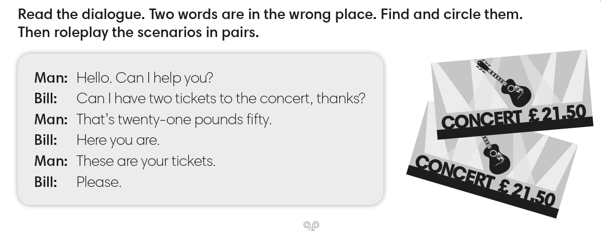
IrinaPapakhinac

Slide 13
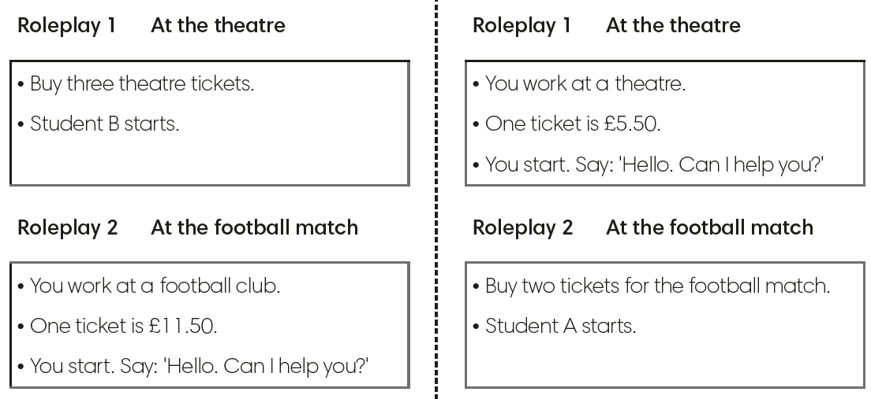
Choose a place.
Roleplay buying a ticket.
IrinaPapakhinac

Slide 14
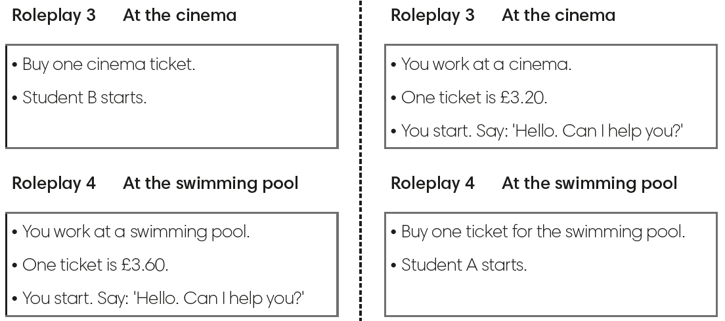
Choose a place.
Roleplay buying a ticket.
IrinaPapakhinac

