Slide 1

What does/do …
Maral.h70@gmail.com

Slide 2
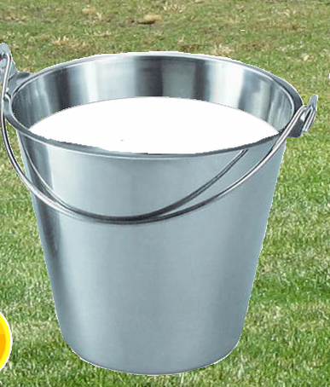
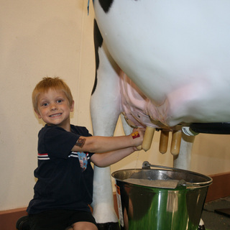
What does he have to do?
He has to milk the cow.

Slide 3

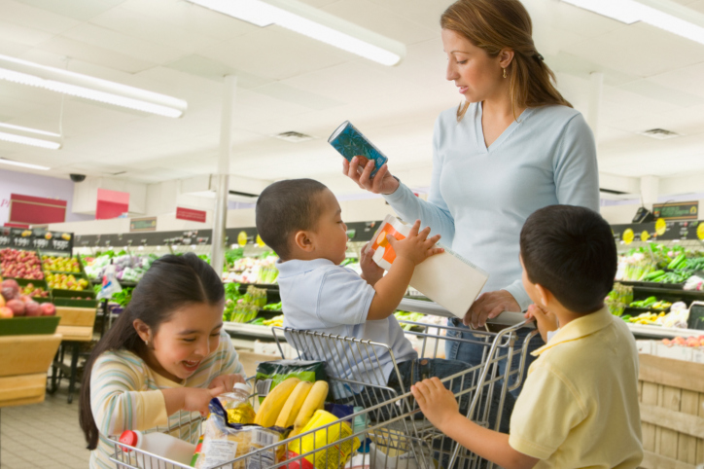
What do they have to do?
They have to go shopping.

Slide 4
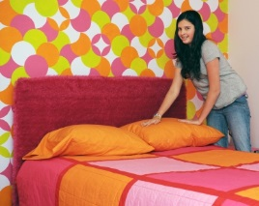
What does she have to do?
She has to make her bed.

Slide 5
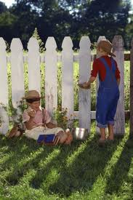
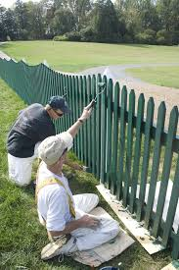
What do they have to do?
They have to paint the fences.

Slide 6
Now, you make question

Slide 7
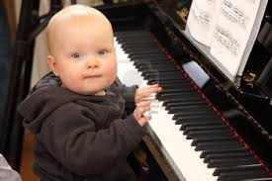
What does he have to do?
He has to play the piano.

Slide 8

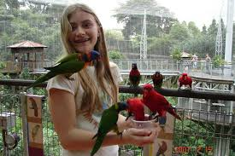
What does she have to do?
She has to feed the birds.

Slide 9

What do they have to do?
They have to take a bus.

Slide 10
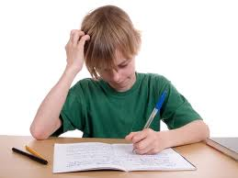
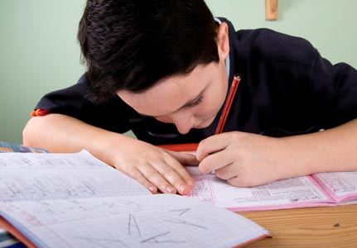
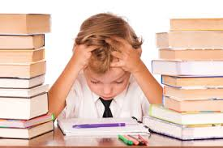
What does he have to do?
He has to do his homework.

Slide 11
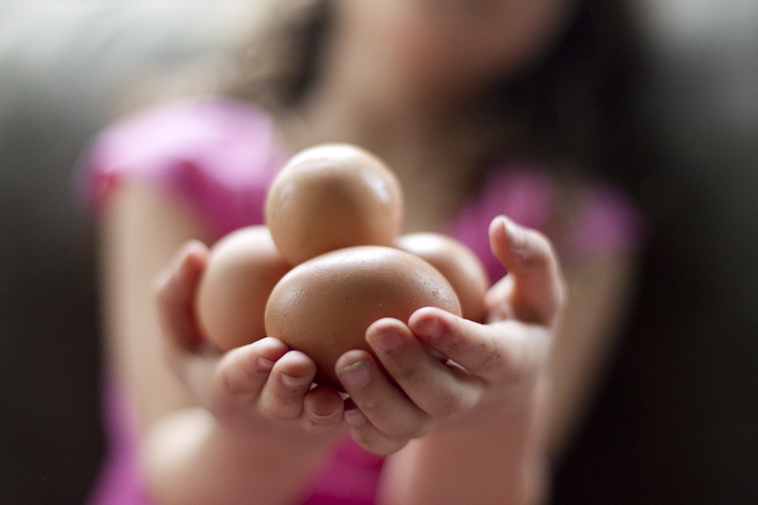
What does she have to do?
She has to collect the eggs.

Slide 12
Thank You!

