Slide 1
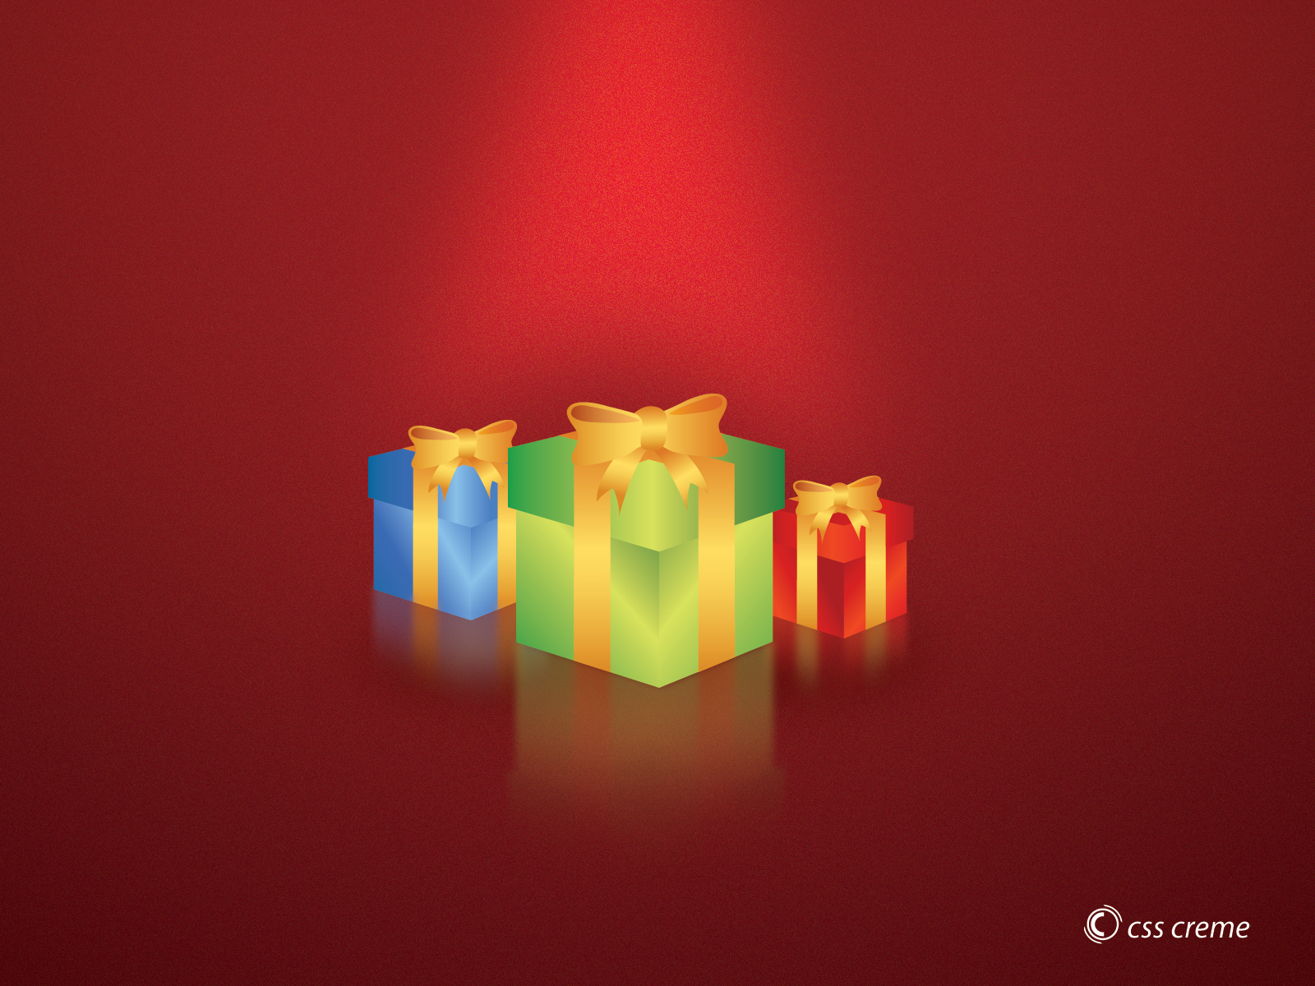


by HERBER

Slide 2
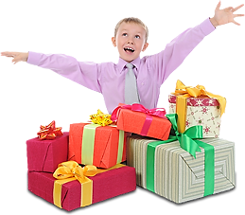
These presents are for me

Slide 3
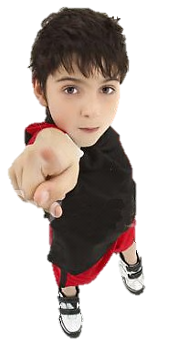

This present is for you

Slide 4
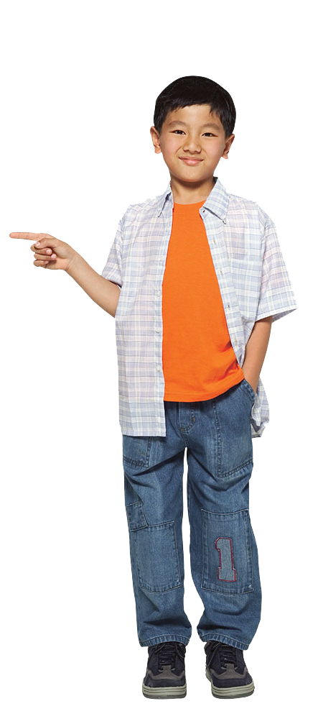
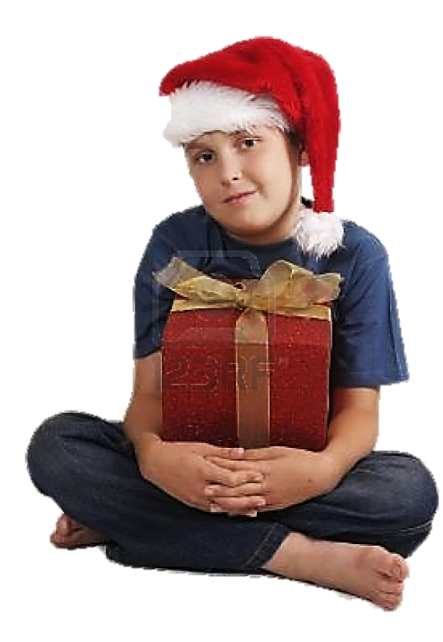
That present is for him

Slide 5
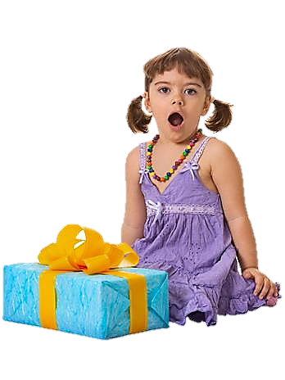
That present is for her

Slide 6
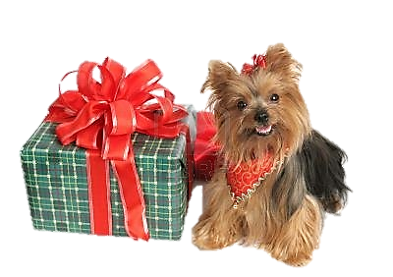
That present is for it

Slide 7
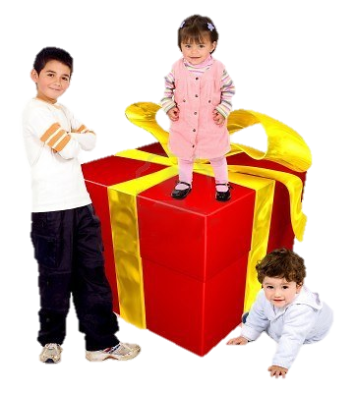
This present is for us

Slide 8
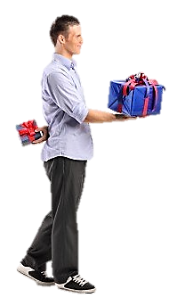
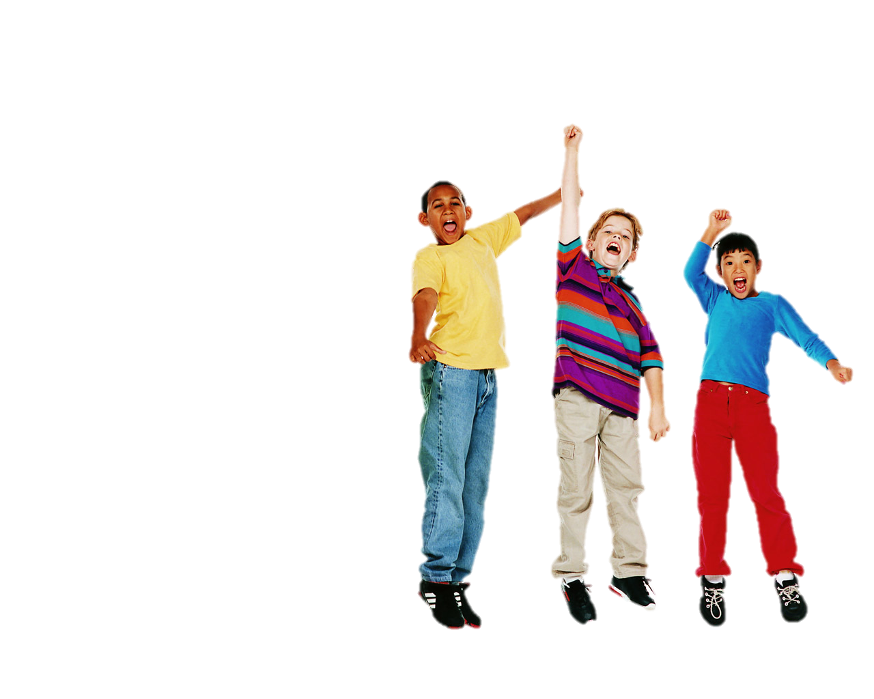
These presents are for you

Slide 9
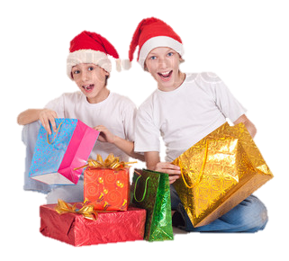
Those presents are for them

Slide 10


Click the object pronouns to complete the chart
I
you
you
her
he
us
them
she
it
me
you
we
him
you
it
they

Slide 11
Click the object pronouns to complete the chart
I
you
you
her
he
us
them
she
me
it
you
we
him
you
it
they

Slide 12
Click the object pronouns to complete the chart
I
you
you
her
he
us
them
she
me
it
you
we
him
you
it
they

Slide 13
Click the object pronouns to complete the chart
I
you
you
her
he
us
them
she
me
it
you
we
him
it
you
they

Slide 14
Click the object pronouns to complete the chart
I
you
you
her
he
us
them
she
me
it
you
we
him
it
you
they

Slide 15
Click the object pronouns to complete the chart
I
you
you
her
he
us
them
she
me
it
you
we
him
it
you
they

Slide 16
Click the object pronouns to complete the chart
I
you
you
her
he
us
them
she
me
it
you
we
him
it
you
they

Slide 17
Click the object pronouns to complete the chart
I
you
you
her
he
us
you
she
me
it
them
we
him
it
you
they

Slide 18
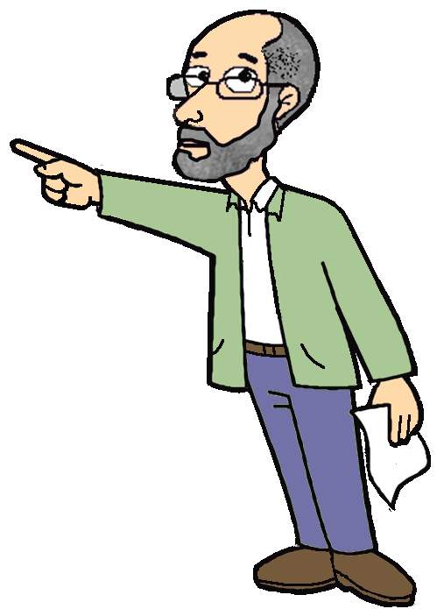
I
me
you
you
he
him
she
her
it
it
we
us
you
you
they
them

Slide 19
Those presents are for Tom and Jim. They’re for ______
you
her
them
us
him
me
it
Click the object pronouns to complete the sentences

Slide 20
Oh, yes. These presents are for ______
you
her
them
us
him
me
it
Click the object pronouns to complete the sentences

Slide 21
I bring a present for ______
you
her
them
us
him
me
it
Click the object pronouns to complete the sentences

Slide 22
That present is for Beth.
It´s for ______
you
her
them
us
him
me
it
Click the object pronouns to complete the sentences

Slide 23
That present is for Cory.
It´s for ______
you
her
them
us
him
me
it
Click the object pronouns to complete the sentences

Slide 24

That present is for Tom.
It´s for ______
you
her
them
us
him
me
it
Click the object pronouns to complete the sentences

Slide 25
Yes, this present is for ______
you
her
them
us
him
me
it
Click the object pronouns to complete the sentences

