Slide 1
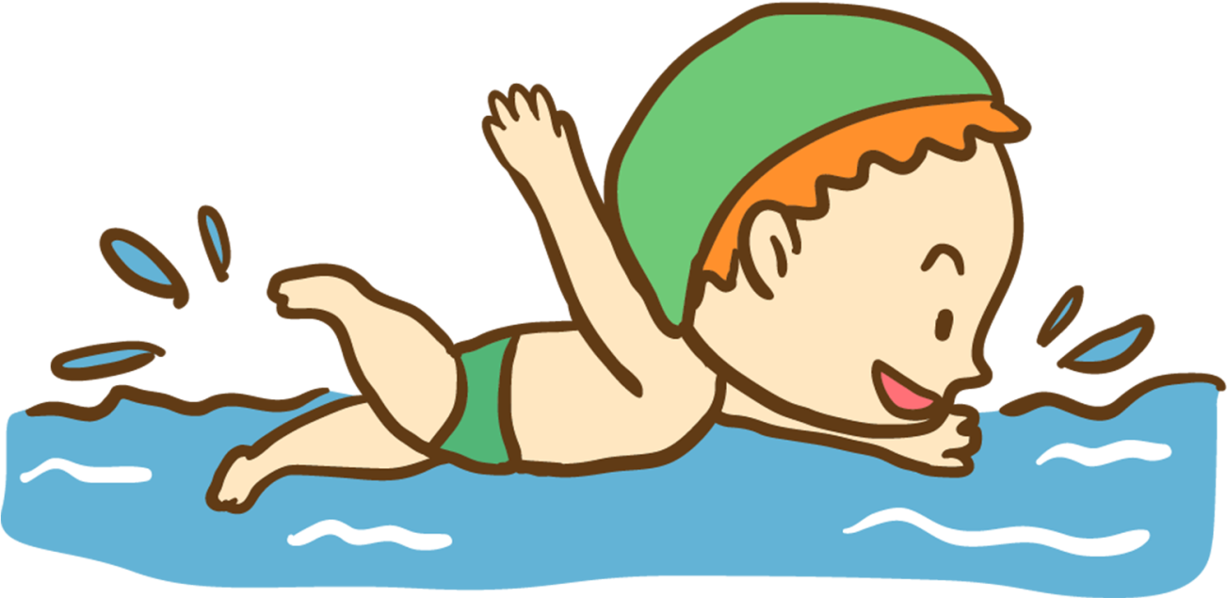
I like / don’t like swimming.
Notes:
Students tell about themselves. They choose “I like” or “I don’t like”

Slide 2
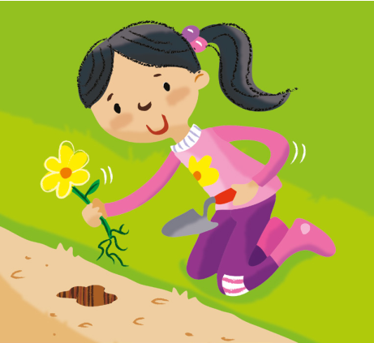
I like / don’t like planting flowers

Slide 3
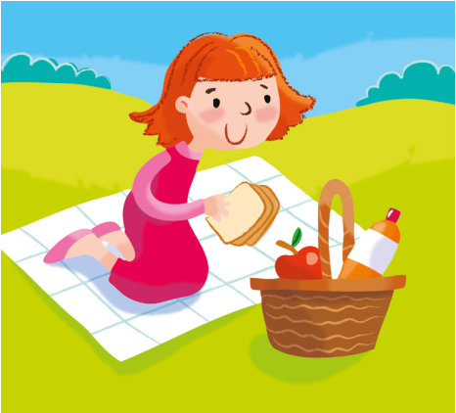
I like / don’t like having a picnic.

Slide 4
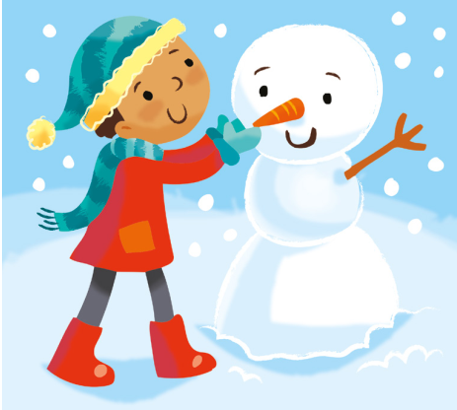
I like / don’t like making a snowman.

Slide 5
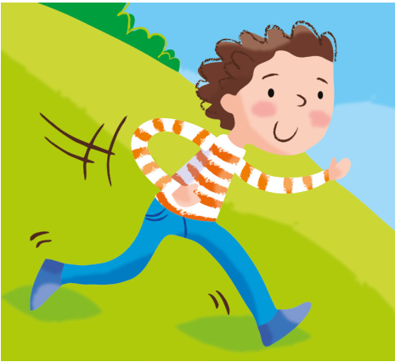
I like / don’t like playing outside.

Slide 6
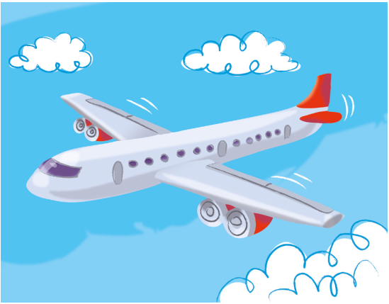
I like / don’t like flying on a plane.

Slide 7
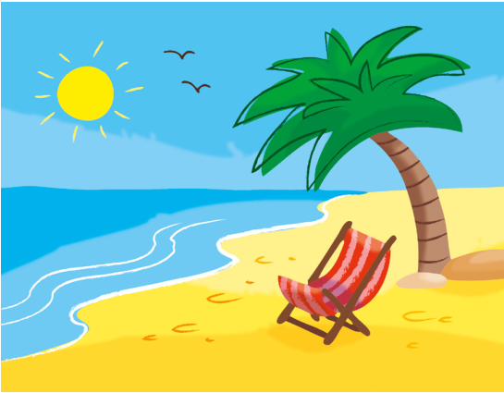
I like / don’t like going on holiday.

Slide 8

I like / don’t like wearing sunglasses.

Slide 9
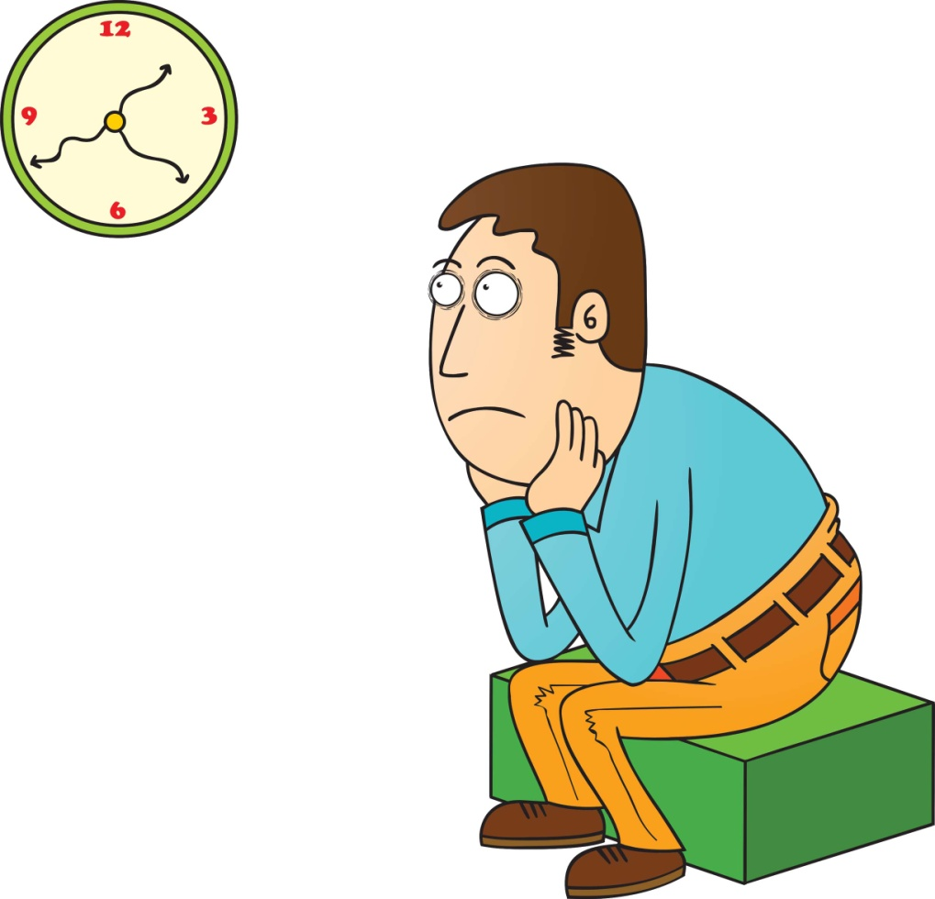
I like / don’t like waiting.

Slide 10
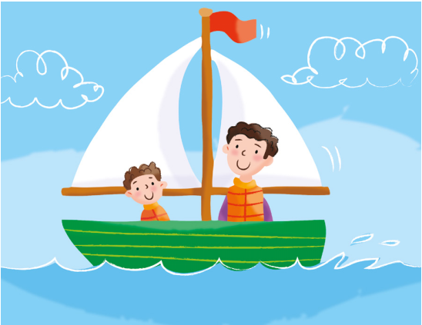
I like / don’t like sailing.

Slide 11
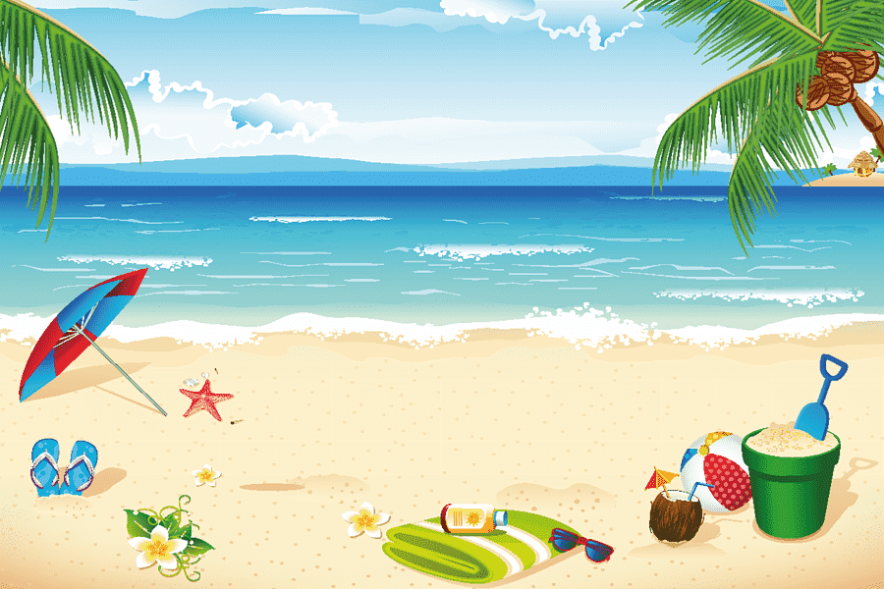
I like / don’t like going to the beach.

Slide 12
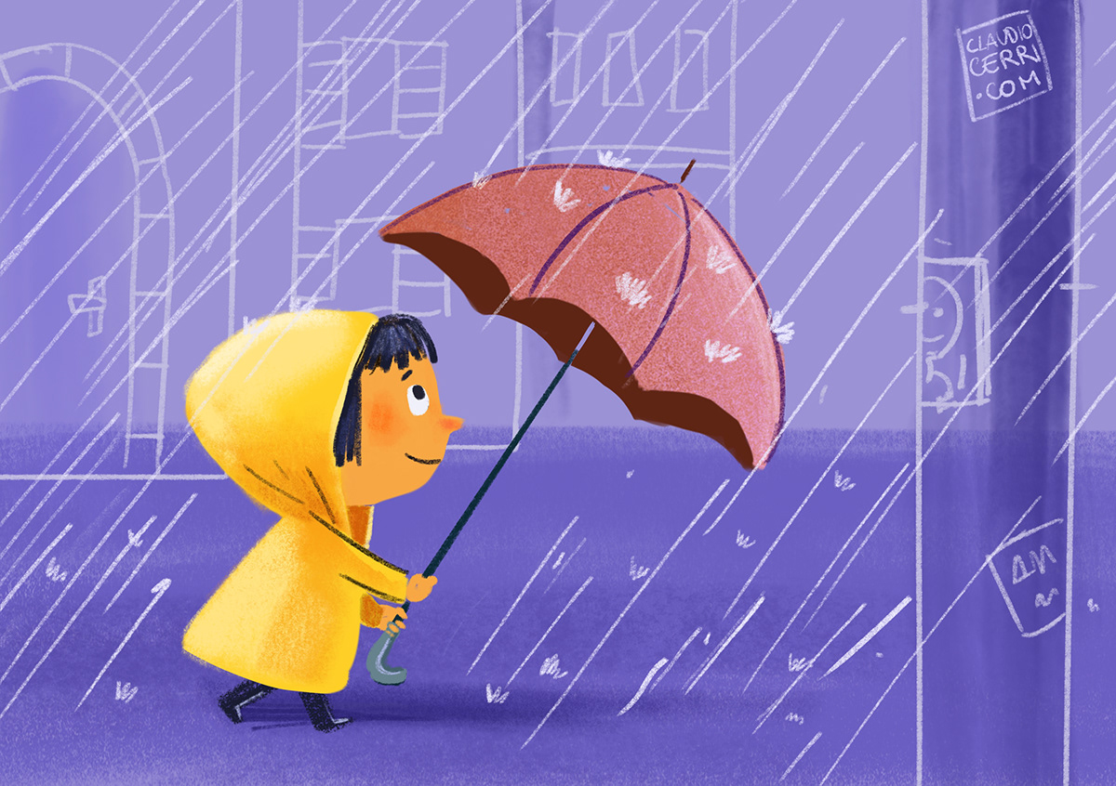
I like / don’t like walking in the rain.

Slide 13
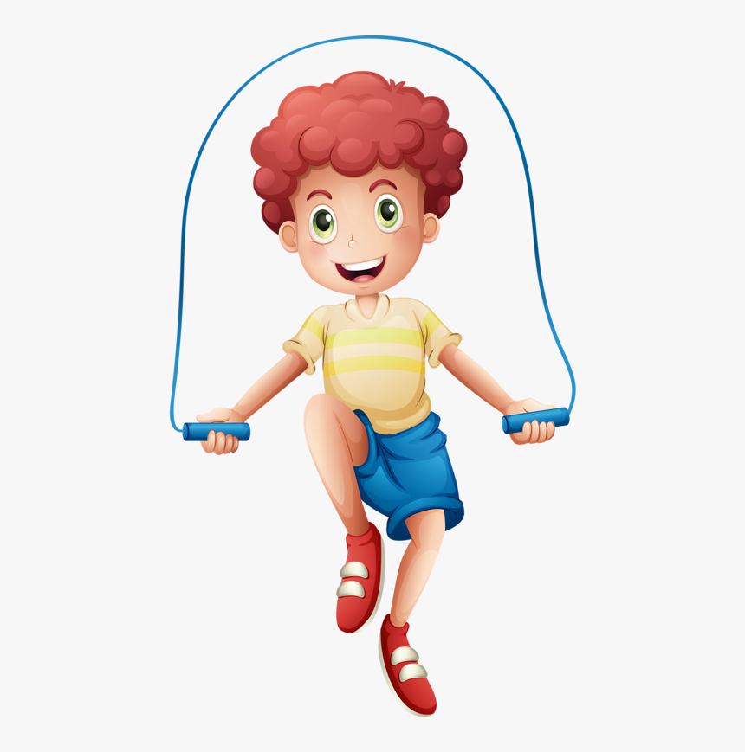
I like / don’t like skipping.

Slide 14
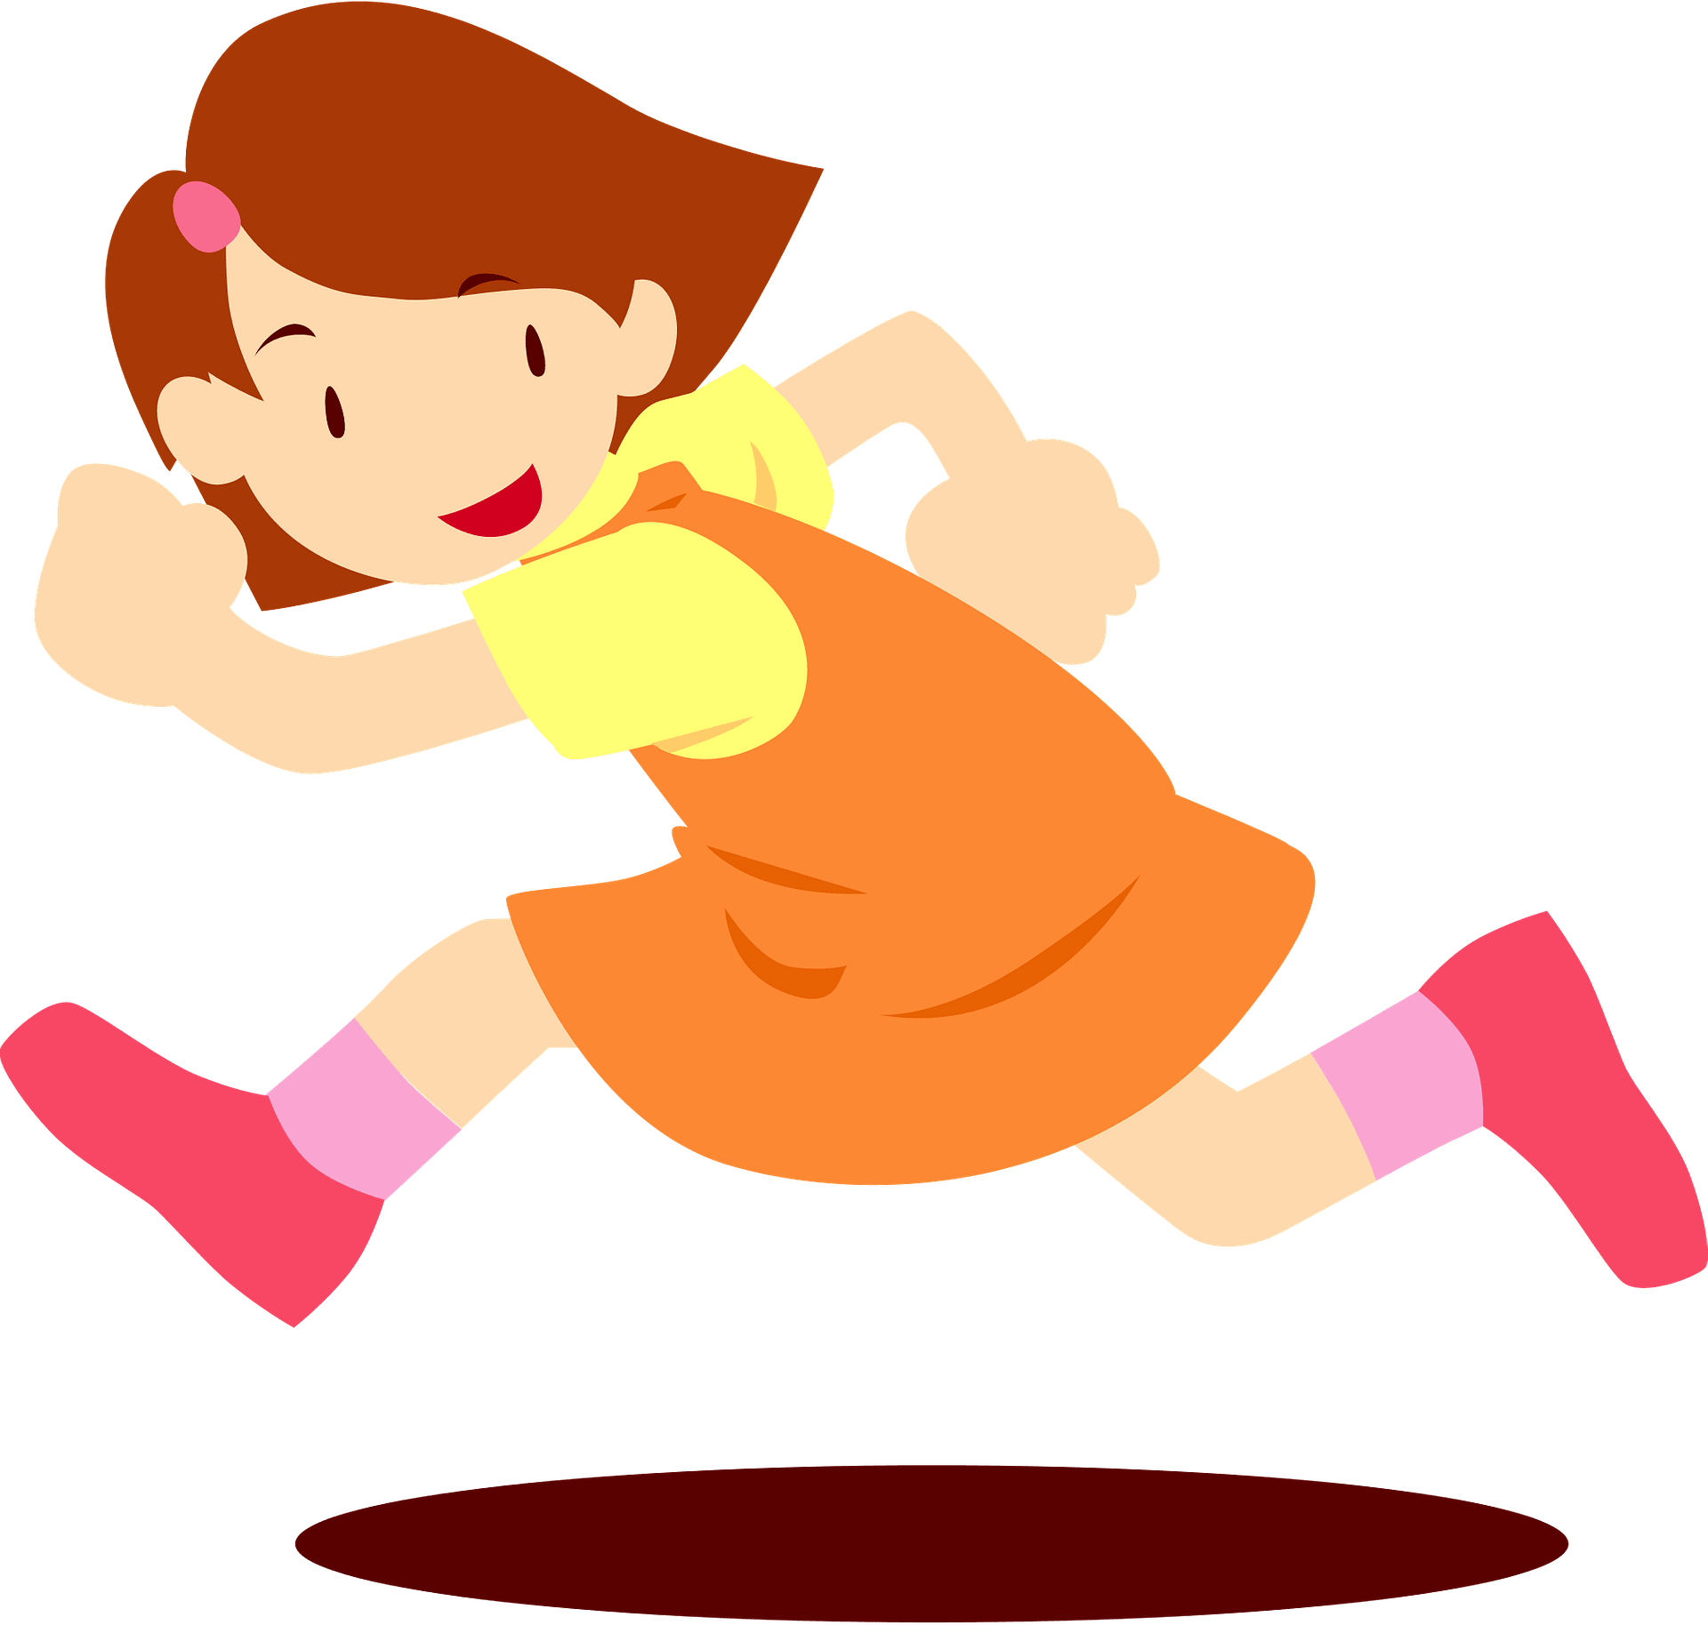
I like / don’t like running.

Slide 15
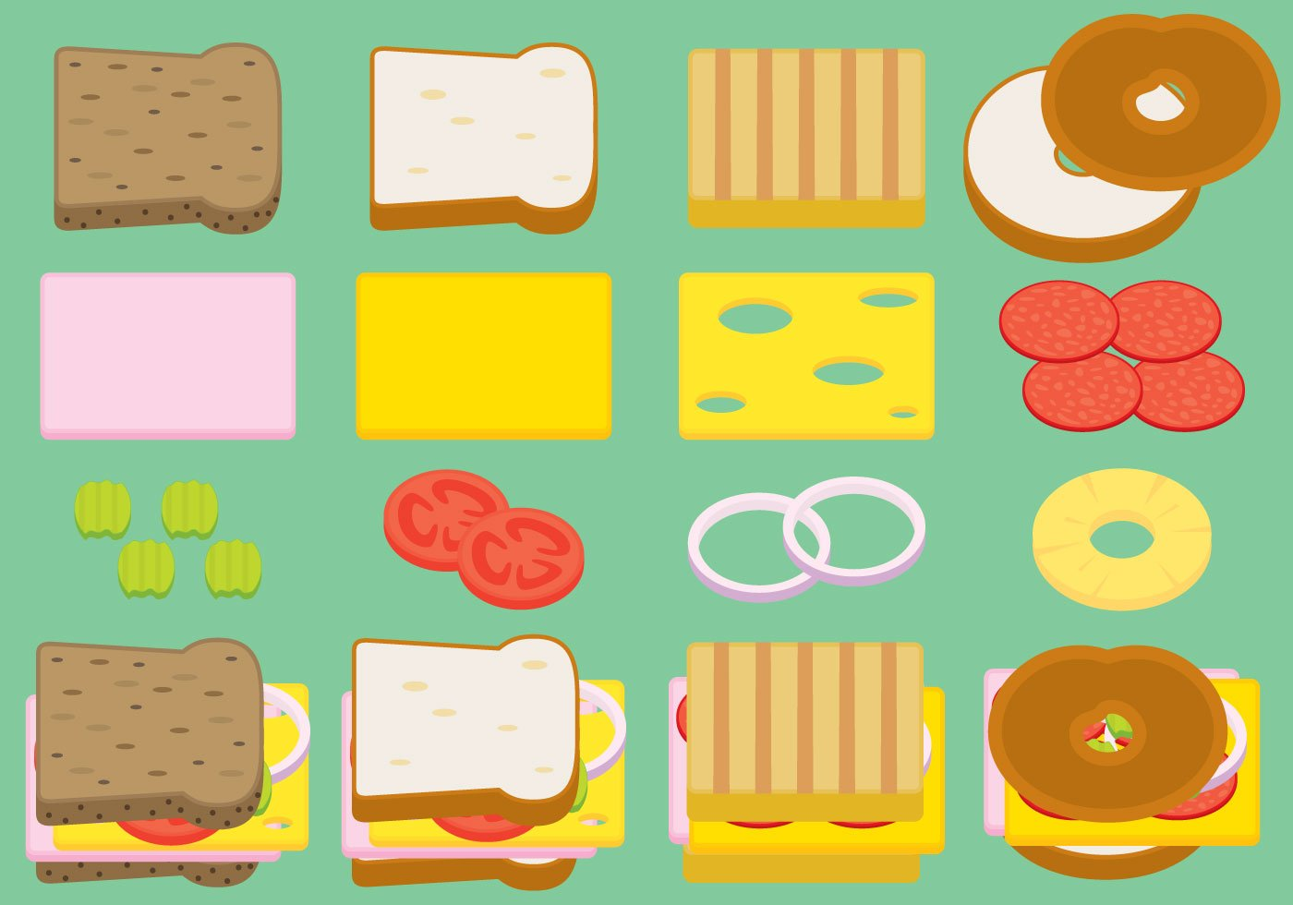
I like / don’t like making sandwiches.

