Slide 1
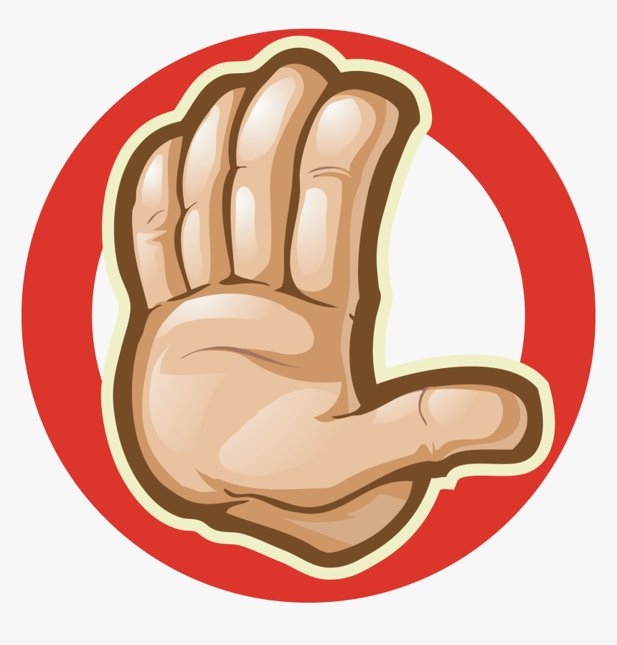
Stop! Don’t stop!

Slide 2
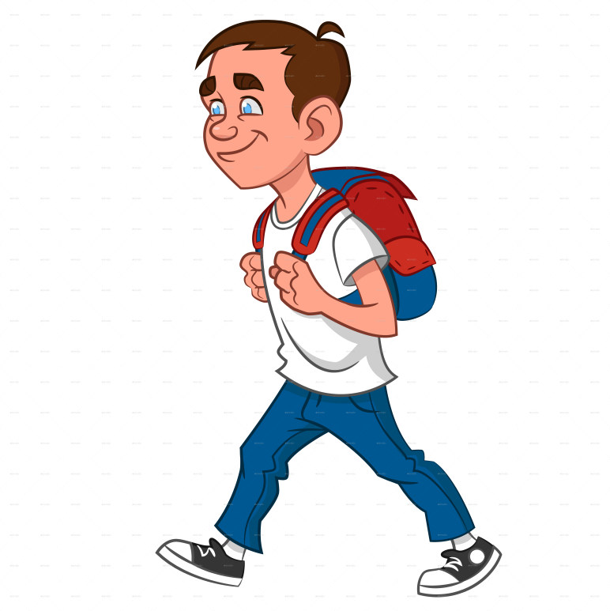
Walk! Don’t walk!

Slide 3
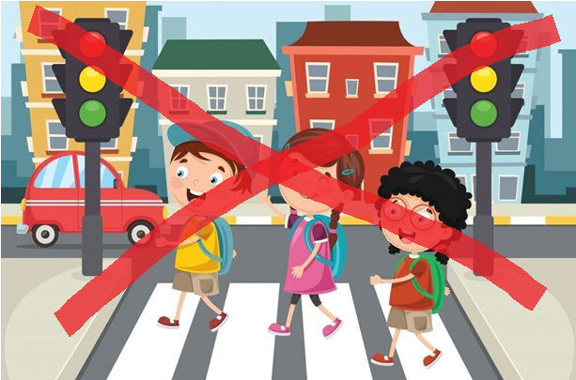
Cross! Don’t cross!

Slide 4
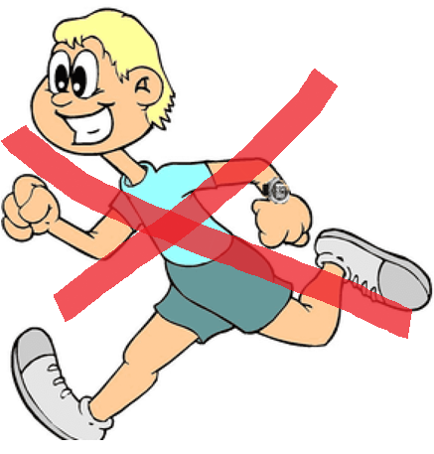
Run! Don’t run!

Slide 5
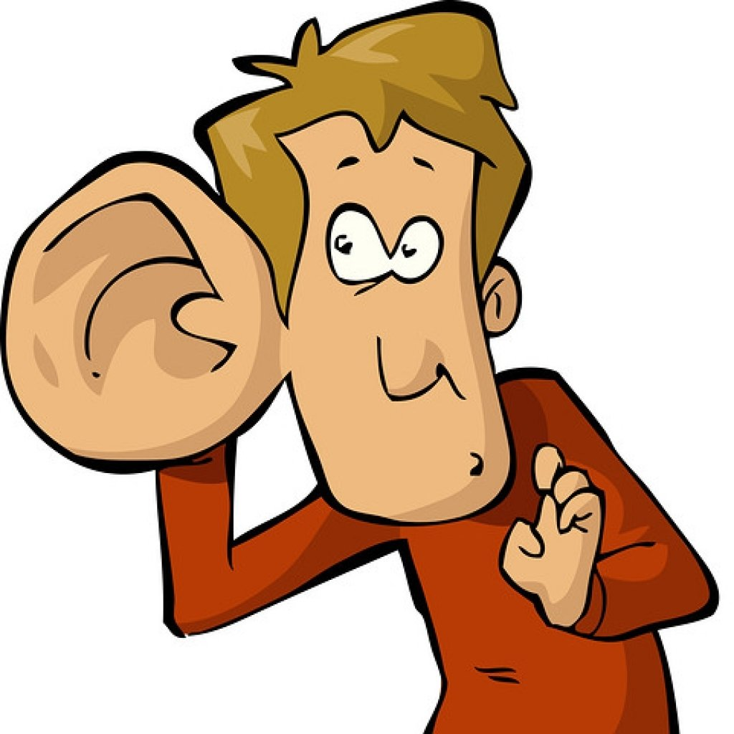
Listen! Don’t listen!

Slide 6
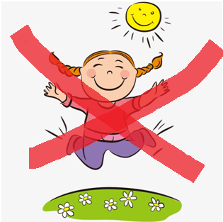
Jump! Don’t jump!

Slide 7
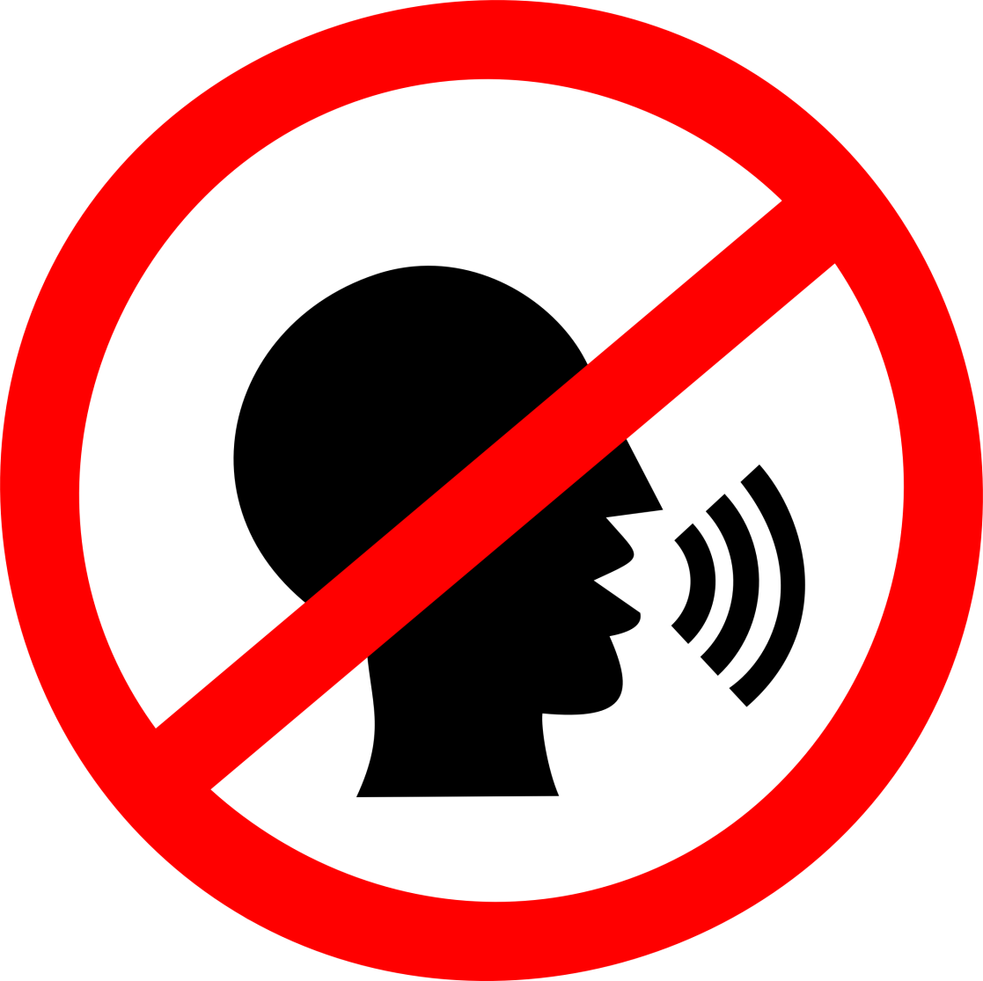
Talk! Don’t talk!

Slide 8
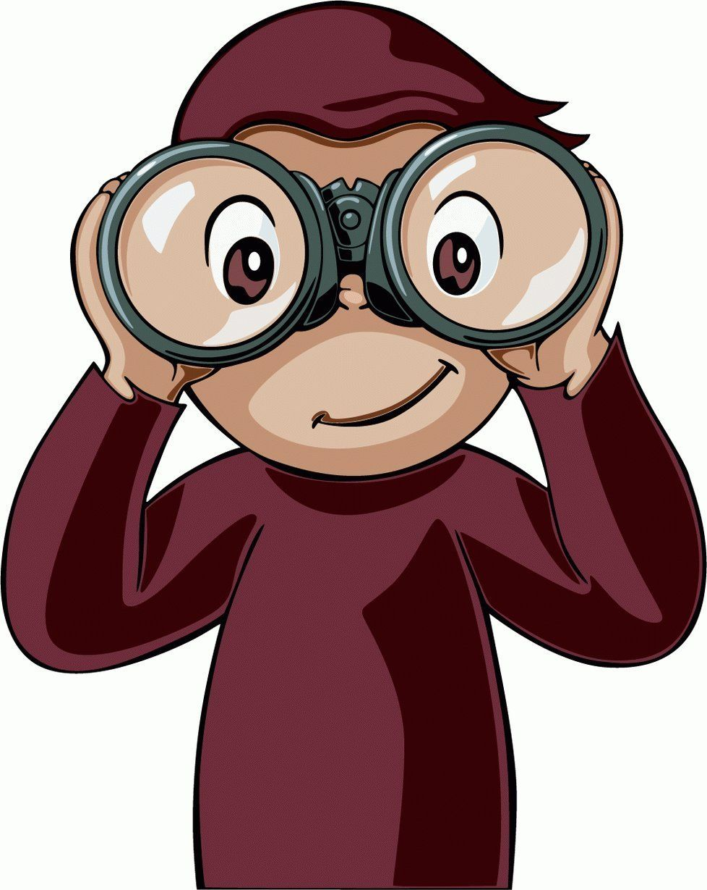
Look! Don’t look!

Slide 9
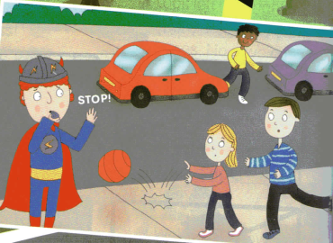
Play next to traffic!
Don’t play next to traffic!

Slide 10
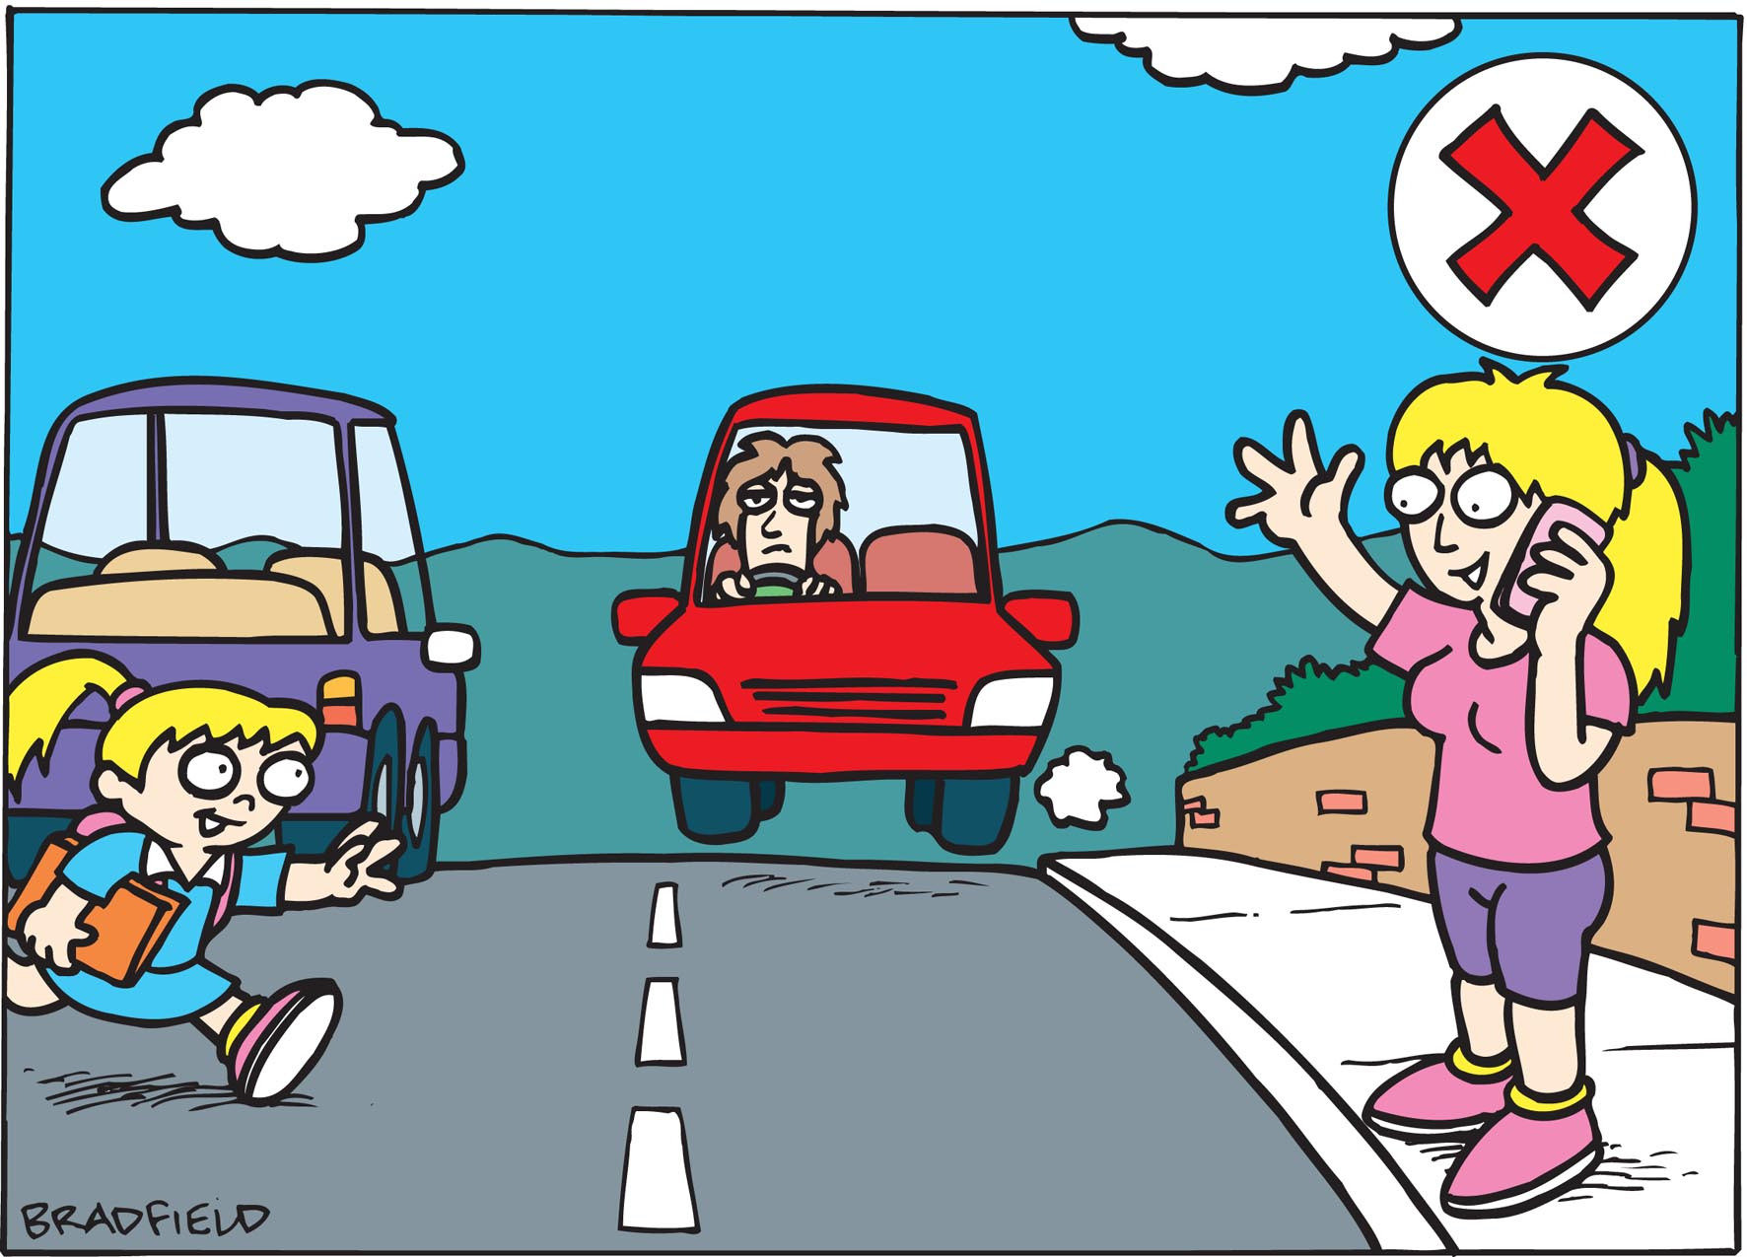
Walk on the road!
Don’t walk on the road!

Slide 11
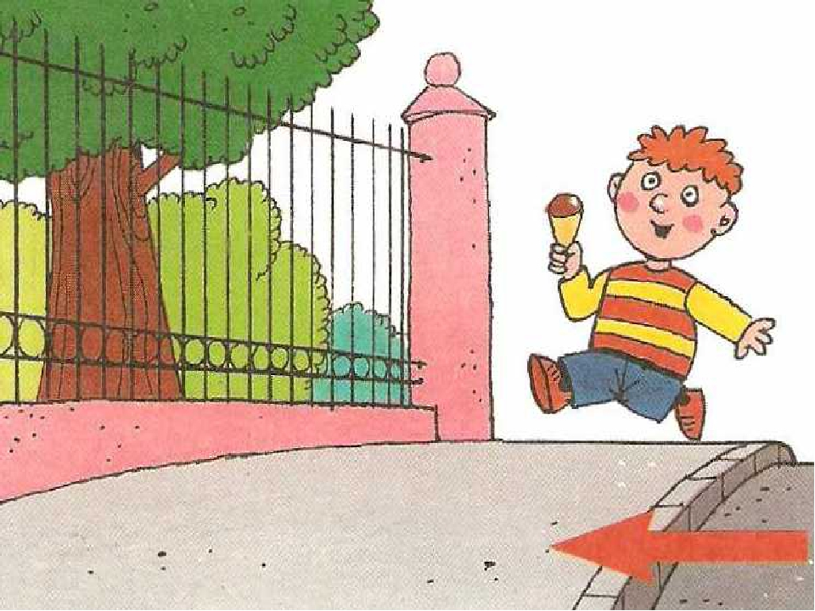
Walk on the pavement!
Don’t walk on the pavement!

Slide 12
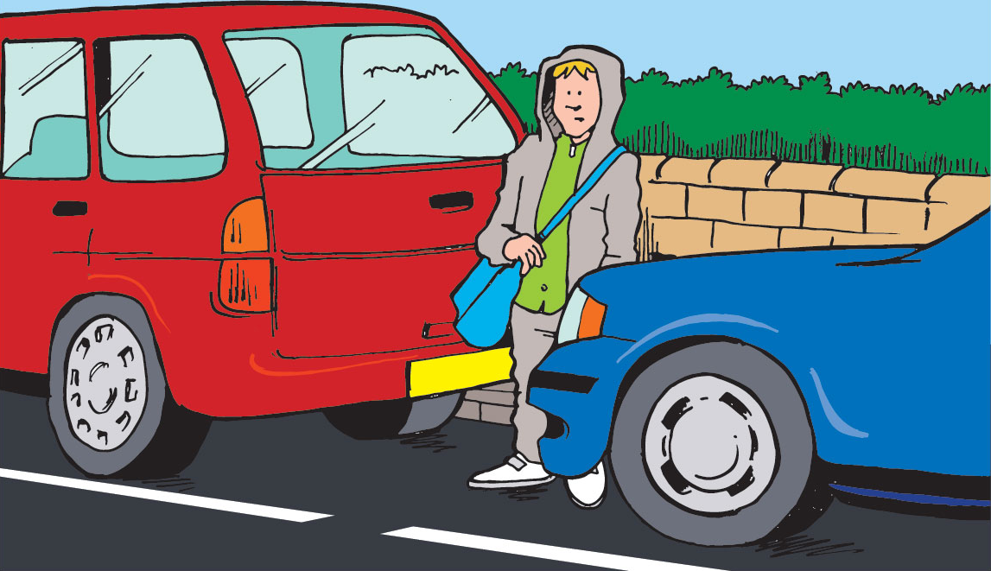

Cross the road next to cars!
Don’t cross the road next to cars!

Slide 13
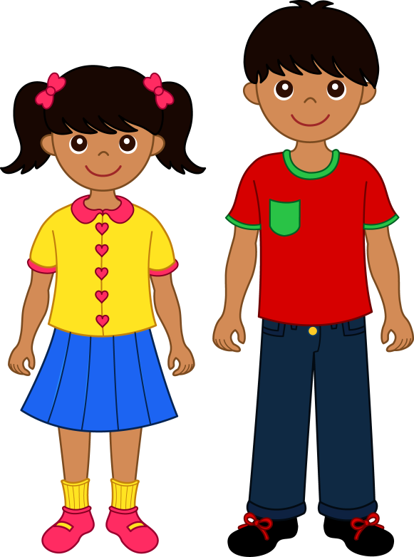
Wear clothes in bright colours!
Don’t wear clothes in bright colours!

Slide 14
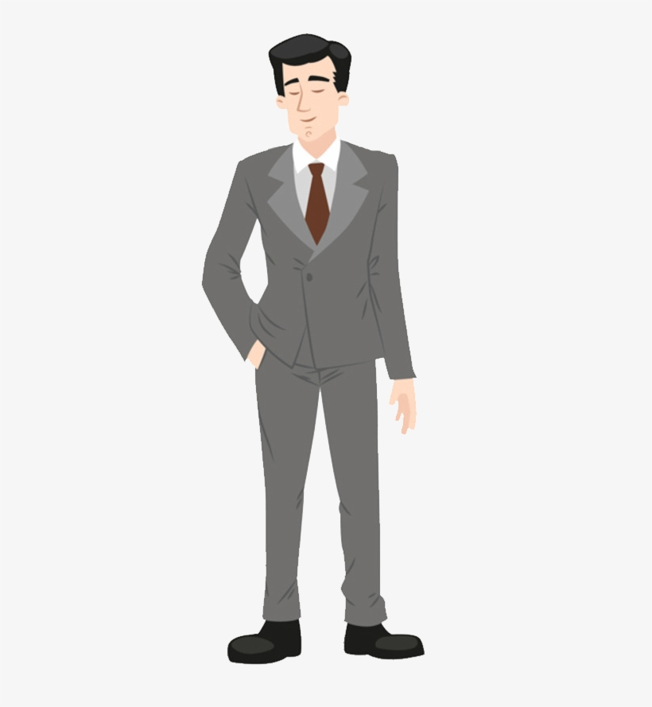
Wear black and brown!
Don’t wear black or brown!

Slide 15
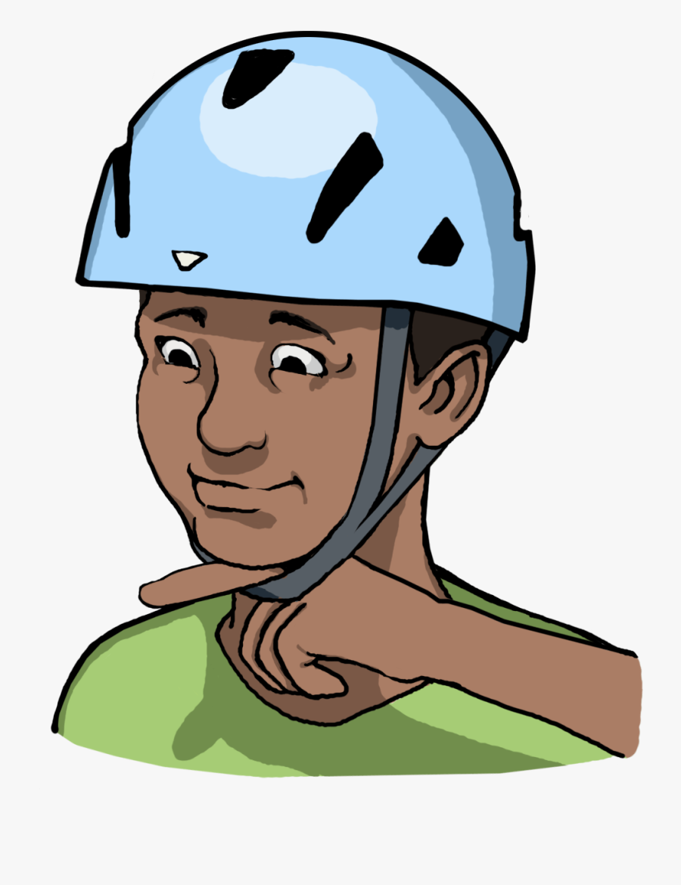
Wear a helmet!
Don’t wear a helmet!

Slide 16
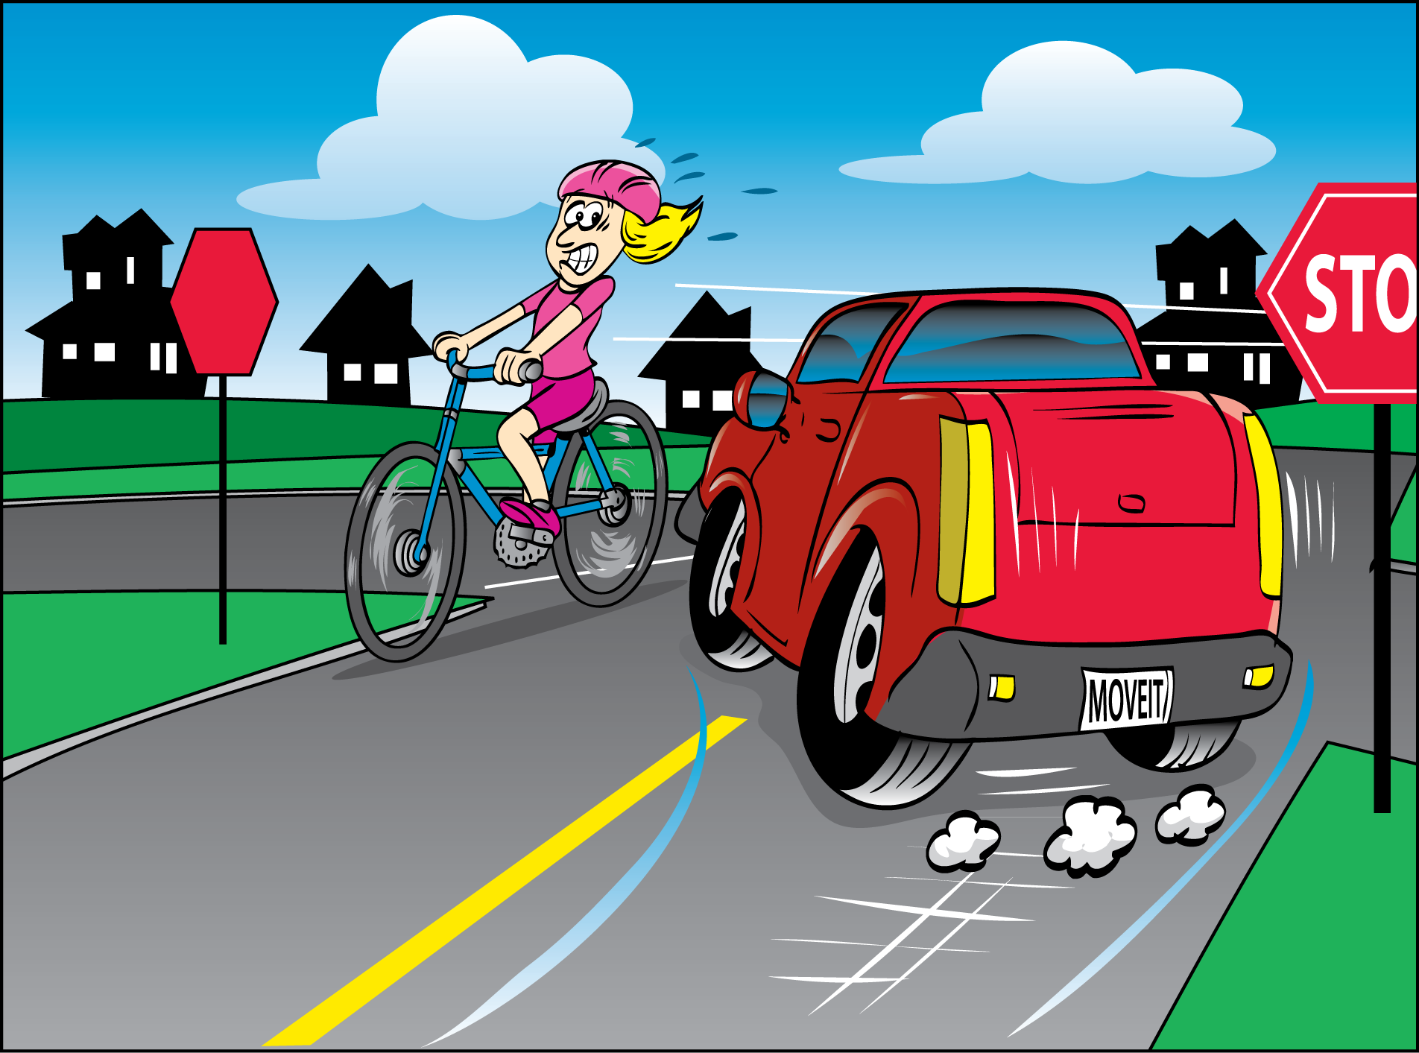
Cycle on busy roads!
Don’t cycle on busy roads!

Slide 17
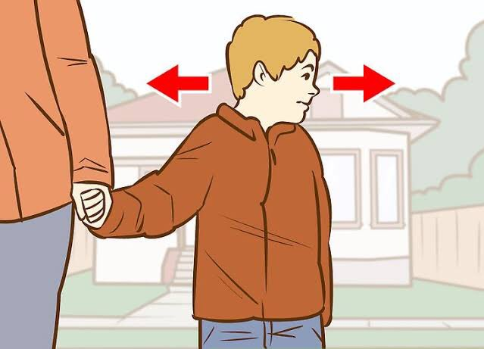
Look left and right for traffic.
Don’t look left and right for traffic.

Slide 18

Listen to music!
Don’t listen to music!

Slide 19
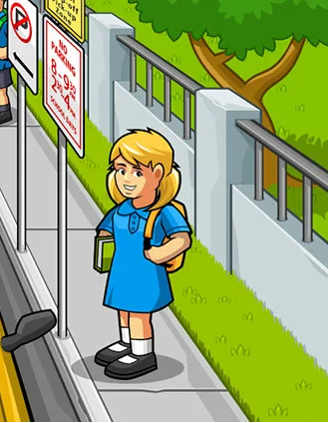
Wait in a safe place.
Don’t wait in a safe place.

Slide 20
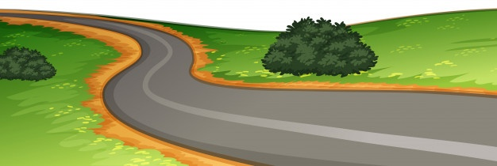
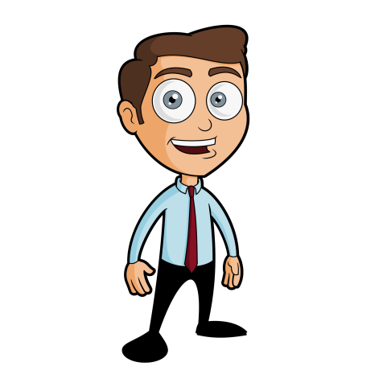
Stand near the road.
Don’t stand near the road.

Slide 21
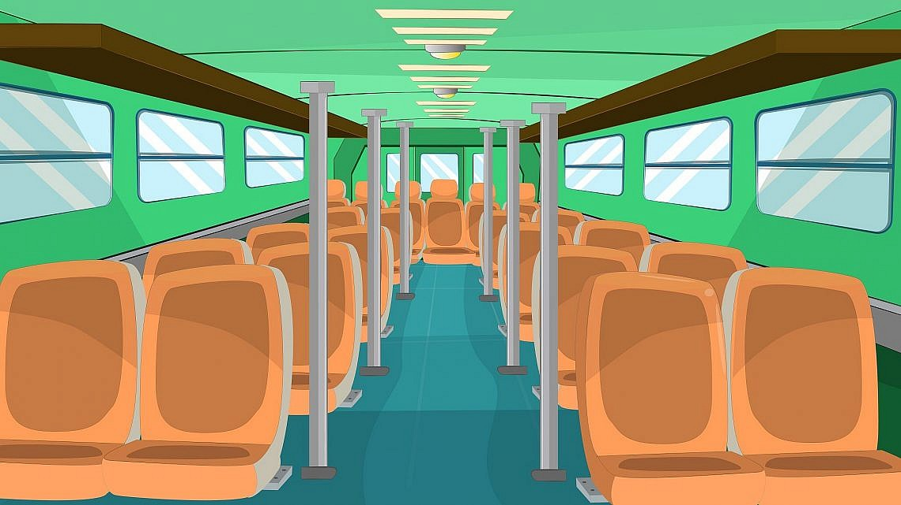
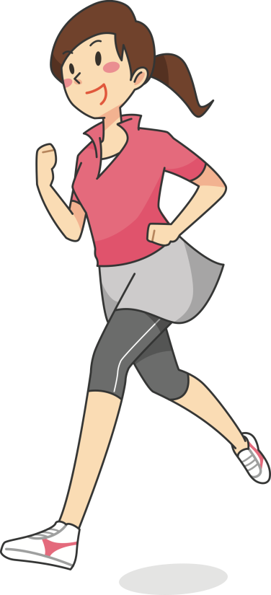
Run on the bus.
Don’t run on the bus.

Slide 22
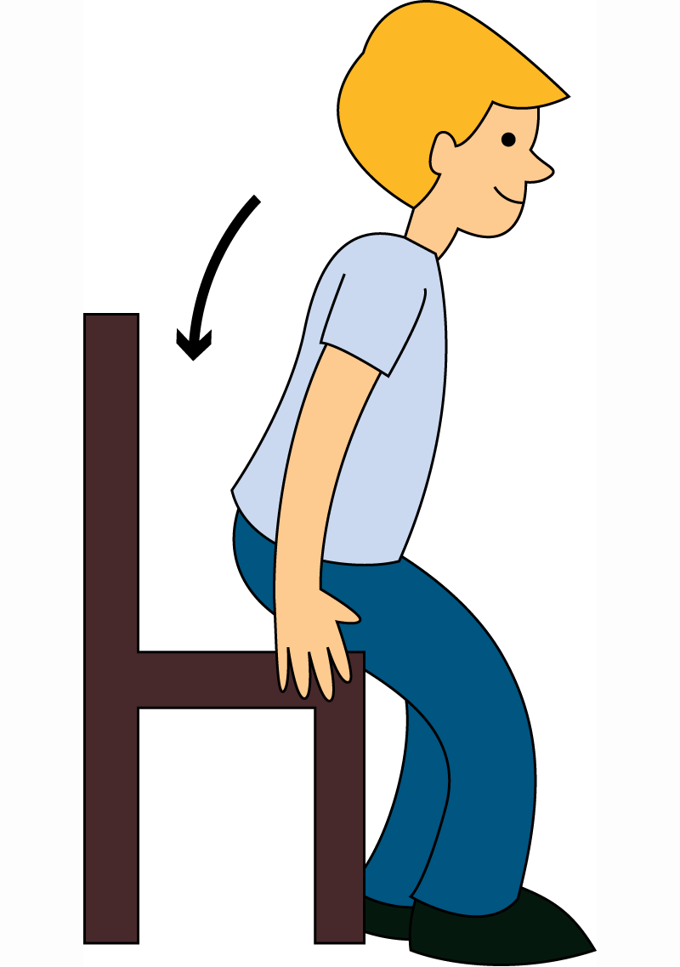
Sit down.
Don’t sit down.

Slide 23
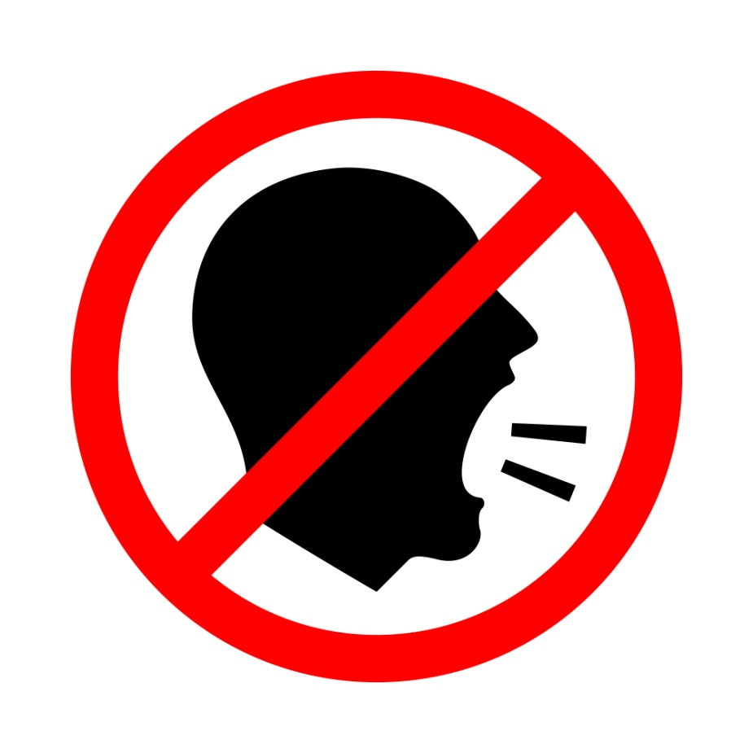
Shout!
Don’t shout!

Slide 24
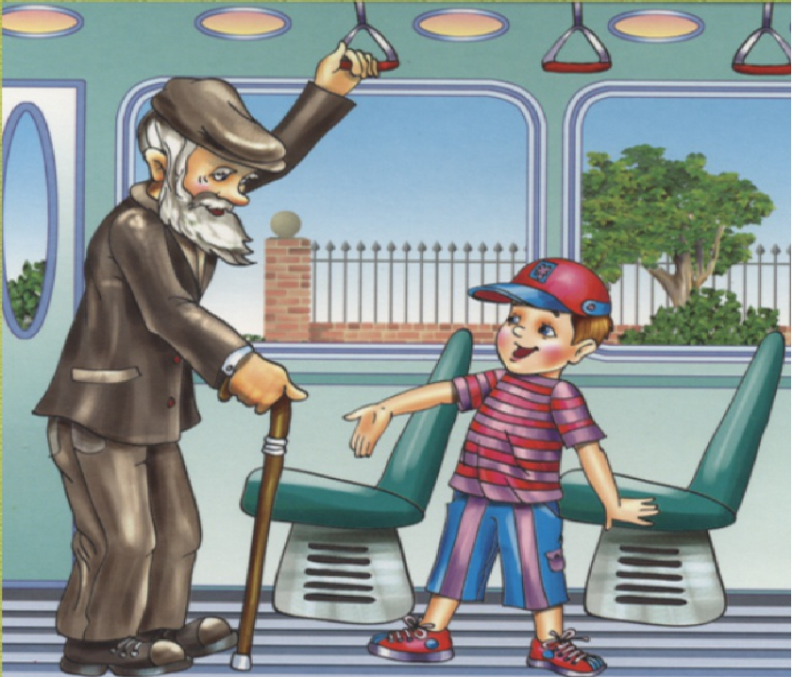
Be polite to the driver and other people.
Don’t be polite to the driver and other people.

Slide 25
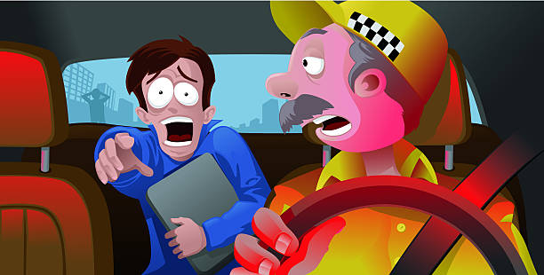
Talk to the driver when he is driving.
Don’t talk to the driver when he is driving.

Slide 26
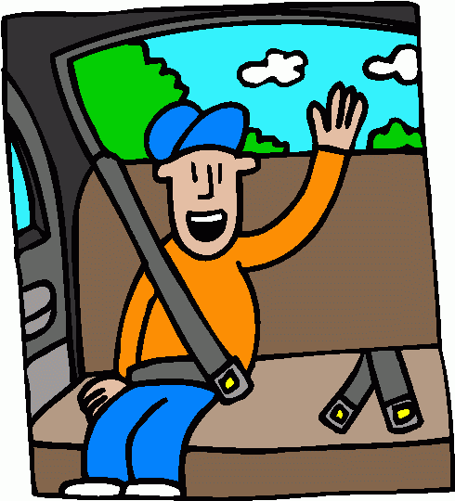
Sit on the back seat.
Don’t sit on the back seat.

Slide 27
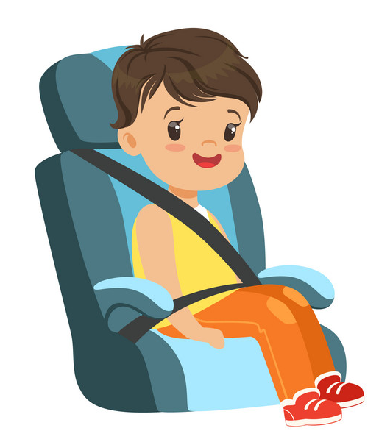
Wear your seat belt.
Don’t wear your seat belt.

Slide 28
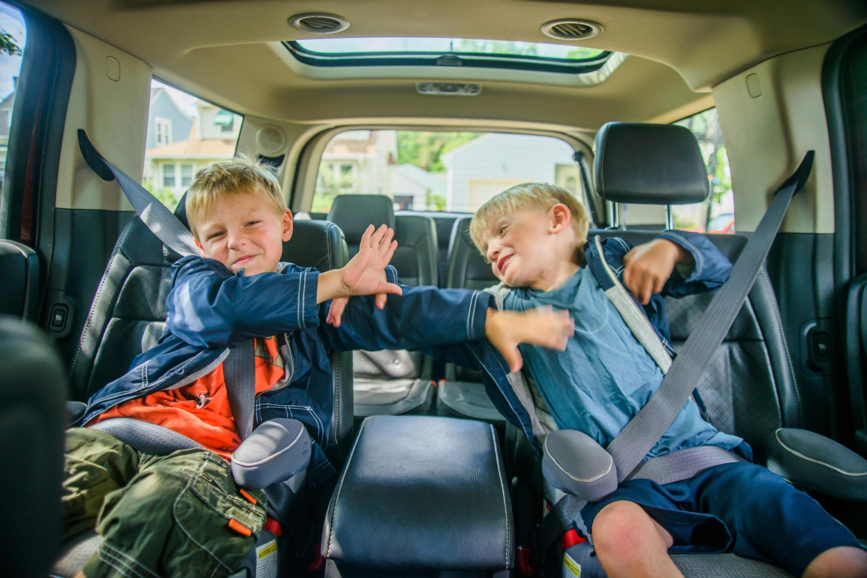
Play in the car.
Don’t play in the car.

Slide 29
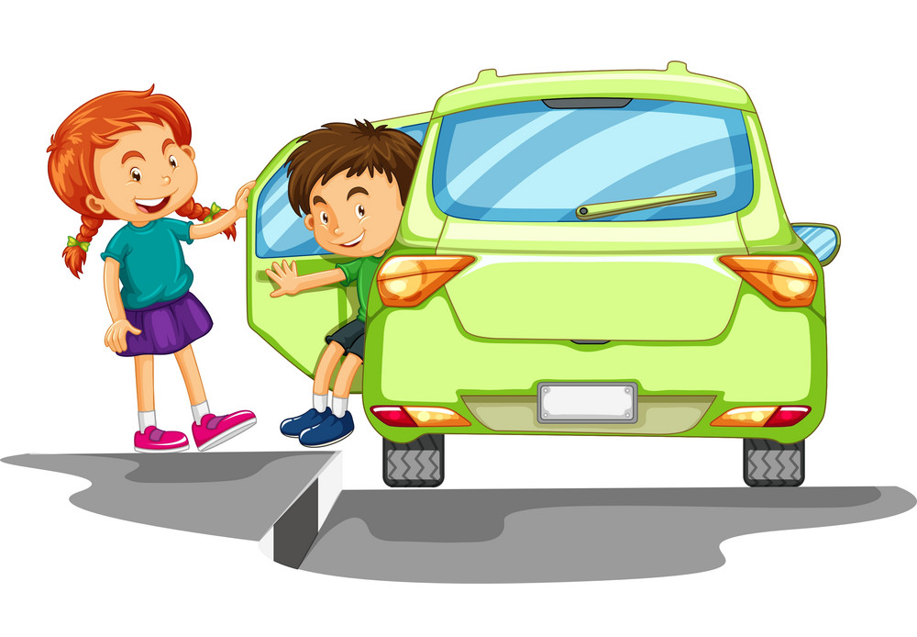
Use the door next to the pavement.
Don’t use the door next to the pavement.

Slide 30
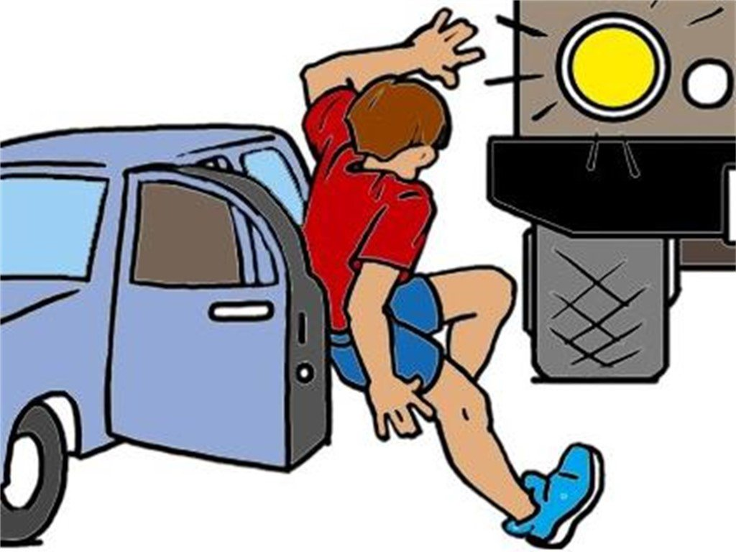
Open the door next to traffic.
Don’t open the door next to traffic.

