Slide 1
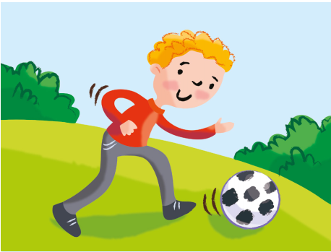

1. He / play / football (+) / basketball (-)
He plays football, but he doesn’t play basketball.

Slide 2
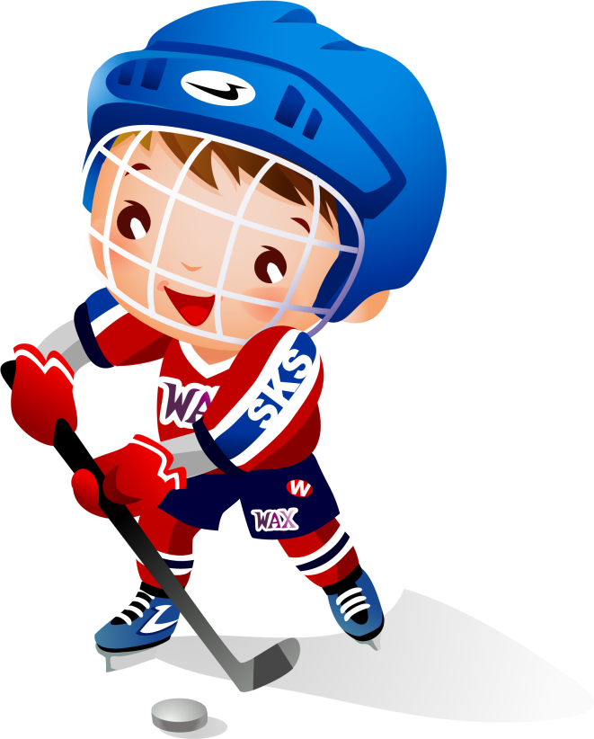
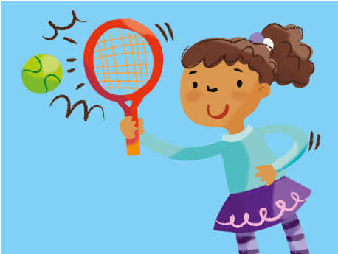
2. He / play / hockey (+) / tennis (-)

Slide 3

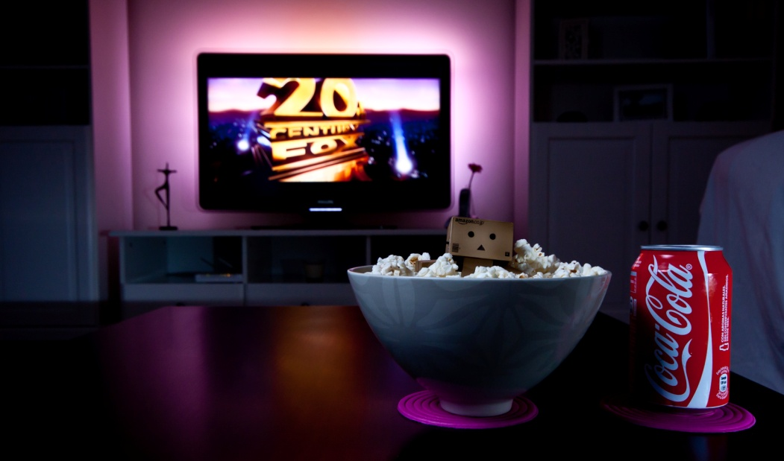
3. He / watch / cartoons (+) / films (-)

Slide 4
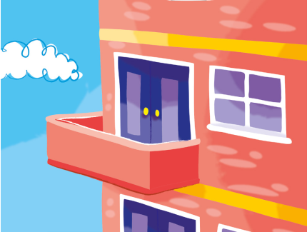
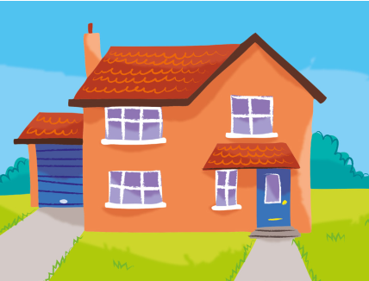
4. He / live / in a flat (+) / in a house (-)

Slide 5
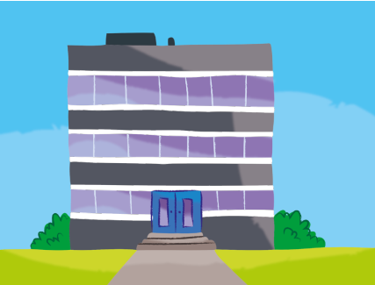
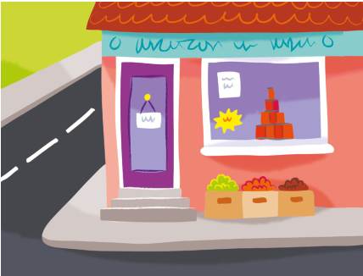
5. She / work / in a big building (+) / in the shop (-)

Slide 6
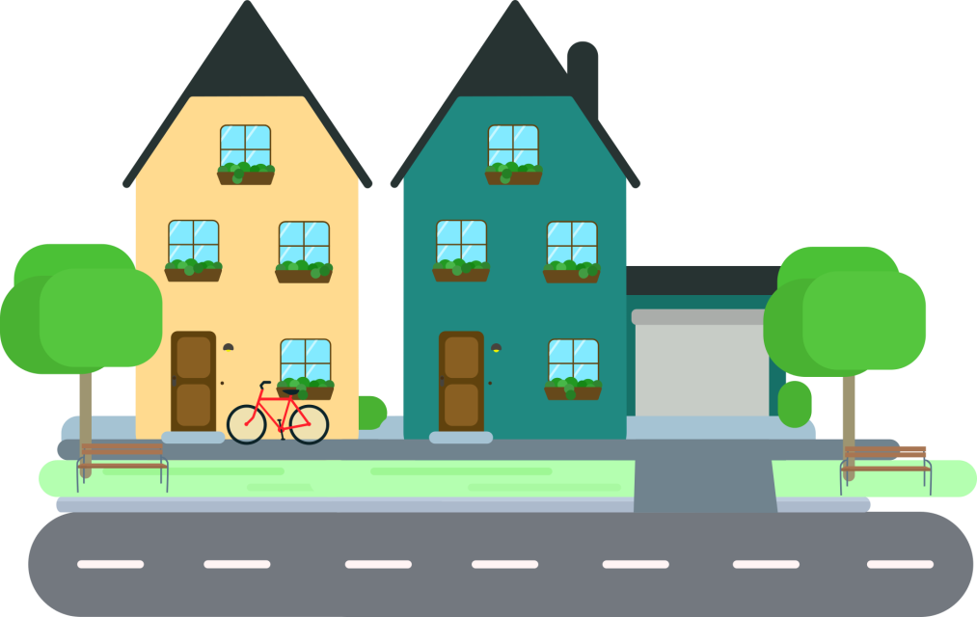
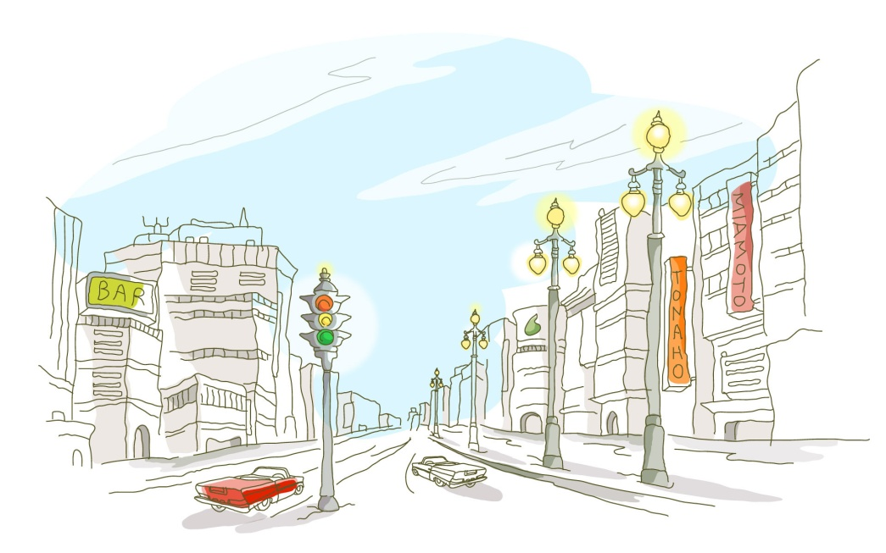
6. She / live / on Green Street (+) / on White Street (-)

Slide 7


7. She / go / to Blue School (+) / to Red School (-)

Slide 8


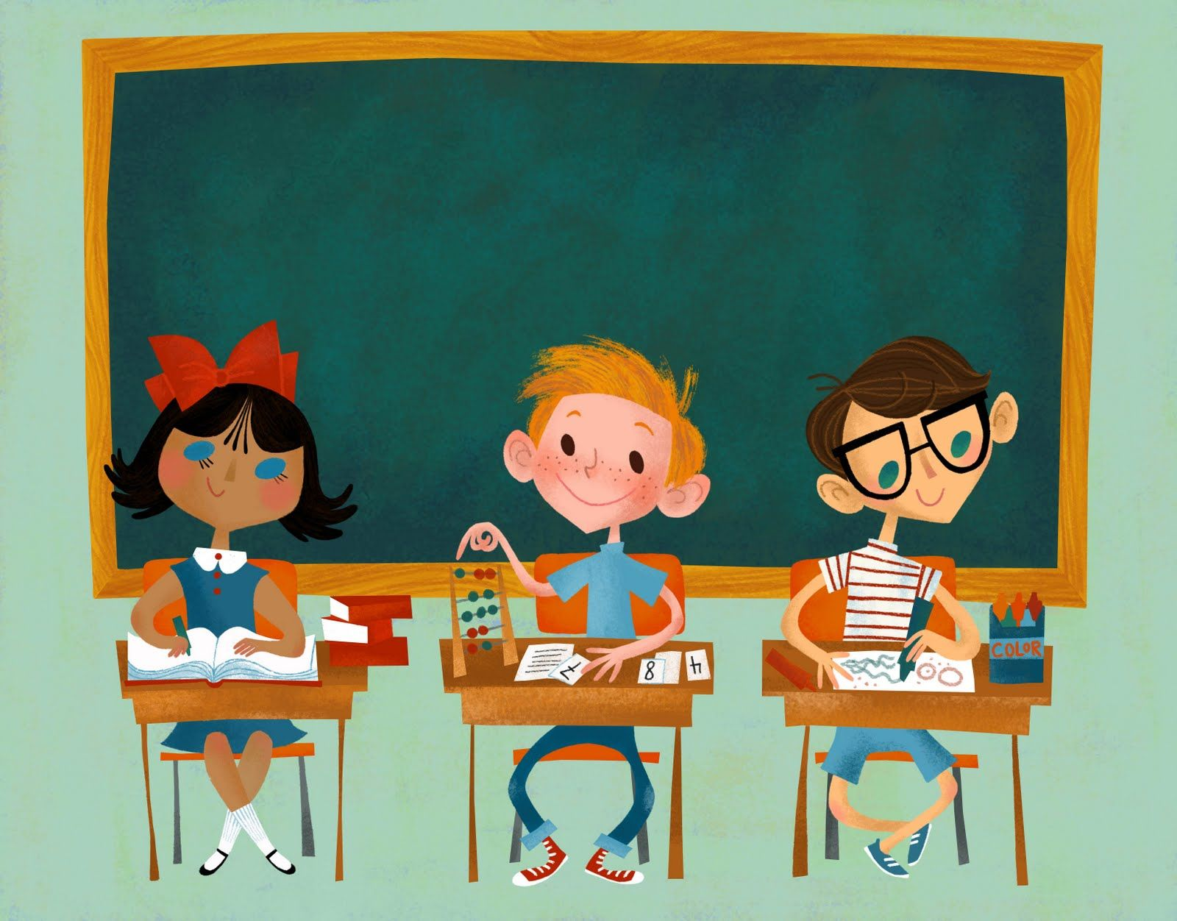
8. She / start school / at 9 o’clock (+) / at 11 o’clock

Slide 9
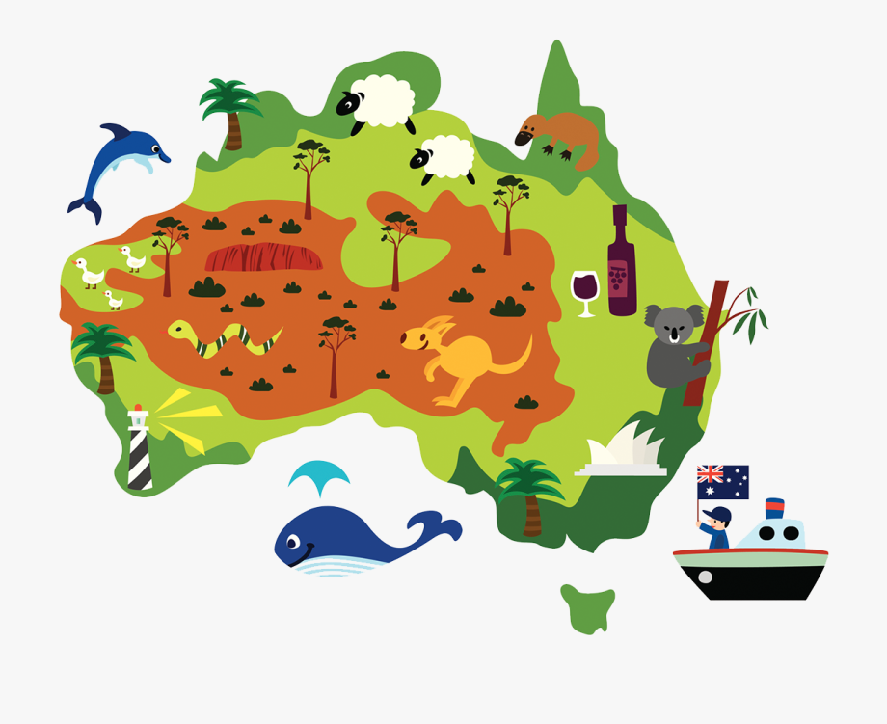
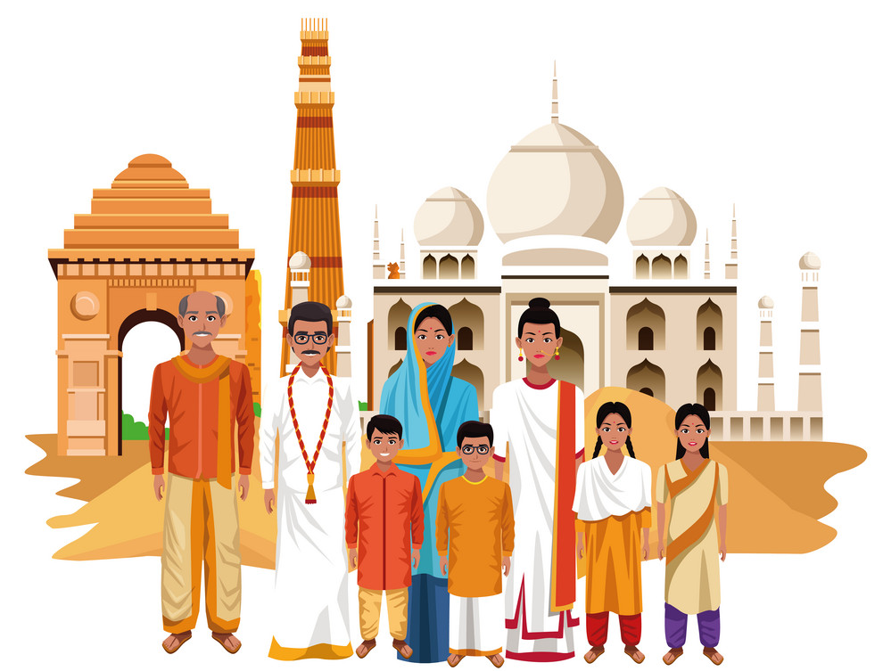
9. He / live / in Australia (+) / in India (-)

Slide 10
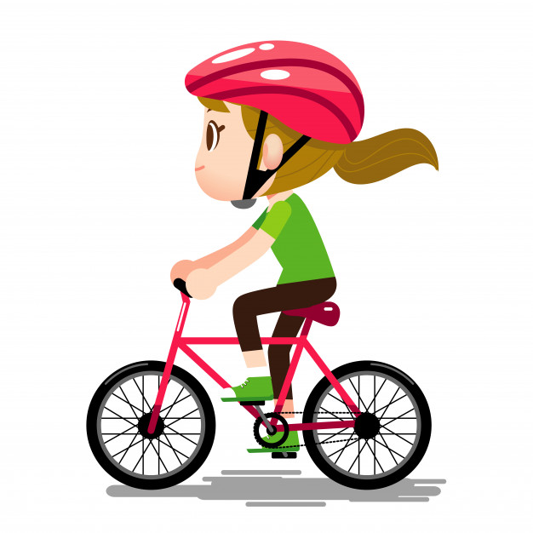
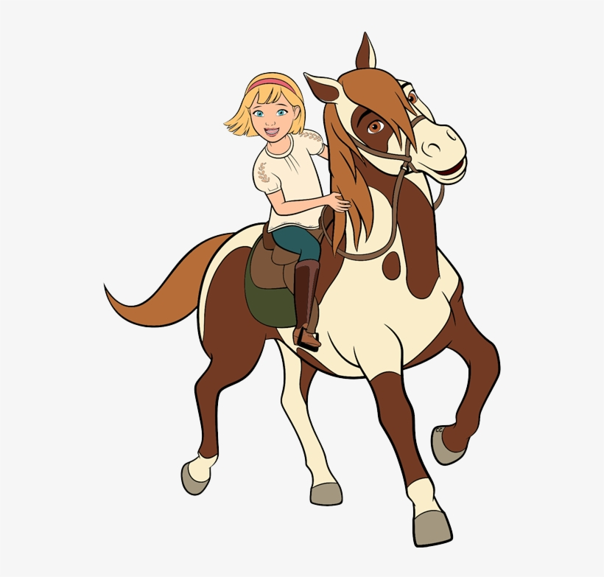
10. She / ride / a bike (+) / a horse (-)

Slide 11


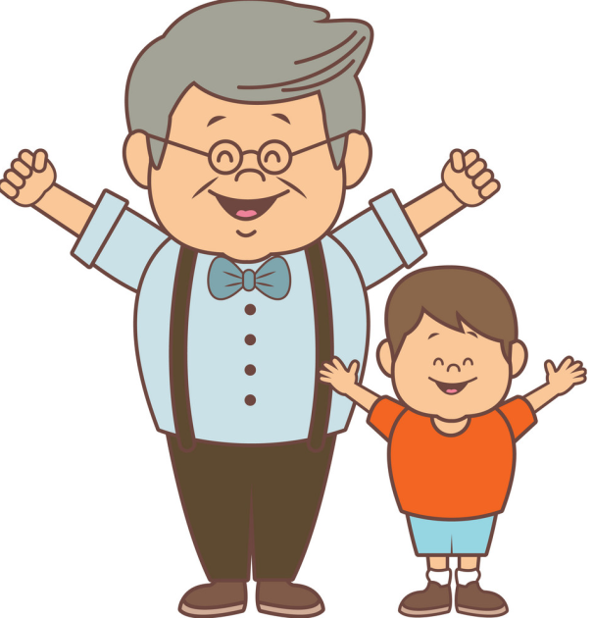
11. He / visit his Grandpa / on Saturday (+) / on Sunday (-)

Slide 12
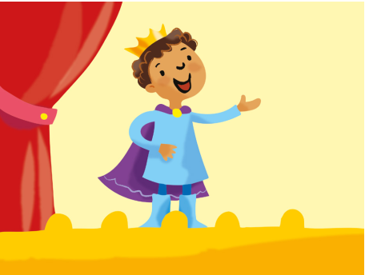
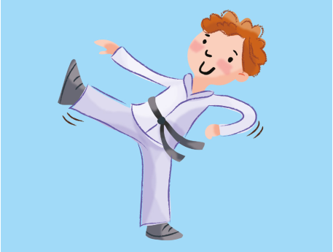
12. She / do / drama (+) / karate (-)

