Slide 1

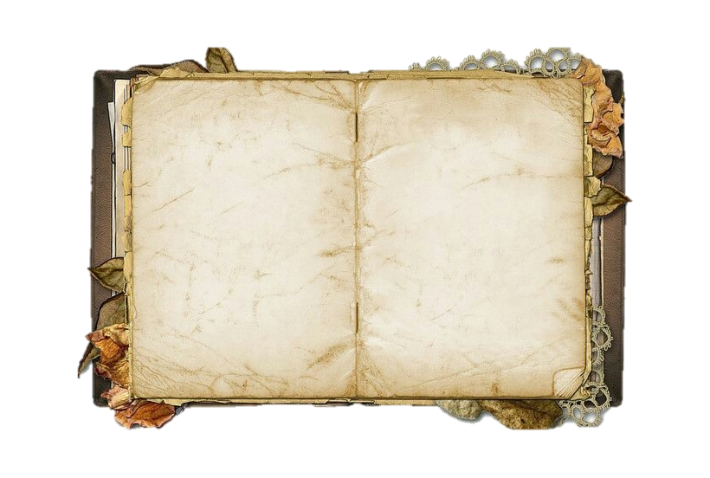


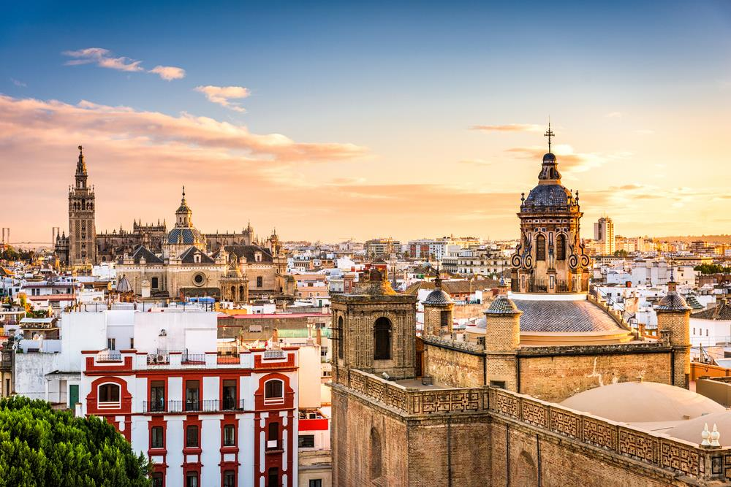
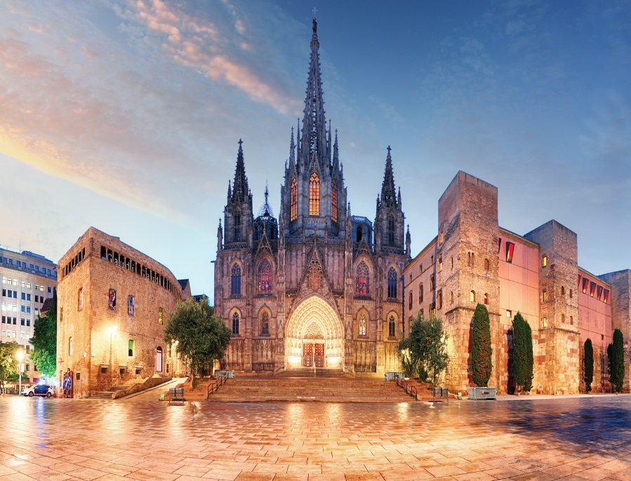
Where were you
a year ago?
I was in Spain.
click
Spain

Slide 2
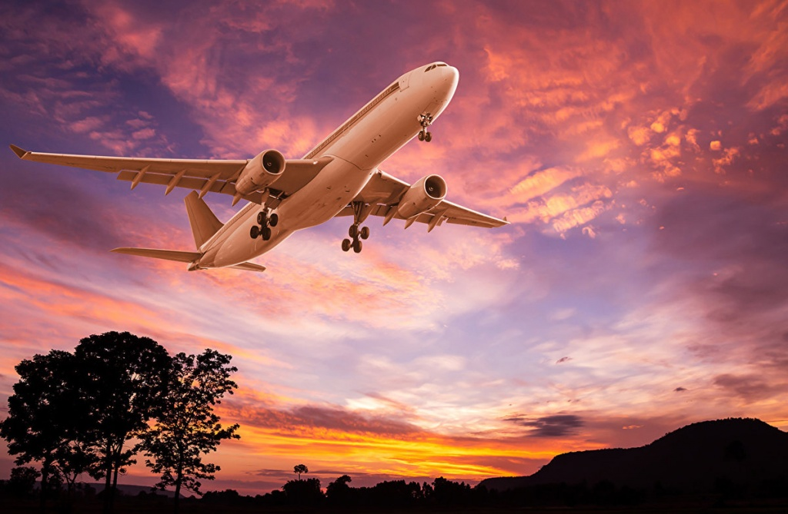
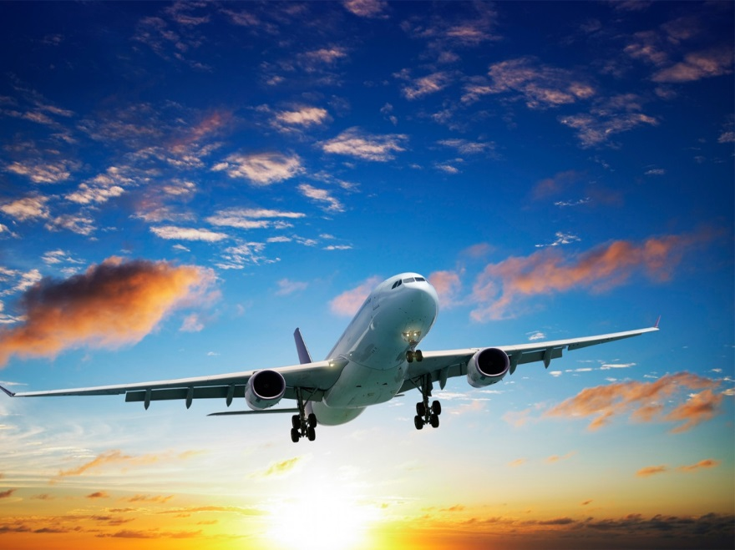
How did you
get there?
I got there
by plane.
click

Slide 3
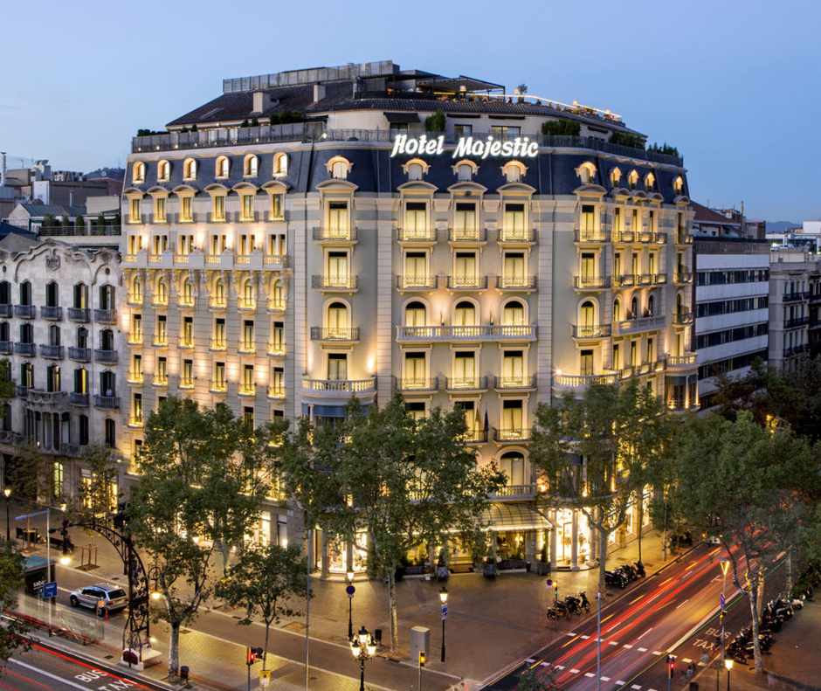
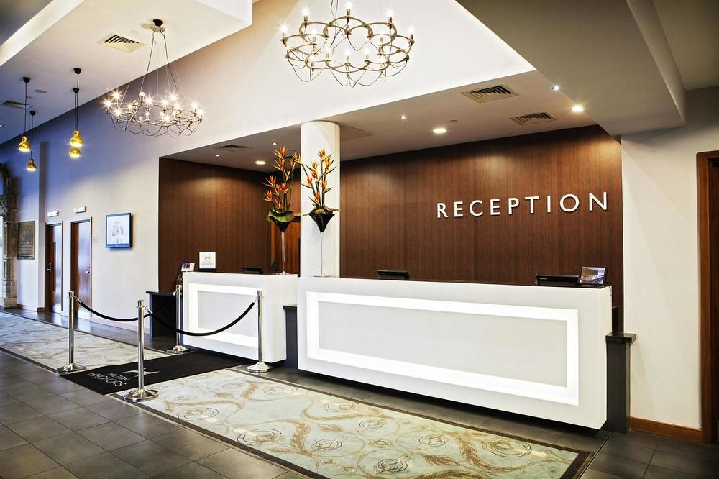
Where did you
stay at?
I stayed at a
Hotel.
click

Slide 4
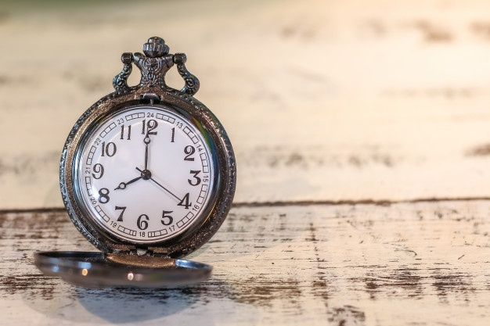
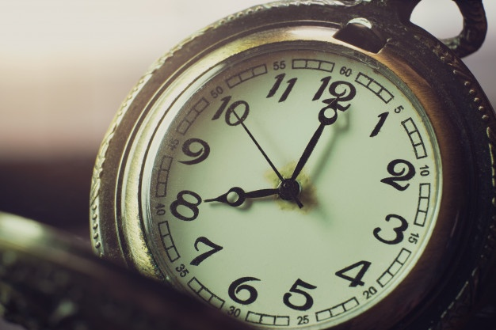
When did your day begin?
My day began
at 8 o’clock.
click

Slide 5

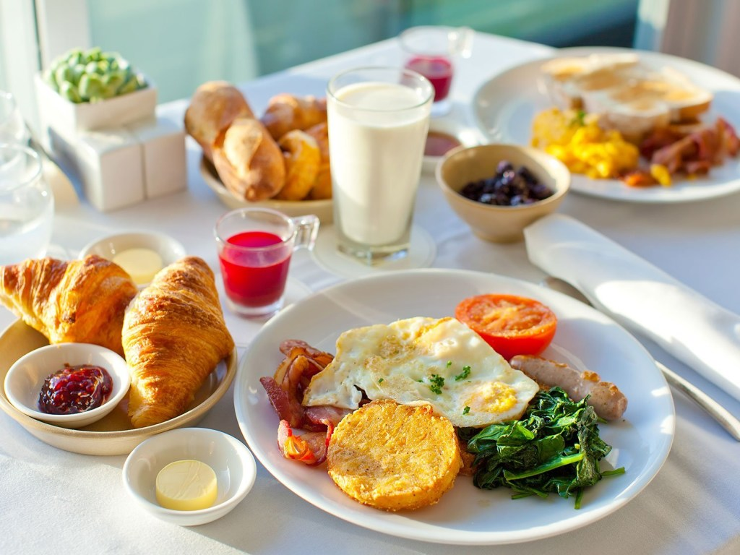
Did you have breakfast?
Yes, I did.
click
I was hungry.

Slide 6
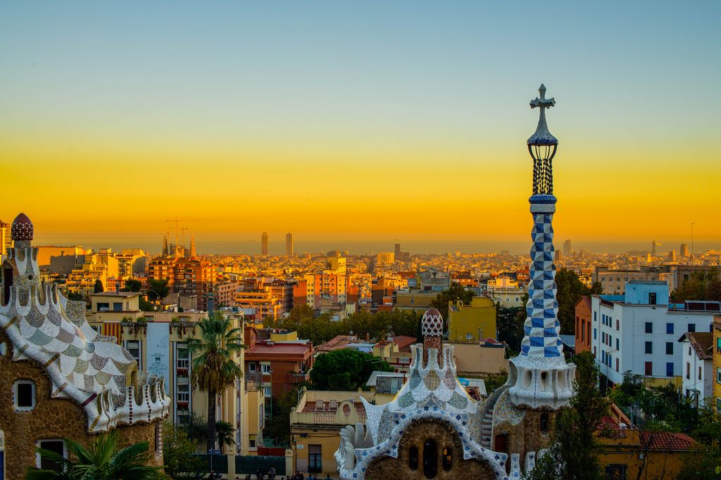
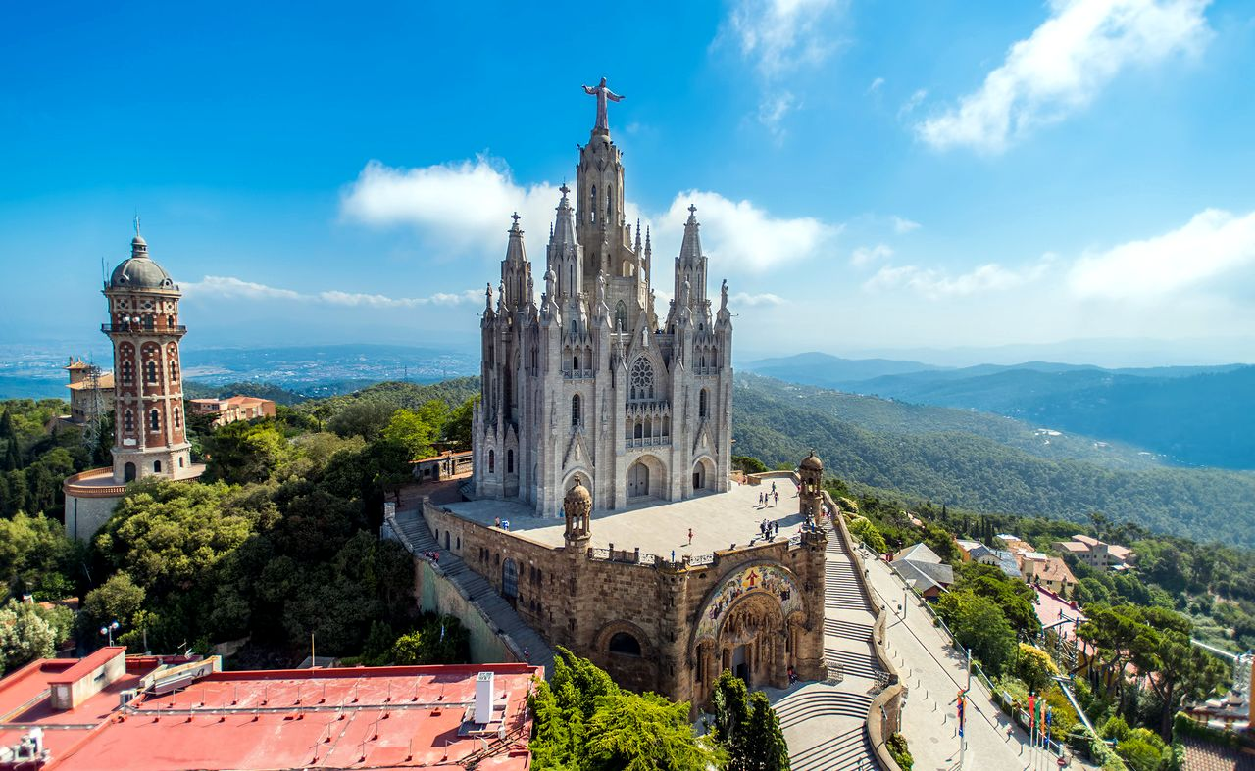
Where did you go after breakfast?
I went to
Barcelona
click
Barcelona

Slide 7
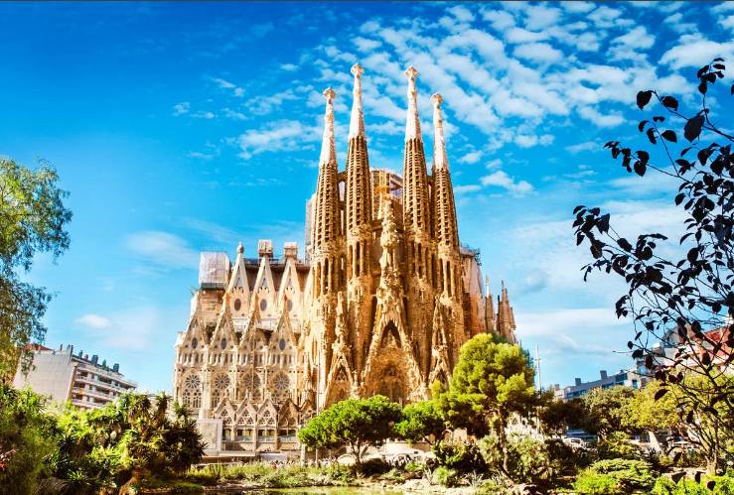
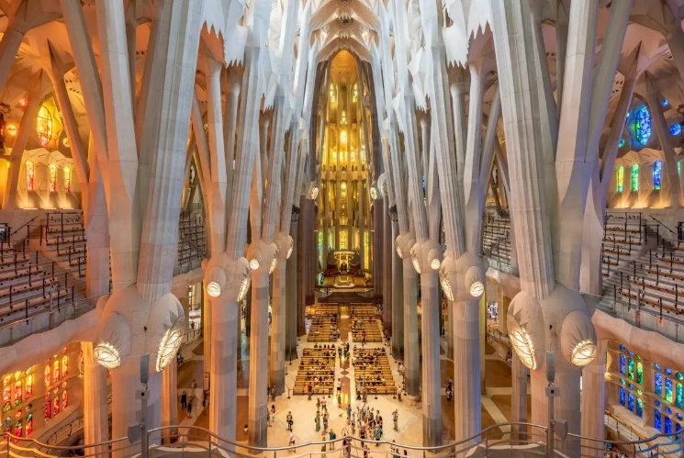
What sights did you see there?
I saw
the Sagrada Familia
click
Sagrada Familia

Slide 8
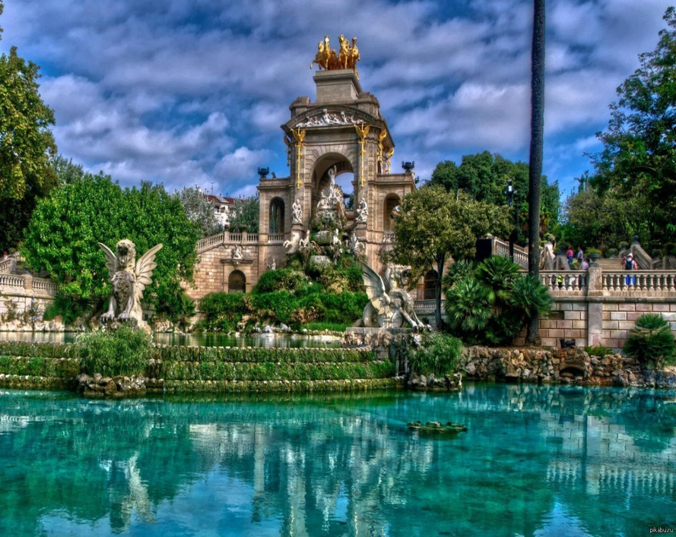
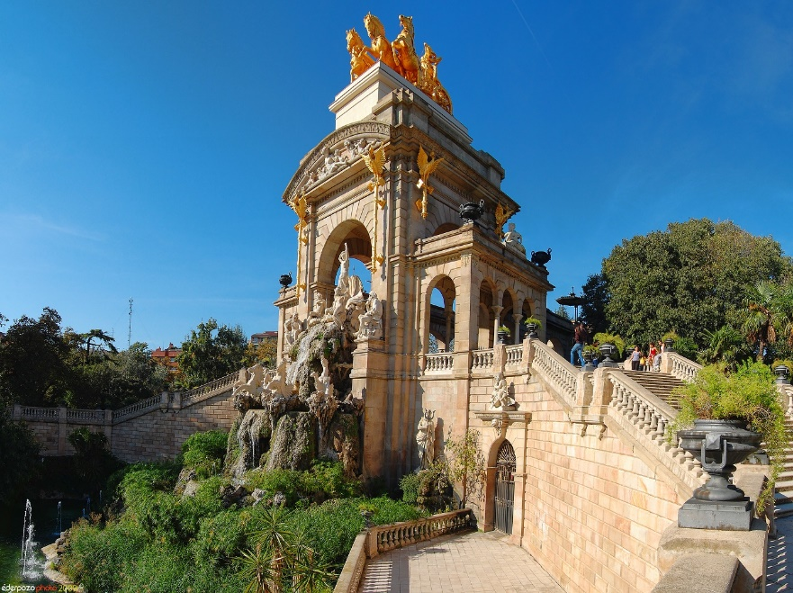
What else did you visit there?
I visited
Citadel Park.
click
Citadel Park

Slide 9
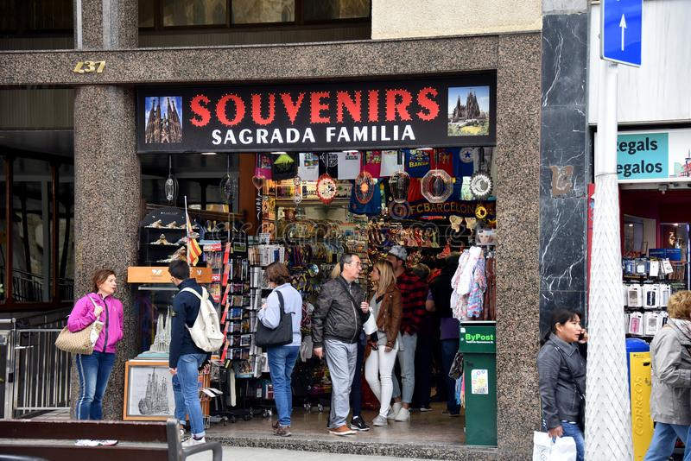
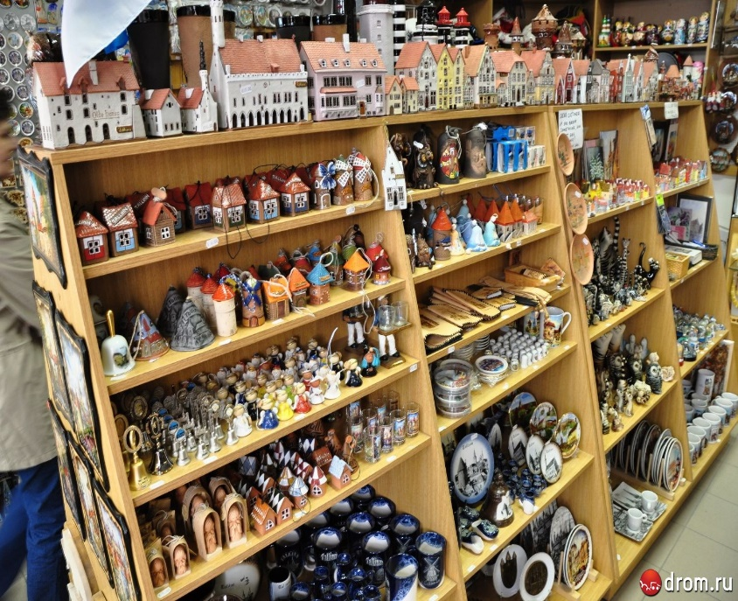
Where else did
you go?
I went to a souvenir shop.
click

Slide 10
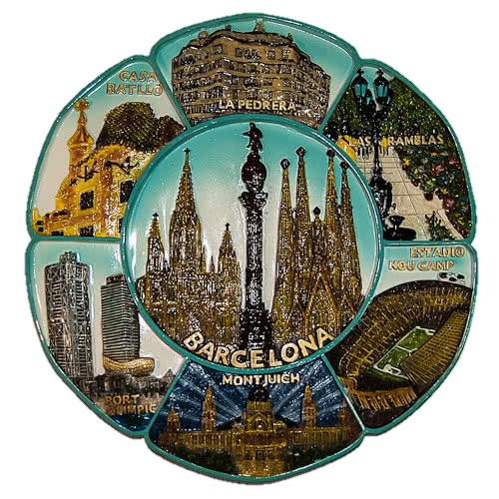


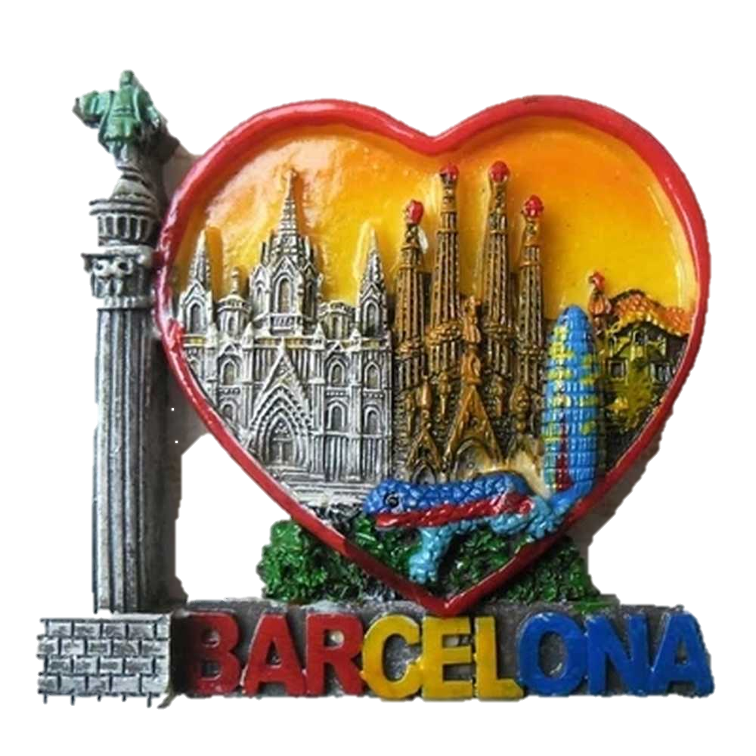
What did you
buy there?
I bought some souvenirs.
click
I
souvenirs

Slide 11

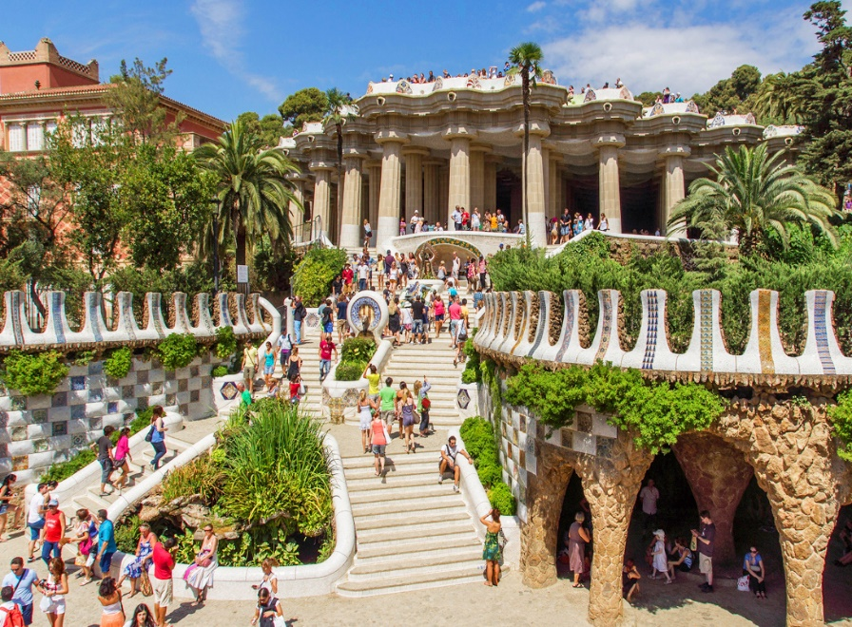
Did you enjoy
your visit?
Yes, I did.
click
I
The End

