Slide 1
Disclaimer/s
We hope you find the information on our website and resources useful.
Animations
This resource has been designed with animations to make it as fun and engaging as possible. To view the content in the correct formatting, please view the PowerPoint in ‘slide show mode’. This takes you from desktop to presentation mode. If you view the slides out of ‘slide show mode’, you may find that some of the text and images overlap each other and/or are difficult to read.
To enter slide show mode, go to the slide show menu tab and select either from beginning or from current slide.
You may wish to delete this slide before beginning the presentation.

Slide 3
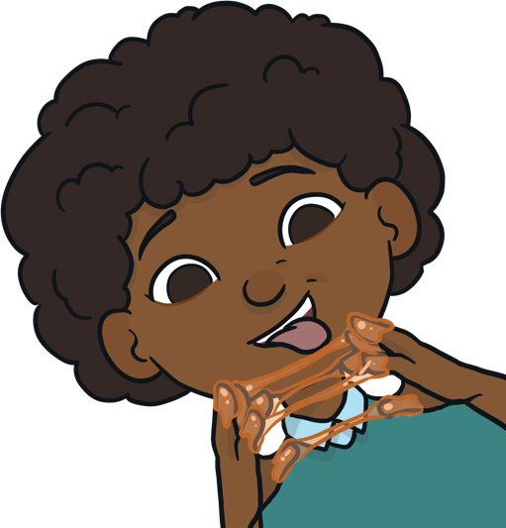
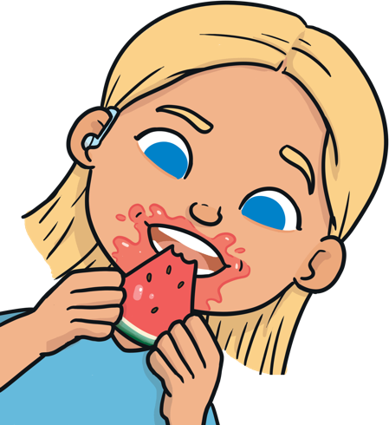
Instructions
Choose the word that best describes the food.
See if you can get them all correct!
Start

Slide 4
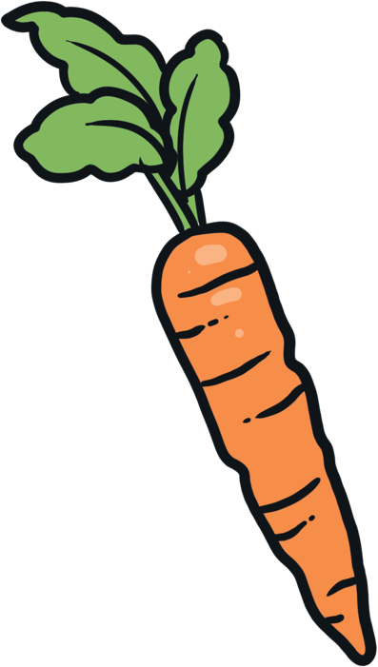
Describe the Food
carrot
Well done!
Next
crunchy
soft
sticky
Try again!
Try again!

Slide 5
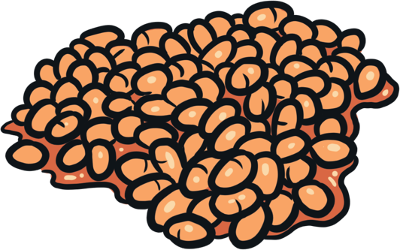
Describe the Food
baked beans
Well done!
Next
crunchy
squishy
crispy
Try again!
Try again!

Slide 6
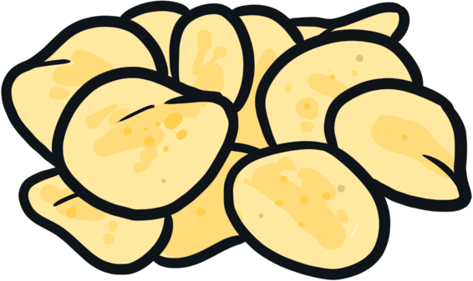
Describe the Food
crisps
Well done!
Next
chewy
juicy
crispy
Try again!
Try again!

Slide 7

Describe the Food
honey
Well done!
Next
crispy
creamy
sticky
Try again!
Try again!

Slide 8

Describe the Food
ice cream
Well done!
Next
creamy
chewy
crunchy
Try again!
Try again!

Slide 9
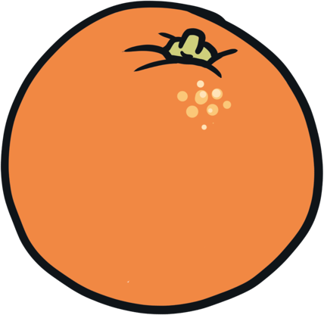
Describe the Food
orange
Well done!
creamy
juicy
Next
crispy
Try again!
Try again!

Slide 10

Describe the Food
doughnut
Well done!
Next
crunchy
juicy
soft
Try again!
Try again!

Slide 11

Describe the Food
apple
Well done!
Next
squishy
chewy
crunchy
Try again!
Try again!

Slide 12
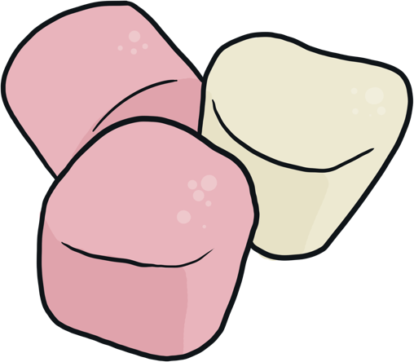
Describe the Food
marshmallows
Well done!
Next
crunchy
juicy
chewy
Try again!
Try again!

Slide 13
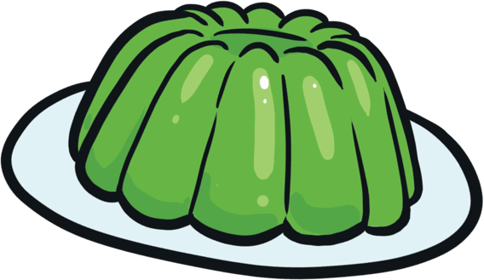
Describe the Food
jelly
Well done!
Next
sticky
crunchy
creamy
Try again!
Try again!

Slide 14
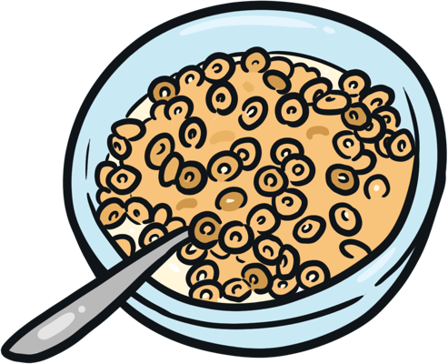
Describe the Food
cereal
Well done!
Next
sticky
crispy
juicy
Try again!
Try again!

Slide 15
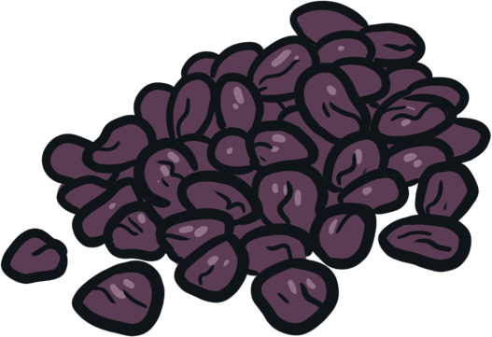
Describe the Food
raisins
Well done!
Next
chewy
crunchy
creamy
Try again!
Try again!

Slide 16

Describe the Food
banana
Well done!
Next
crunchy
crispy
squishy
Try again!
Try again!

Slide 17
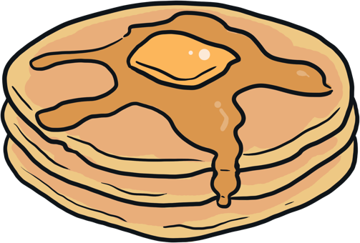
Describe the Food
pancakes
Well done!
Next
creamy
soft
juicy
Try again!
Try again!

Slide 18
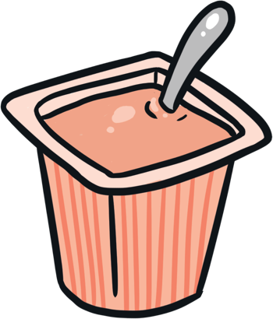
Describe the Food
yoghurt
Well done!
Next
crunchy
creamy
crispy
Try again!
Try again!

Slide 19
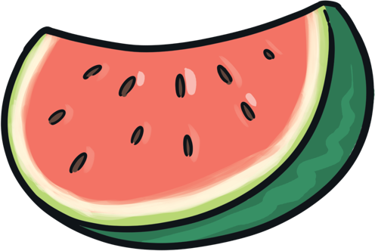
Describe the Food
watermelon
Well done!
Next
juicy
creamy
squishy
Try again!
Try again!

