Slide 1
HAS GOT
HAVE GOT
SANDRIM

Slide 2
HAS GOT
I
HE
WE
SHE
HAVE GOT
YOU
IT
THEY

Slide 3
He
I
You
She
They
We
It
HAVE GOT
HAS GOT

Slide 4
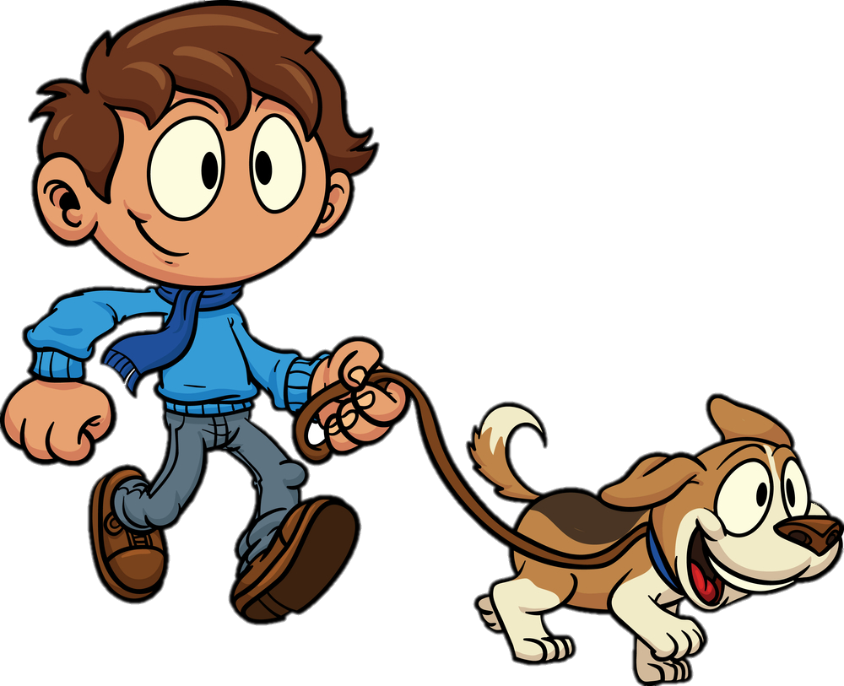
I have got a dog
I

Slide 5
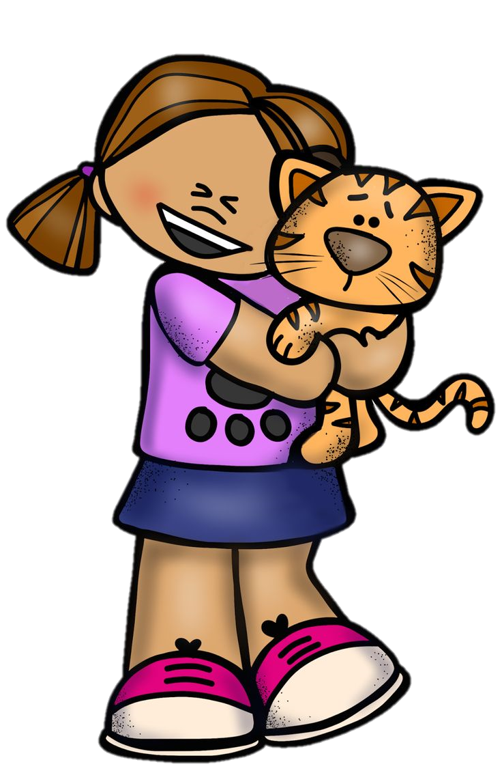
She has got a cat
Kate
She

Slide 6
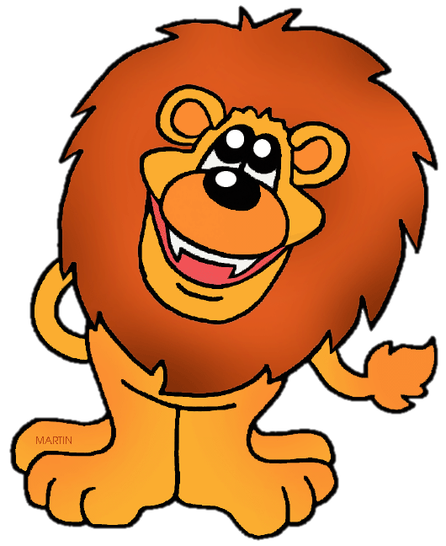
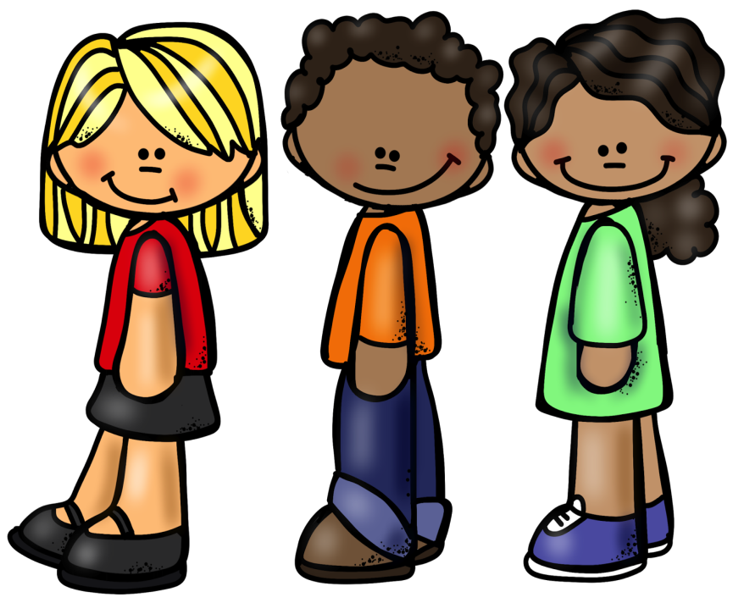
We have got a lion
We
Kate

Slide 7
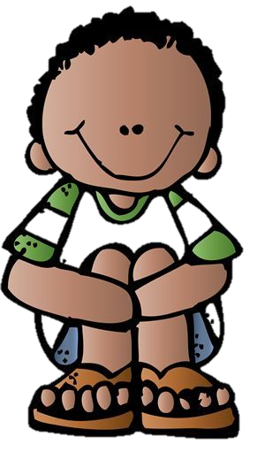

He has got a puppy
He
Kate

Slide 8
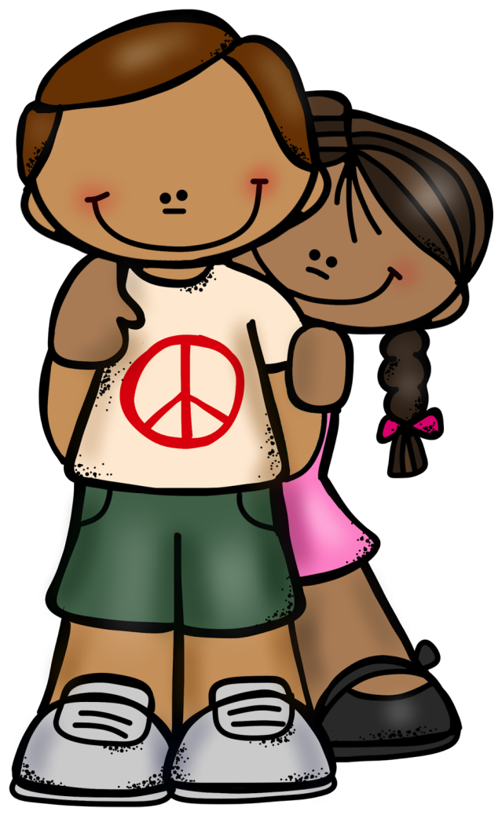
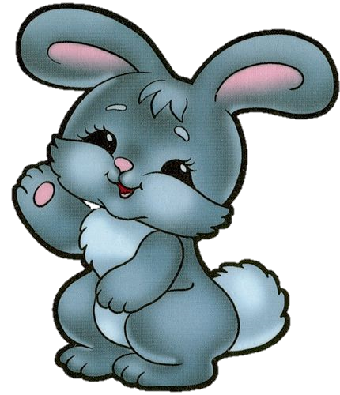
Tim and Liz have got a rabbit
Tim and Liz

Slide 9


Kate has got a bear
Kate

Slide 10

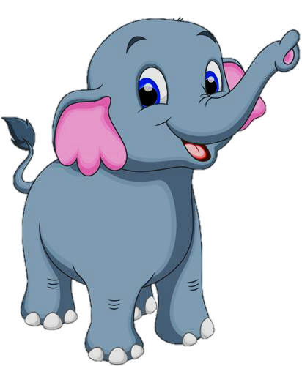
Tom has got an elephant
Tom

Slide 11
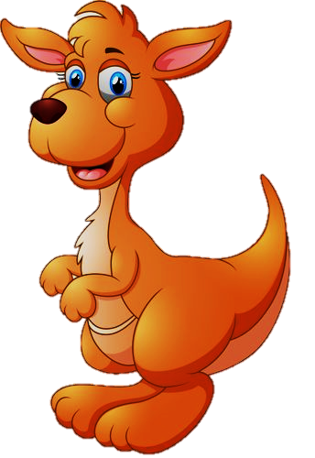

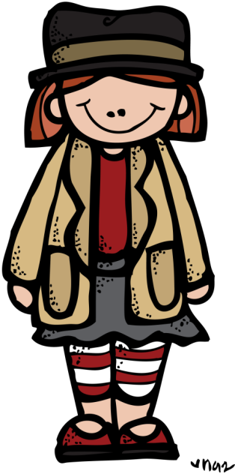
They have got a kangaroo
They

Slide 12
HAVE
GOT
HAS
GOT
SHE
HE
IT
I
?
WE
YOU
THEY

Slide 13
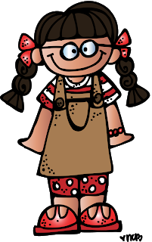
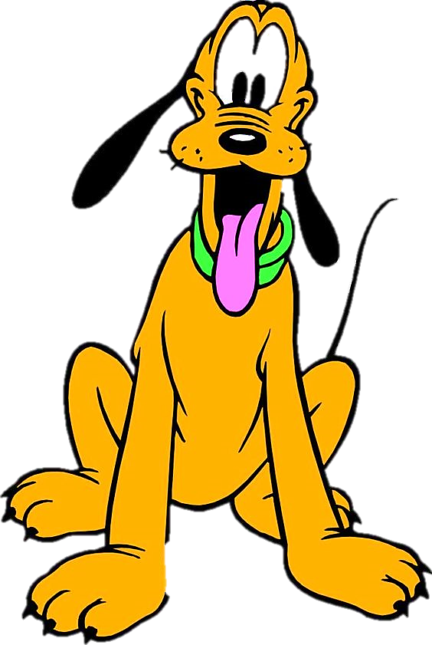
SHE
HAS
GOT A DOG
?
YES, SHE HAS.

Slide 14
SHE
HAS
GOT A CAT
?
NO, SHE HASN’T.

Slide 15
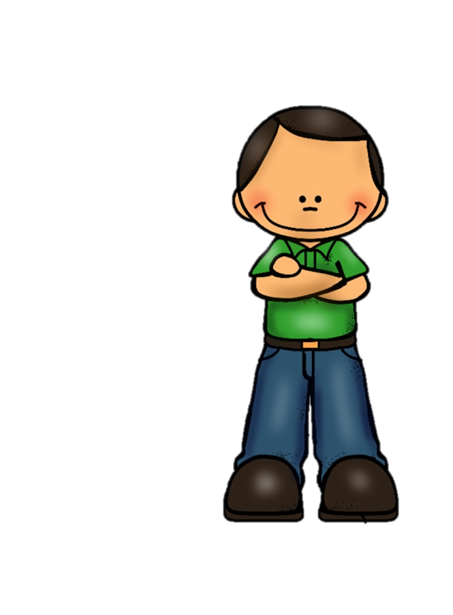
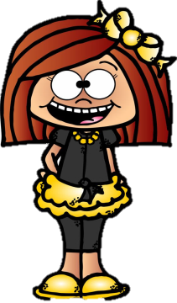
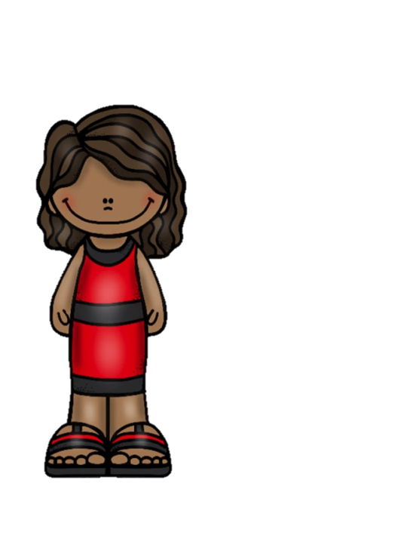
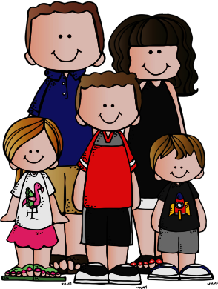
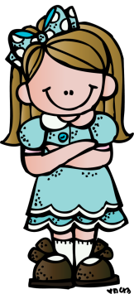
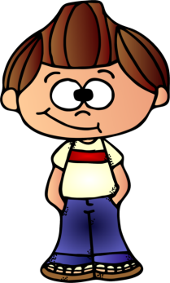
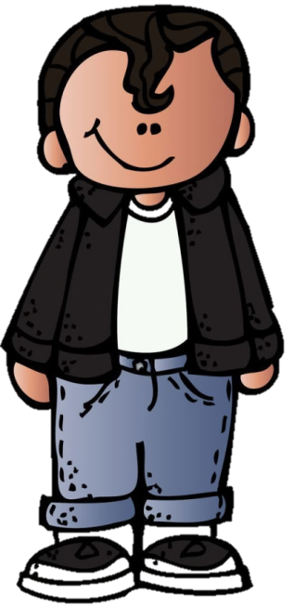
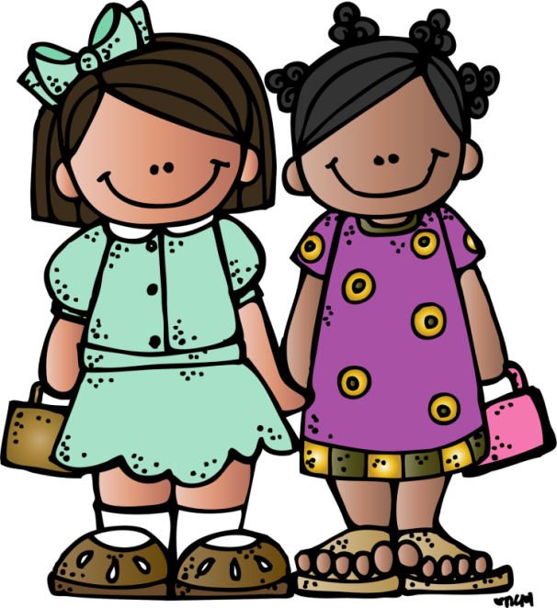

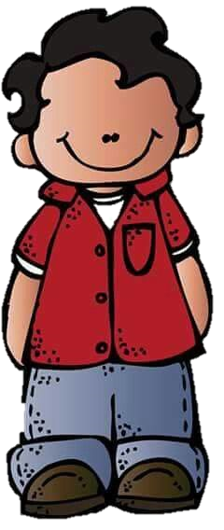
Guess what they have got

Slide 16
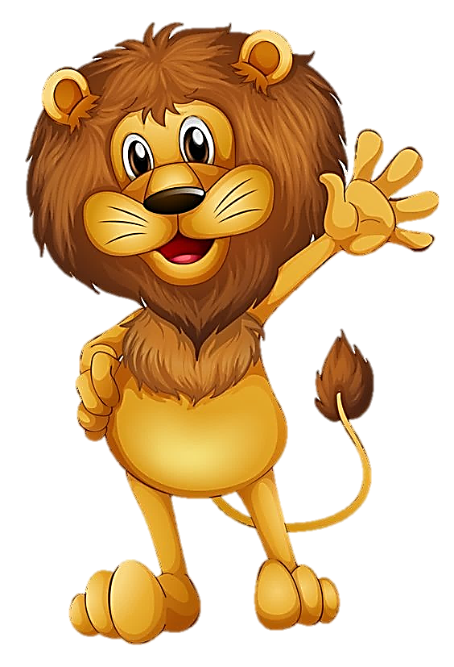
She has got a lion
check
She
Click on it

Slide 17
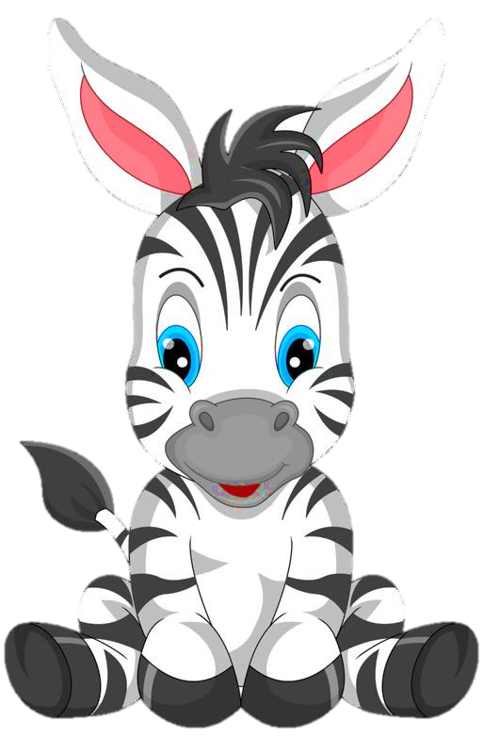

The girls have got a zebra
check
The girls

Slide 18

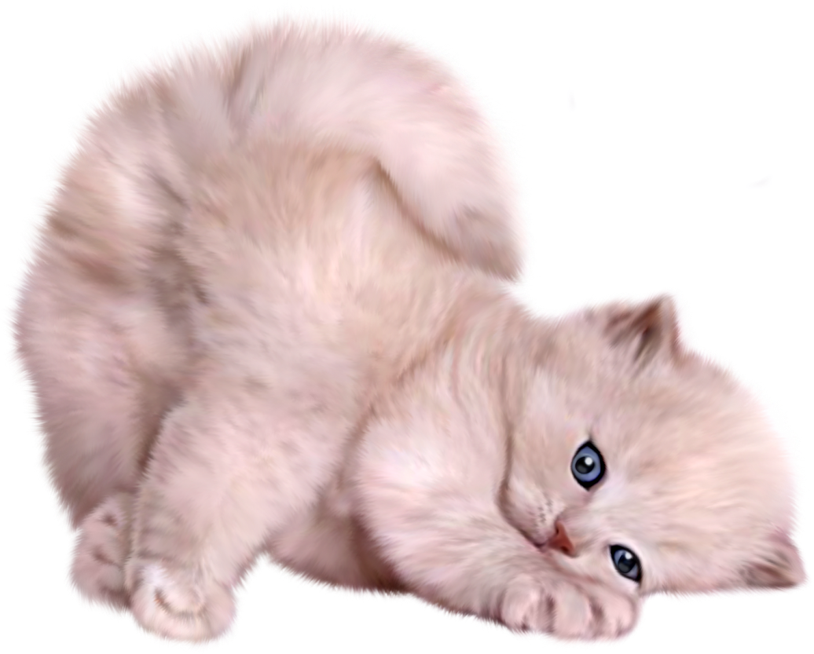
Pam has got a kitten
check
Pam

Slide 19
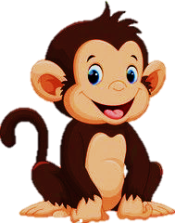

Sam has got a monkey
check
Sam

Slide 20


She has got a frog
check
She

Slide 21
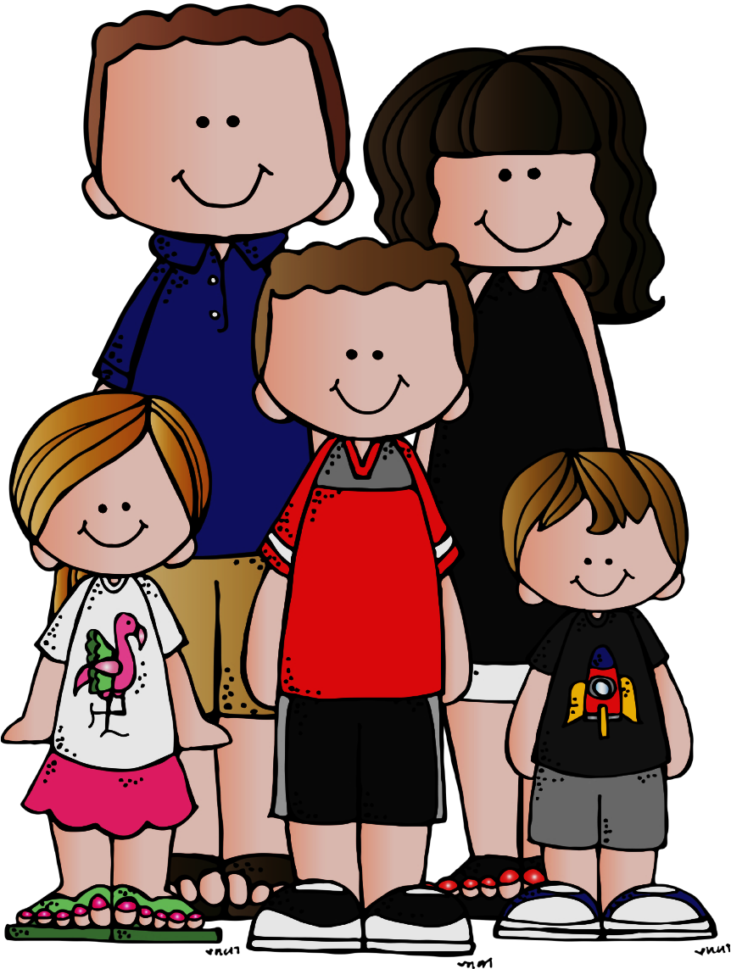

We have got a dog
check
We

Slide 22
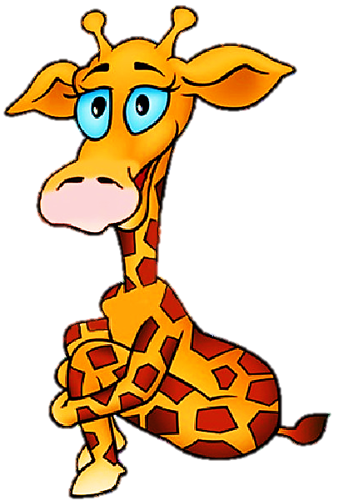
He has got a giraffe
check
He

Slide 23

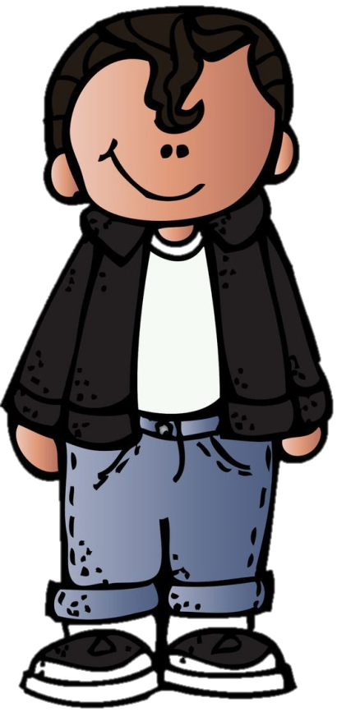
She has got a snake
check
They

Slide 24

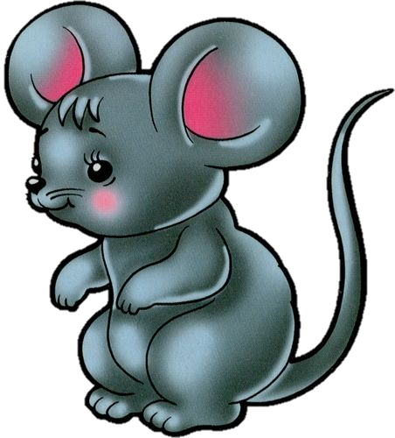
Ann has got a mouse
check
Ann

