Slide 1


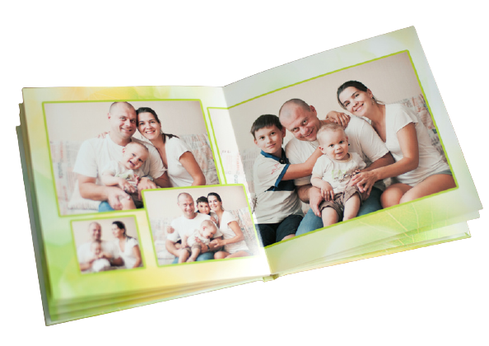


IrinaPapakhina

Slide 2



1. Have you got a family album?
2. Whose photos are there in your photo album?
IrinaPapakhina

Slide 3
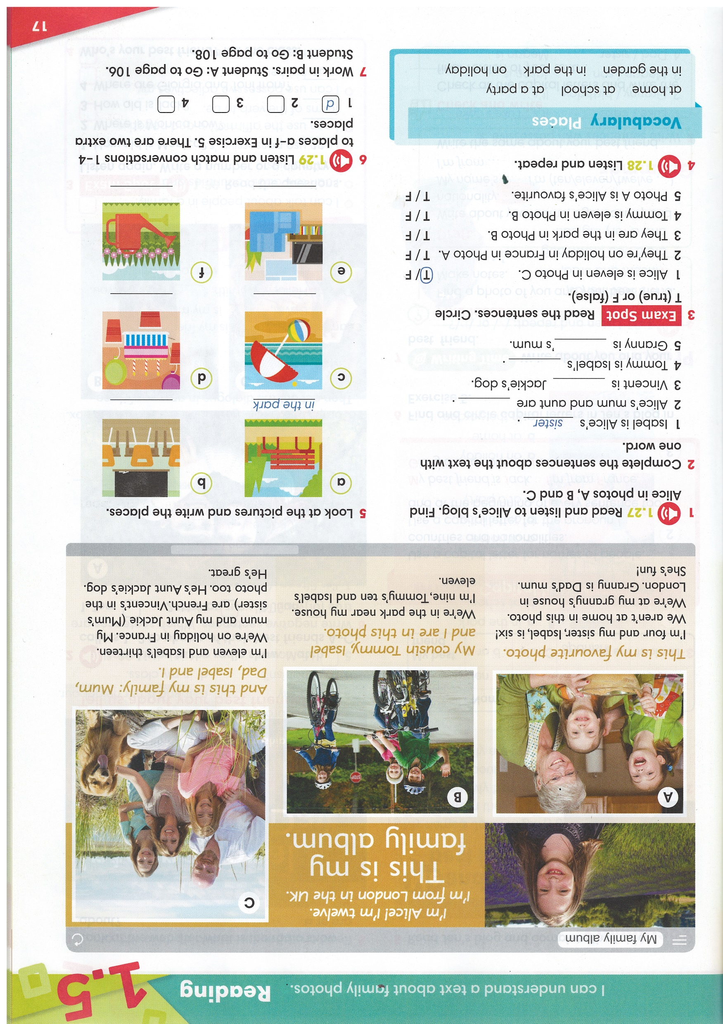



Can you find Alice in photos A, B and C?
Who are the other children in the photos?
Listen and check your answers.
IrinaPapakhina

Slide 4
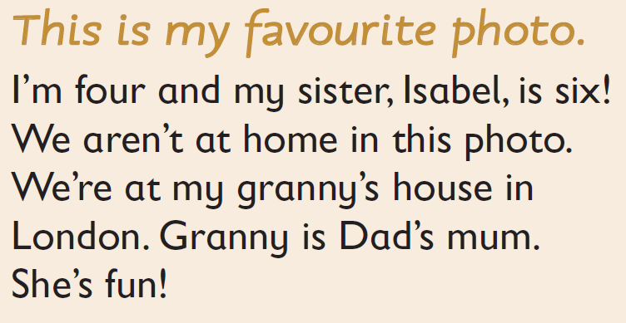
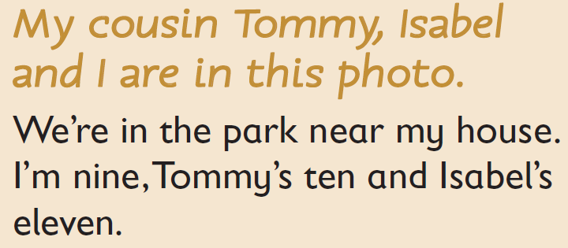
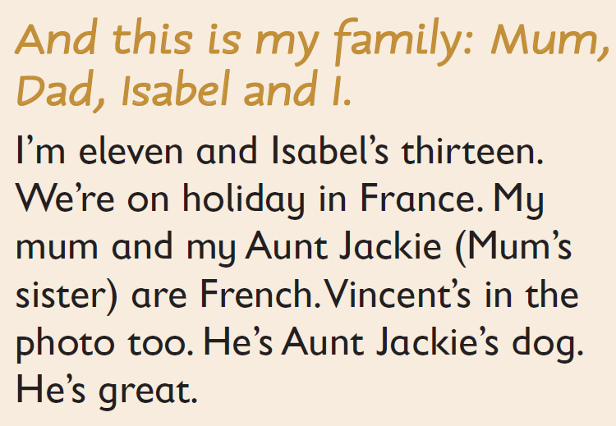
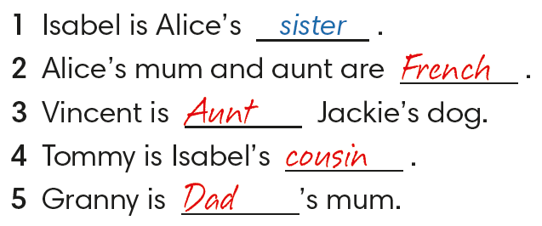

Complete the sentences about the text with ONE word.
IrinaPapakhina

Slide 5
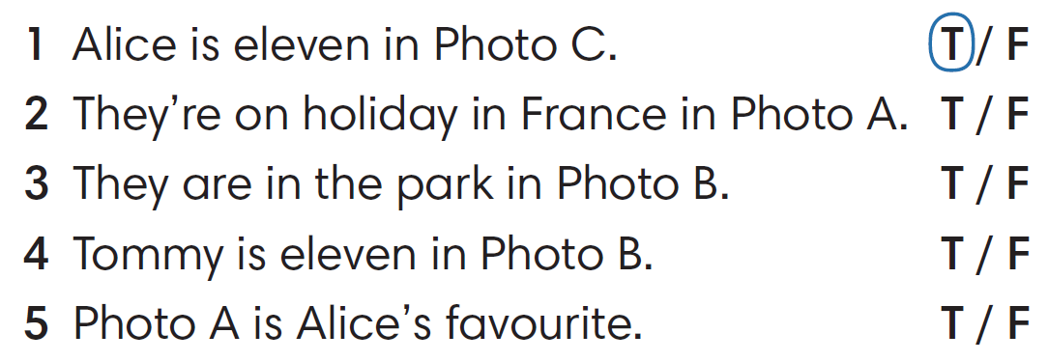
Read the sentences
Circle true (T) or false (F).
Correct the false sentences.
IrinaPapakhina

Slide 6
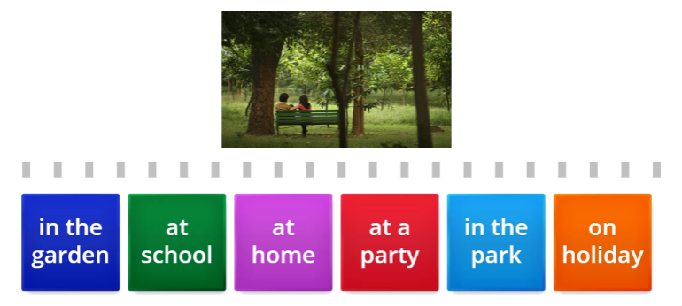

IrinaPapakhina

Slide 7
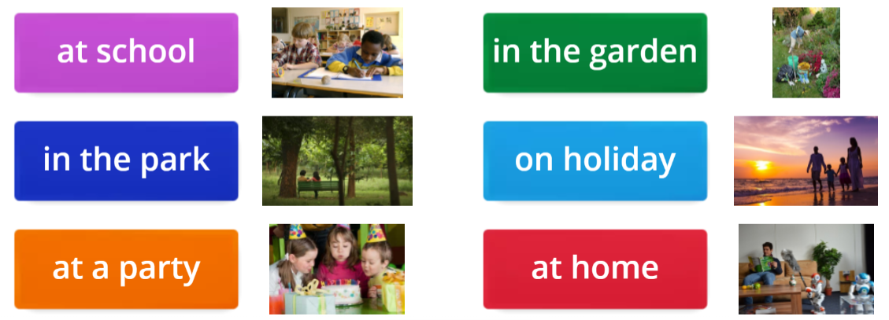
What do you usually do at these places?
IrinaPapakhina

Slide 8

IrinaPapakhina

Slide 9

at school
1. Look at the pictures and write the places.
2. Listen and match conversations 1 -4 to places a – f.
There are two extra places.
on holiday
at a party
at home
in the garden
IrinaPapakhina

Slide 10

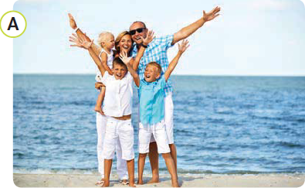
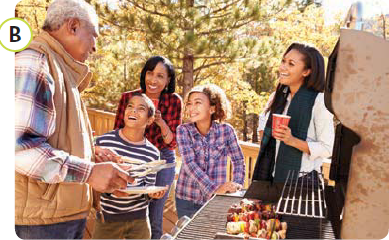
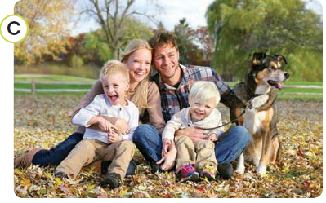
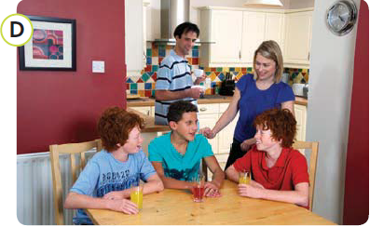
IrinaPapakhina

Slide 11

This is my … Her name is … She is …
This is Arina’s …
IrinaPapakhina

Slide 12
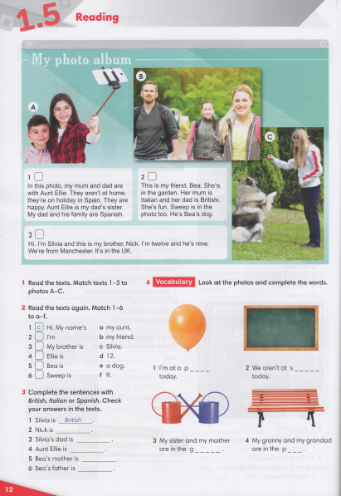


IrinaPapakhina

Slide 13
IrinaPapakhina

