Slide 1
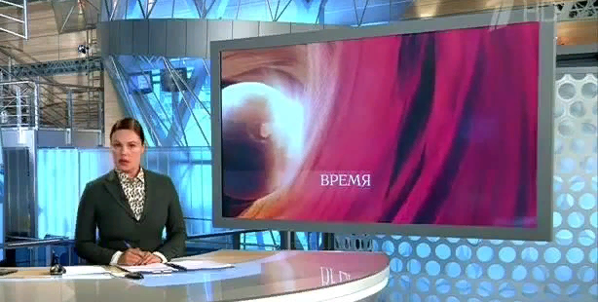


He’s finished his homework.
He can go out.

Slide 2
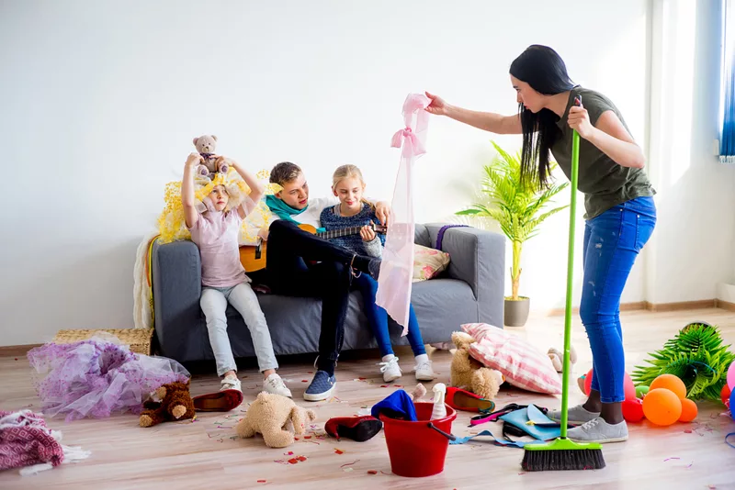
You’ve made a mess!
You are naughty!

Slide 3

I’ve put the books on the shelf.
I like reading.

Slide 4



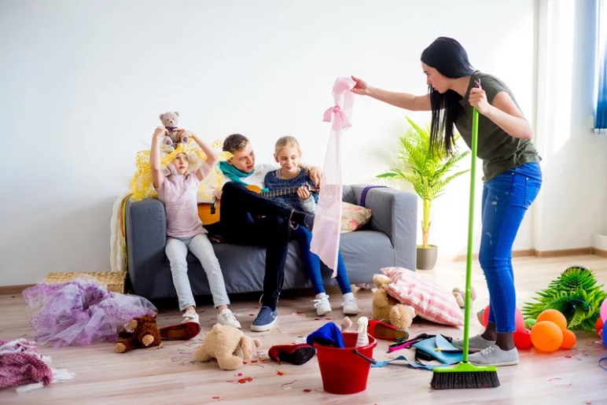
past
He’s finished his homework.
He can go out.
past
I’ve put the books on the shelf.
I like reading.
present
present
past
You’ve made a mess!
You are naughty!
Which of these actions happened in the past?
present
Which of these actions are still true now?

Slide 5
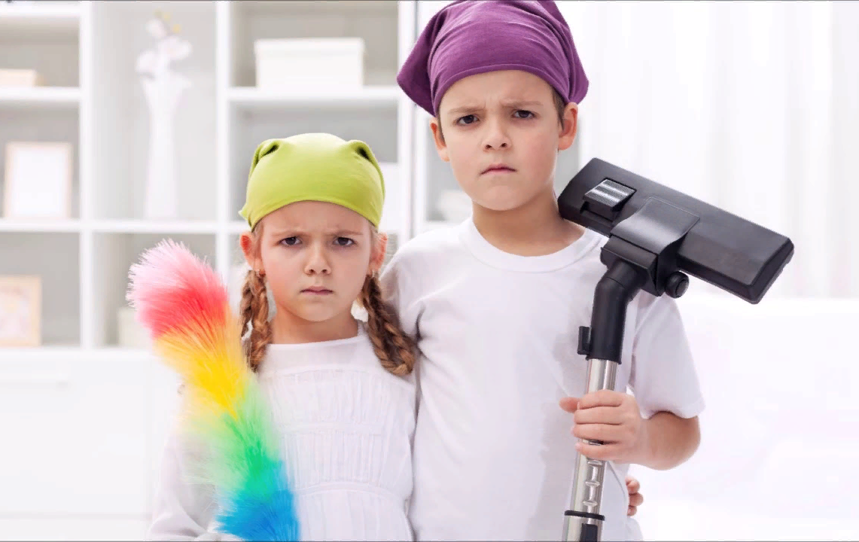

Use the present perfect for actions in the past that are still true now.
They’ve tidied their room.
This means the room is tidy now.

Slide 6
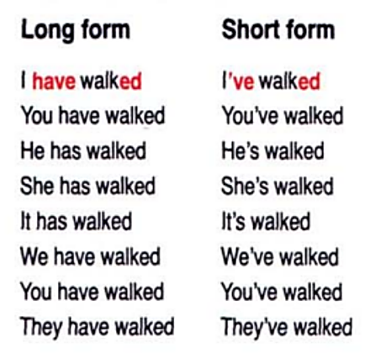

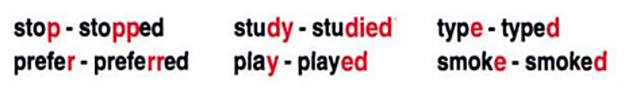
Present Perfect
Irregular verbs…
Regular verbs
past participle
have/has Ved/₃

Slide 7
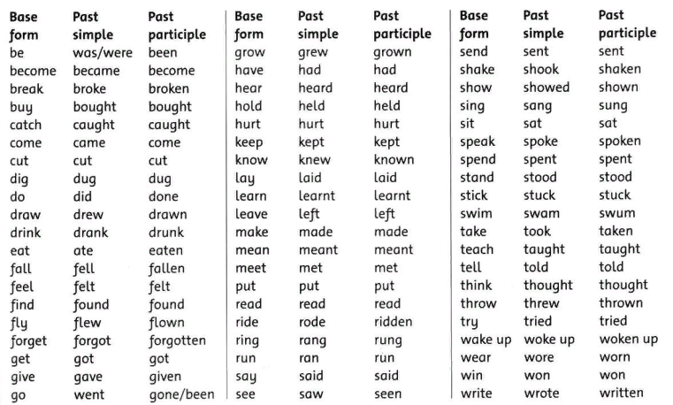
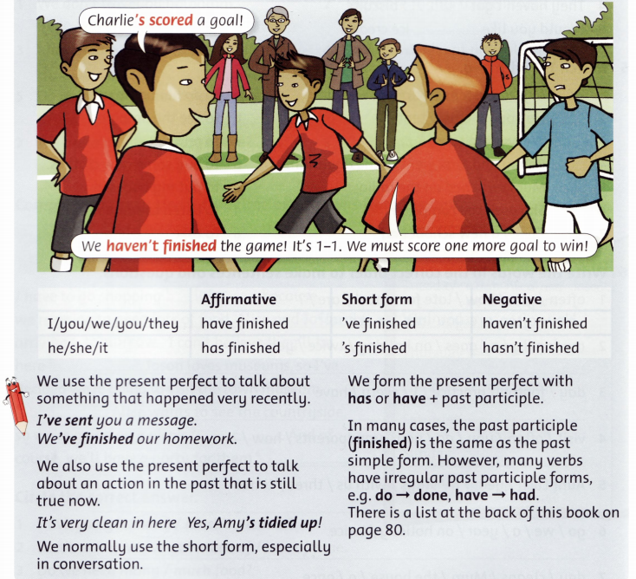
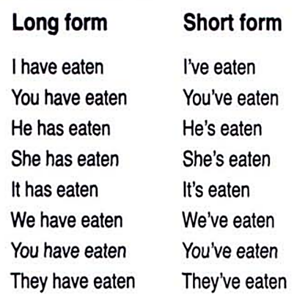

Irregular verbs
have/has Ved/₃
Irregular verb list

Slide 8
Underline have/has and circle the part participle (V₃).
1. We’ve saved our documents.
2. I’ve put the speakers on the shelf.
3. He’s made a mess.
4. She has printed her homework.
5. I’ve sent you a message.
6. We’ve finished our homework.
7. Amy’s tidied up!

Slide 9

Change the base forms into past participles, e.g. make - made
put
finish
say
play
go
have
throw
Well done!
finished
went
had
thrown
played
Ok!
put
said
Irregular verb list

Slide 10
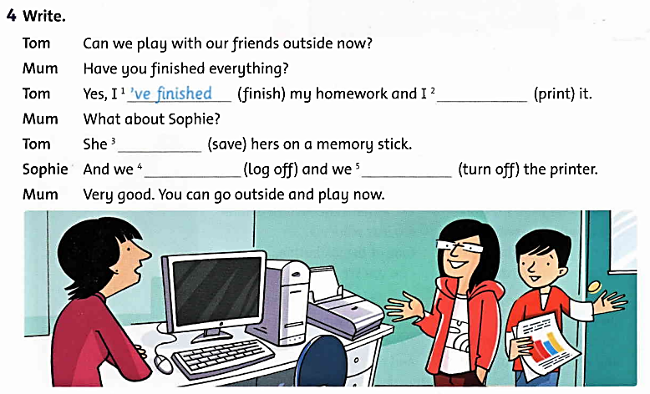
‘ve printed
‘s saved
‘ve logged off
‘ve turned off

Slide 11
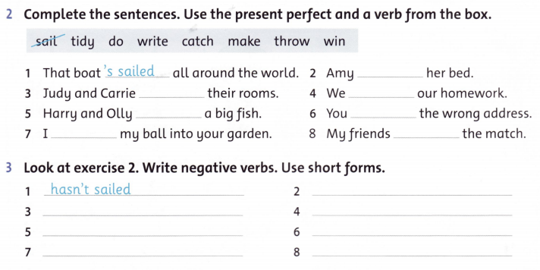
‘s made
have tidied
‘ve done
have caught
‘ve written
‘ve thrown
have won
hasn’t made
haven’t tidied
haven’t done
haven’t caught
haven’t written
haven’t thrown
haven’t won

Slide 12
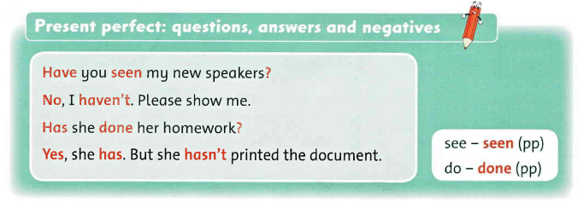

Slide 13
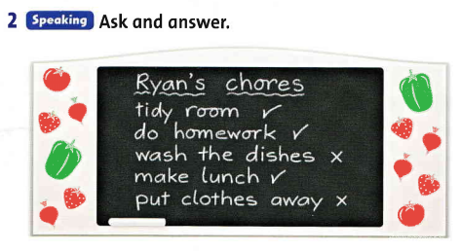


Now write about what Ryan has and hasn’t done.
He has tidied his room
and …
Have you tidied your room?
Yes, I have.
ex. 3

Slide 14
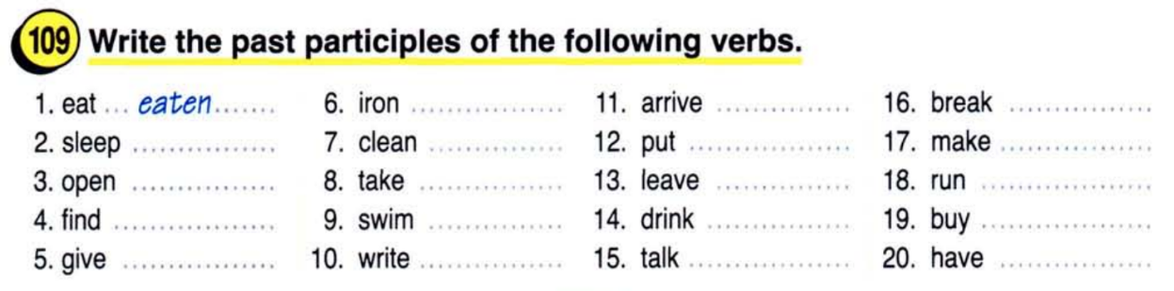
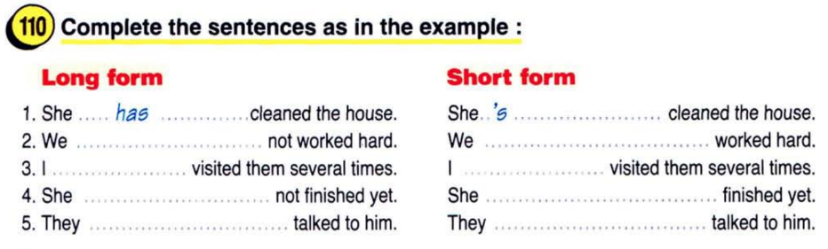
ironed
arrived
broken
slept
cleaned
put
made
opened
taken
left
run
found
swum
drunk
bought
given
written
talked
had
have
haven’t
have
‘ve
has
hasn’t
have
haven’t

Slide 15
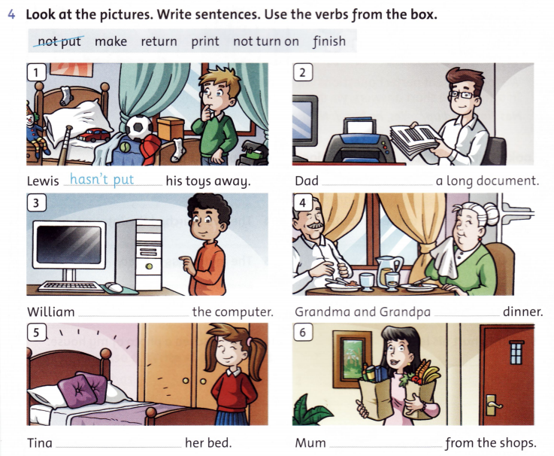
‘s printed
hasn’t turned on
‘ve finished
‘s made
‘s returned

Slide 16
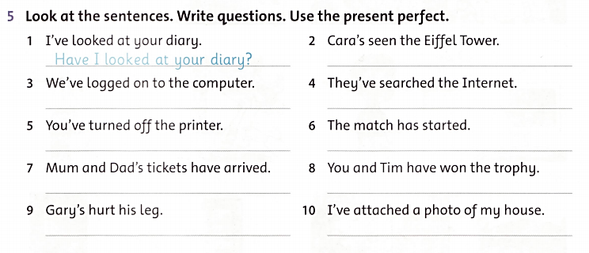
Has Cara seen the Eiffel Tower?
Have we logged on to the computer?
Have they searched the Internet?
Have you turned off the printer?
Has the match started?
Have Mum and Dad’s tickets arrived?
Have you and Tim won the trophy?
Has Gary hurt his leg?
Have I attached a photo of my house?

Slide 17


