Slide 1

What day goes before Tuesday?

Slide 2

What day goes before Friday?

Slide 3

What day goes before Wednesday?

Slide 4

What day goes before Monday?

Slide 5

What day goes before Thursday?

Slide 6
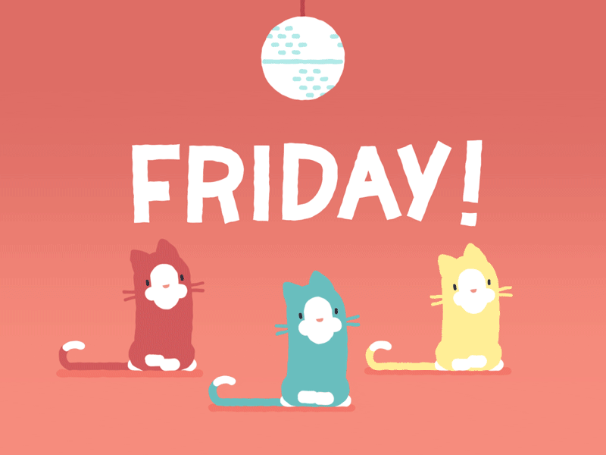
What day goes before Saturday?

Slide 7
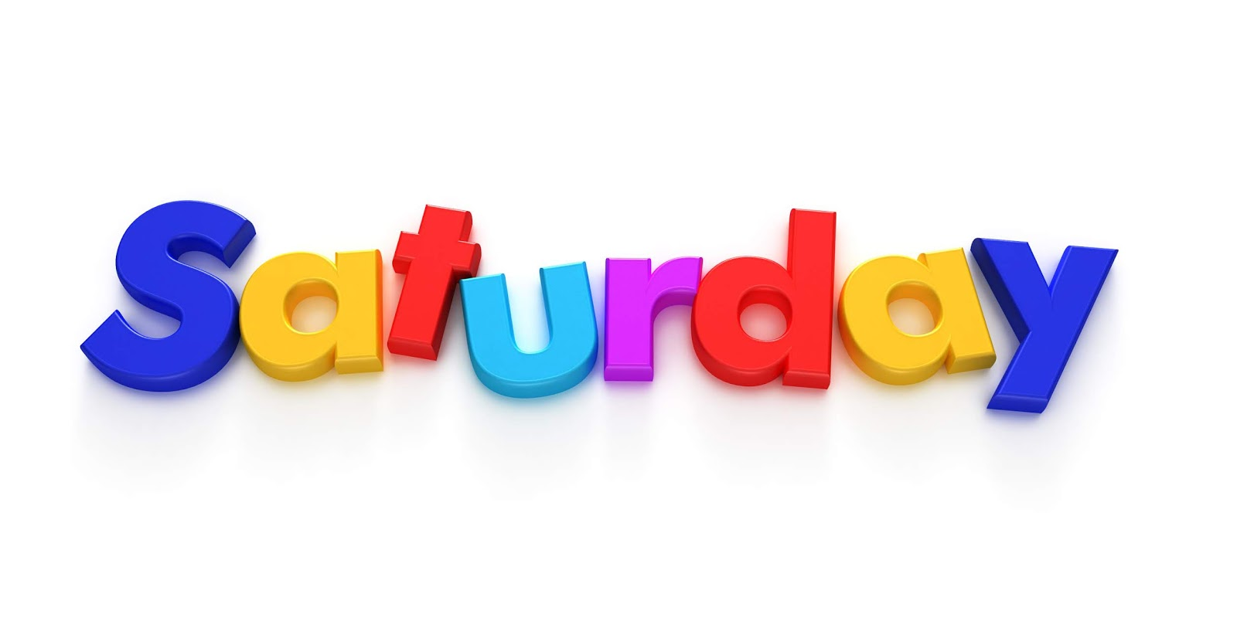
What day goes before Sunday?

Slide 8
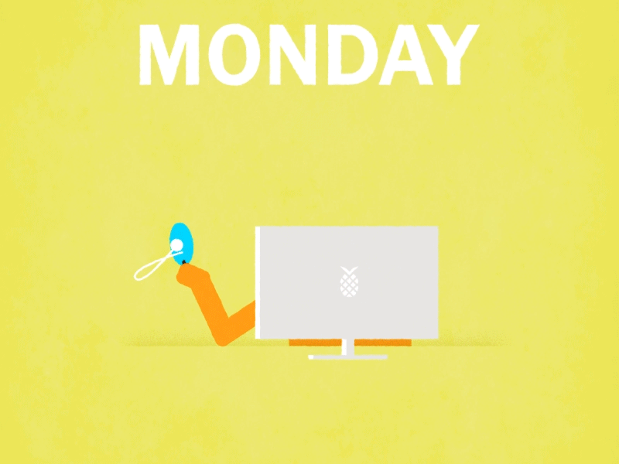
What day goes after Sunday?

Slide 9

What day goes after Wednesday?

Slide 10
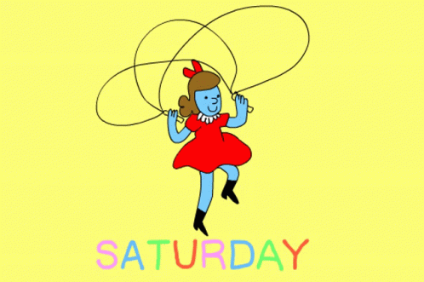
What day goes after Friday?

Slide 11

What day goes after Monday?

Slide 12
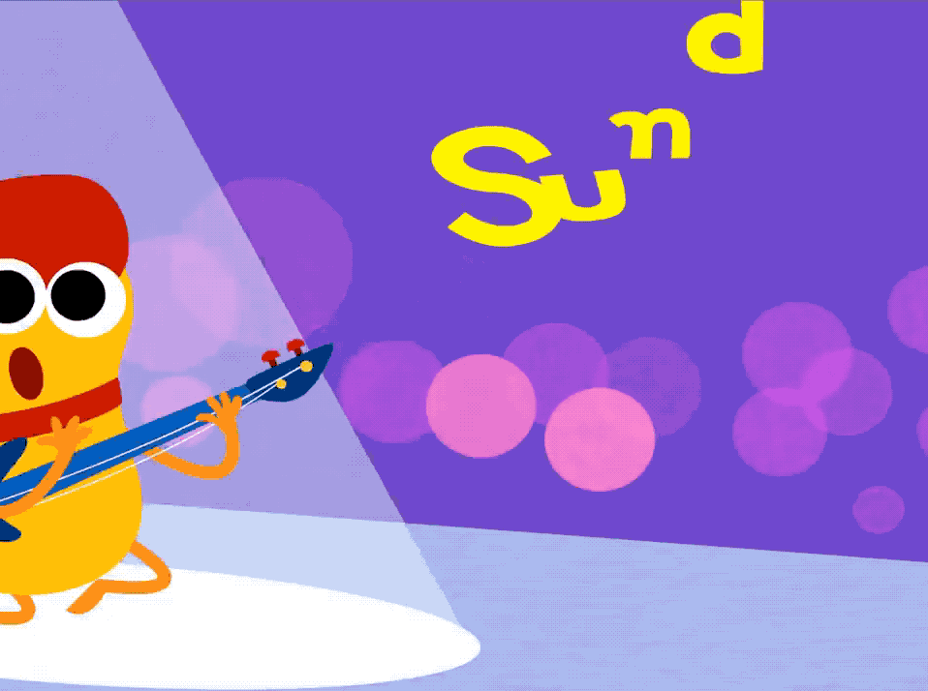
What day goes after Saturday?

Slide 13

What day goes after Tuesday?

Slide 14
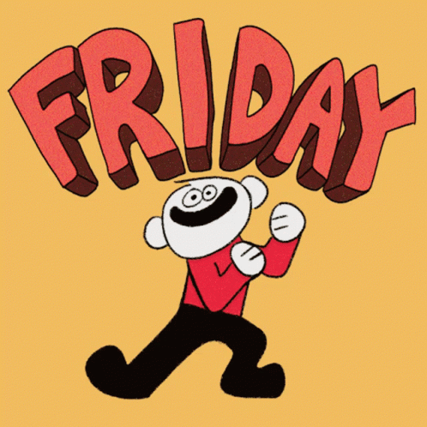
What day goes after Thursday?

