Slide 1
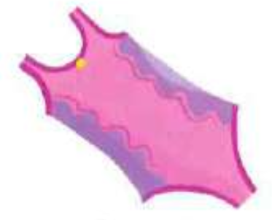
I ________ wear a swimming costume.

Slide 2
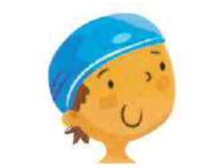
Sam ________ wear a swimming cap.

Slide 3
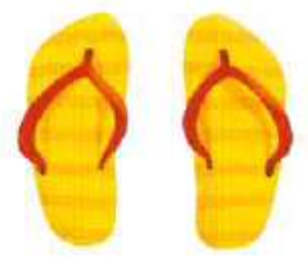
We ______ wear flip flops.

Slide 4
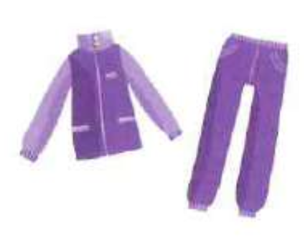
Liza ______ wear a tracksuit.

Slide 5
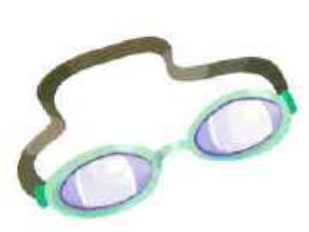
They ______ wear goggles.

Slide 6
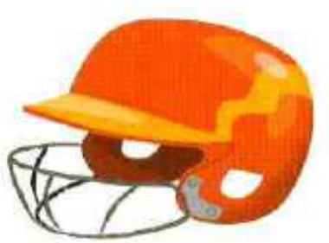
You _______ wear a helmet.

Slide 7
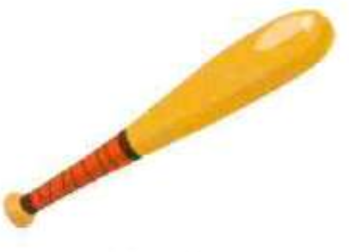
Tom _____ bring a bat.

Slide 8

Kate _____ bring a glove.

Slide 9
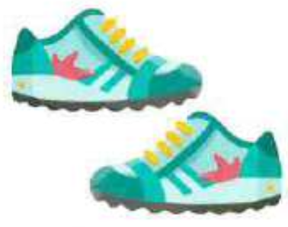
The children ______ wear trainers.

Slide 10
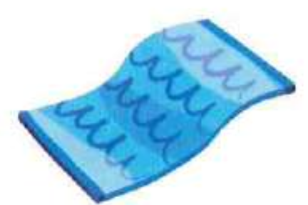
My dad _____ bring a towel.

