Slide 1






IrinaPapakhina

Slide 2

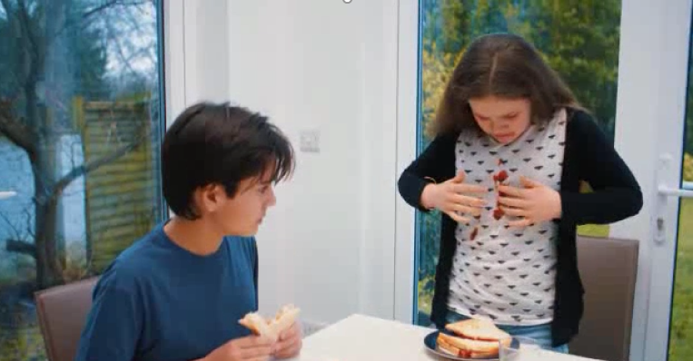

Who’s in the photo?
Where are they?
What is there on the plate?
GUESS: Whose house is it?
Watch the video and check your answers.
IrinaPapakhina

Slide 3
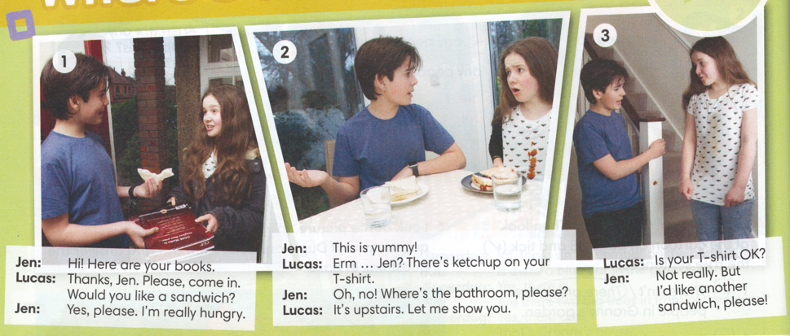
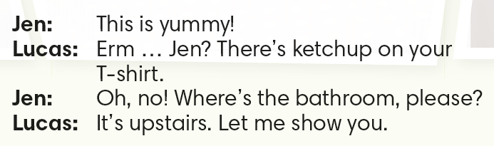
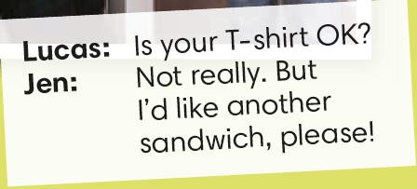
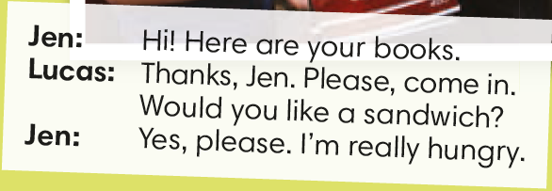

Can you remember the words?
IrinaPapakhina

Slide 4
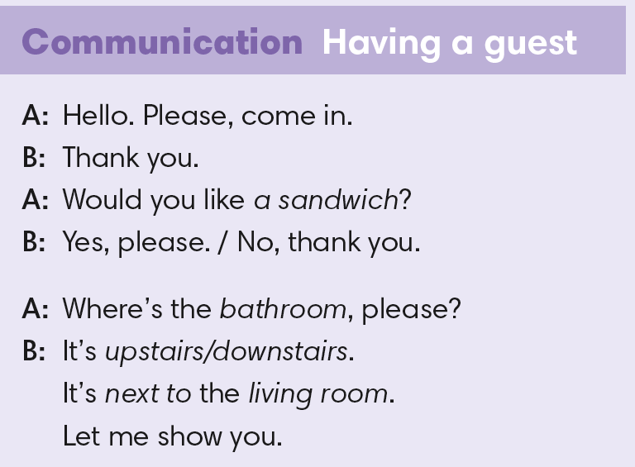

IrinaPapakhina

Slide 5
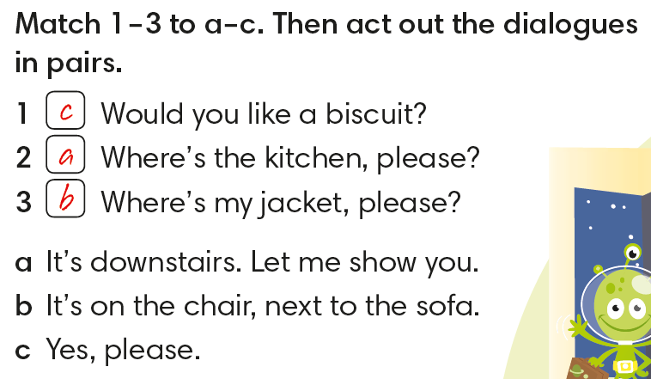
Match 1 – 3 to a – c.
IrinaPapakhina

Slide 6
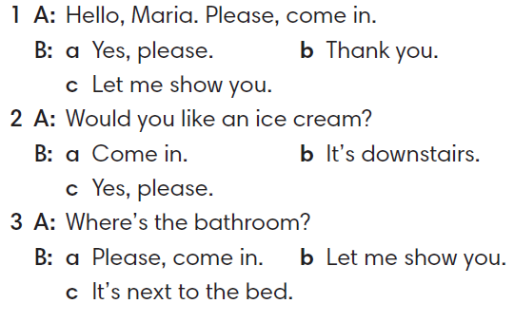
Circle the correct answer.
IrinaPapakhina

Slide 7
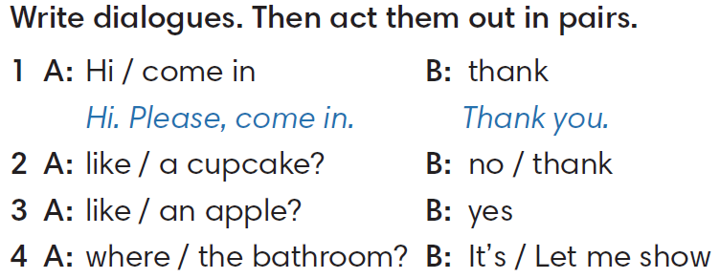
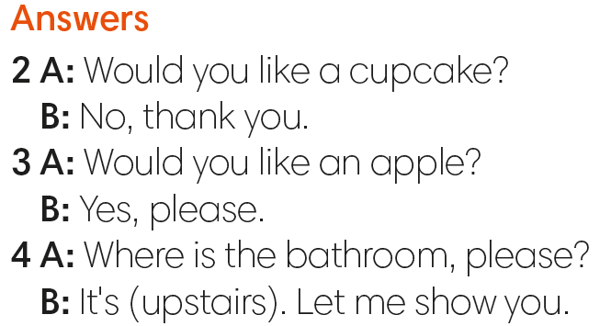
Make the dialogues.
IrinaPapakhina

Slide 8
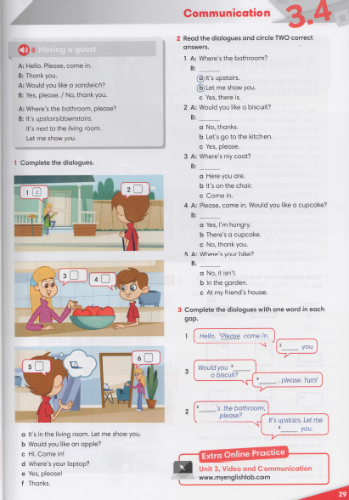


IrinaPapakhina

Slide 9
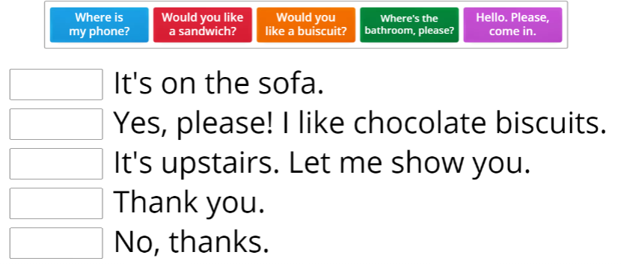
IrinaPapakhina

