Slide 1
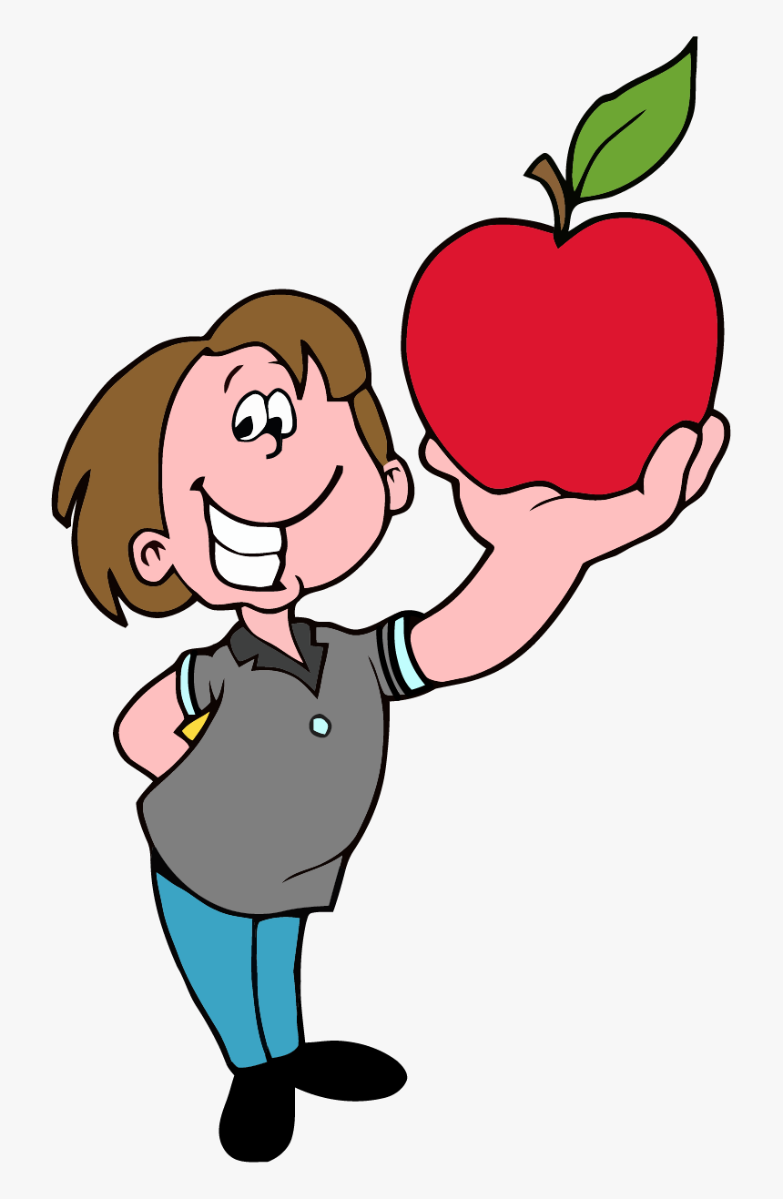
_____ did you ___ (eat)?
I ____ (eat) an apple.

Slide 2
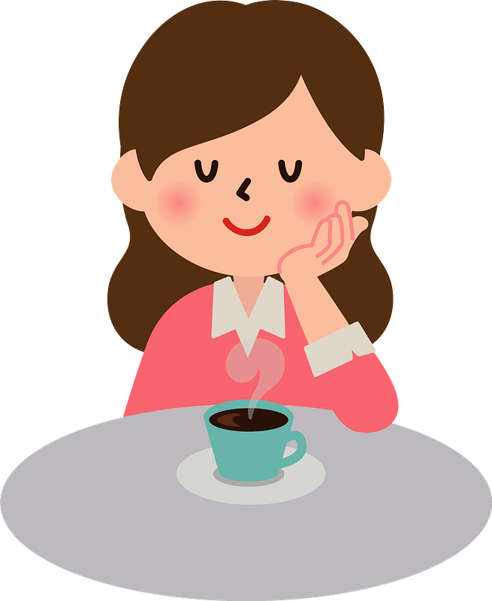
___ did you ___ (drink)?
I ____ (drink) some coffee.

Slide 3
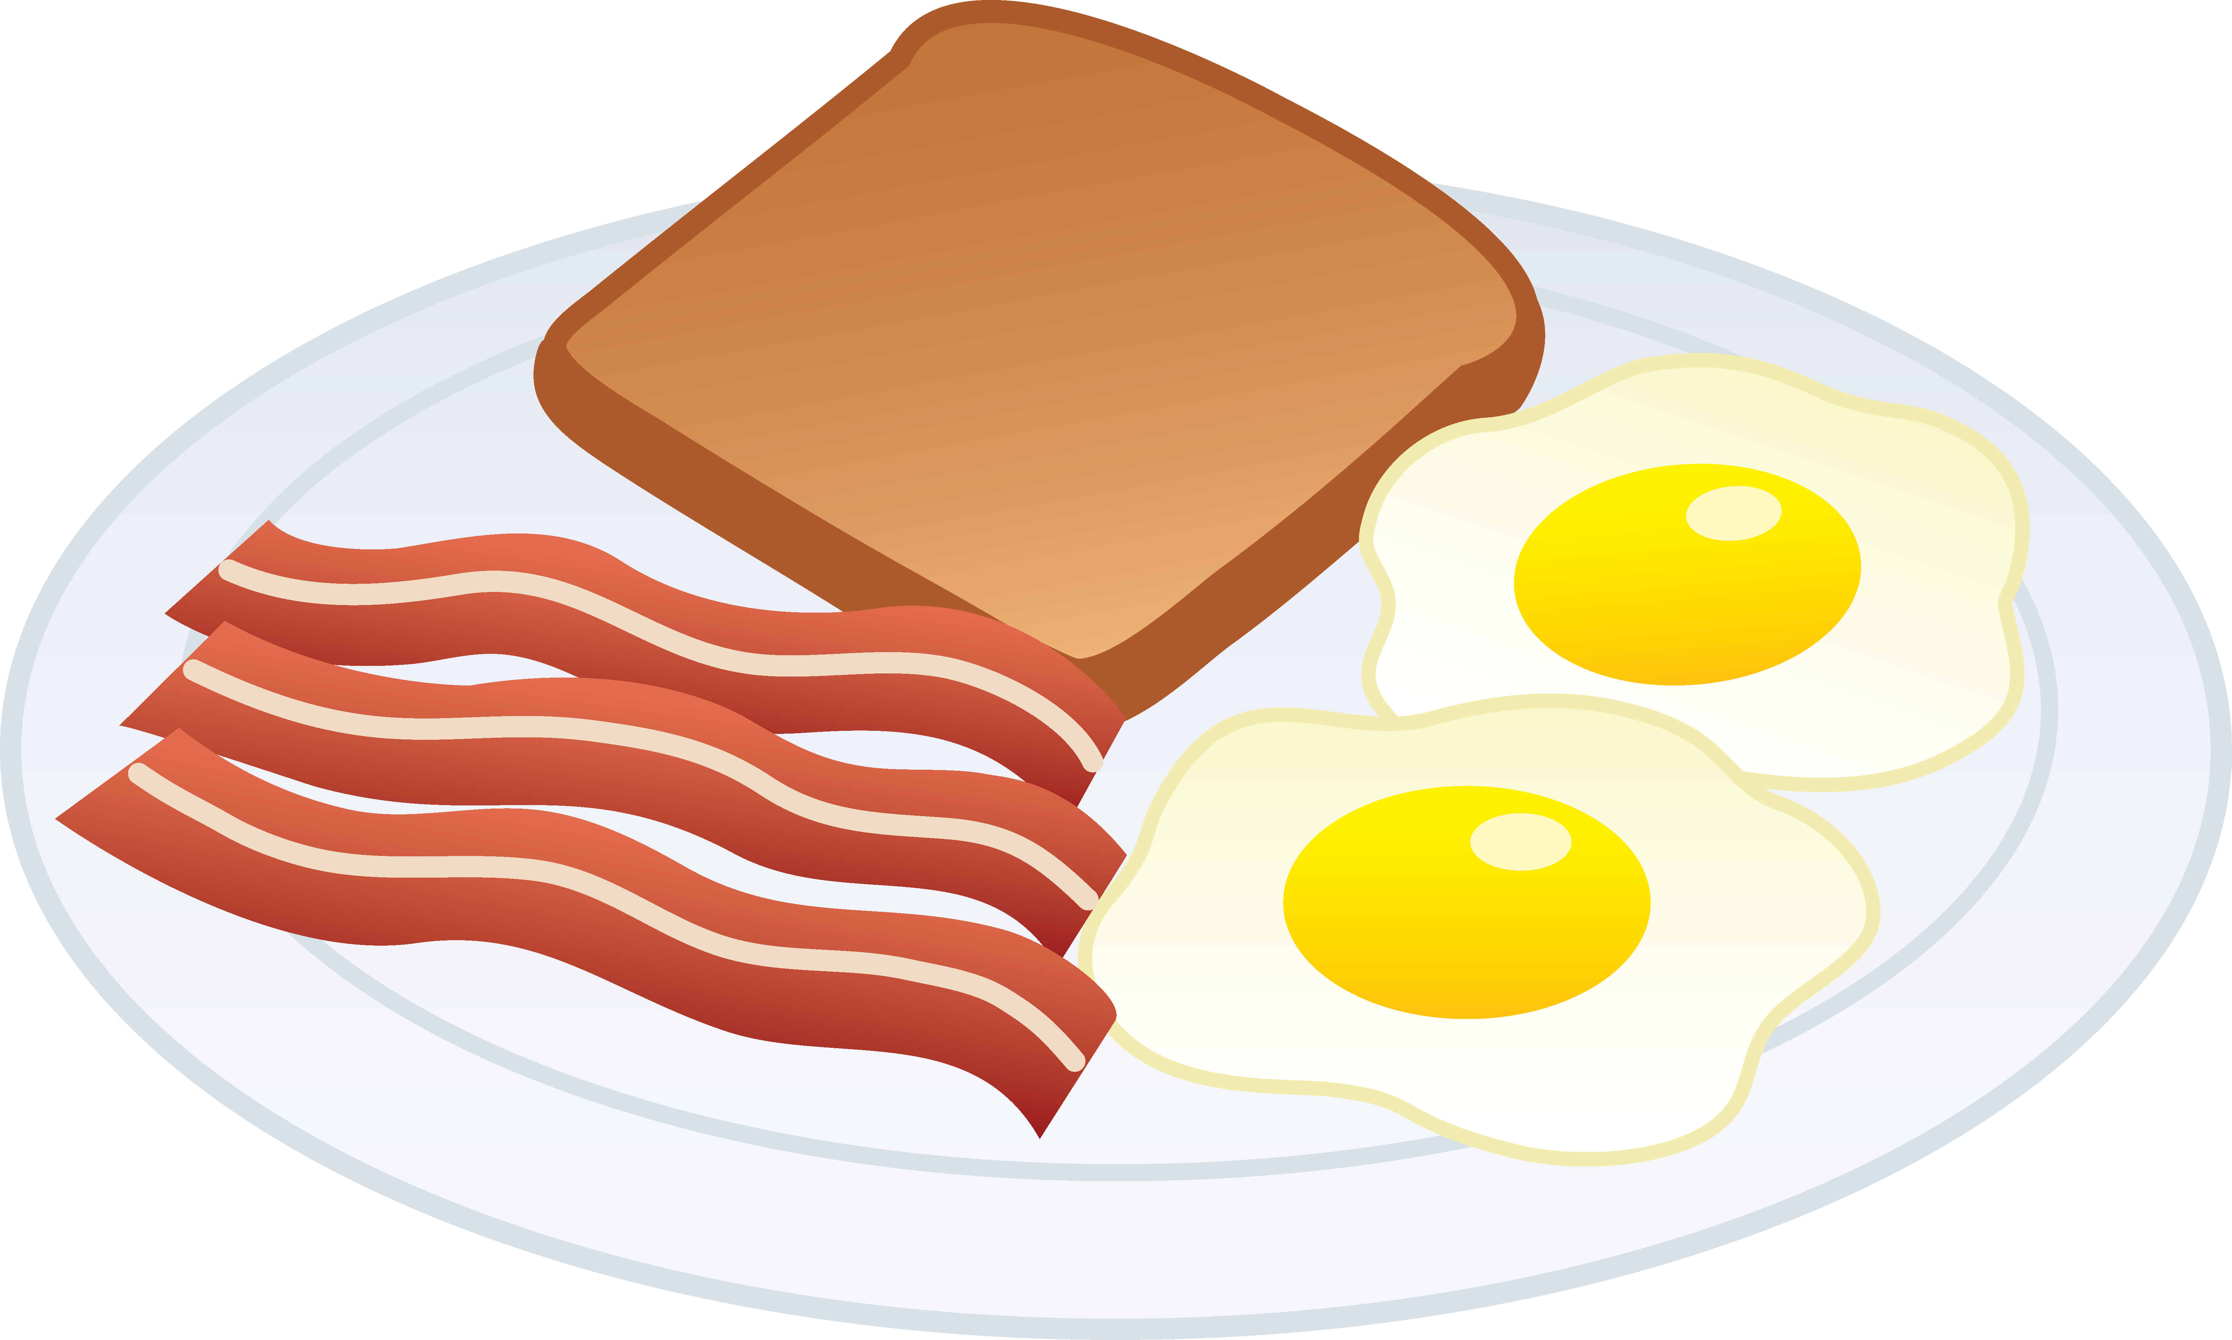
___ did you ___ (have) for breakfast?
I ___ (have) eggs, bread and bacon.

Slide 4
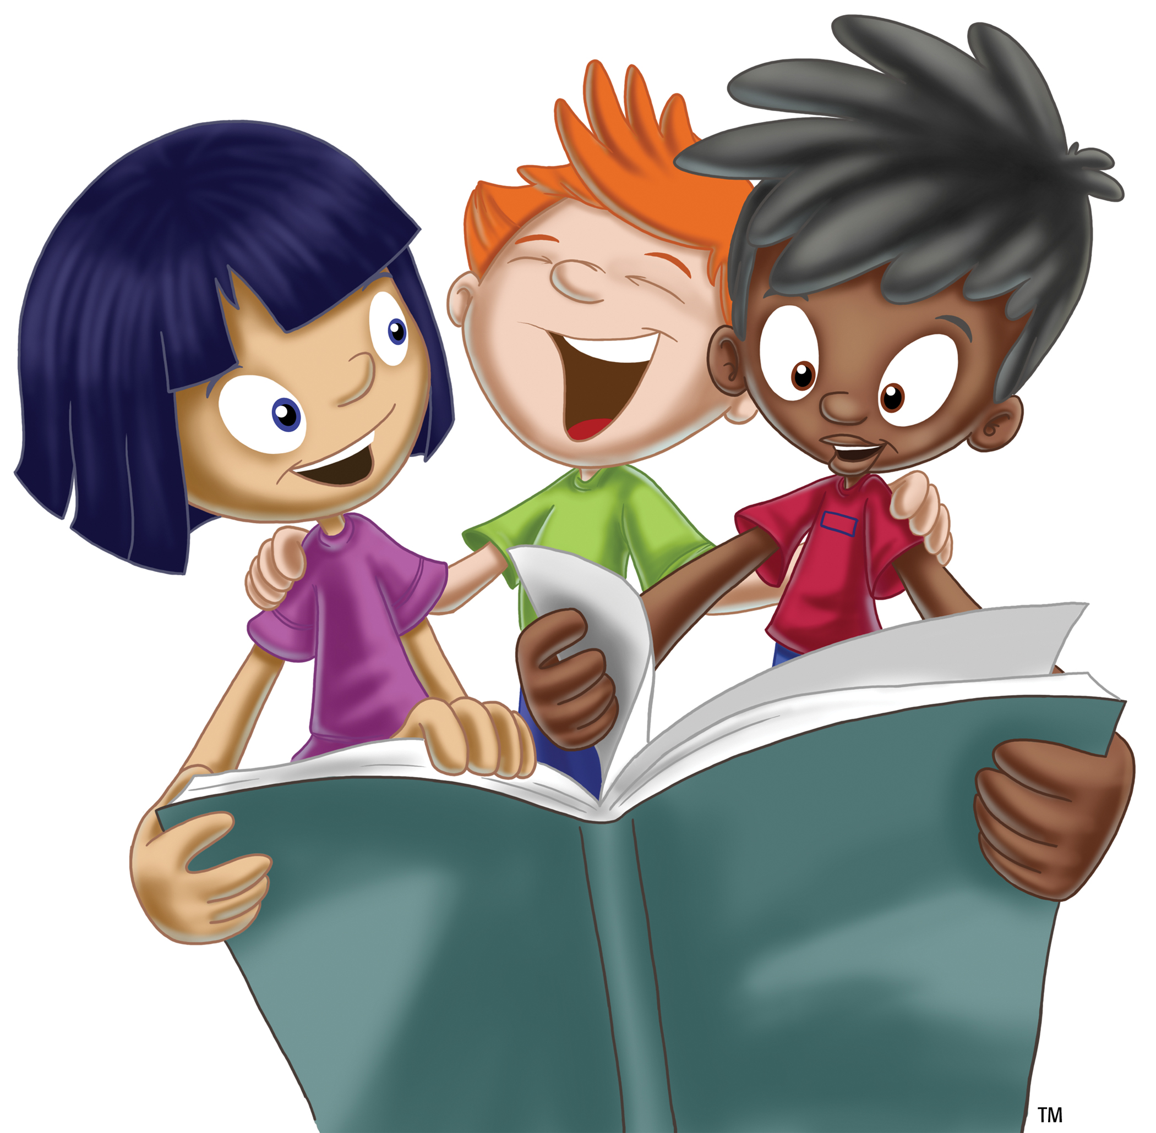
___ did they ___ (read)?
They ___ (read) a funny story.

Slide 5
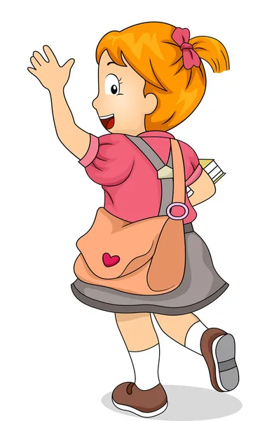
___ did she ___ (say)?
She ___ (say) goodbye.

Slide 6
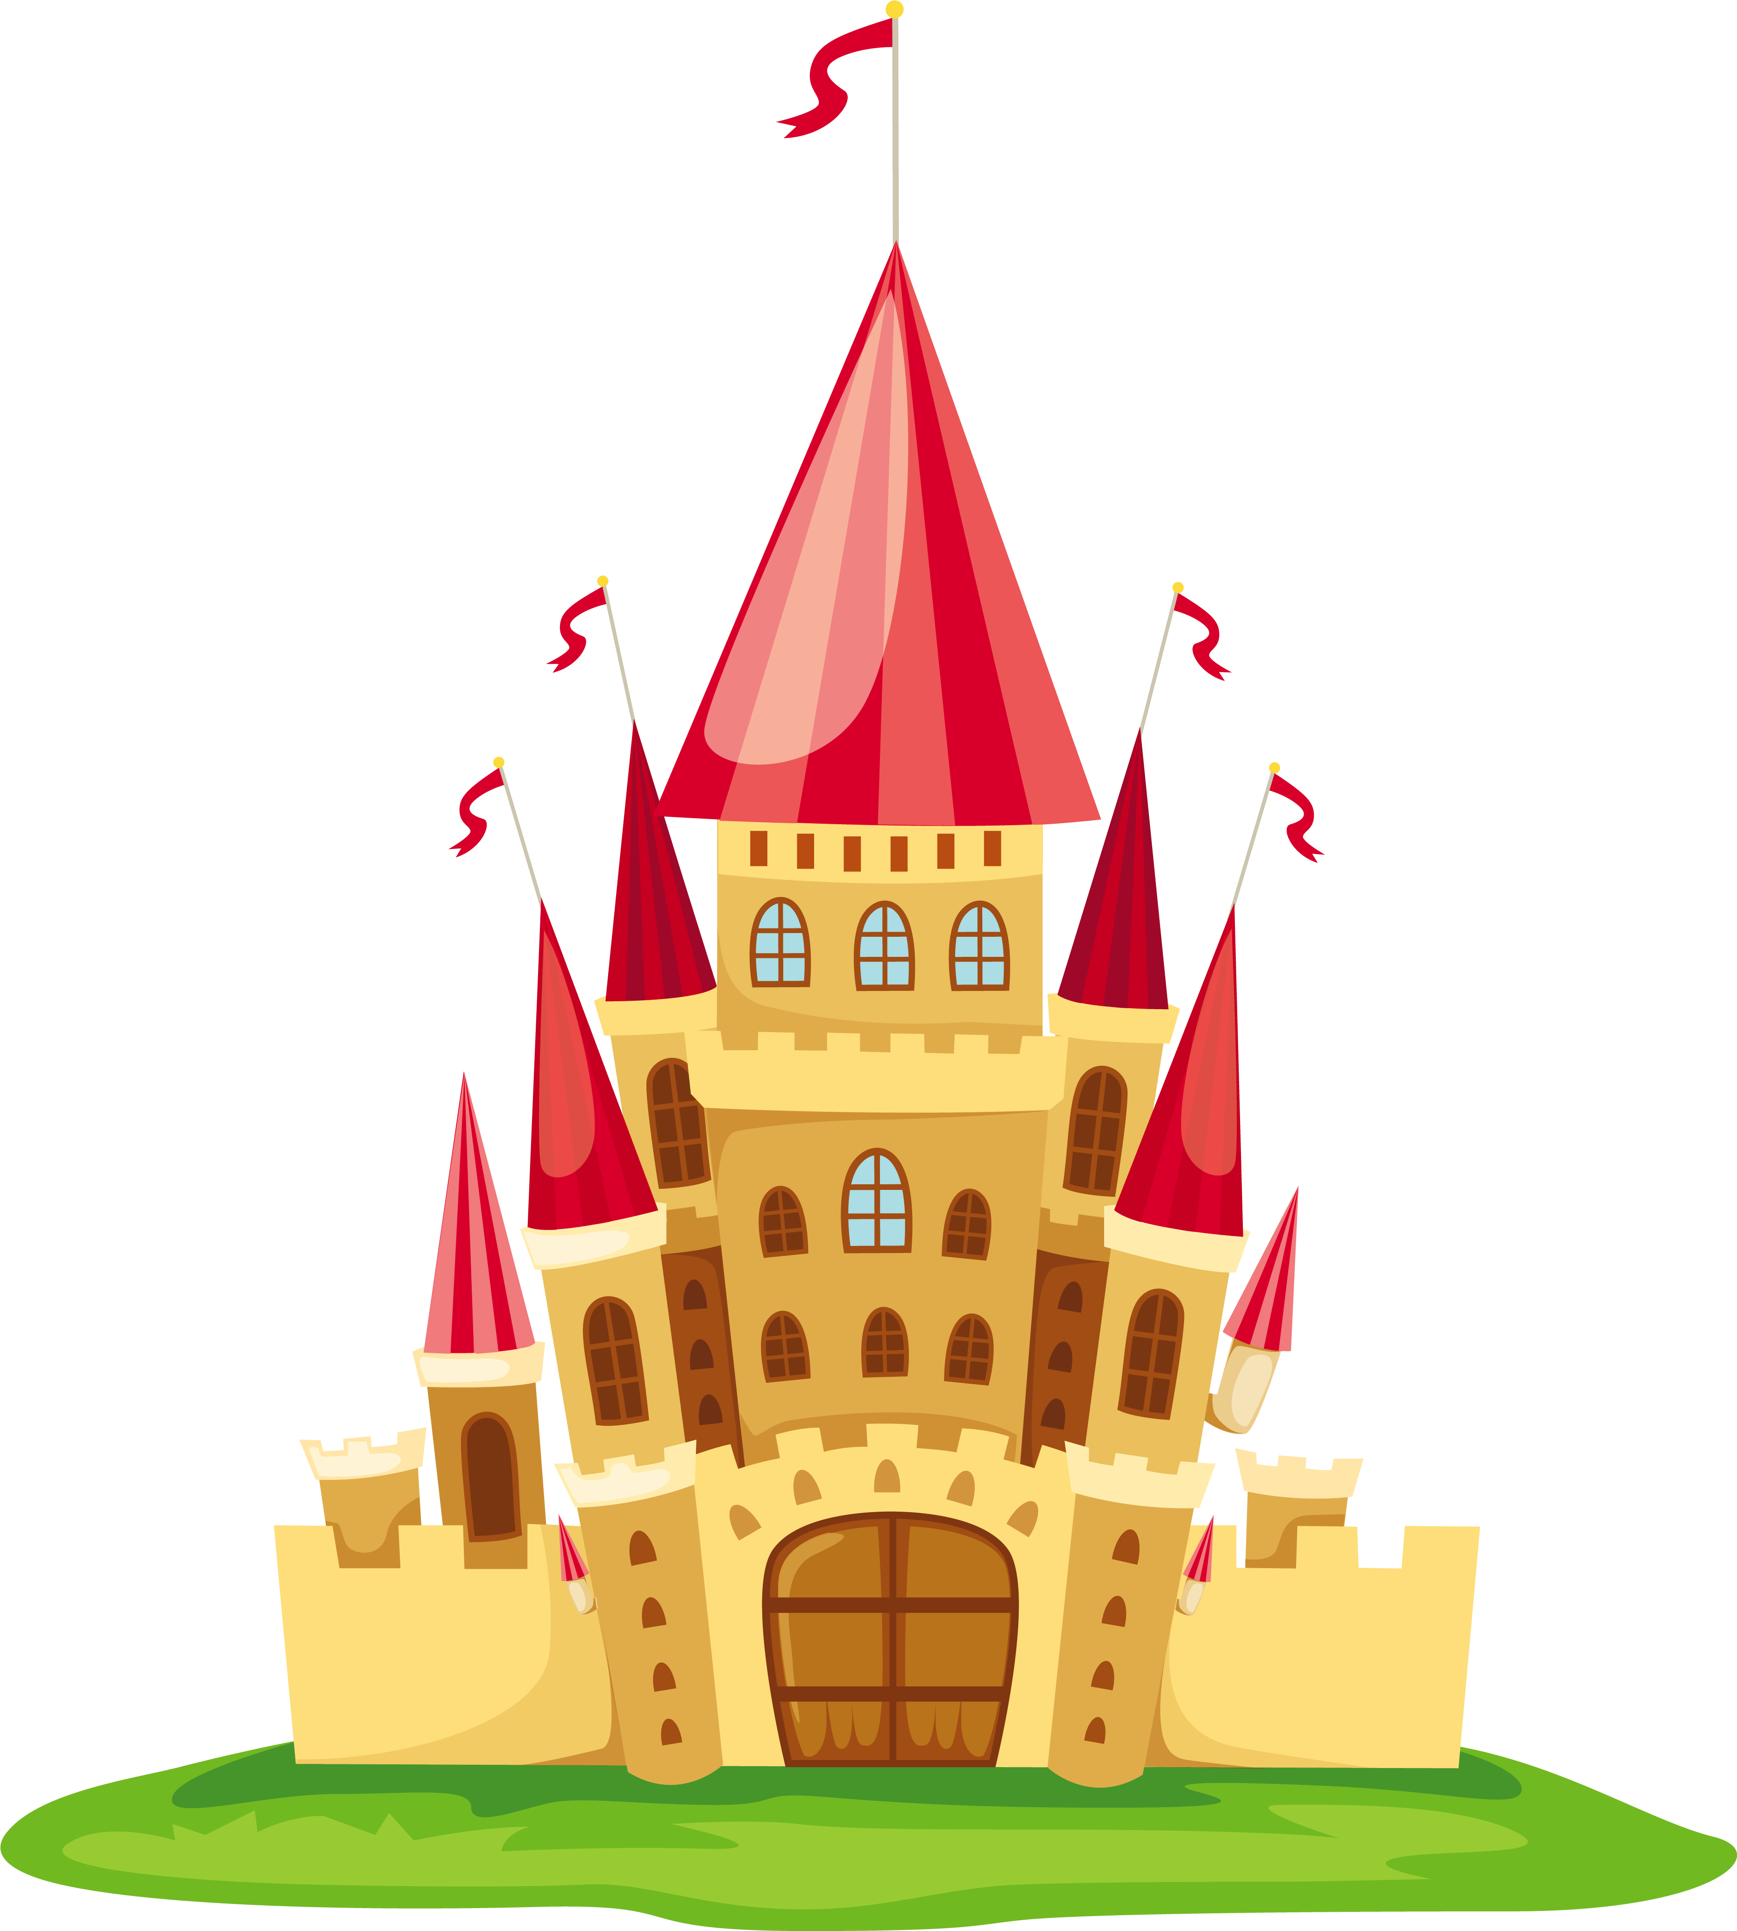
___ did you ___ (see)?
I ___ (see) a castle.

Slide 7
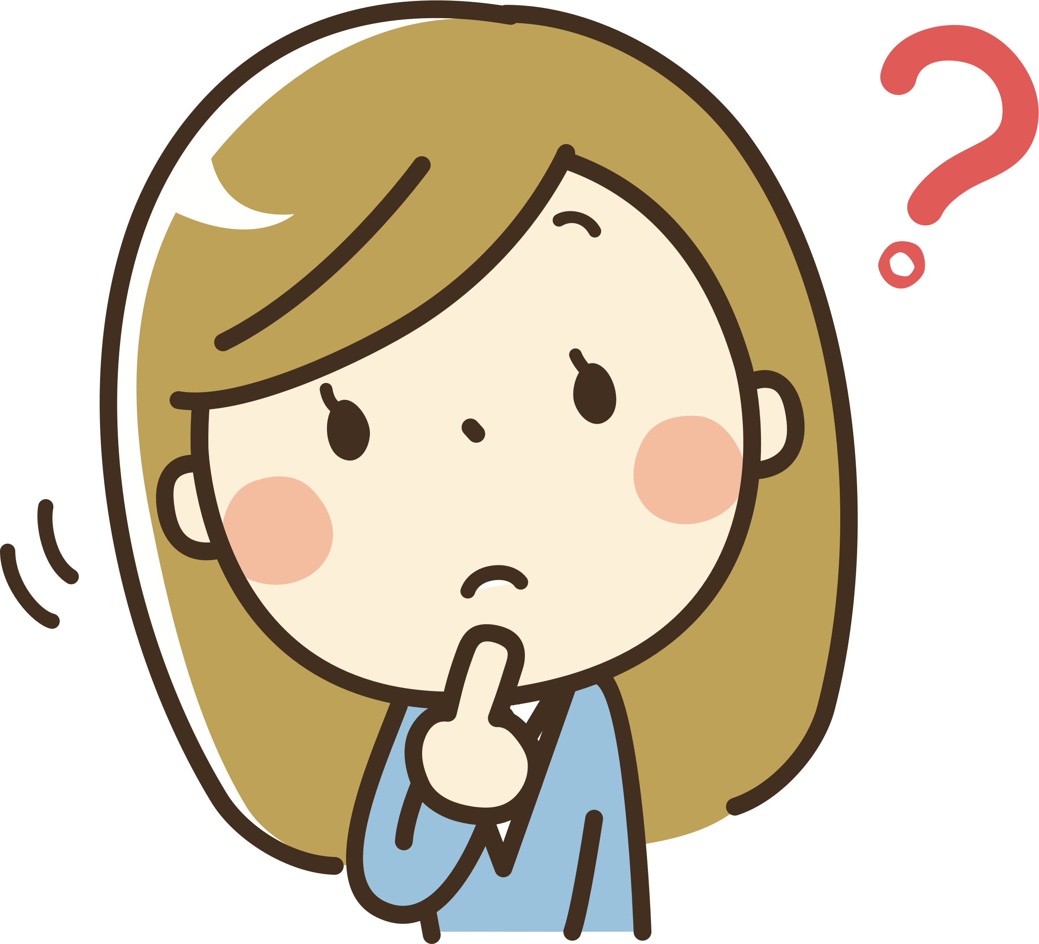
___ did she ___ (think) about?
She ____ (think) about her homework.

Slide 8
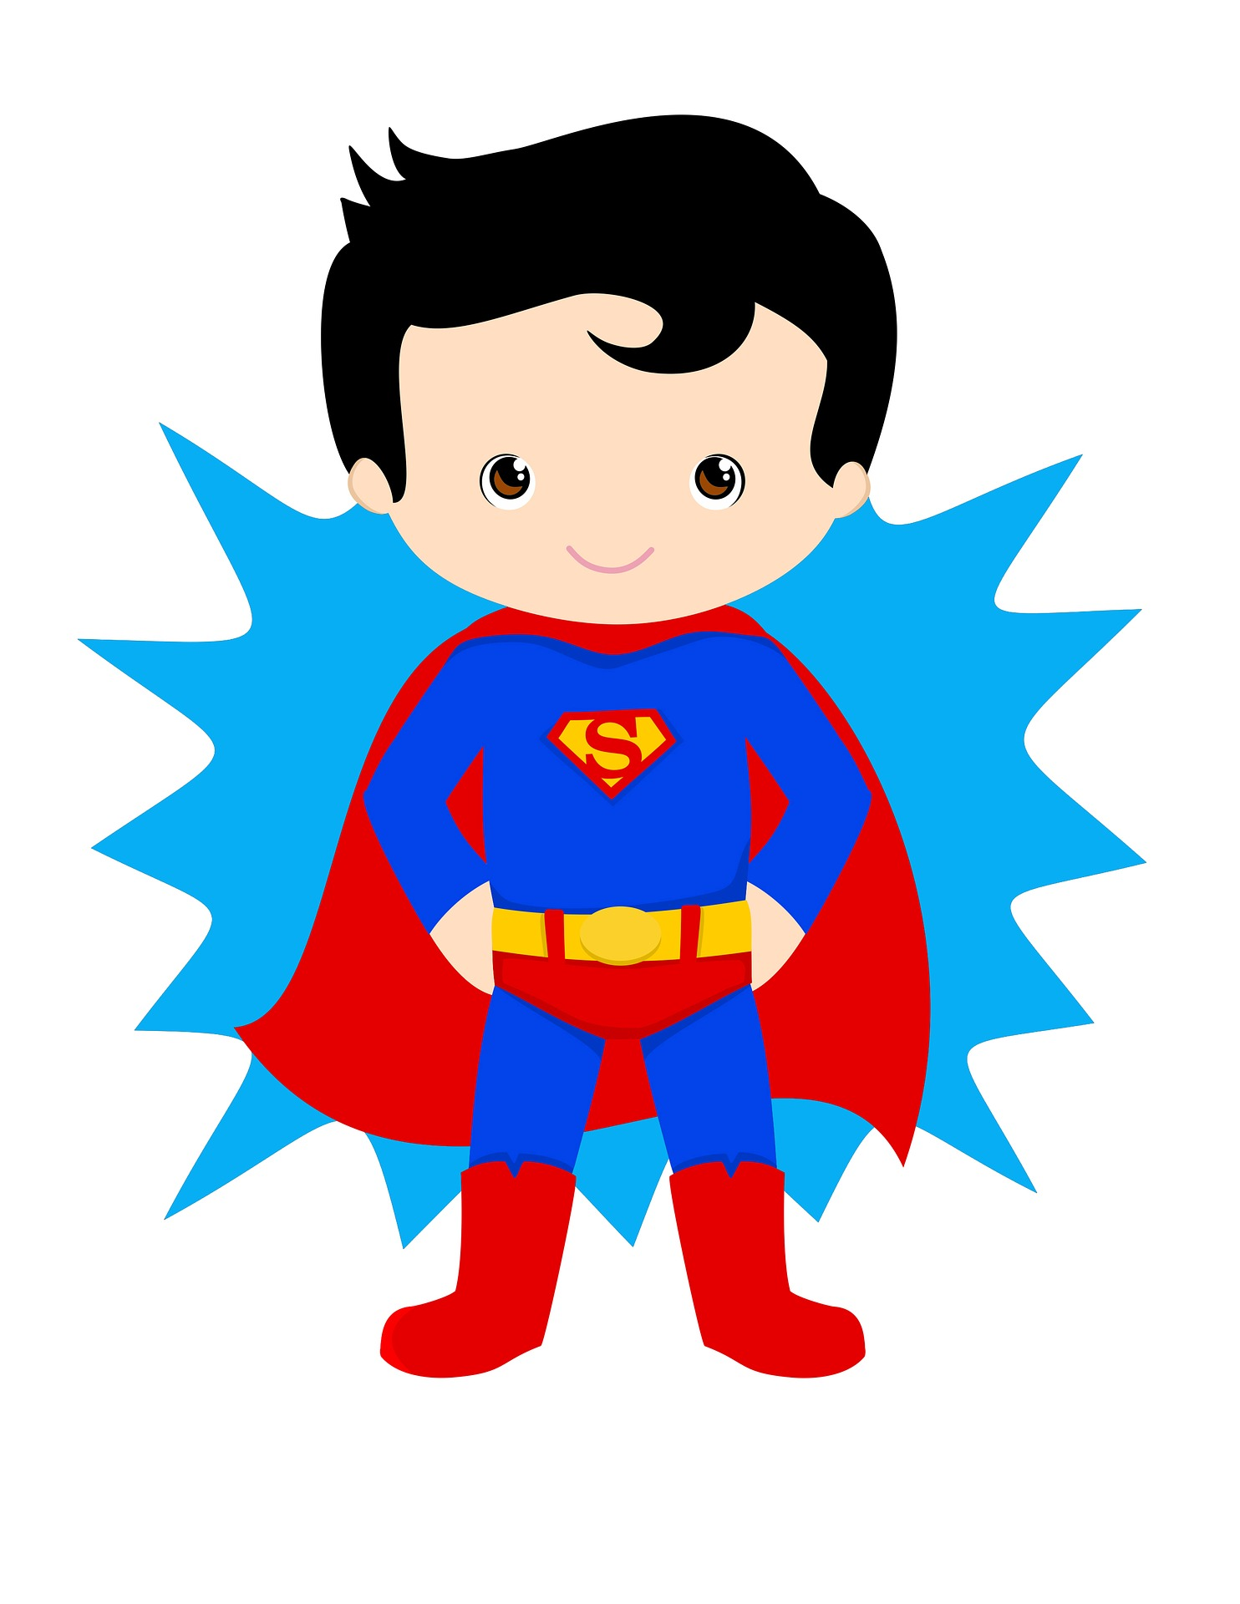
___ did he ___ (wear) for the party?
He ___ (wear) a costume of a super hero.

Slide 9
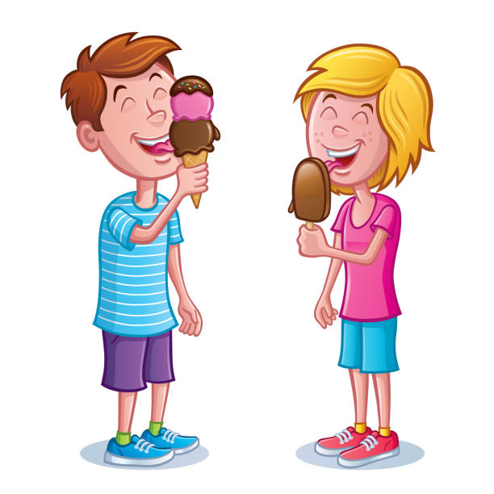
___ did you ___ (eat) ice cream with?
I ___ (eat) ice cream with my friend.

Slide 10
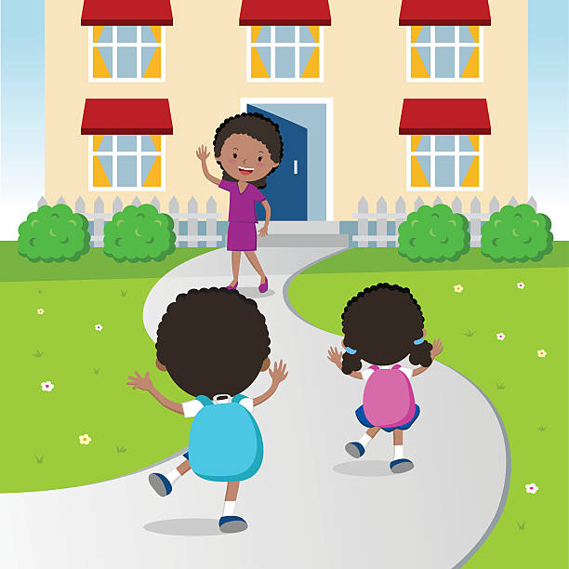
__ did you __ (come) home with?
I ___ (come) home with my sister.

Slide 11
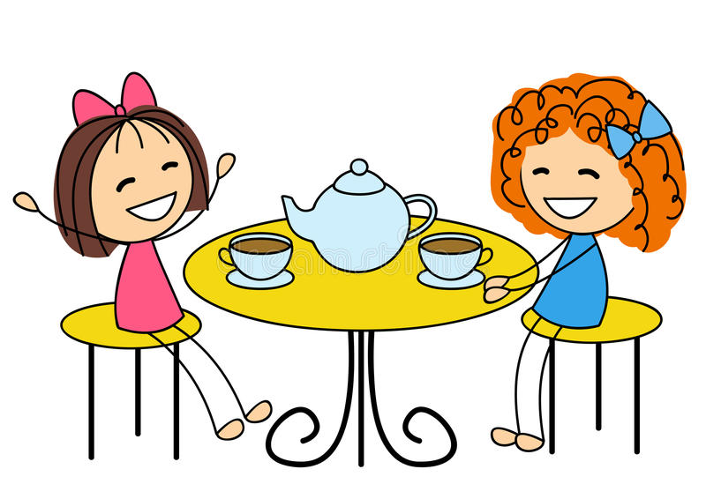
__ did you __ (drink) tea with?
I ___ (drink) tea with my friend Kate.

Slide 12
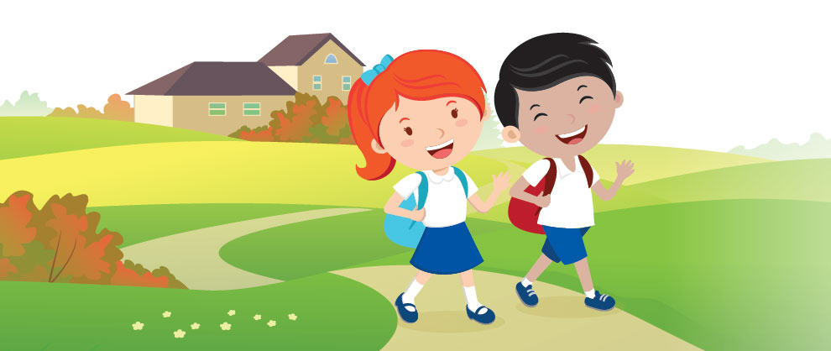
___ did you ___ (go) to school with?
I ___ (go) to school with Linda.

Slide 13
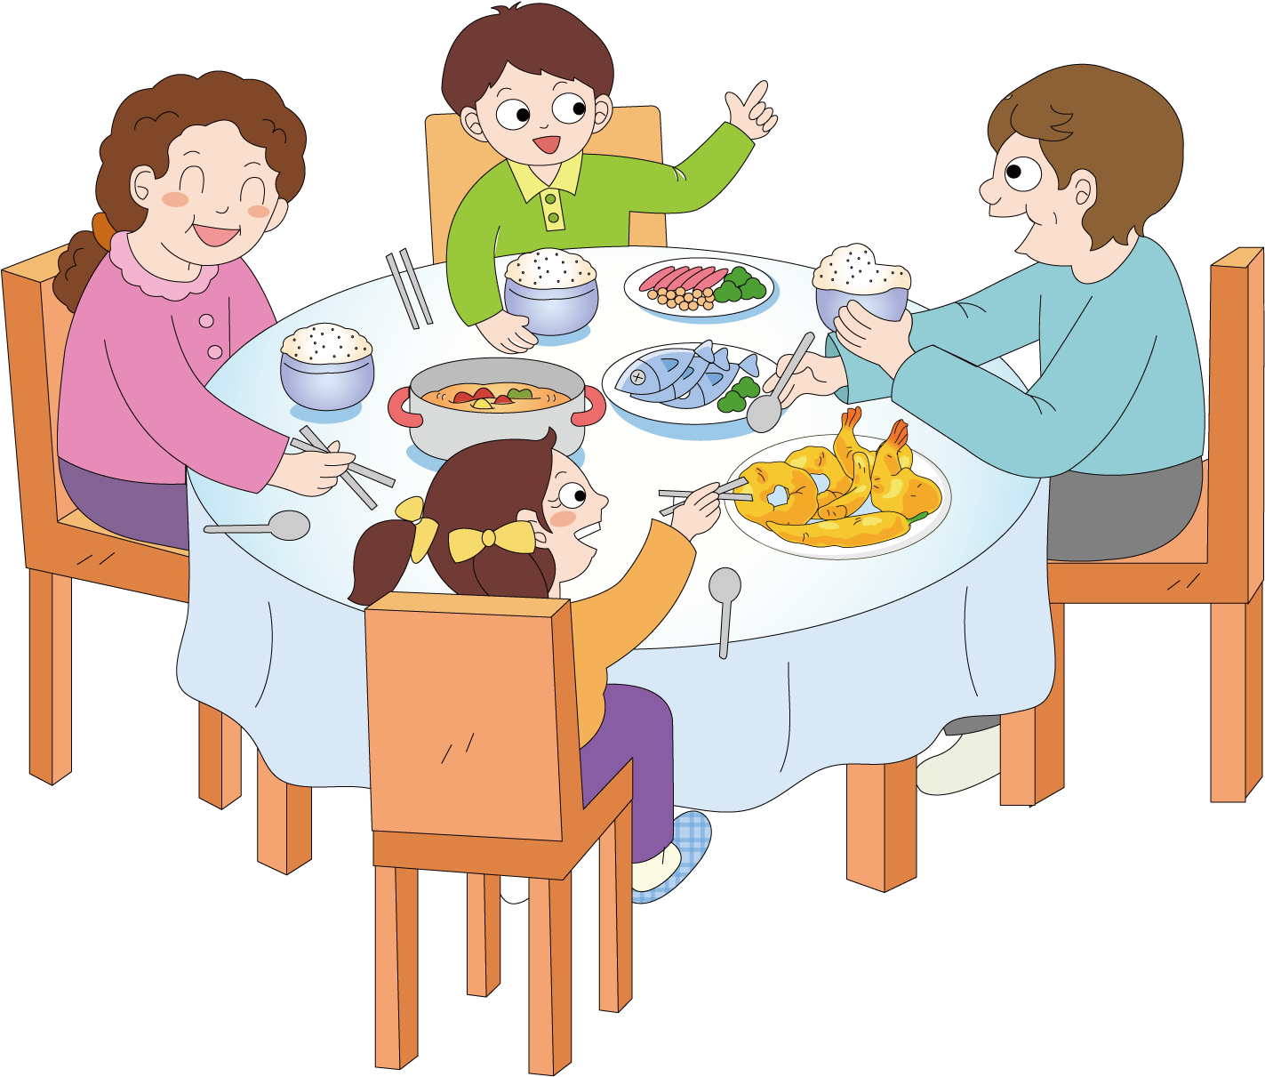
__ did you __ (have) dinner with?
I __ (have) dinner with my family.

Slide 14
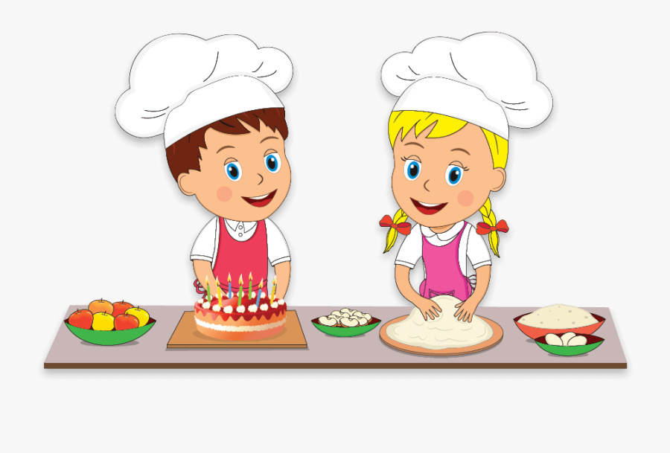
__ did you __ (make) a cake with?
I ___ (make) a cake with my friend.

Slide 15

__ did you __ (read) a book with?
I ___ (read) a book with my dad.

Slide 16
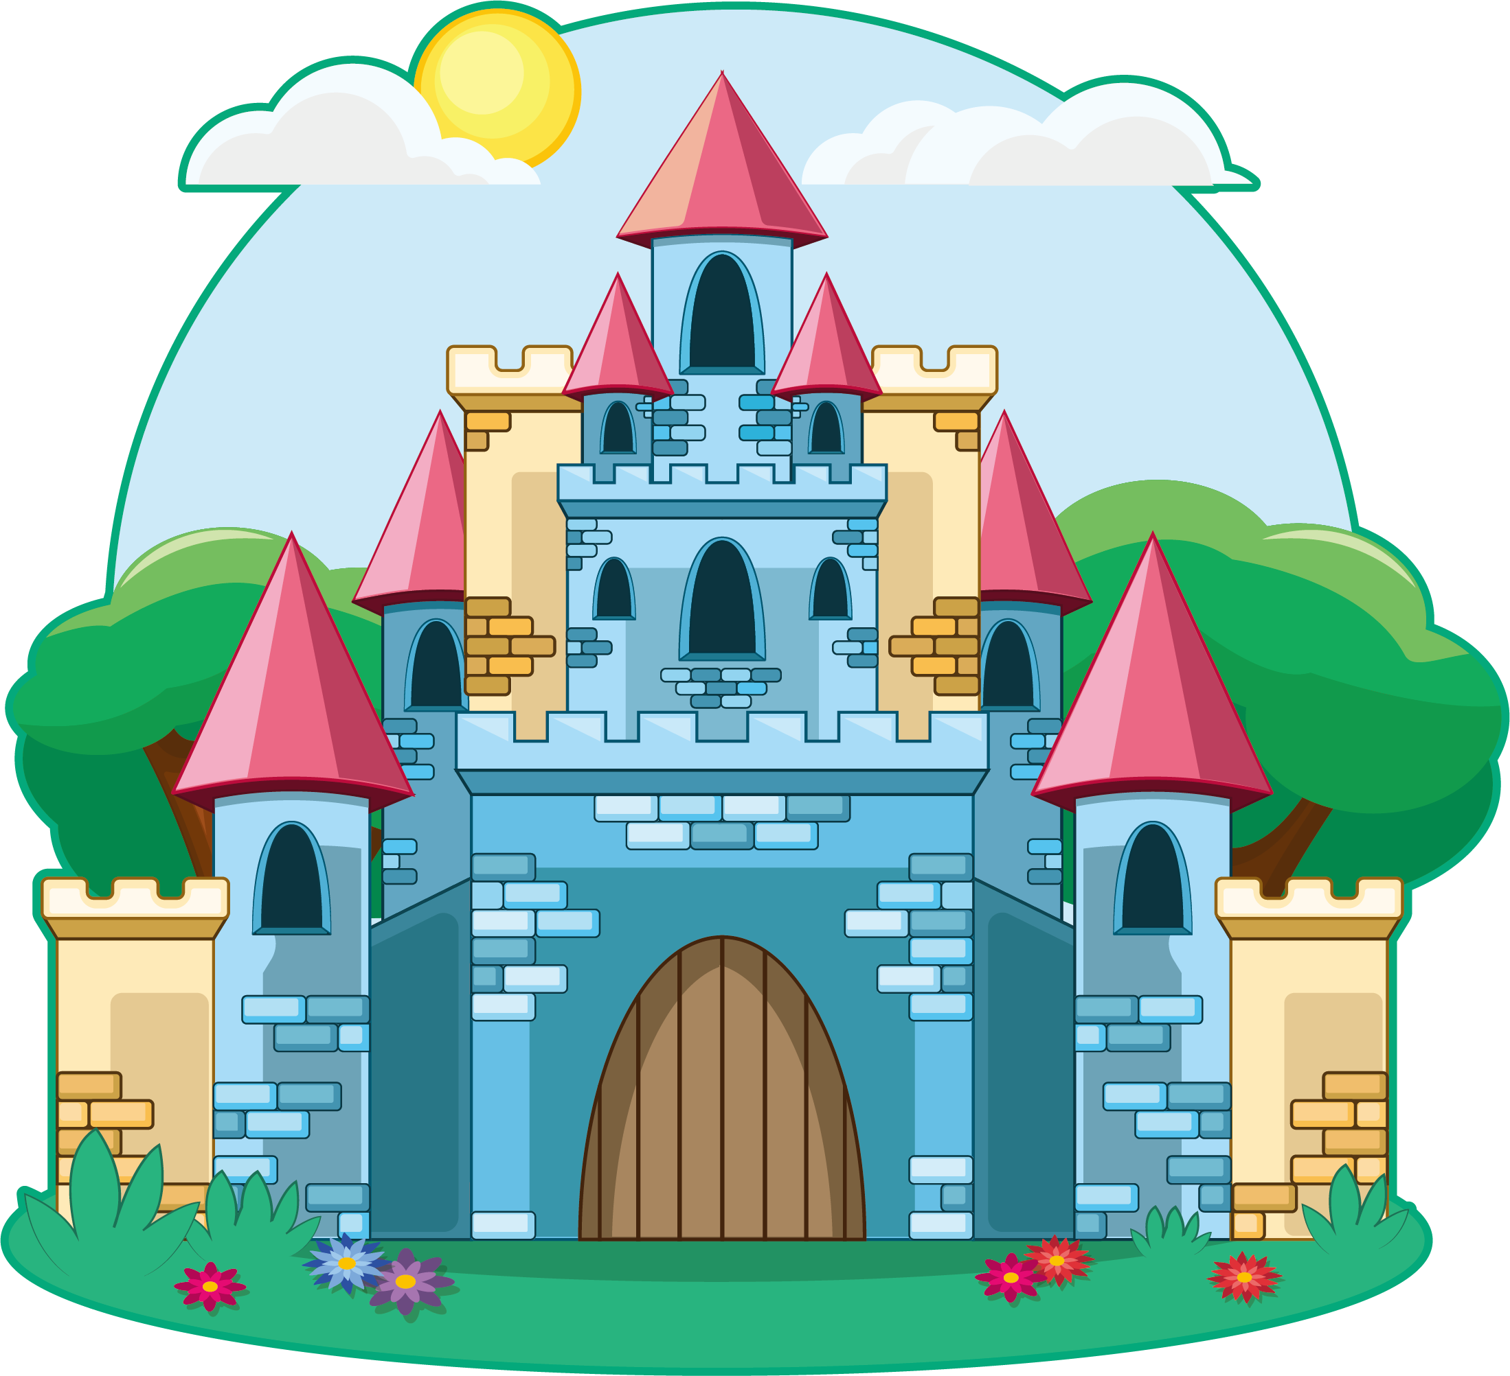
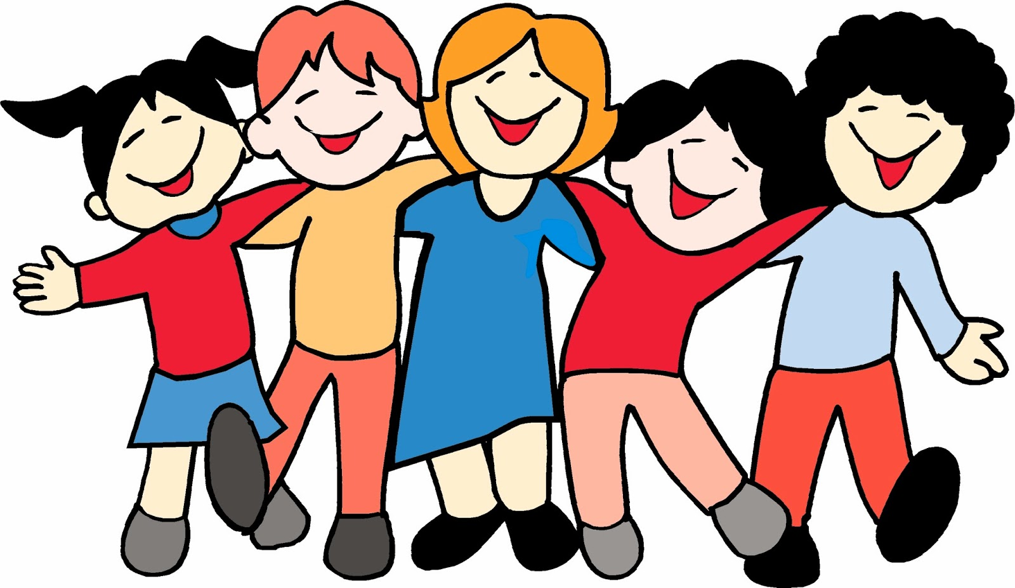
__ did you __ (see) a castle with?
I ___ (see) a castle with

Slide 17
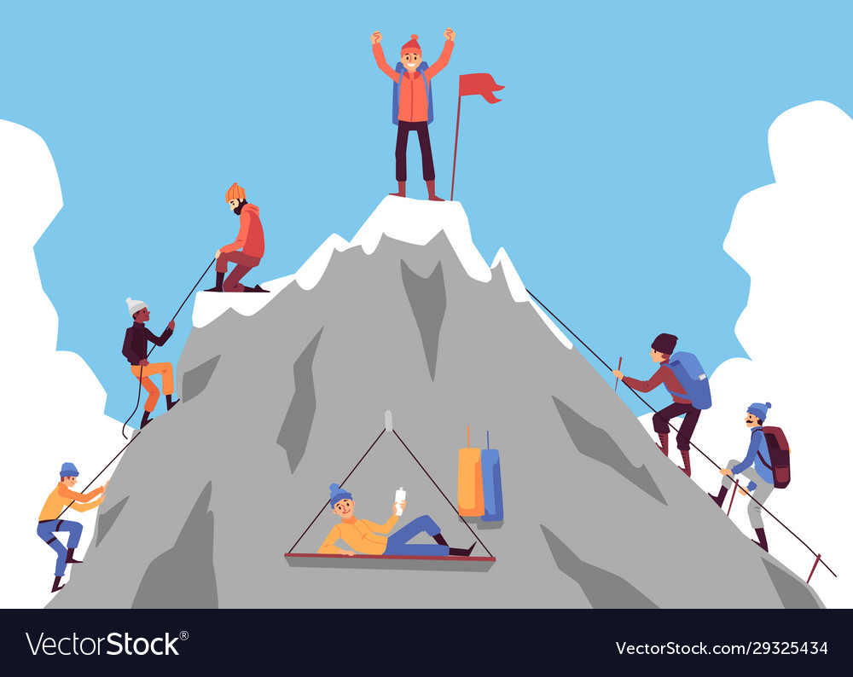
__ did you __ (stand) on the mountain with?
I ___ (stand) on the mountain with my friends.

Slide 18
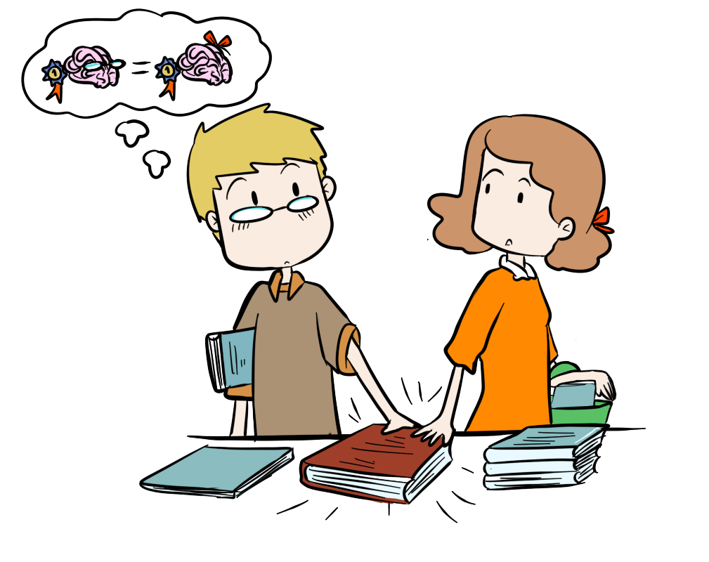
__ did you ___ (think) about your homework with?
I ___ (think) about my homework with my friend.

Slide 19
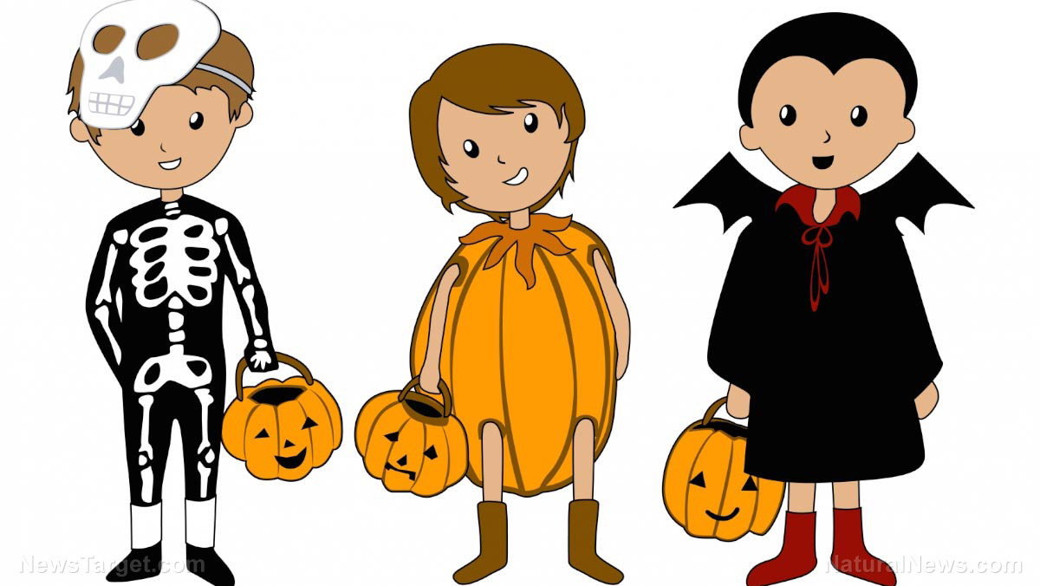
___ did you __ (wear) your costumes?
We ___ (wear) our costumes yesterday.

Slide 20
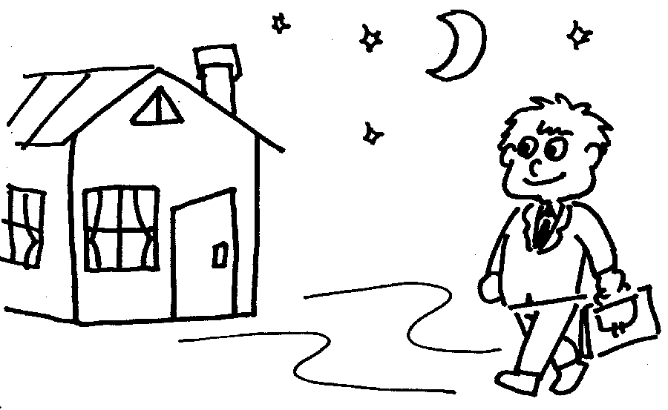
__ did you __ (come) home late?
I __ (come) home late last night.

Slide 21
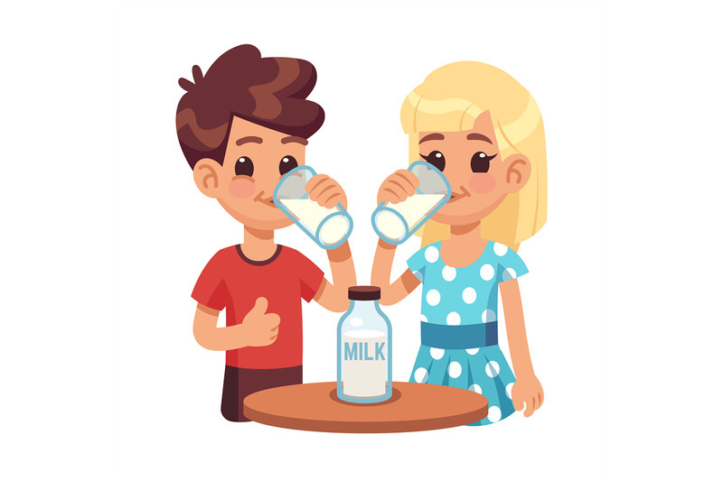
__ did you __ (drink) milk?
We ___ (drink) milk last Friday.

Slide 22
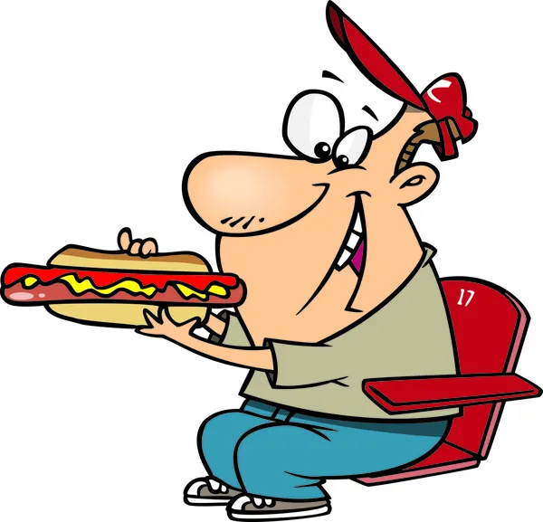
__ did you __ (eat) a hotdog?
I __ (eat) a hotdog last Saturday.

Slide 23
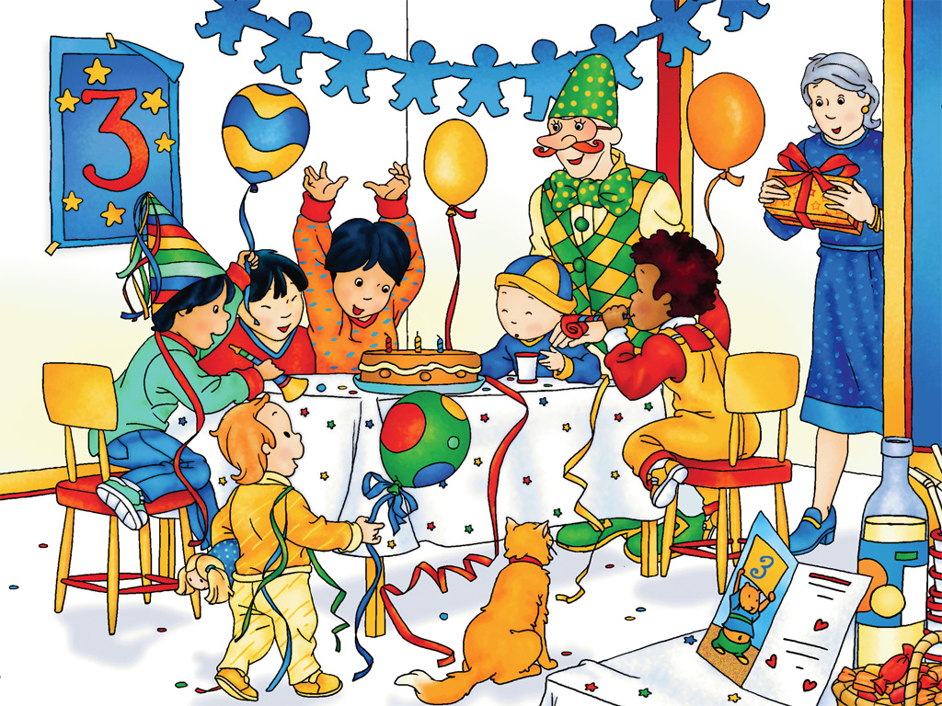
__ did you __ (go) to the party?
We __ (go) to the party last Saturday.

Slide 24
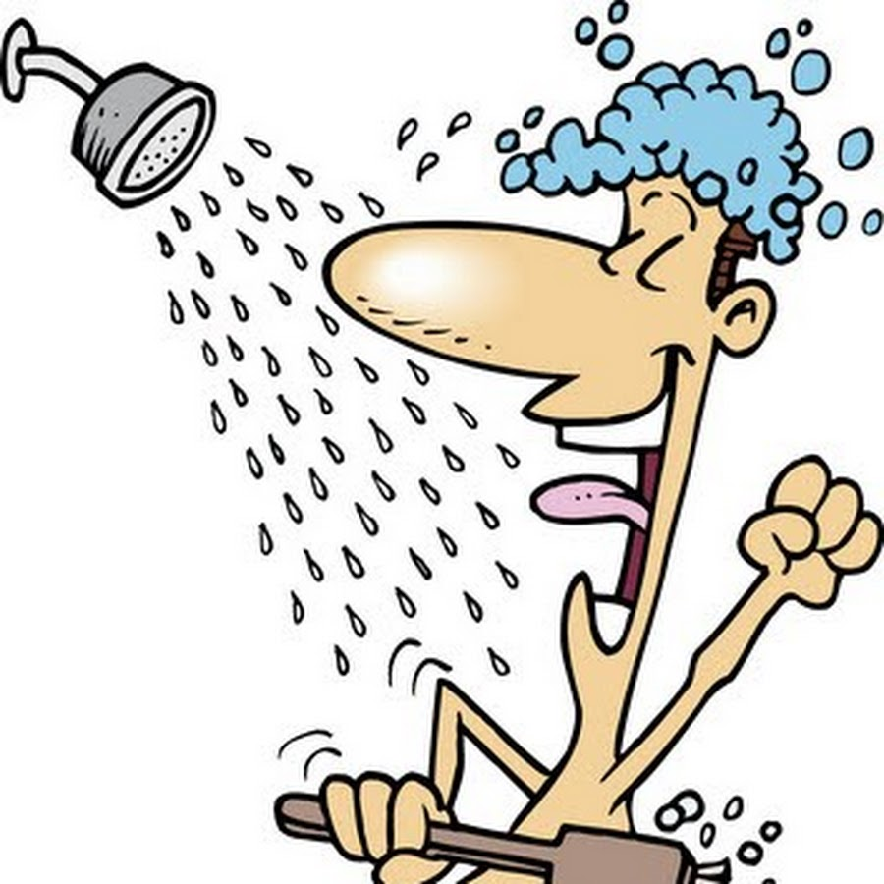
__ did you __ (have) a shower?
I ___ (have) a shower yesterday.

Slide 25
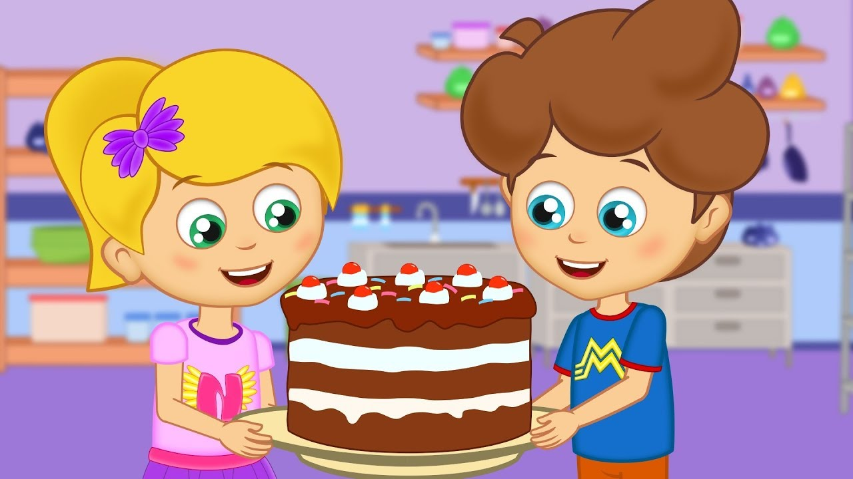
__ did you __ (make) a cake?
I __ (make) a cake last Sunday.

Slide 26
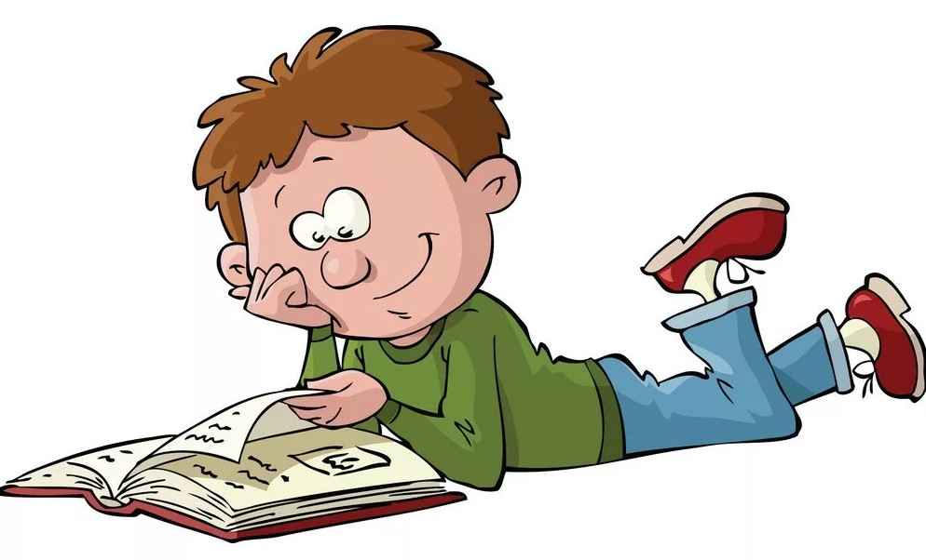
__ did you __ (read) this book?
I ___ (read) this book last weekend.

Slide 27
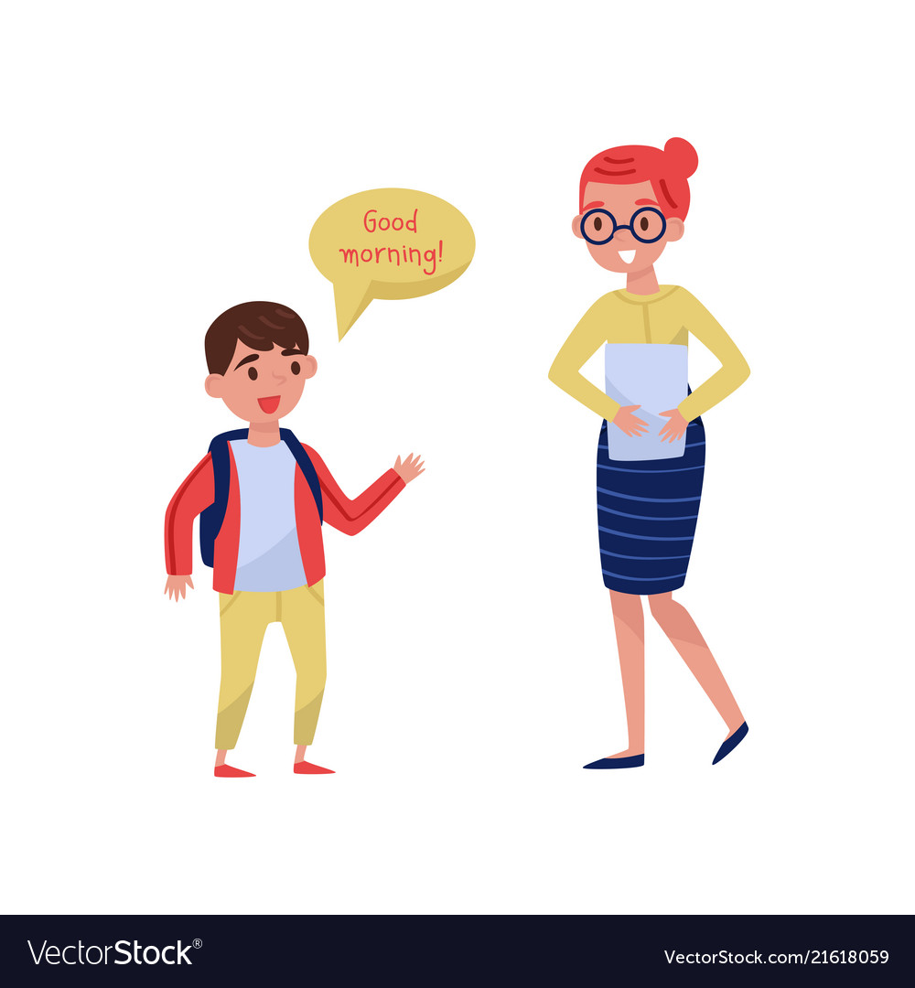
__ did you __ (say) good morning to your teacher?
I ___ (say) good morning to my teacher 5 minutes ago.

Slide 28
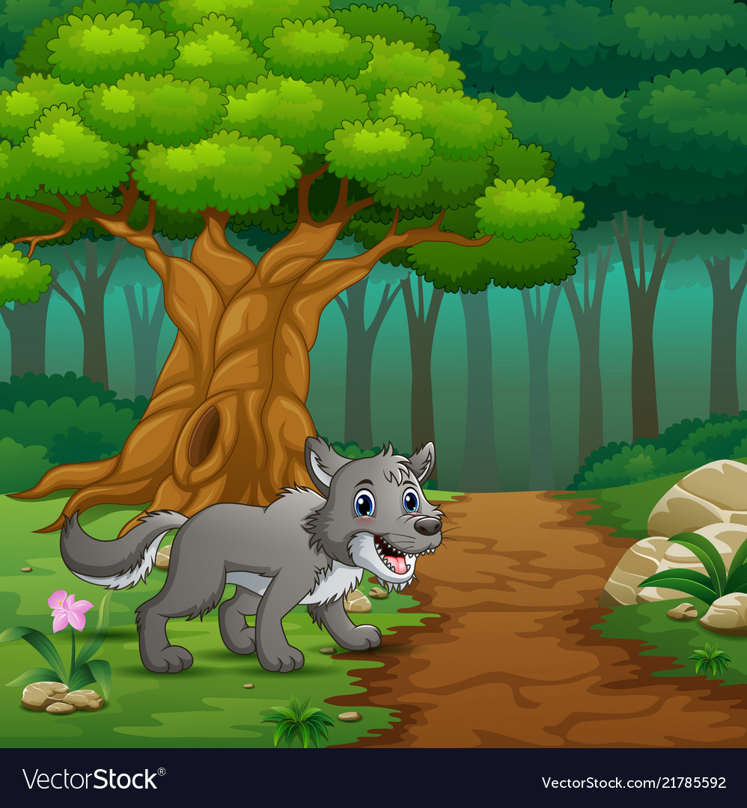
__ did you __ (see) a wolf in the forest?
I ___ (see) a wolf in the forest last night.

Slide 29
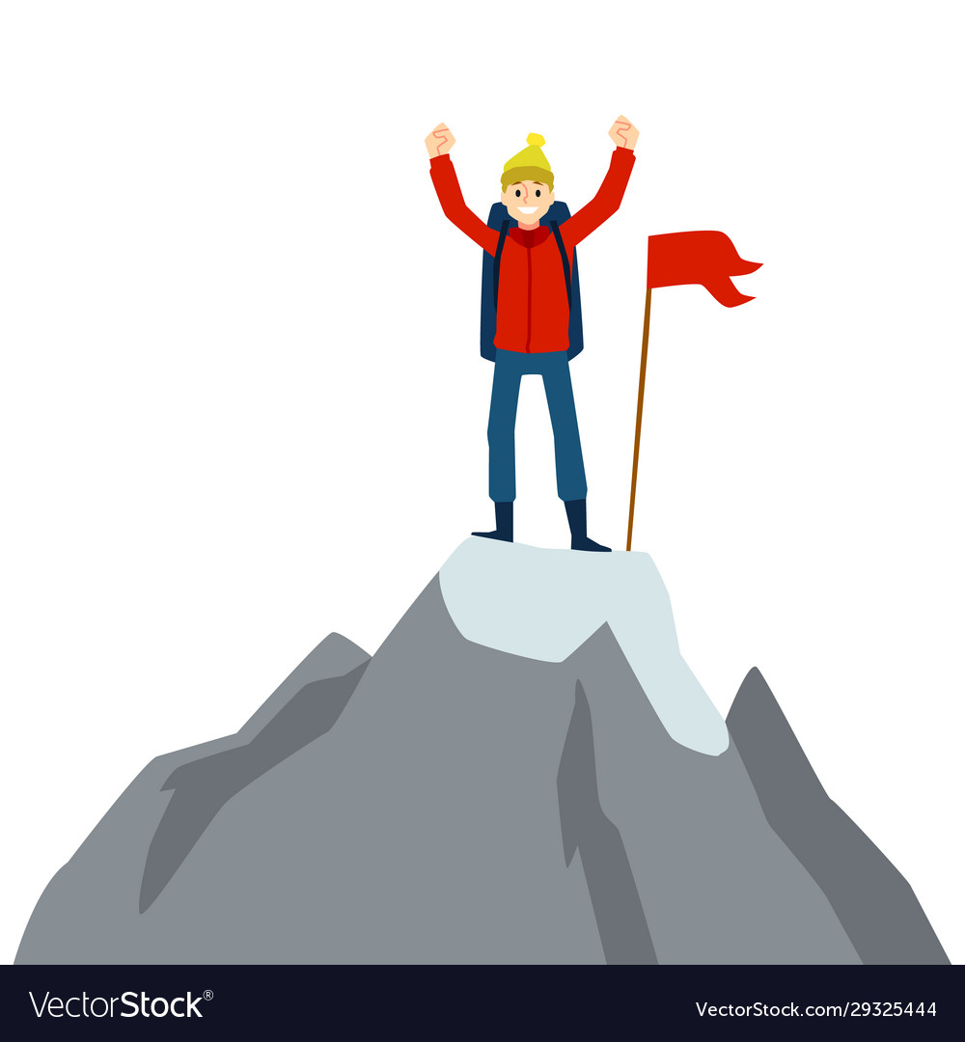
__ did you __ (stand) on the mountain?
I ___ (stand) on the mountain last year.

Slide 30
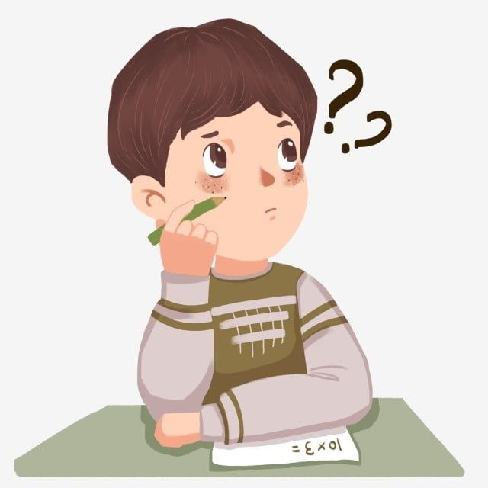
__ did you __ (think) about your homework?
I __ (think) about my homework yesterday afternoon.

Slide 31
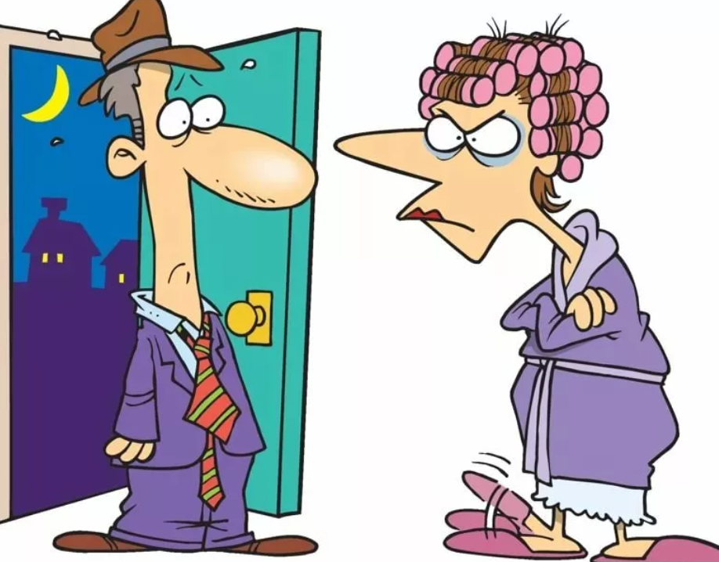
__ did you __ come late yesterday?
I __ (come) home late yesterday.

Slide 32
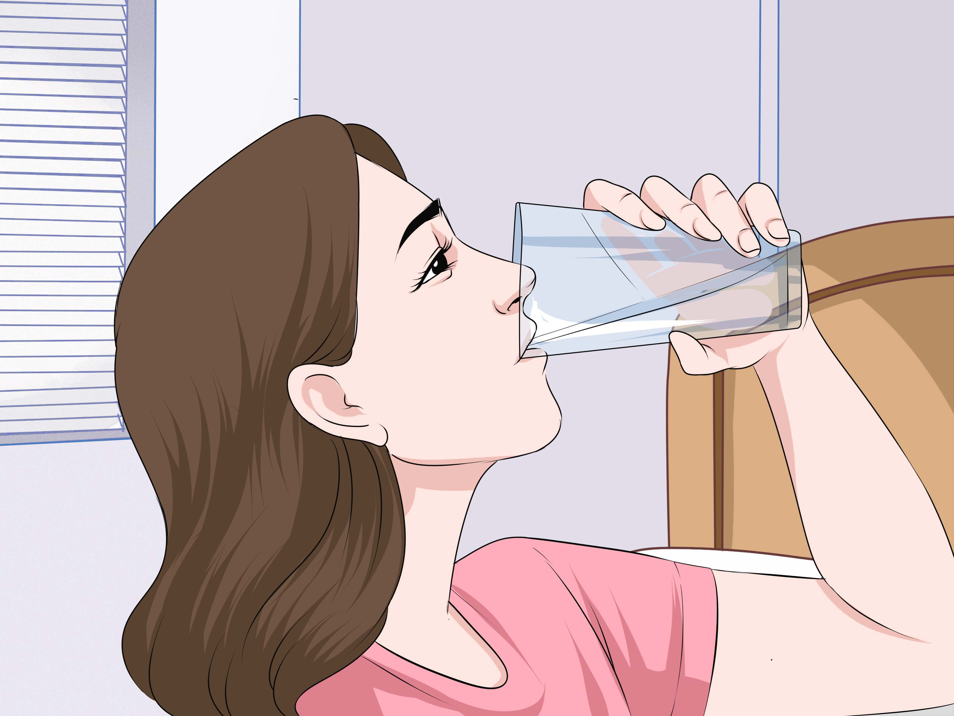
__ did you ___ (drink) water yesterday?
I __ (drink) water in the kitchen yesterday.

Slide 33
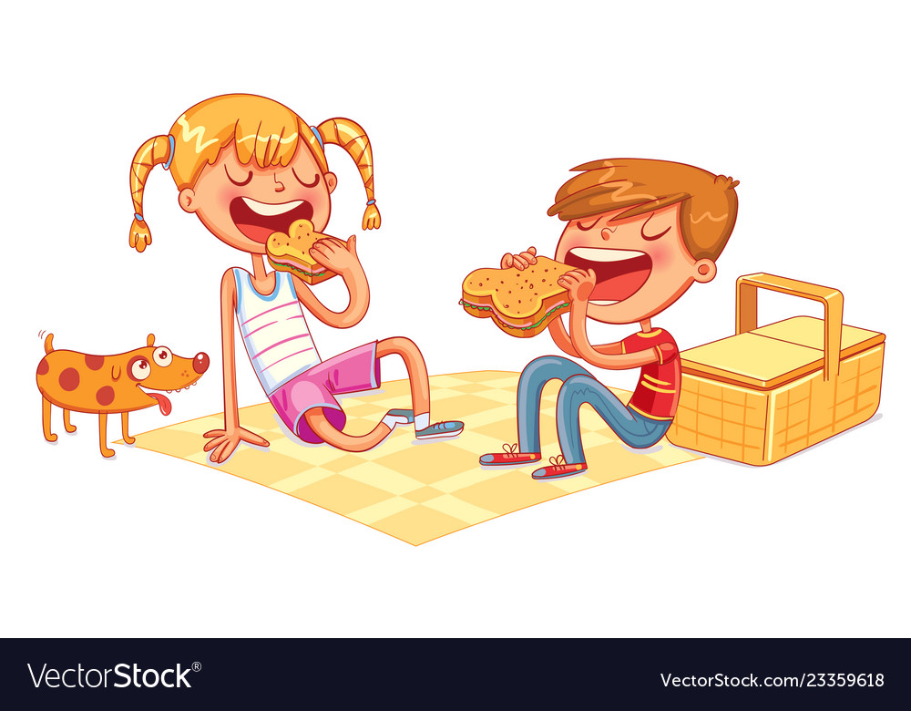
__ did you __ (eat) a sandwich yesterday?
I __ (eat) a sandwich on a picnic yesterday.

Slide 34
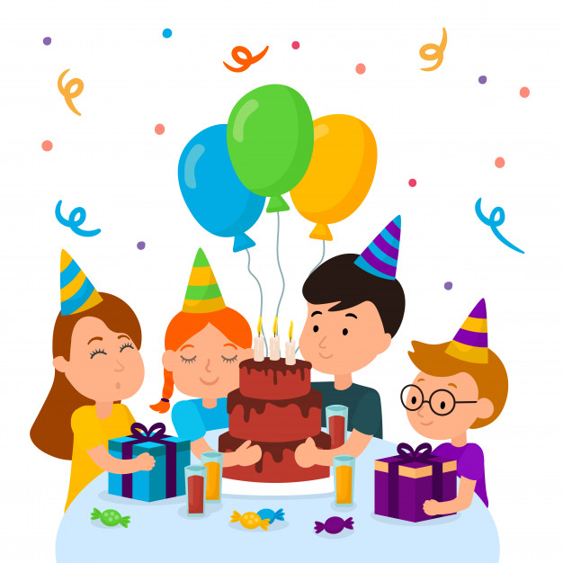
__ did you __ (go) yesterday?
I __ (go) to the party yesterday.

Slide 35
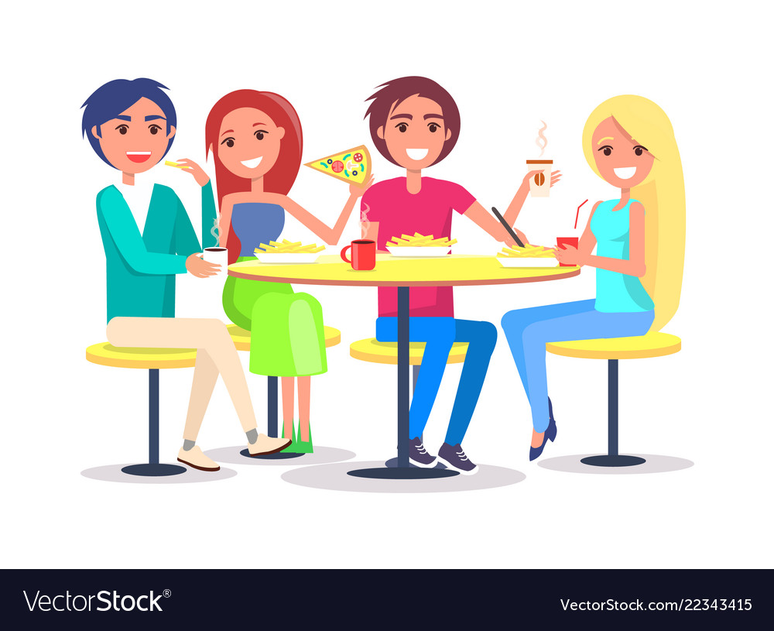
__ did you __ (have) a party yesterday?
I __ (have) a party in a café yesterday.

Slide 36
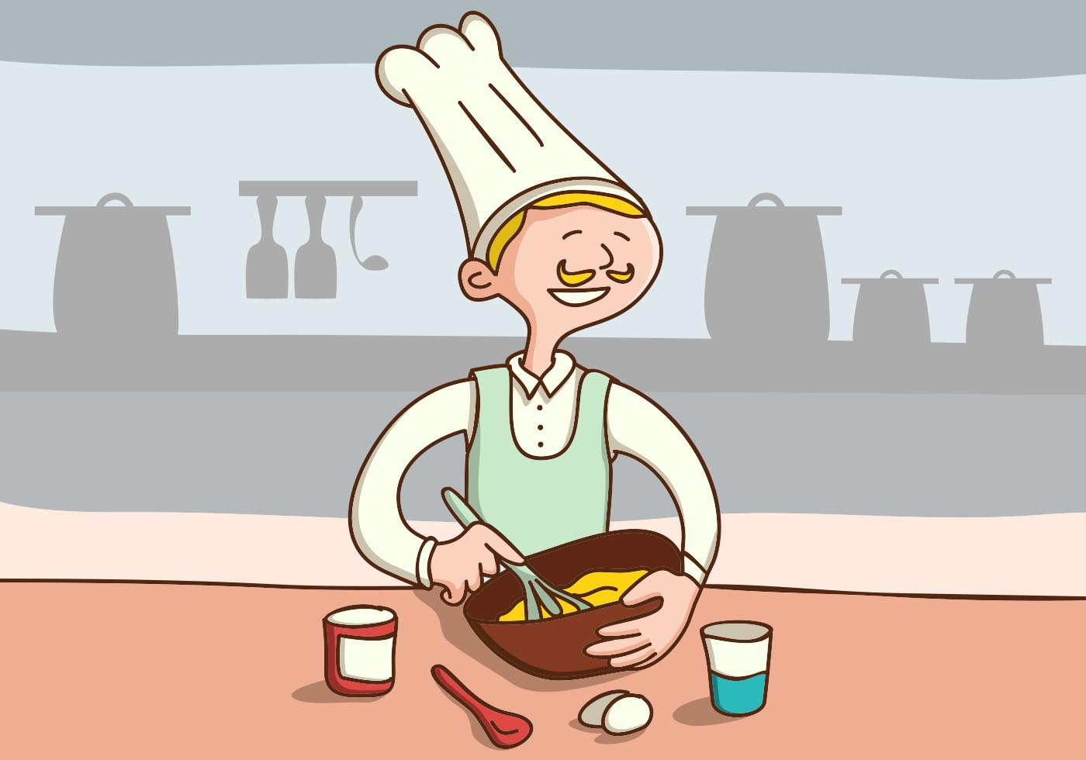
__ did you __ (make) a cake yesterday?
I __ (make) a cake in the kitchen yesterday.

Slide 37

__ did you __ (read) this book yesterday?
I __ (read) this book in the library yesterday.

Slide 38
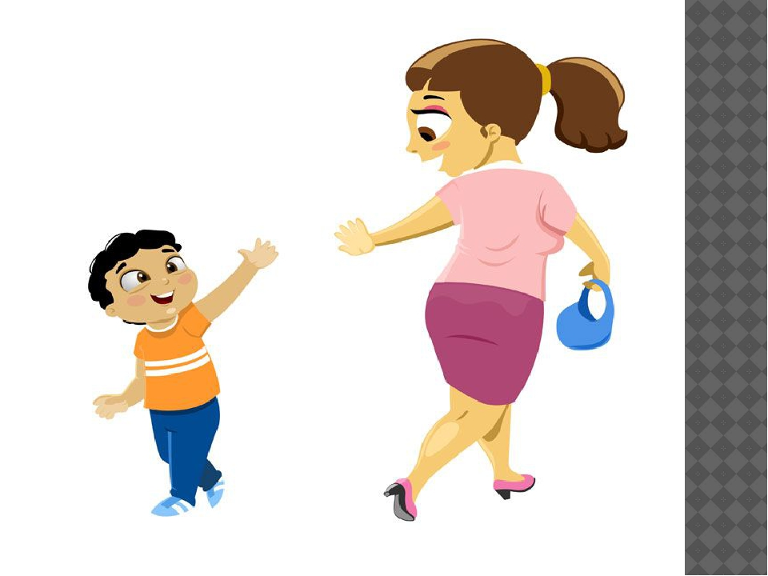
__ did you __ (say) goodbye to your teacher?
I ___ (say) goodbye to my teacher in the classroom.

Slide 39
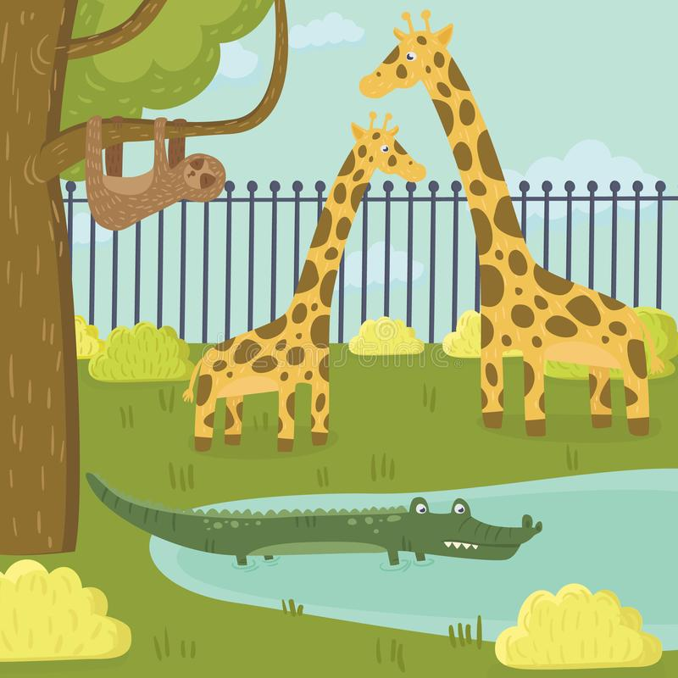
__ did you __ (see) the giraffe yesterday?
I __ (see) the giraffe in the zoo yesterday.

Slide 40
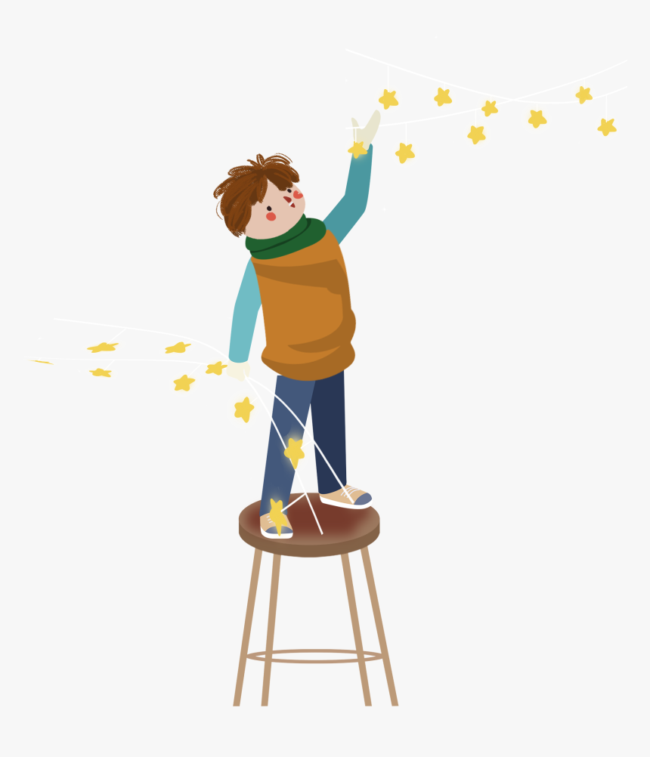
__ did you __ (stand) yesterday?
I __ (stand) on the chair yesterday.

Slide 41
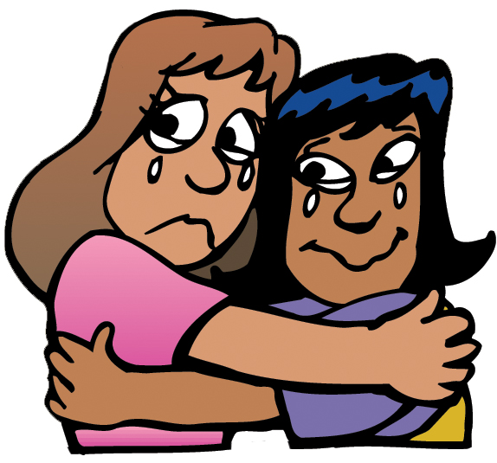
__ did you __ (say) goodbye to your friends ?
I __ (say) goodbye to my friends sadly.

Slide 42

__ did you __ (read) the book yesterday?
I ___ (read) the book quickly.

Slide 43
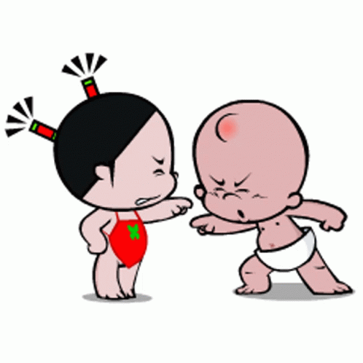
__ did you __ (talk) to your friend?
I ___ (talk) to my friend angrily.

Slide 44
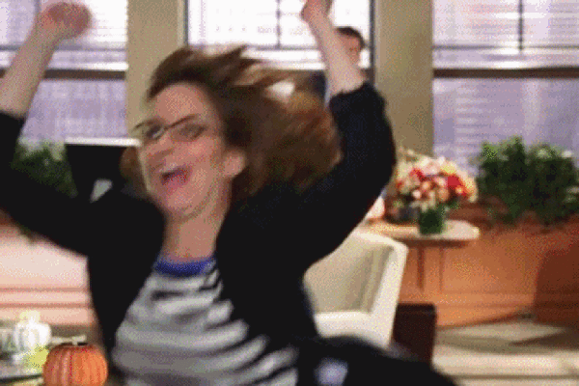
__ did you __ (look) at your friend?
I __ (look) at my friend happily.

Slide 45
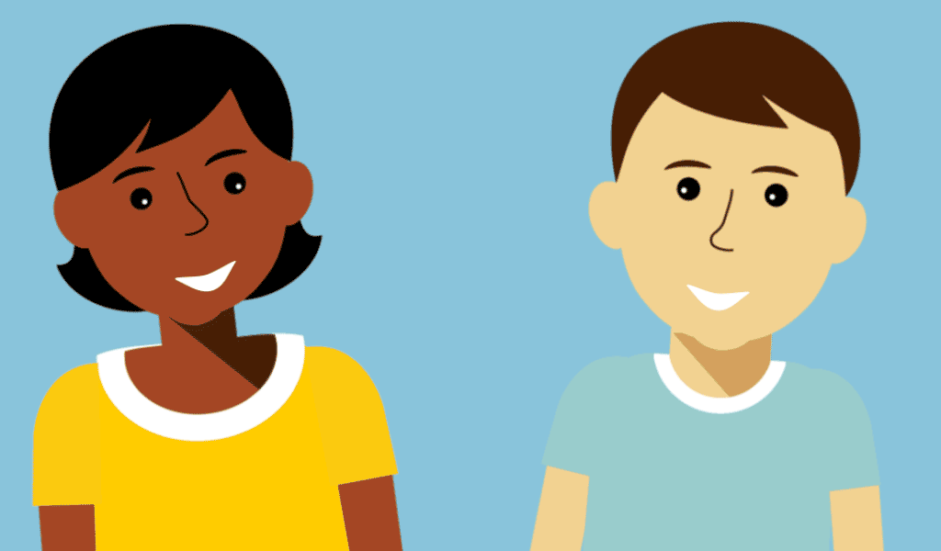
__ did you __ (talk) to your friend?
I ___ (talk) to my friend kindly.

Slide 46
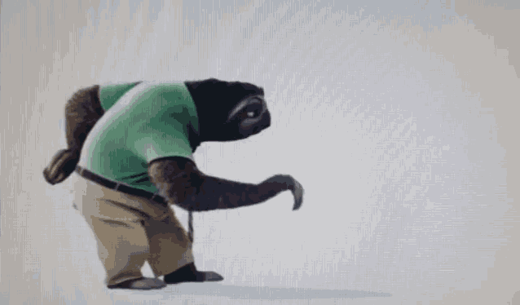
__ did you __ (go) home after school?
I __ (go) home slowly.

