Slide 1
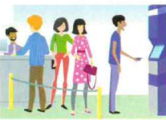
Last Monday I ______ in the

Slide 2
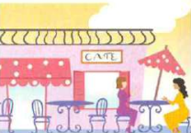
Today I ____in the

Slide 3

Last Tuesday he _____ in the

Slide 4
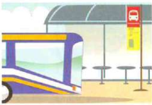
Today he ____ at the

Slide 5

Last Wednesday she ____ in

Slide 6
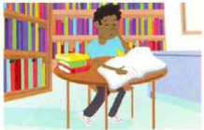
Today she ____ in the

Slide 7
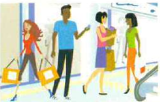
Last Thursday you _____ in the

Slide 8

Today you _____ in the

Slide 9
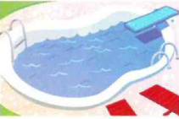
Last Friday they _____ in the

Slide 10
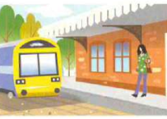
Today they ____ at the

Slide 11
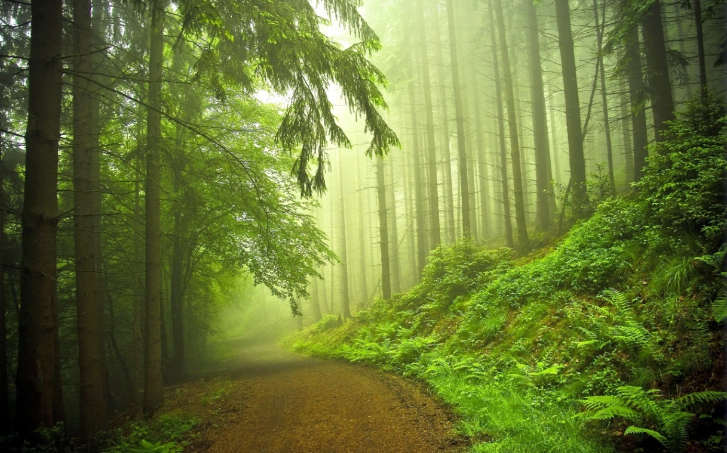
Last Saturday we ____ in the

Slide 12
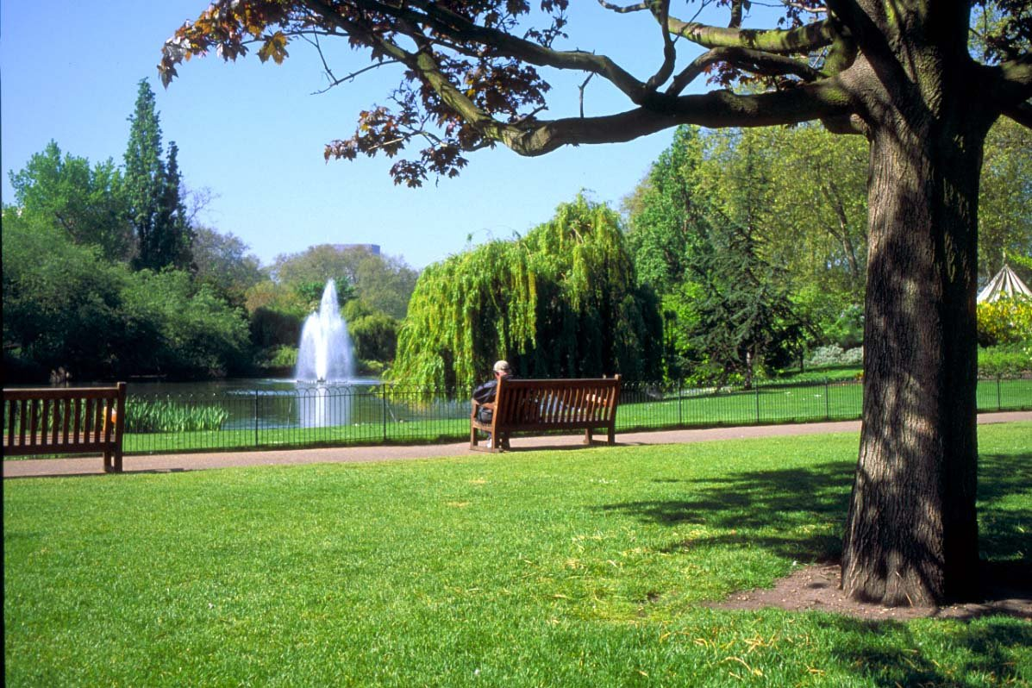
Today we _____ in the

Slide 13
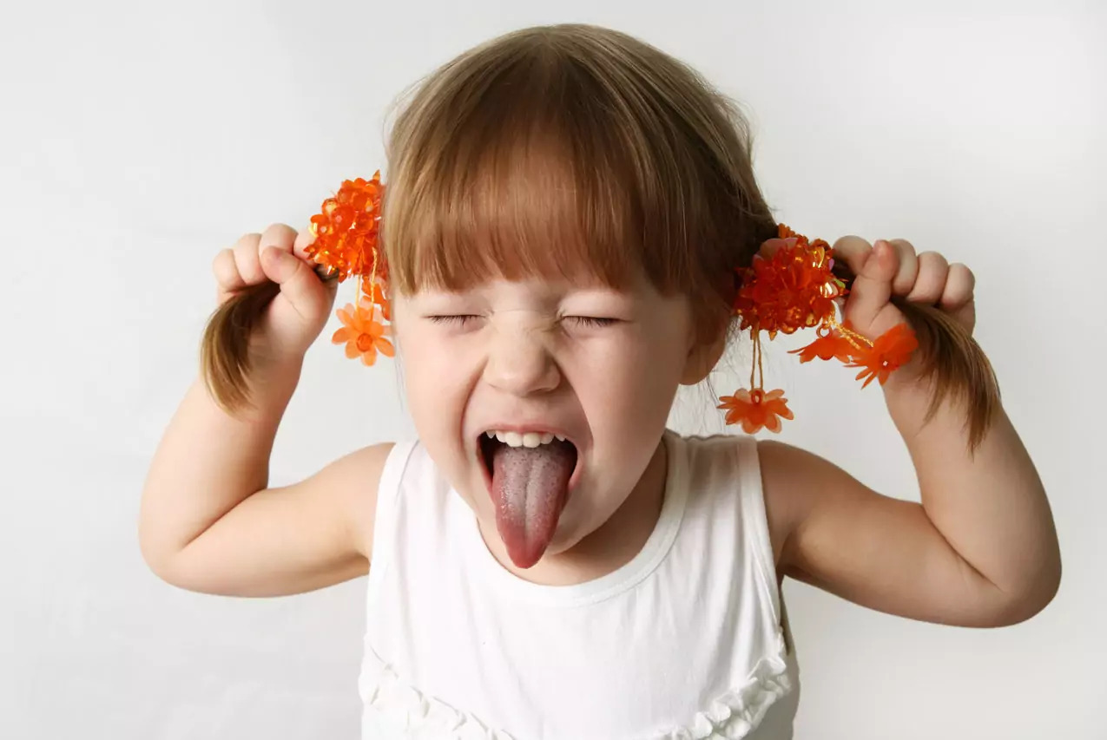
Yesterday I _____

Slide 14
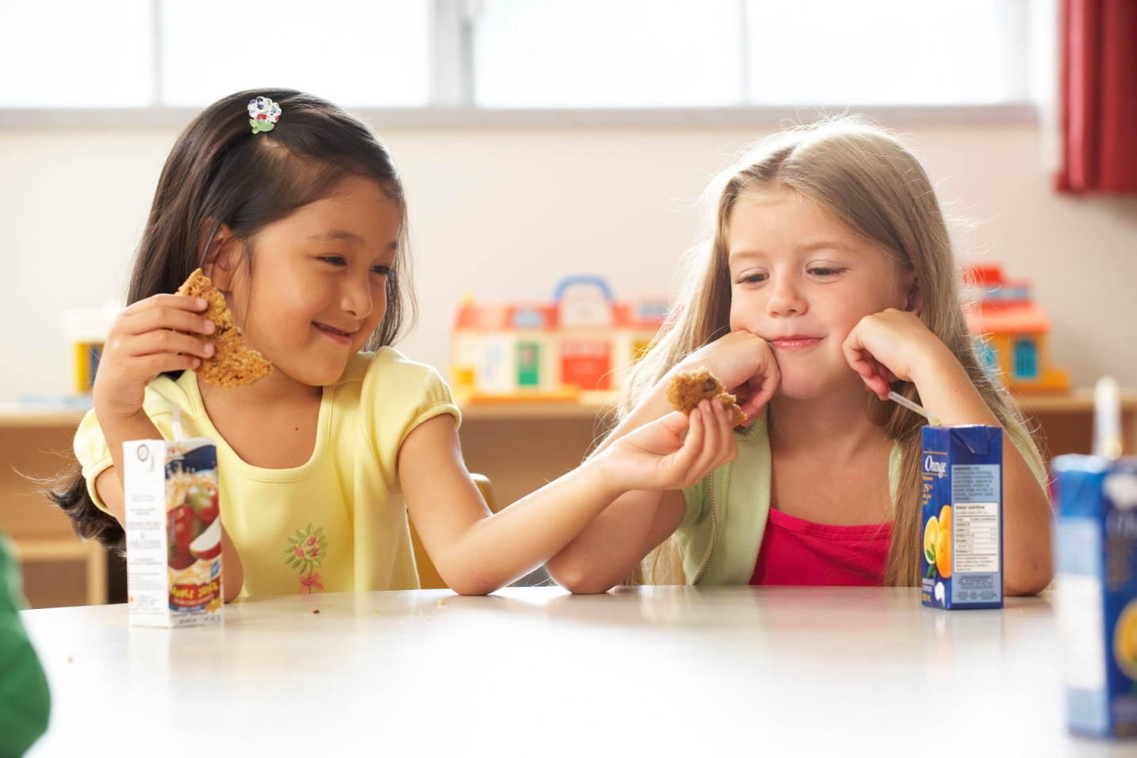
But today I _____

Slide 15
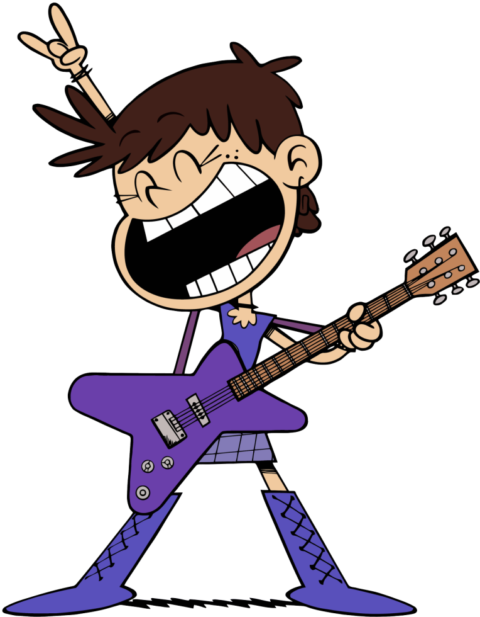
Yesterday he _____

Slide 16
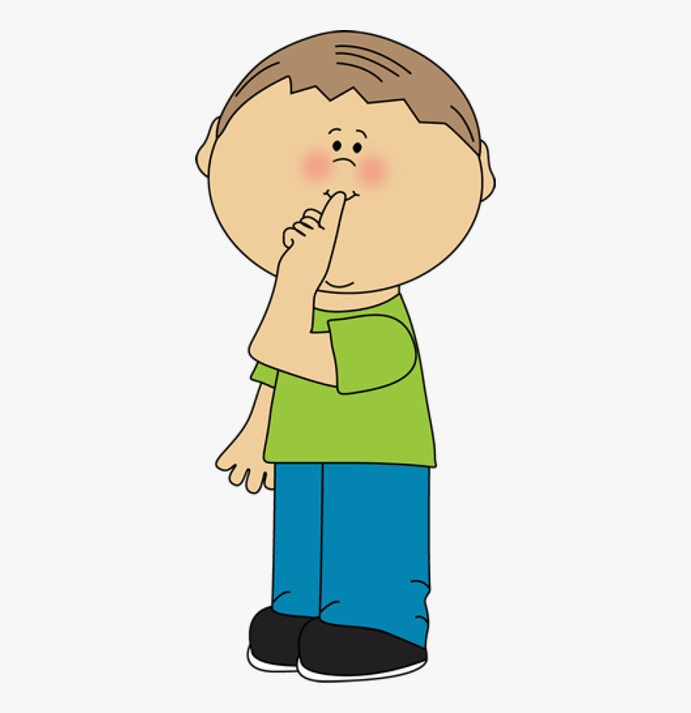
But today he ____

Slide 17
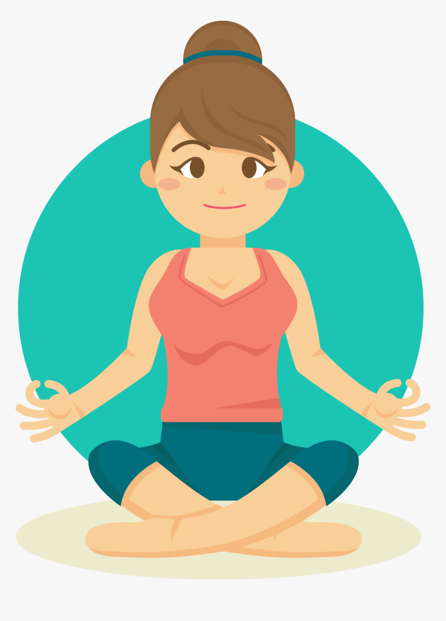
Yesterday she ______

Slide 18
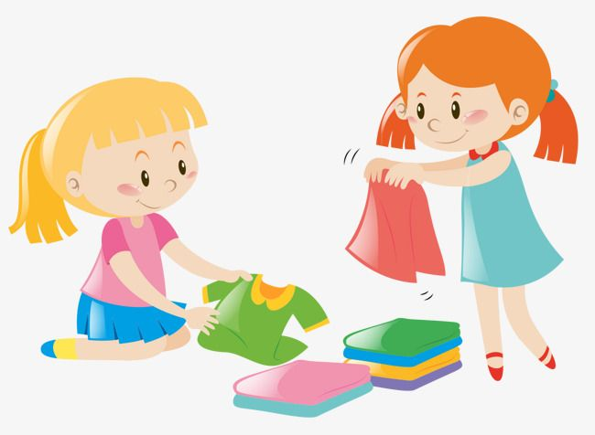
Today she _____

