Slide 1



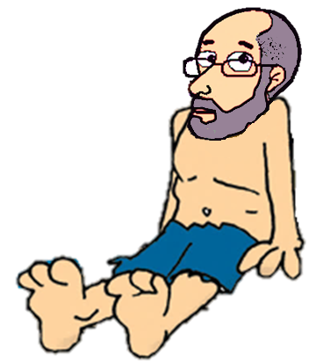





Slide 2


1/12
Children ___________ play with fire.
mustn’t
Click on the right raft to complete the sentence and rescue me, please!
mustn’t
don’t have to

Slide 3
mustn’t
You ________ speak to the driver
when the bus is moving. It's dangerous.
2/12
mustn’t
don’t have to

Slide 4
3/12
I like Sundays because I ____________ go to work.
don’t have to
don’t have to
mustn’t

Slide 5
4/12
mustn’t
It is forbidden. You __________ do that.
mustn’t
don’t have to

Slide 6
5/12
don’t have to
You _____________ arrive before 9 p.m.
but you should be here before midgnight.
don’t have to
mustn’t

Slide 7
6/12
When the traffic light is red,
you _________ go on.
mustn’t
mustn’t
don’t have to

Slide 8
7/12
don’t have to
You _____________ stay here, you can go home.
don’t have to
mustn’t

Slide 9
8/12
don’t have to
You ____________ ask my permission.
You can do what you want.
don’t have to
mustn’t

Slide 10
don’t have to
9/12
You _____________ drink alcohol,
you can have a soft drink.
don’t have to
mustn’t

Slide 11
10/12
mustn’t
Visitors __________ smoke.
mustn’t
don’t have to

Slide 12
don’t have to
11/12
It's optional. We ____________ to go
if you don't want to.
don’t have to
mustn’t

Slide 13
This is very important.
You __________ forget what I said.
12/12
mustn’t
mustn’t
don’t have to
EXIT

