Slide 1




IrinaPapakhinac

Slide 2
What can you do to have fun?
IrinaPapakhinac

Slide 3

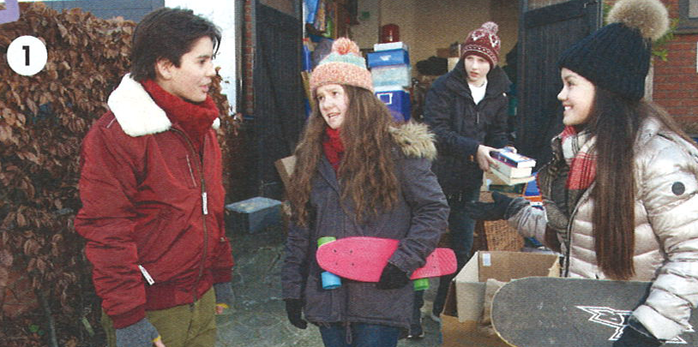
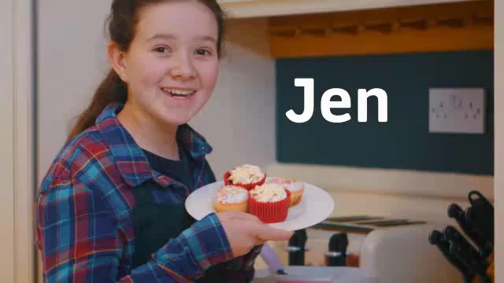
Look at the photo.
Lucas, Jen, Alex and Lian want to have fun.
GUESS
What can they do?
Watch the video and check your answers.
IrinaPapakhinac

Slide 4
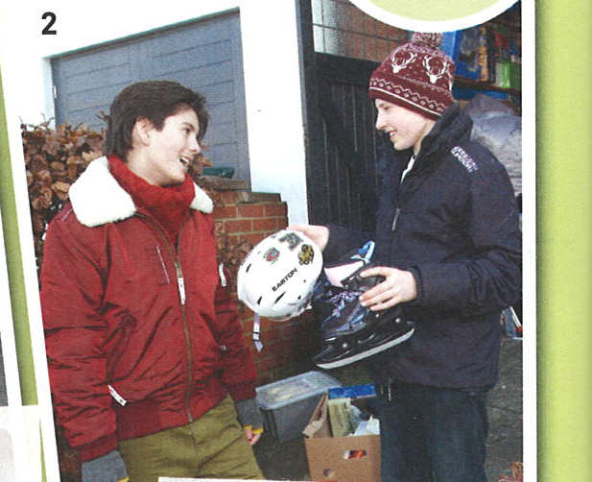
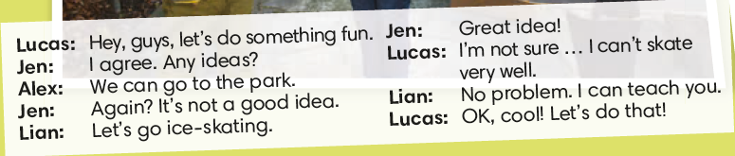
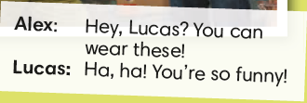
How can we suggest doing something?
How can we agree?
How can we disagree?
IrinaPapakhinac

Slide 5
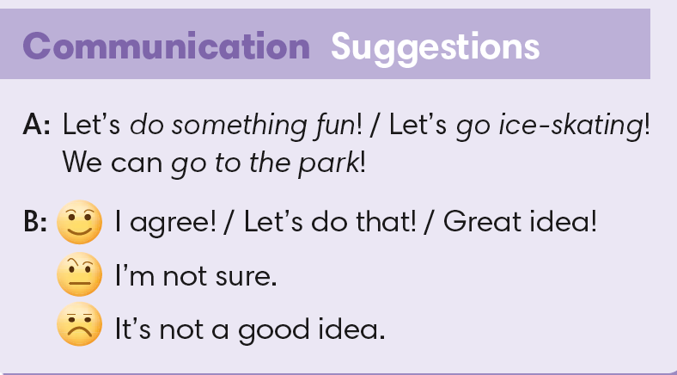


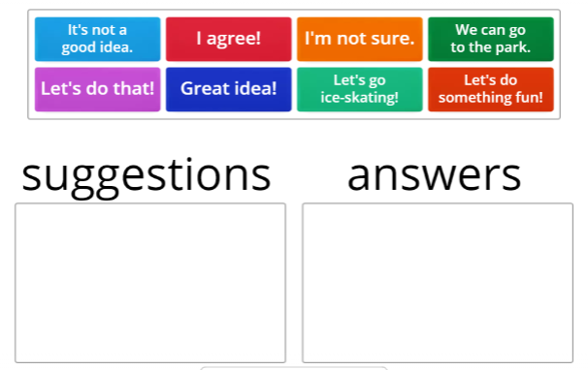
IrinaPapakhinac

Slide 6
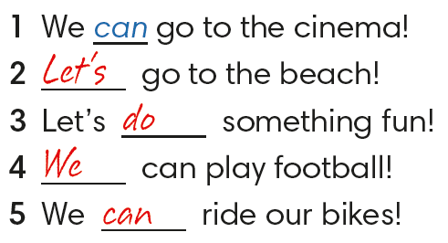

IrinaPapakhinac

Slide 7
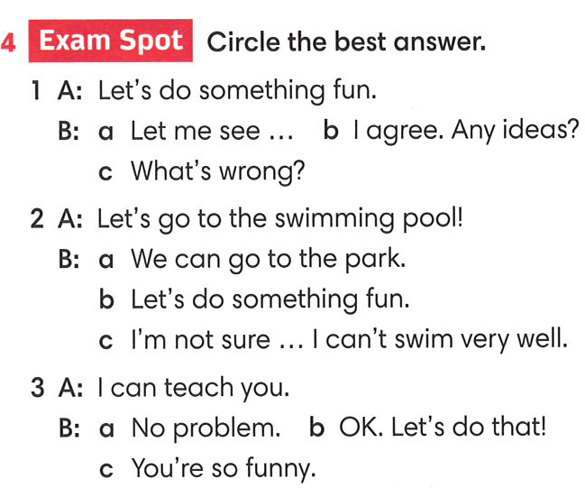
IrinaPapakhinac

Slide 8

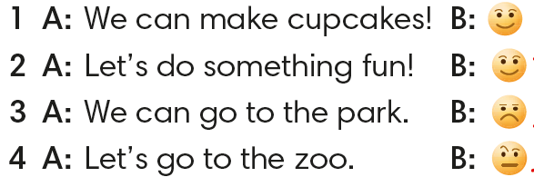
IrinaPapakhinac

Slide 9
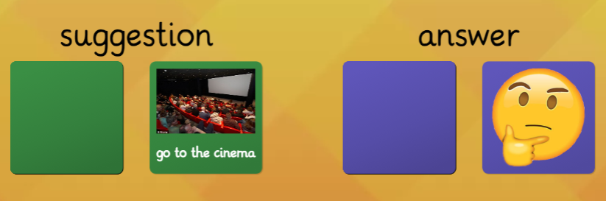
IrinaPapakhinac

Slide 10
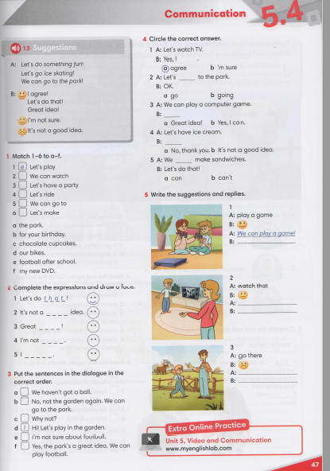


IrinaPapakhinac

Slide 11
IrinaPapakhinac

Slide 12
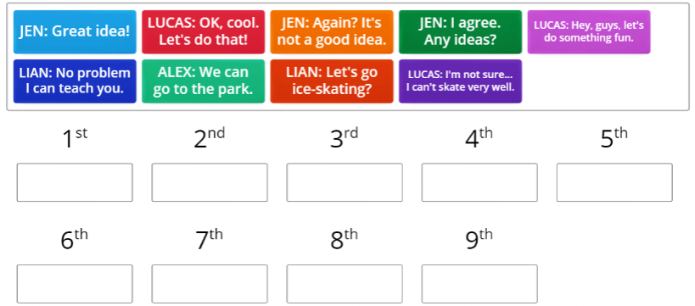
IrinaPapakhinac

Slide 13
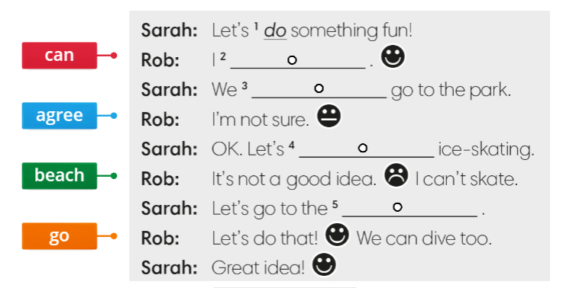
IrinaPapakhinac

