Slide 1
BE SAFE!

Slide 2
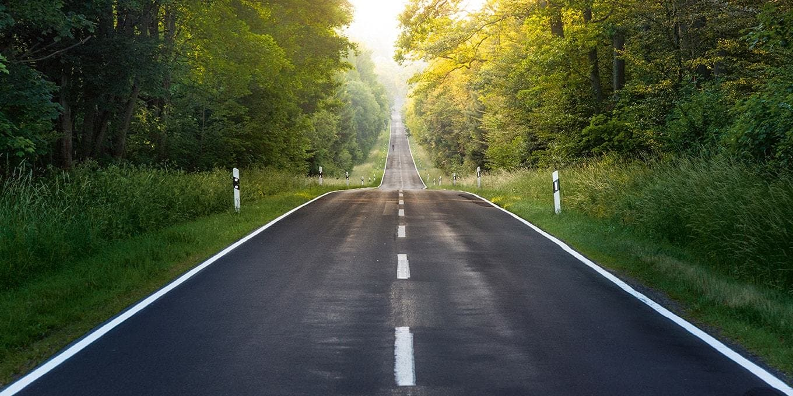
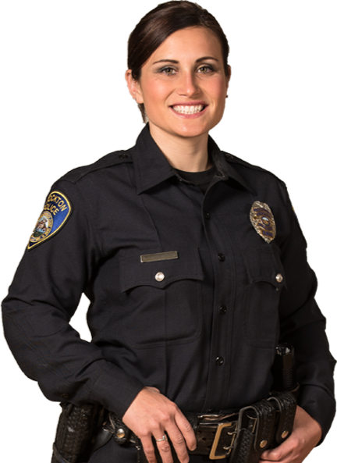
Hi guys!
Today we will learn
how to be safe!
Let’s start!

Slide 3
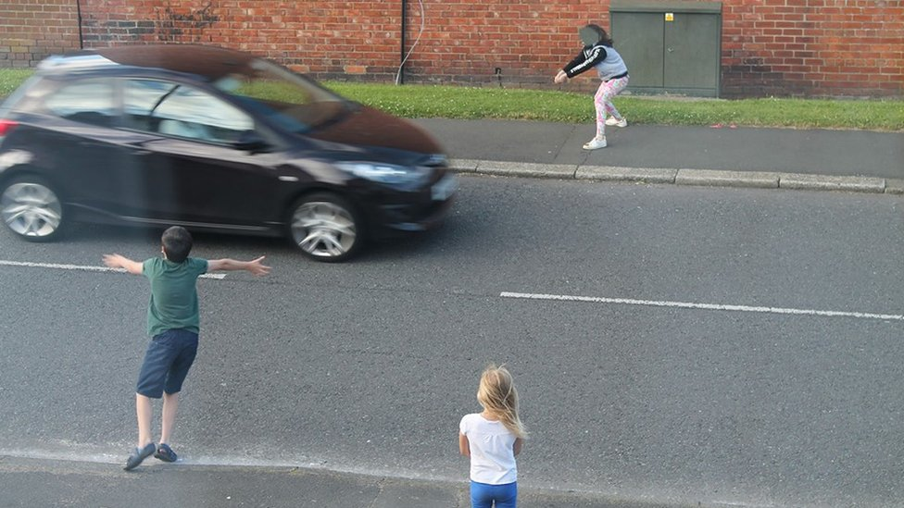
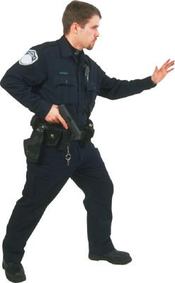
???

Slide 4
Don’t play
next to traffic!

Slide 5
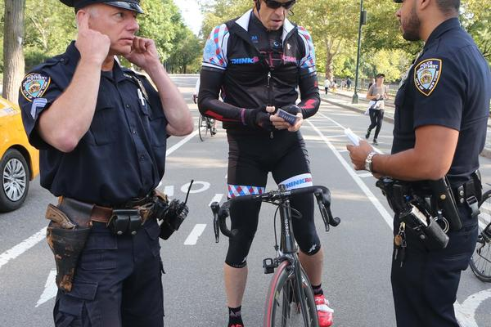
???

Slide 6
Don’t listen
to music!

Slide 7
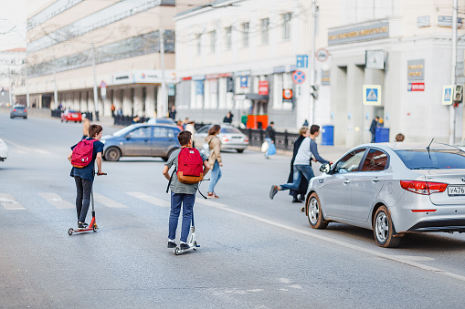
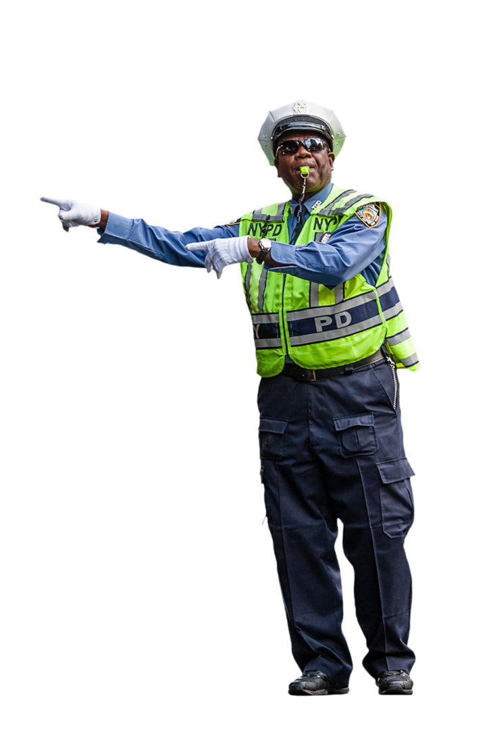
???

Slide 8
Don’t cross the road next to cars

Slide 9
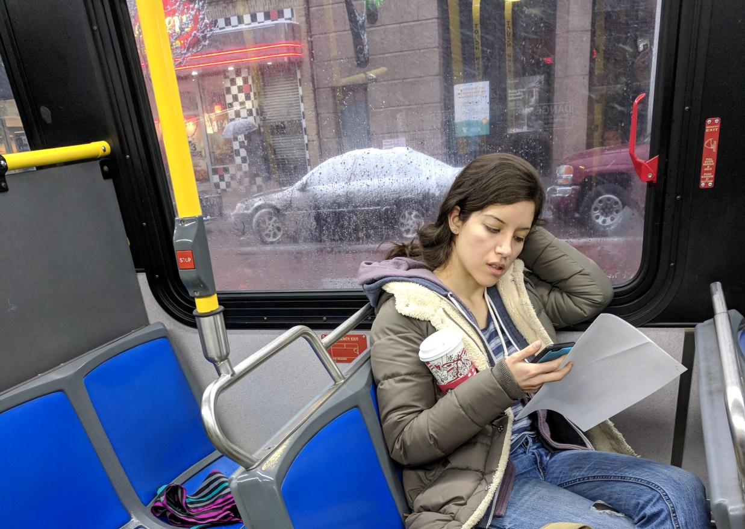


???

Slide 10
Don’t shout!
Be polite to the driver and to other people!

Slide 11
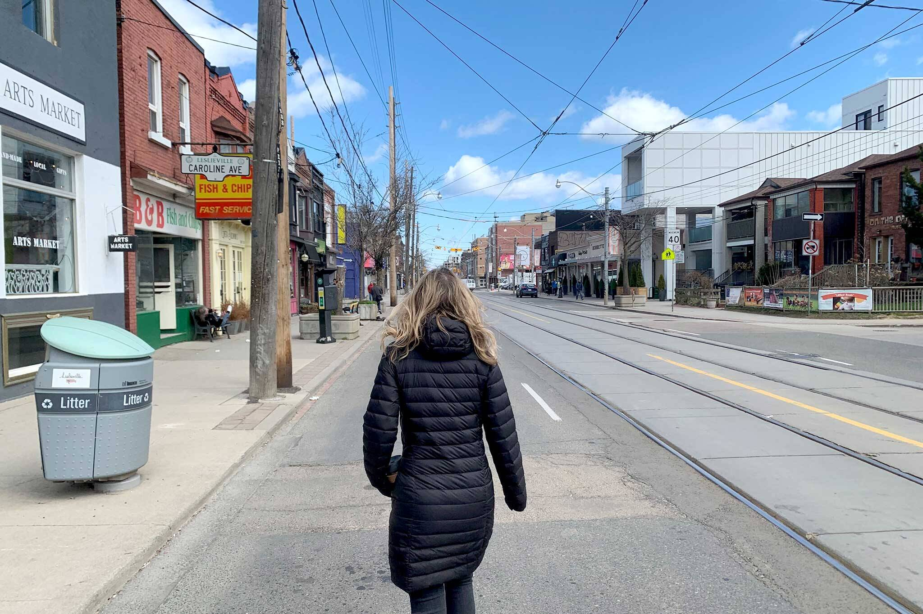
???

Slide 12
Don’t walk
on the road!
Walk on the pavement!

Slide 13
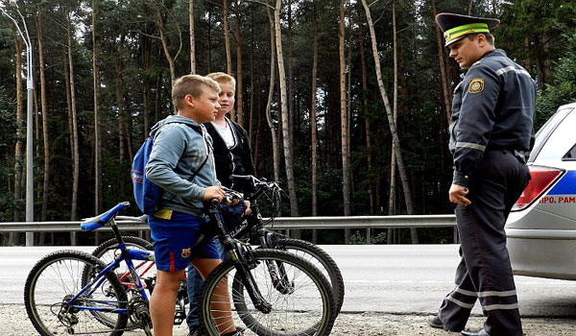
???

Slide 14
Wear a helmet!

Slide 15
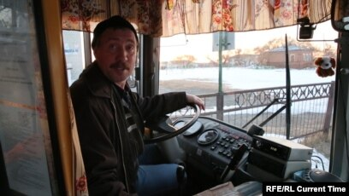
???

Slide 16
Don’t talk to the driver when he is driving

Slide 17
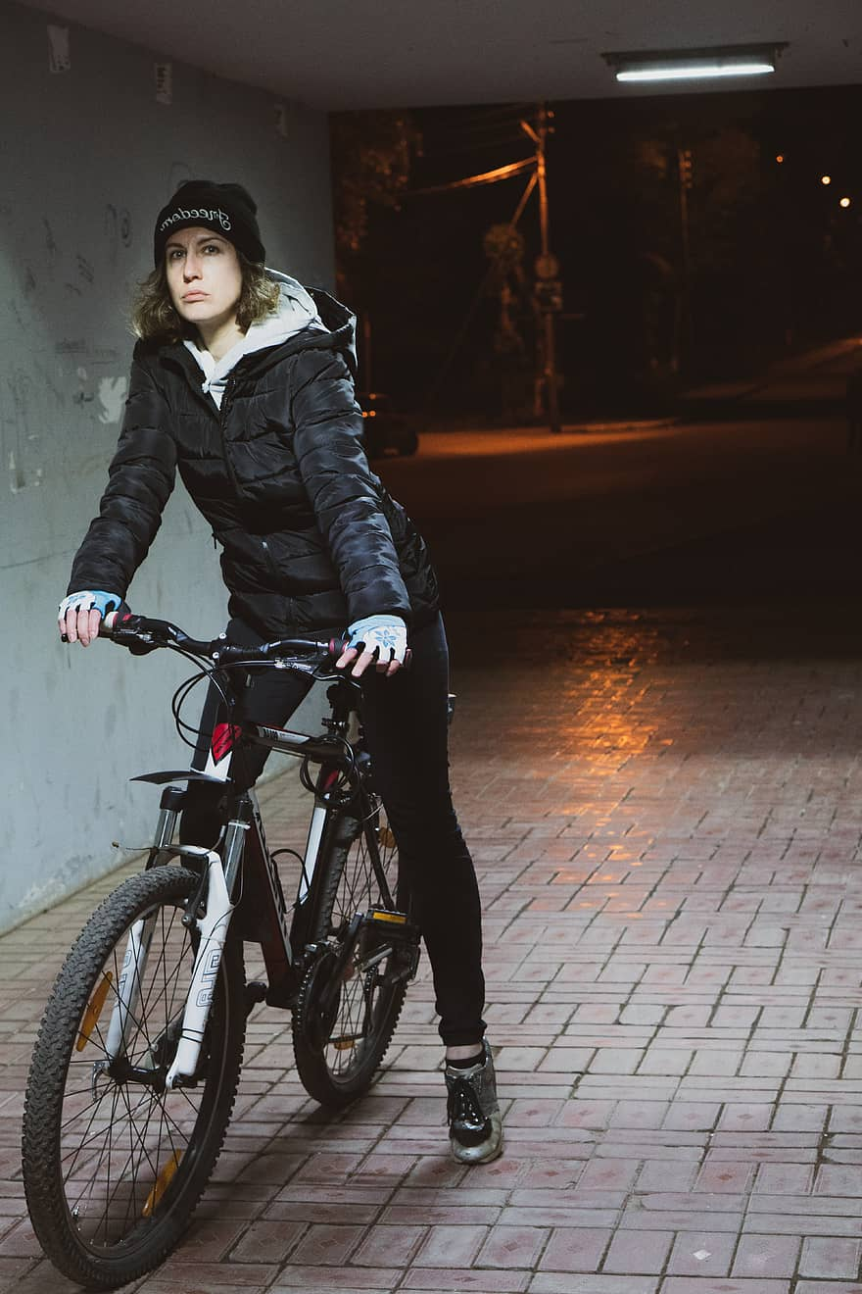

???

Slide 18
Wear clothes in bright colours!

Slide 19
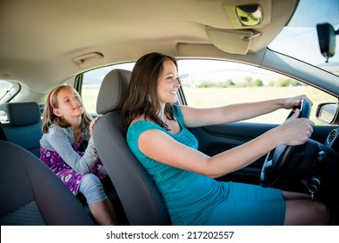
???

Slide 20
Wear your seat belts!

Slide 21
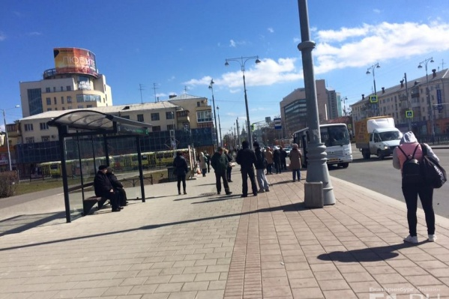
???

Slide 22
Wait in safe place!
Don’t stand
near the road!

Slide 23
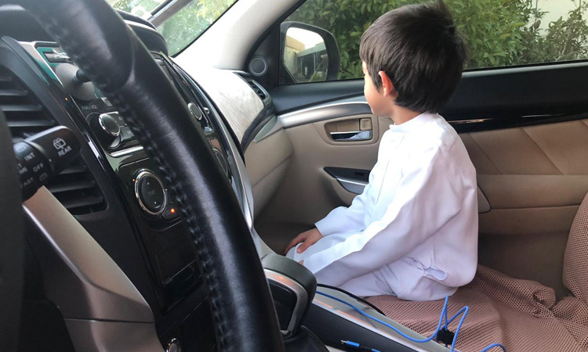
???

Slide 24
Sit in the back seat!

