Slide 1

GRAMMAR
SNOW
By Artem Morozov
START
© Artem Morozov, 2020

Slide 2
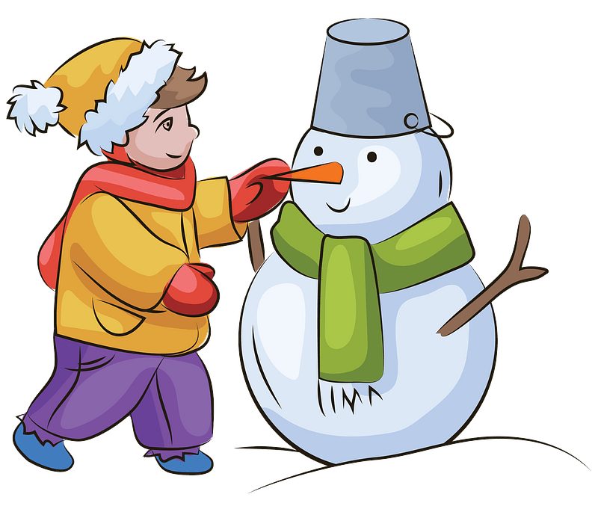
CHECK
Were you hungry this morning?
morning?
this
you
hungry
Were

Slide 3
CHECK
Were you born in another city?
Were
born
another city?
in
you

Slide 4
CHECK
Where were you at 7 o’clock?
Where
you
7 o’clock?
at
were

Slide 5
CHECK
Were
week?
happy
last
you
Were you happy last week?

Slide 6
CHECK
Were
Monday?
Were you angry on Monday?
on
angry
you

Slide 7
CHECK
were
ago?
you
an hour
Where were you an hour ago?
Where

Slide 8
CHECK
you
were
at home
When
yesterday
When were you at home yesterday?

Slide 9
CHECK
you
Were
morning?
this
Were you tired this morning?
tired

Slide 10
CHECK
Was your mother busy last evening?
Was
last
busy
evening?
your mother

Slide 11
CHECK
month?
last
were
Where
you
Where were you last month?

Slide 12
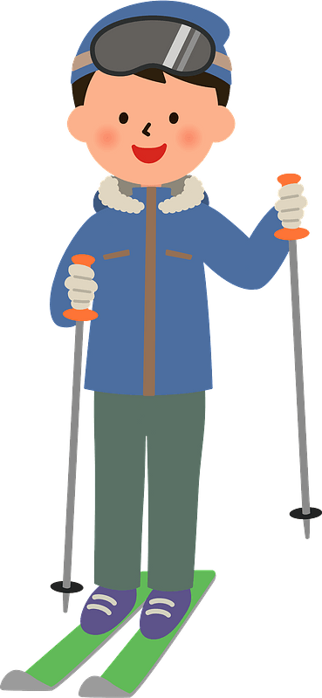
Well done!

