Slide 1
Lifestyles.
Present Simple and Present Continuous.
GO!

Slide 2
Grammar
Present Simple
and
Present Continuous

Slide 3
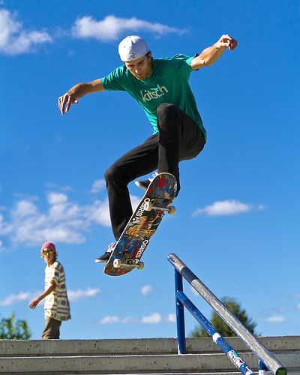

Listen to the audio and answer the questions
Where is Gary?
What is he doing?

Slide 4
Now listen and read and check your answers.
Hi! It’s Gary here, lead singer. Today I’m writing the band’s blog at a special event in a skate park. We’ve got photographers and reporters with us, but we aren’t singing at the moment. One reporter, Ali, is asking us lots of questions: “What do you normally do on Saturday afternoons? What are you doing today?” We tell Ali about our lives. We often travel from one city to the next on Saturday afternoons. Then in the evening we usually play live in concert. We don’t normally skateboard! Today there are lots of skate boarders around because we’re filming our new music video. They’re doing some amazing tricks. I love the video!
Where is Gary?
What is he doing?

Slide 5
Present Simple
Present Continuous
They usually travel on a tour bus.
He doesn’t write his blog every day.
Do they speak English? Yes, they do.
He’s travelling a lot these days.
They aren’t recording a song at the moment.
Is she skateboarding now? No, she isn’t.
Usually, always, never, hardly ever …
Every (day, week, month…), once/twice a day, a week…
Now, at the moment
Today, this week, this month…
State Verbs.
These Verbs are NEVER used in Continuous!
Like, love, hate, know, understand, want, need.

Slide 6
Choose the correct option.
Ali and Gary sit / are sitting on a bench at a skate park.
Gary usually sings / is singing in concerts on Saturday evenings.
The band members don’t often visit / aren’t often visiting skate parks.
The skateboarders do / are doing some fantastic skateboard tricks at the moment.
Sara always wears / is always wearing her lucky blue helmet.
Several people film / are filming skateboarders.

Slide 7
Make questions!
Use Present Simple or Present Continuous.
The people in the park / film / skateboarders
Are the people in the park filming skate boarders?
Gary / work / as a reporter
Does Gary work as a reporter?
Ali / ask / questions at the moment
Is Ali asking questions at the moment?
The band members / usually play / live in concert on Saturday
Do the band members usually play live in concerts on Saturdays?
The skateboarders / perform / in a competition today
Are the skateboarders performing in a competition today?

Slide 8
Complete the text with the correct form of the verb in brackets.
My name’s Sara. I ____________ (love) skateboarding. I’m a real fan. I ____________ (practice) at a local park every weekend. I ________________ (not/often/do) competitions because I’m from a small town.
I’m very excited today because I ______________ (perform) in a video for a famous band. At the moment we ______________ (get ) ready. Lots of people ____________ (come) into he park now. My mom and dad ________________ (sit) near the front because they ________________ (want) to upload photos for their friends!
love
practice
don’t often go
‘m performing
‘re getting
are coming
are sitting
want

Slide 9
Speaking
True or False

Slide 10
Is it True or False for you and your teacher?
You love loud music
You are wearing a T-shirt
You are waiting for something to arrive by post
You always make your bed in the morning
You don’t know how to make a cake
You are reading a good book at the moment
You sometimes forget to bring your book to school
You hate tidying your room
You understand what state verbs are
You are studying hard this week
You don’t often watch TV
You want to live in the countryside one day
You often do exercise after school
You never read blogs
You think English is more difficult than Russian

Slide 11
Great Job!

