Slide 1



Slide 2


Talk about what’s going to happen in the pictures.
Use “going to” to make predictions.

Slide 3
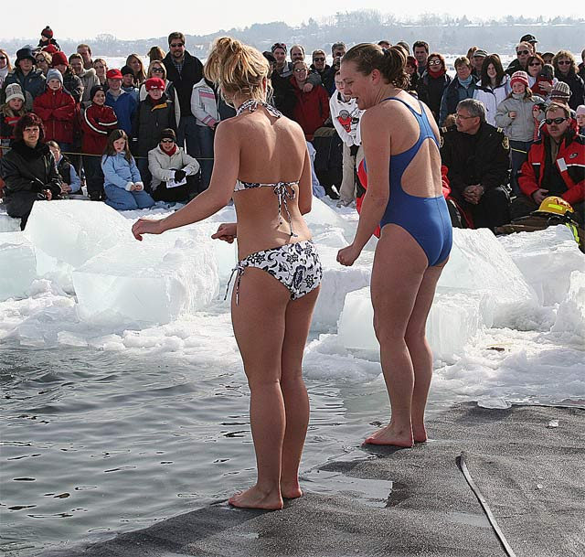
Examples:
They’re going to dive into the icy water.
They’re going to shiver for a long time afterwards.
They’re going to need warm clothes!
The people are going to applaud.
The girls are going to get sick.

Slide 4
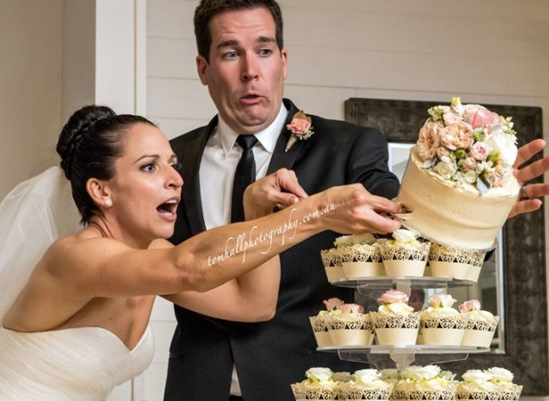
Whoops!

Slide 5
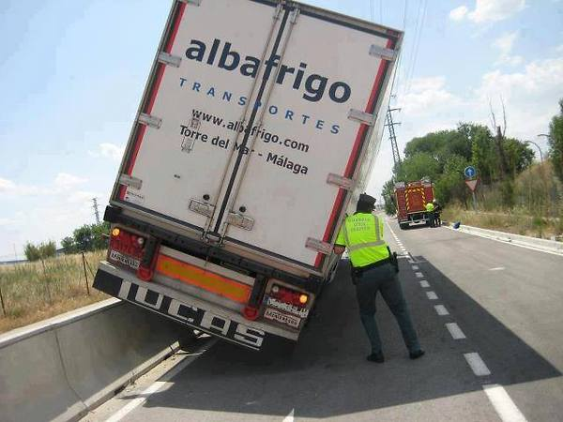
What a disaster!

Slide 6
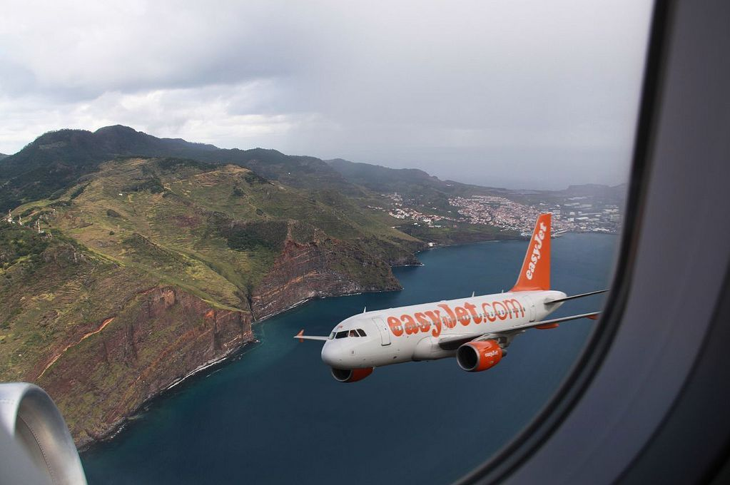
Look out!

Slide 7
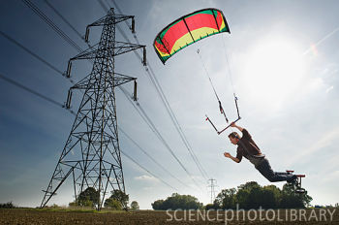
WATCH OUT!

Slide 8
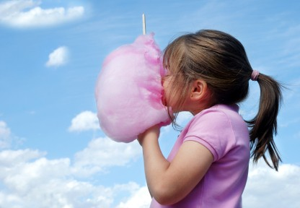
OH MY!

Slide 9
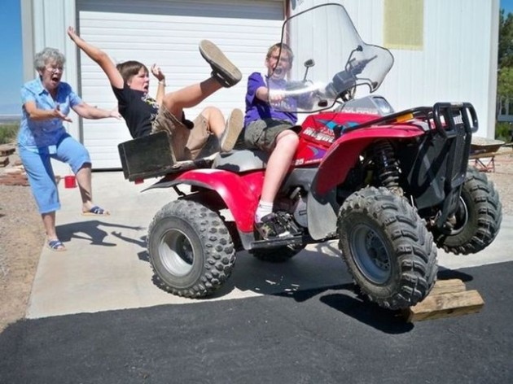
YIKES!

Slide 10
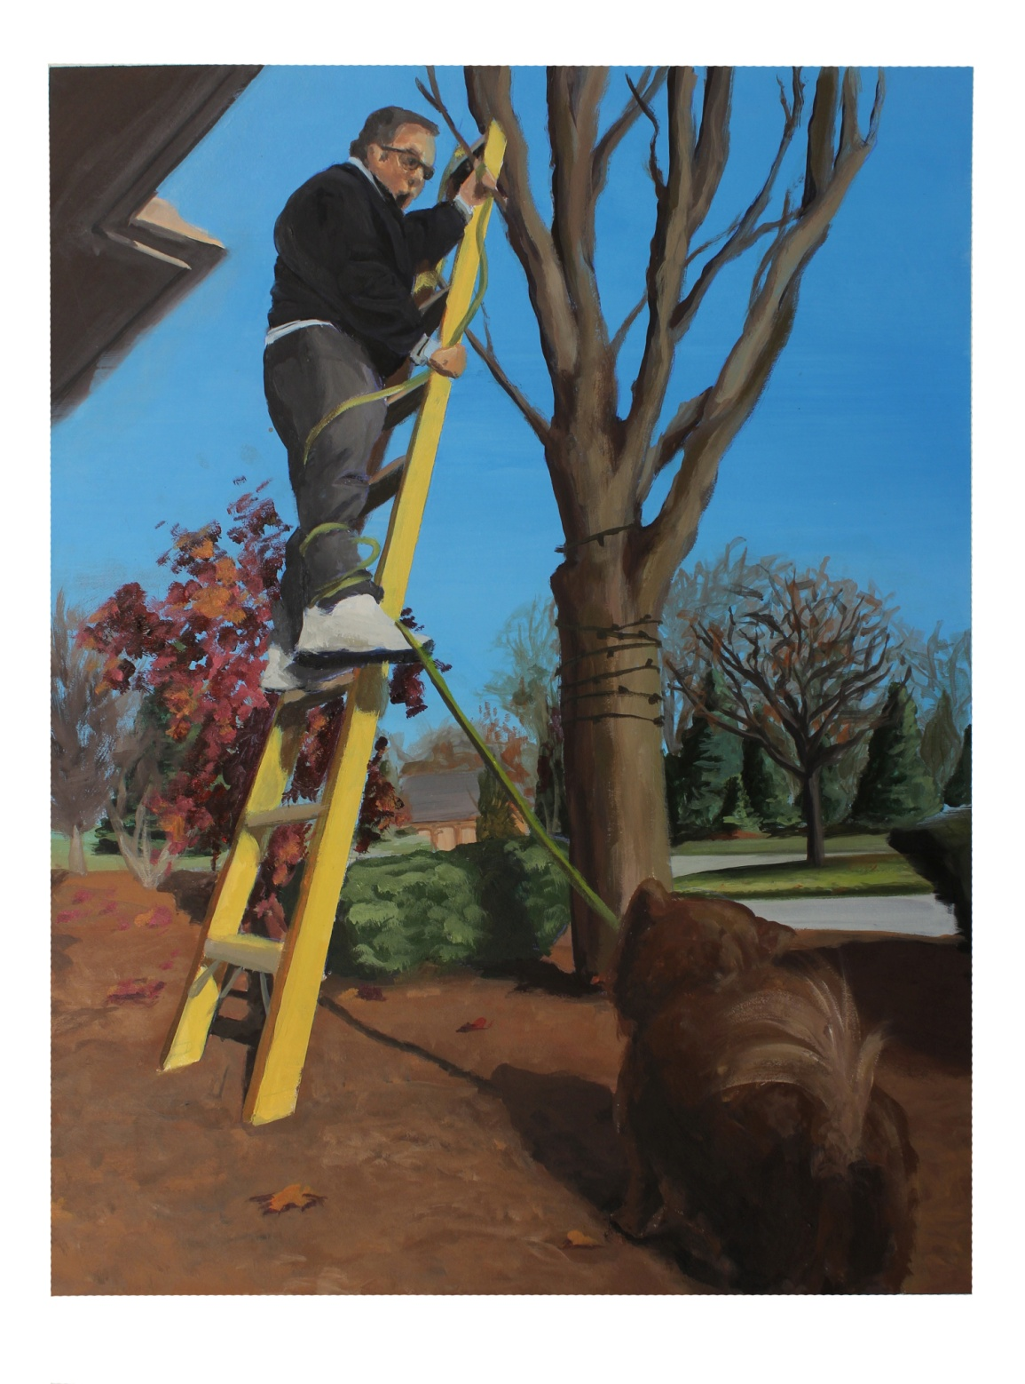
LOOK OUT!

Slide 11
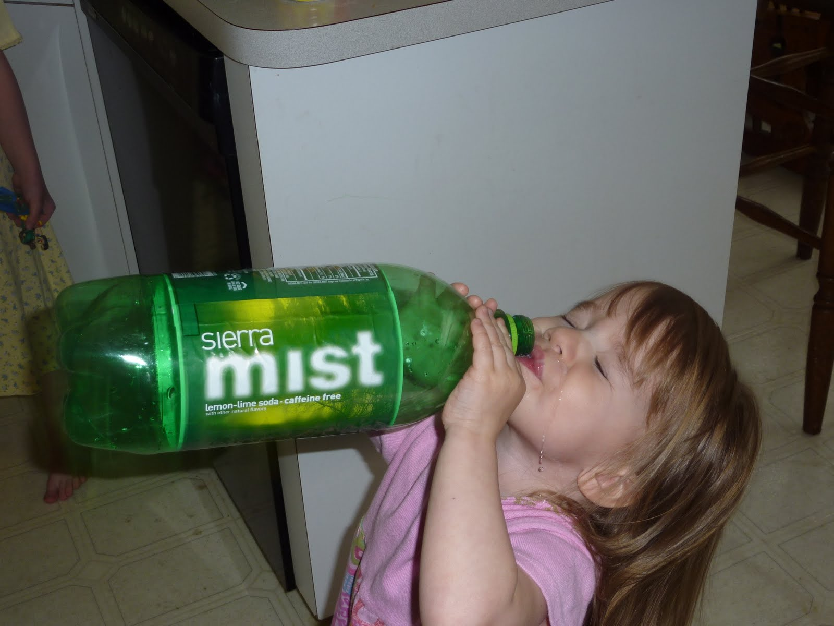
Glug, glug!

Slide 12
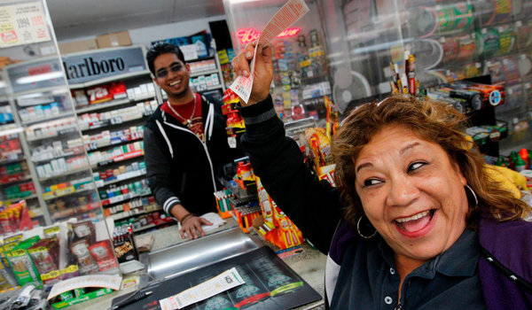
WOW!

Slide 13
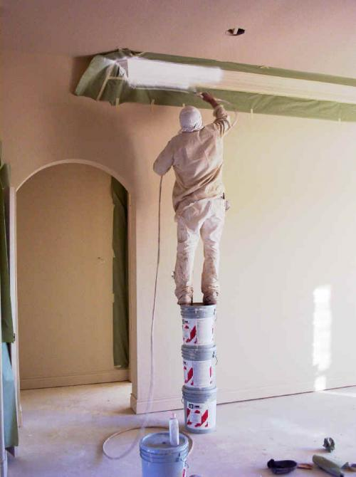
A disaster waiting to happen!

Slide 14
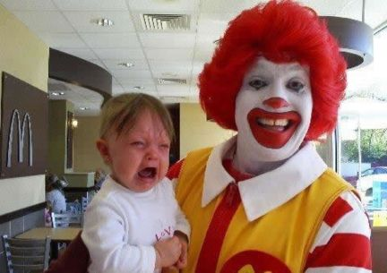
O boy!
What next?

Slide 15
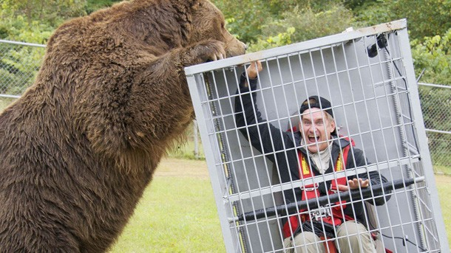
What do I do now?!

Slide 16
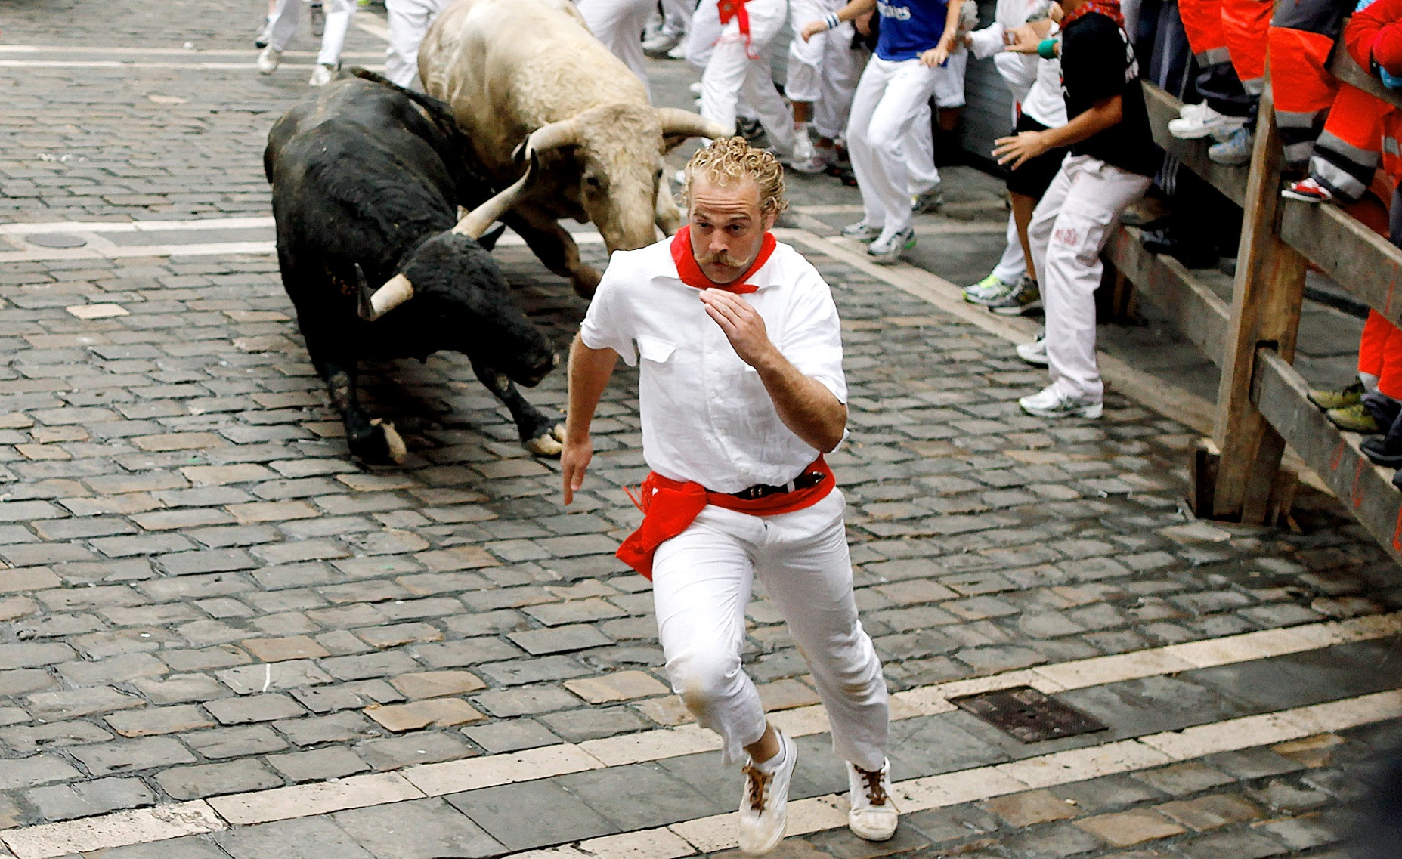
WATCH OUT!

Slide 17
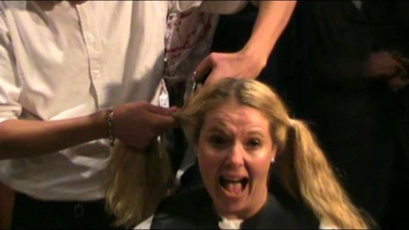
OH NO!

Slide 18
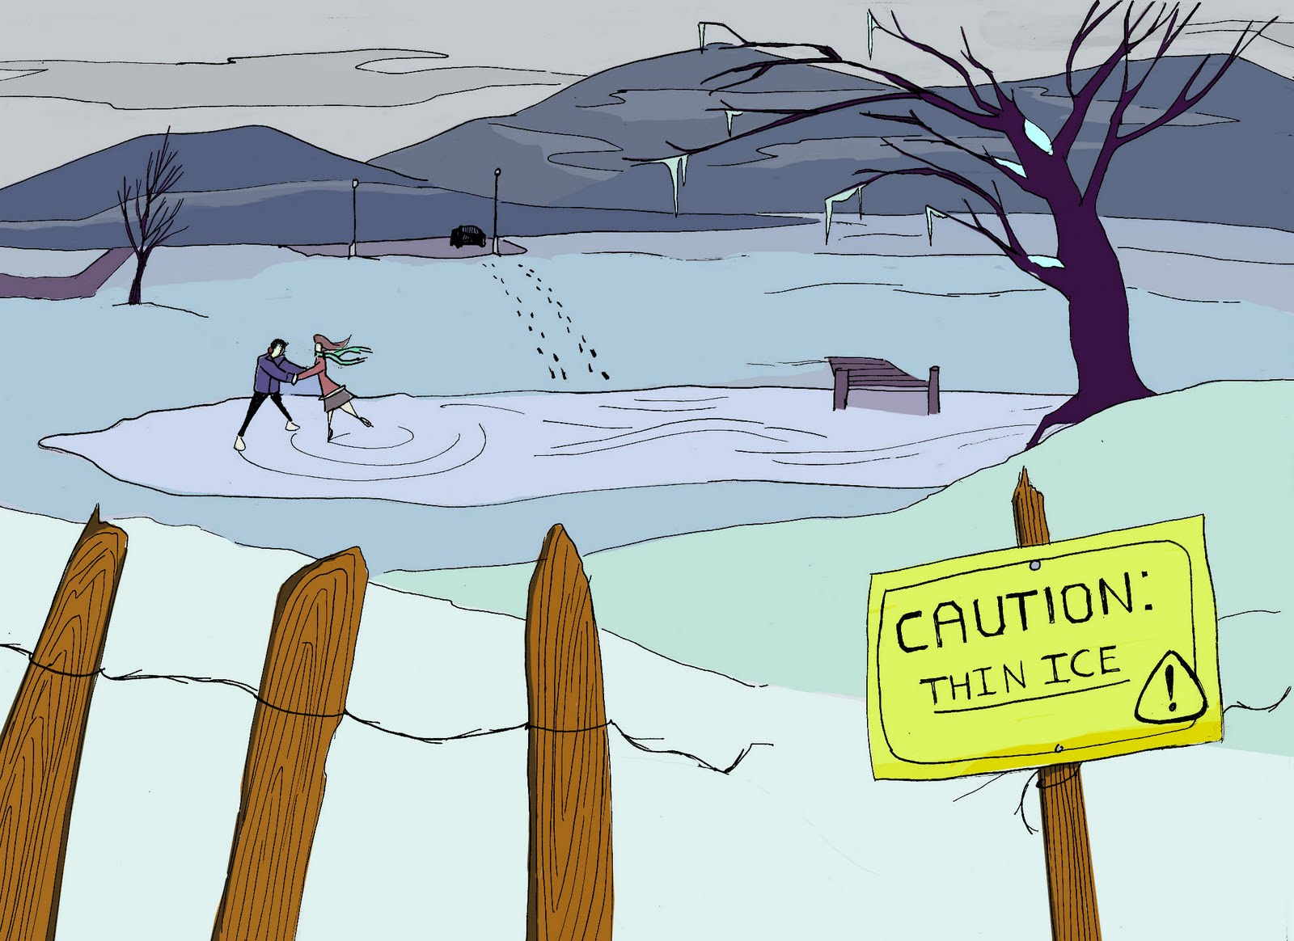

Slide 19
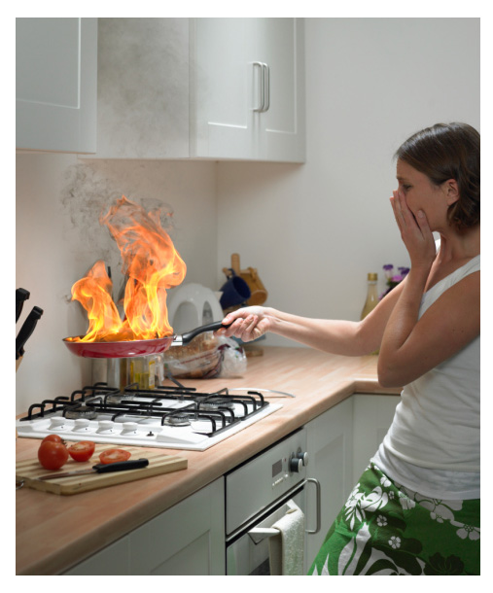
What do I do?

Slide 20
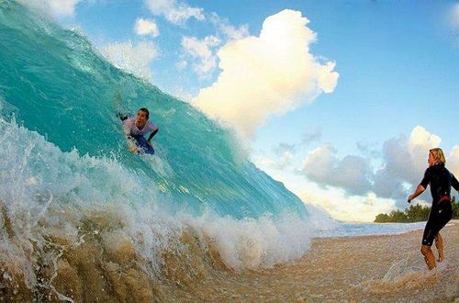
HELP!

Slide 21
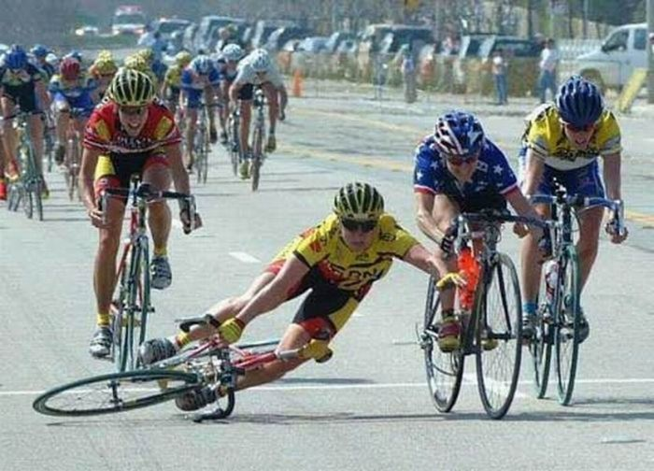
O my goodness!

Slide 22
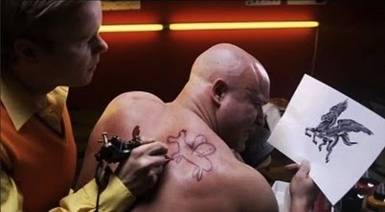
Uh oh!

Slide 23
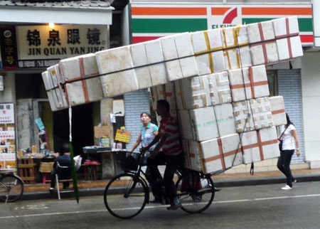
Impossible!

