Slide 1
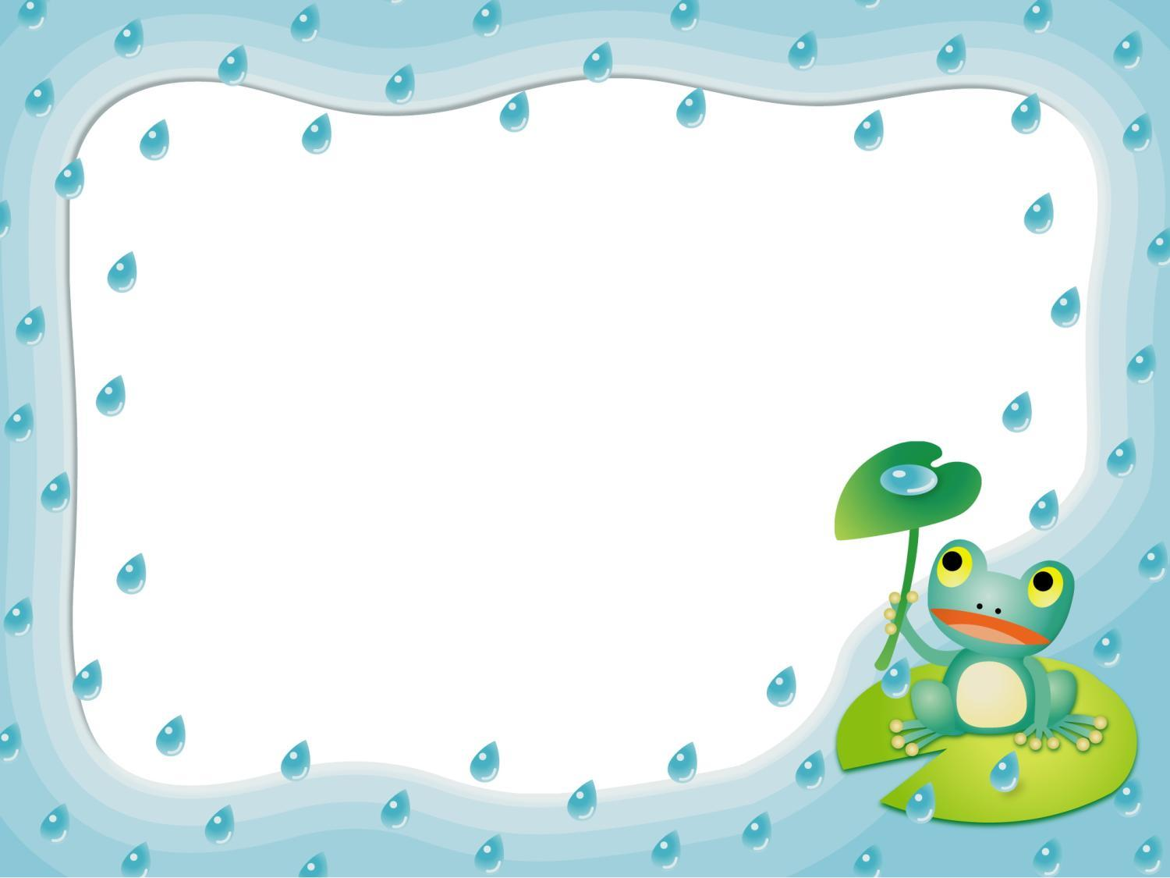
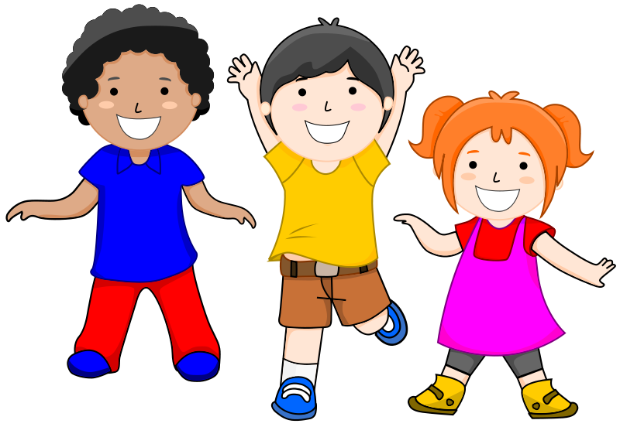
Hi! My name is Tom.
I’ve got 2 friends.
Look at the boy. His name is Rob. Can you see the girl? Her name is Jessica.
They are my good friends.
What is your name? Have you got
friends?

Slide 2

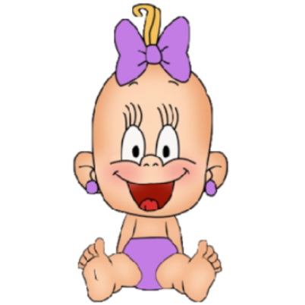


Look at this funny girl.
Her
eyes are big.
My

Slide 3
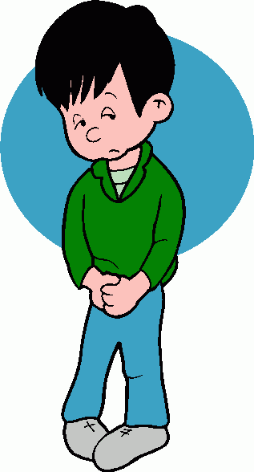
Look at this boy.
Your
face is very sad.
His

Slide 4
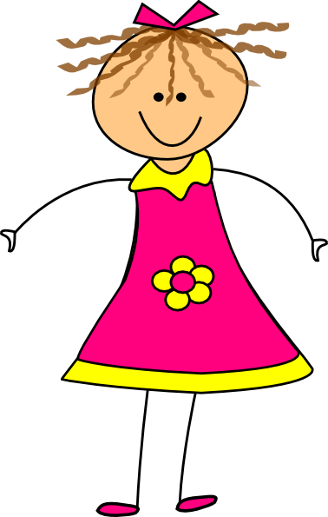
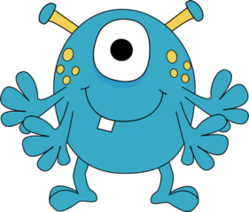
Hello! I am Kitty.
I’ve got a monster pet.
My
monster is blue.
Your

Slide 5
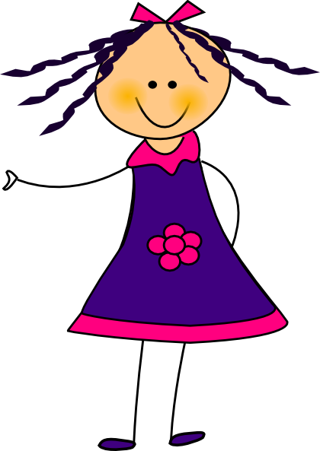
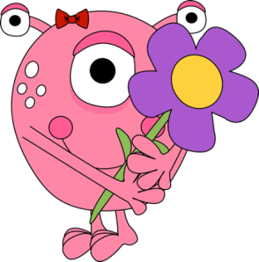
My friend Lizzy has got
a monster, too.
His
monster is pink.
Her

Slide 6
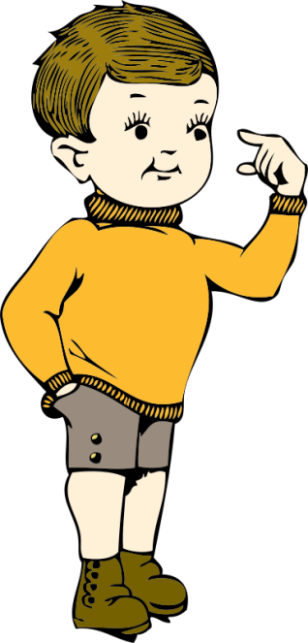
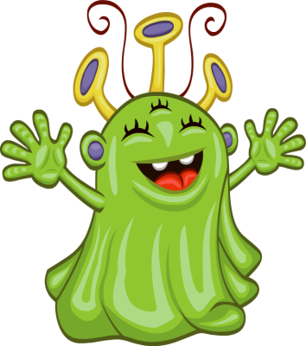
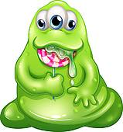
My friend Will has got
two monsters.
His
monsters are green.
Her

Slide 7
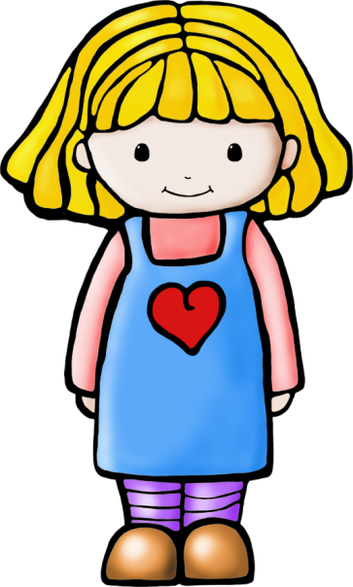
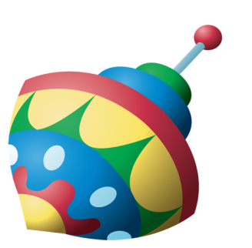
I’ve got a top.
My
top is very big.
His

Slide 8
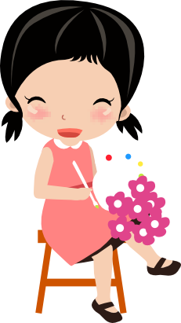
My friend Vicky has got
flowers.
Your
flowers are pink.
Her

Slide 9
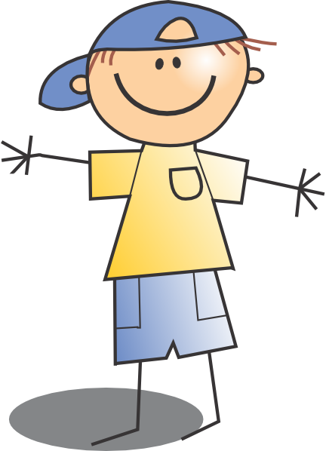
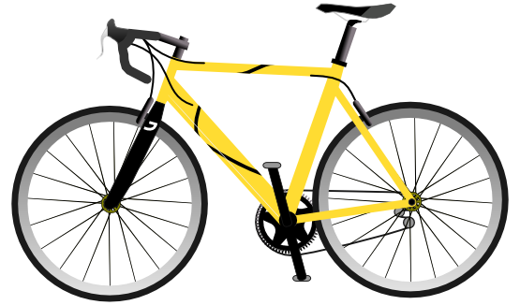
My brother has got a bike.
Her
bike is yellow.
His

Slide 10
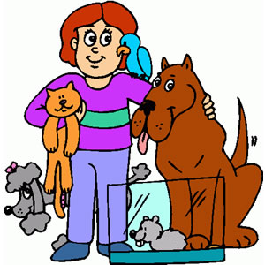
Have you got a pet?
What colour is
my
pet?
your

