Slide 1

This That These Those
By Kev

Slide 2

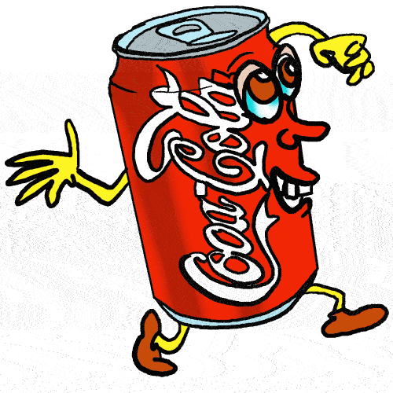

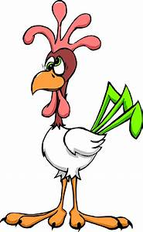
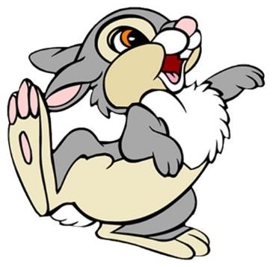

This / That refers to a single thing

Slide 3

This apple
This is something close
we can touch

Slide 4

This book

Slide 5
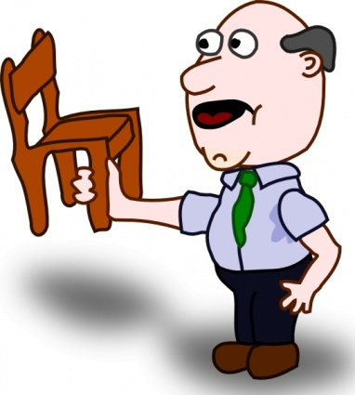
This chair

Slide 6

That is something far
we can’t touch

Slide 7
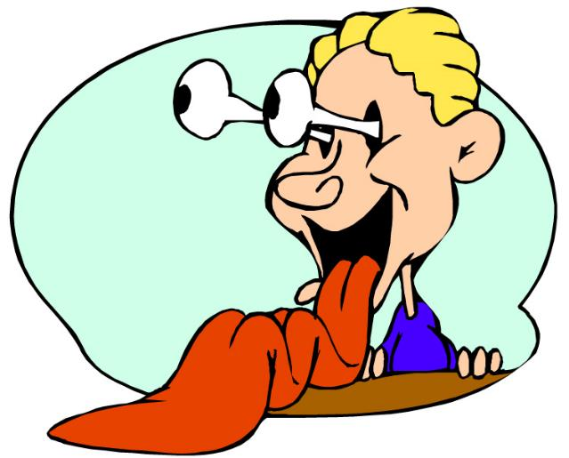

That cake

Slide 8
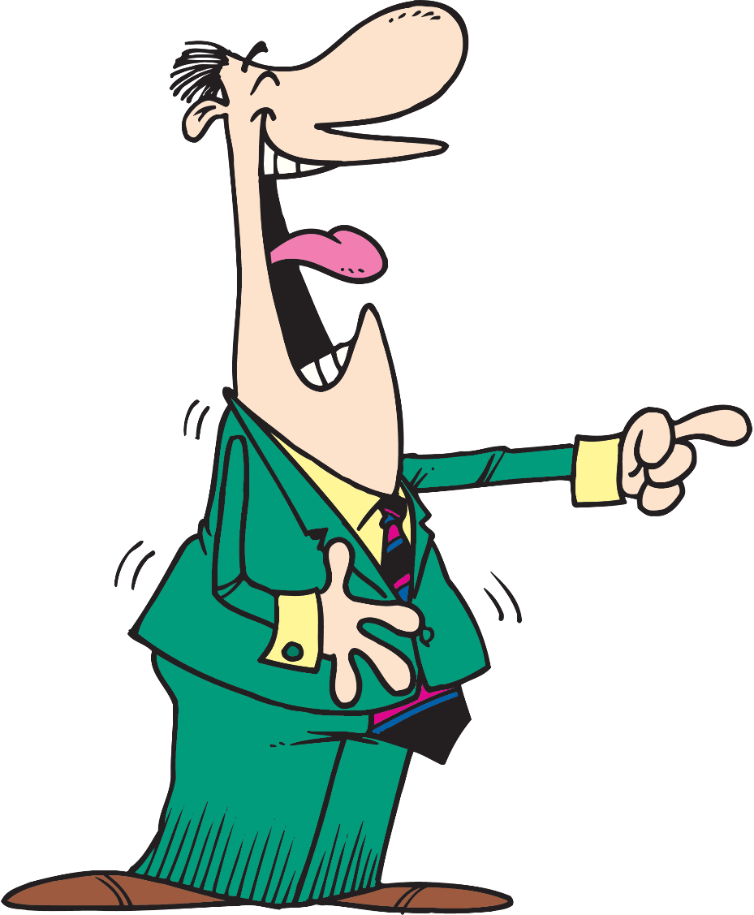
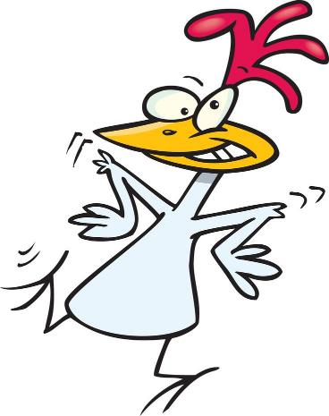
That chicken

Slide 9
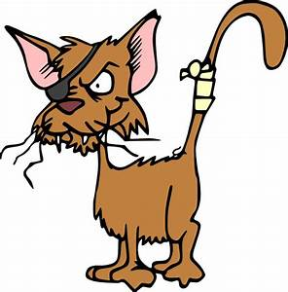
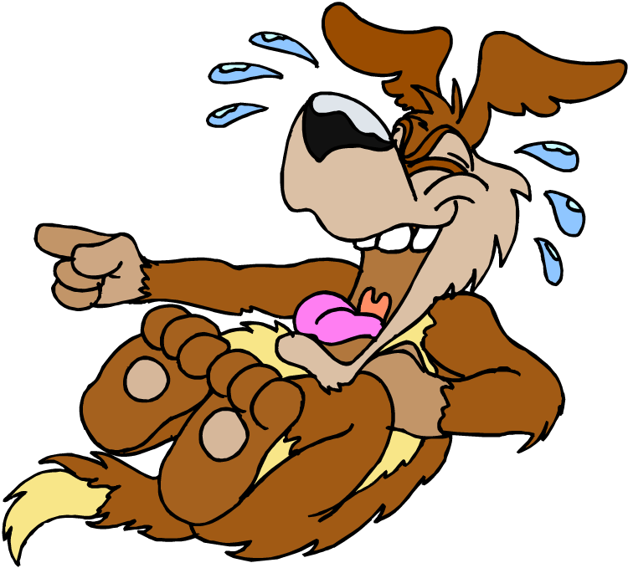
That cat

Slide 10
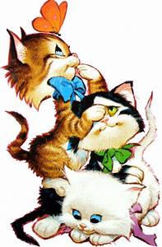
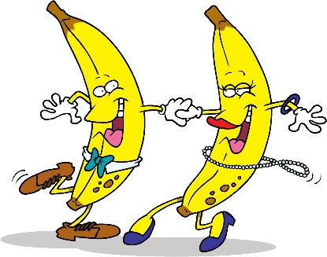
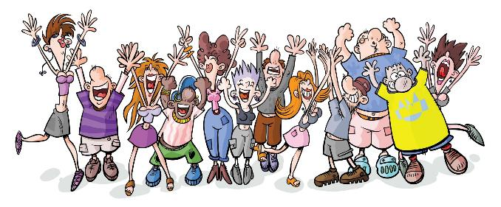
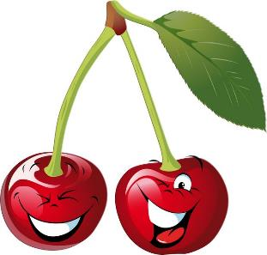
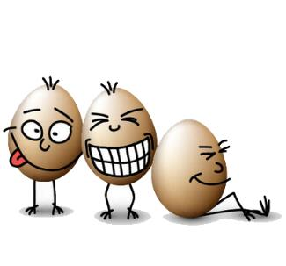
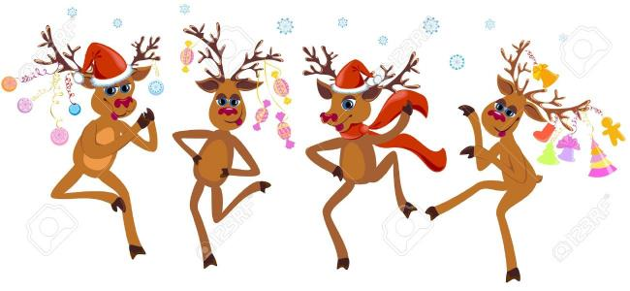
These / Those refers to
more than one thing

Slide 11
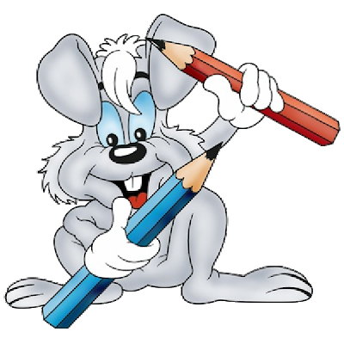
These pencils

Slide 12

These balloons

Slide 13
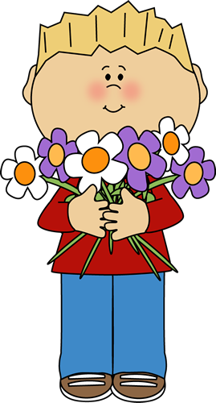
These flowers

Slide 14
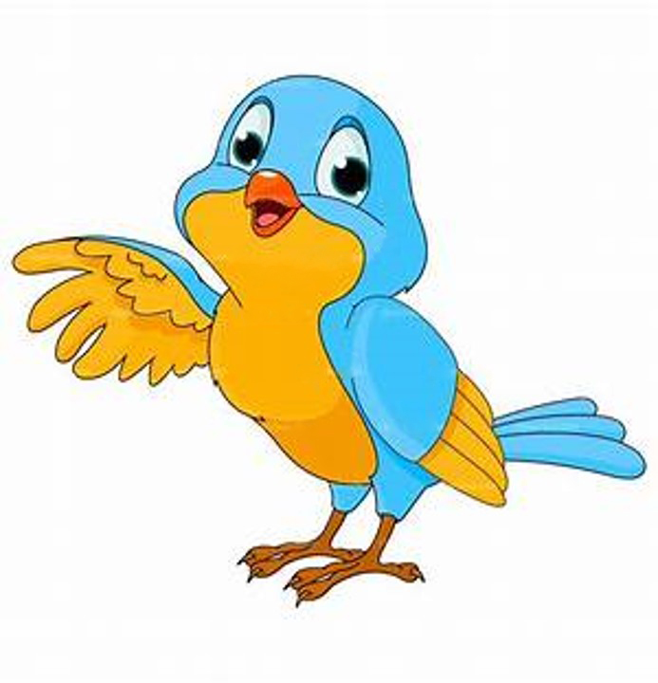
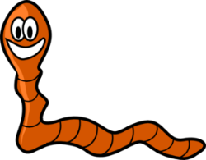
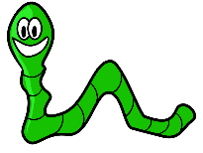


Those worms

Slide 15

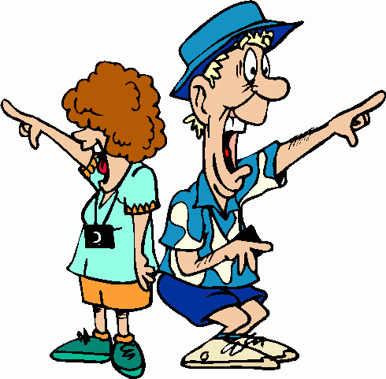
Those birds

Slide 16
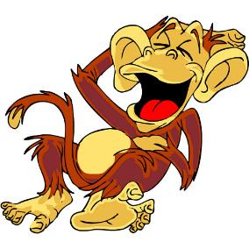
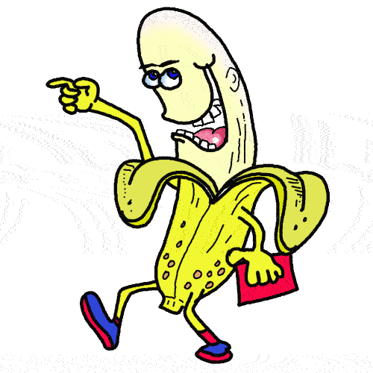
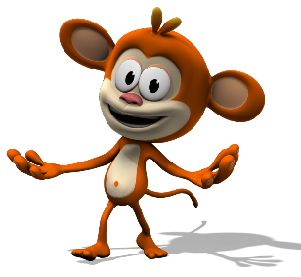

Those monkeys

Slide 17
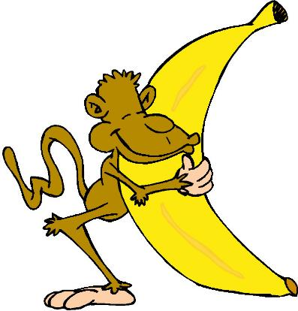


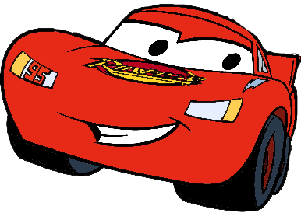
_______ banana.
This
Those
_______ cars.

Slide 18

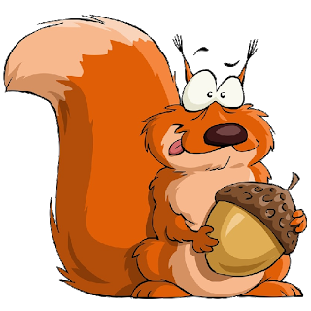
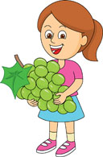
_______ squirel.
That
_______ grapes.
These

Slide 19
Complete with THIS OR THESE
a)________ chair
b)________ chairs
c)________ place
d)________ things
e)________ monkey
f)________ boy
g)________ window
h)________ toy
i)________ hands
j)________ girls

Slide 20
Complete with: THAT or THOSE:
a)________ picture
b)________ books
c)________ key
d)________ cake
e)________ computers
f)________ armchairs
g)________ wolf
h)________ teachers
i)________ plan
j)________ donkey

