Slide 1
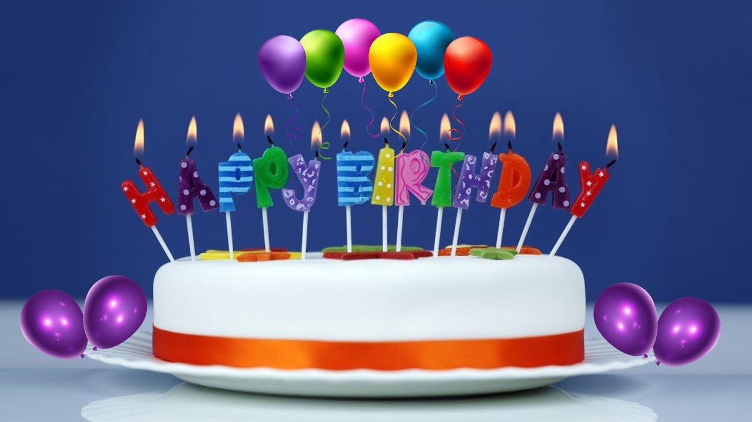




IrinaPapakhina

Slide 2

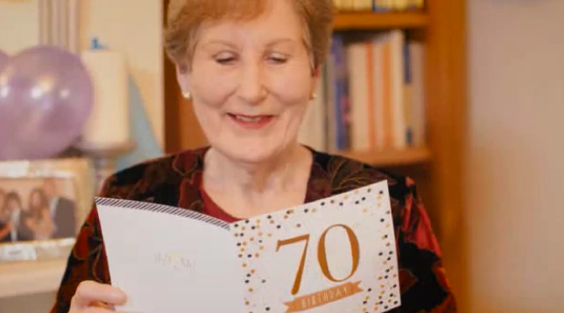
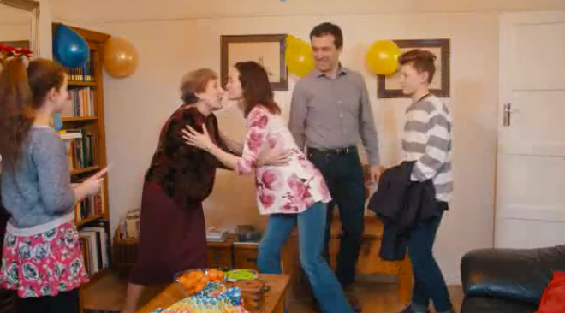
Look at the photo.
How old is granny today?
Whose granny is she?
IrinaPapakhina
Notes:
2. She’s Alex and Jen’s granny

Slide 3
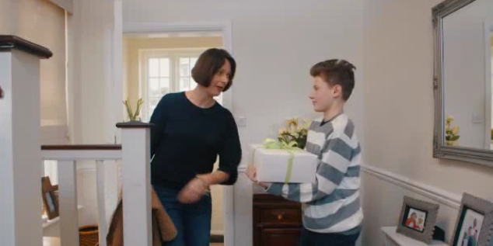

Look at the picture.
Who’s the woman in the picture?
What’s in the box?
Watch the video and check.
IrinaPapakhina

Slide 4
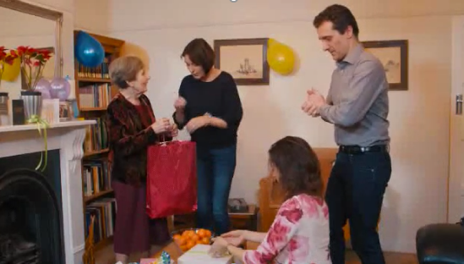
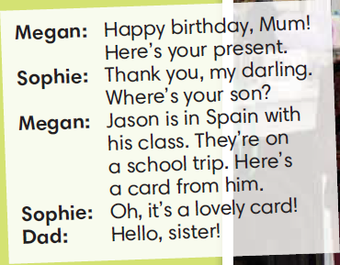

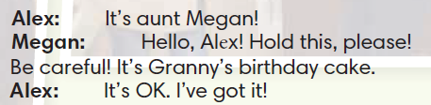
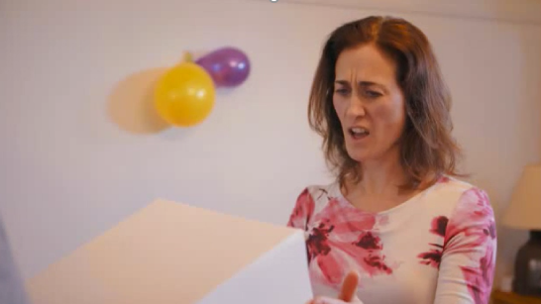
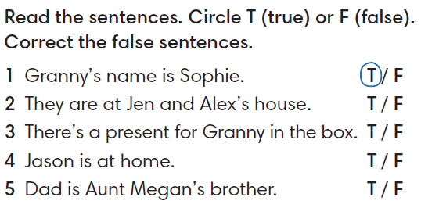

IrinaPapakhina

Slide 5


Find these expressions in the story.
IrinaPapakhina

Slide 6
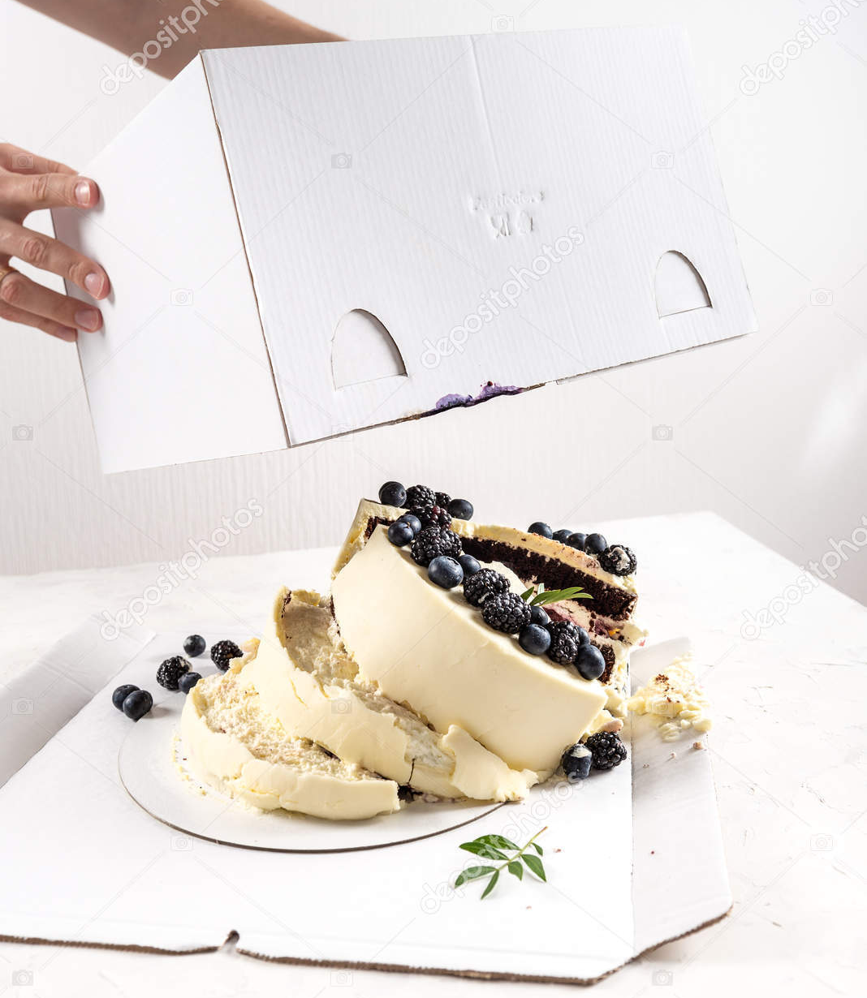
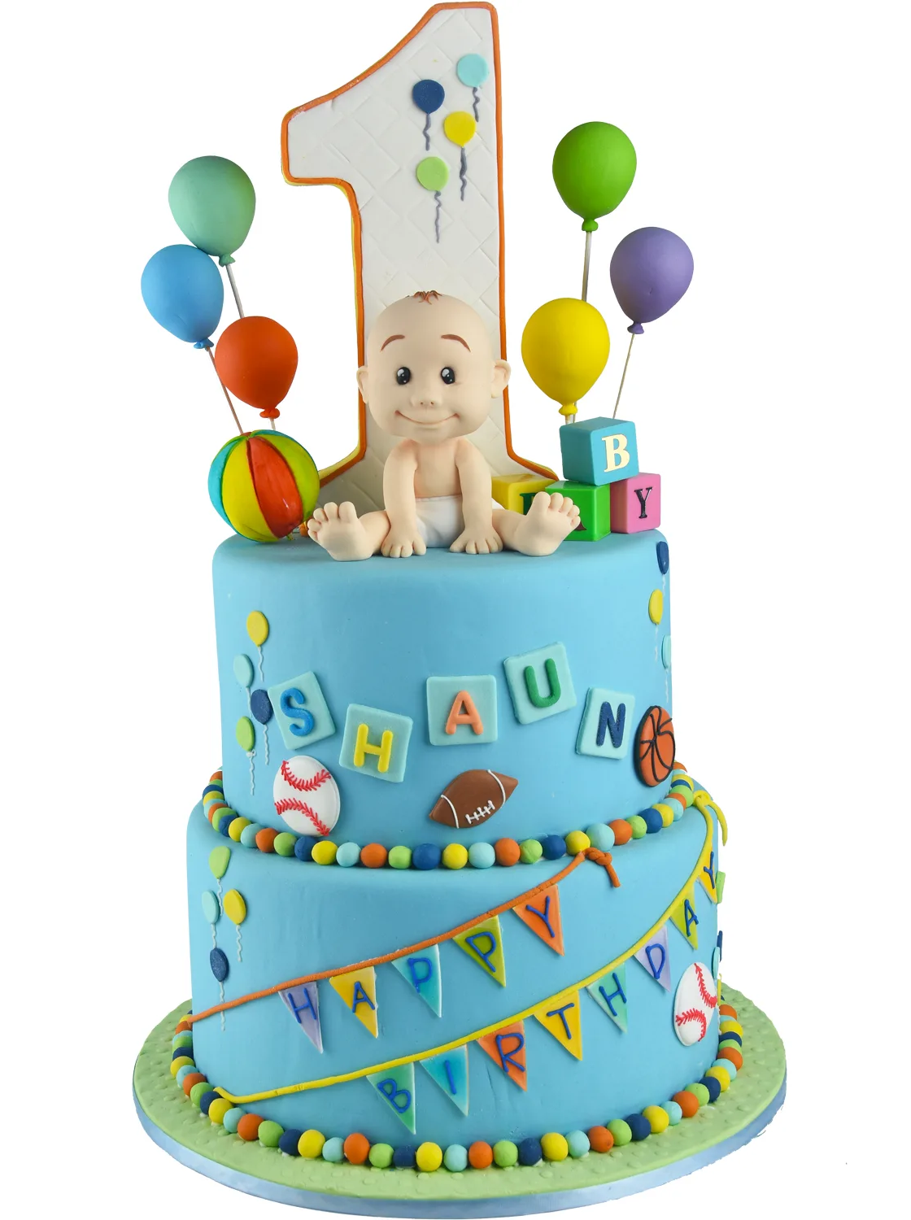
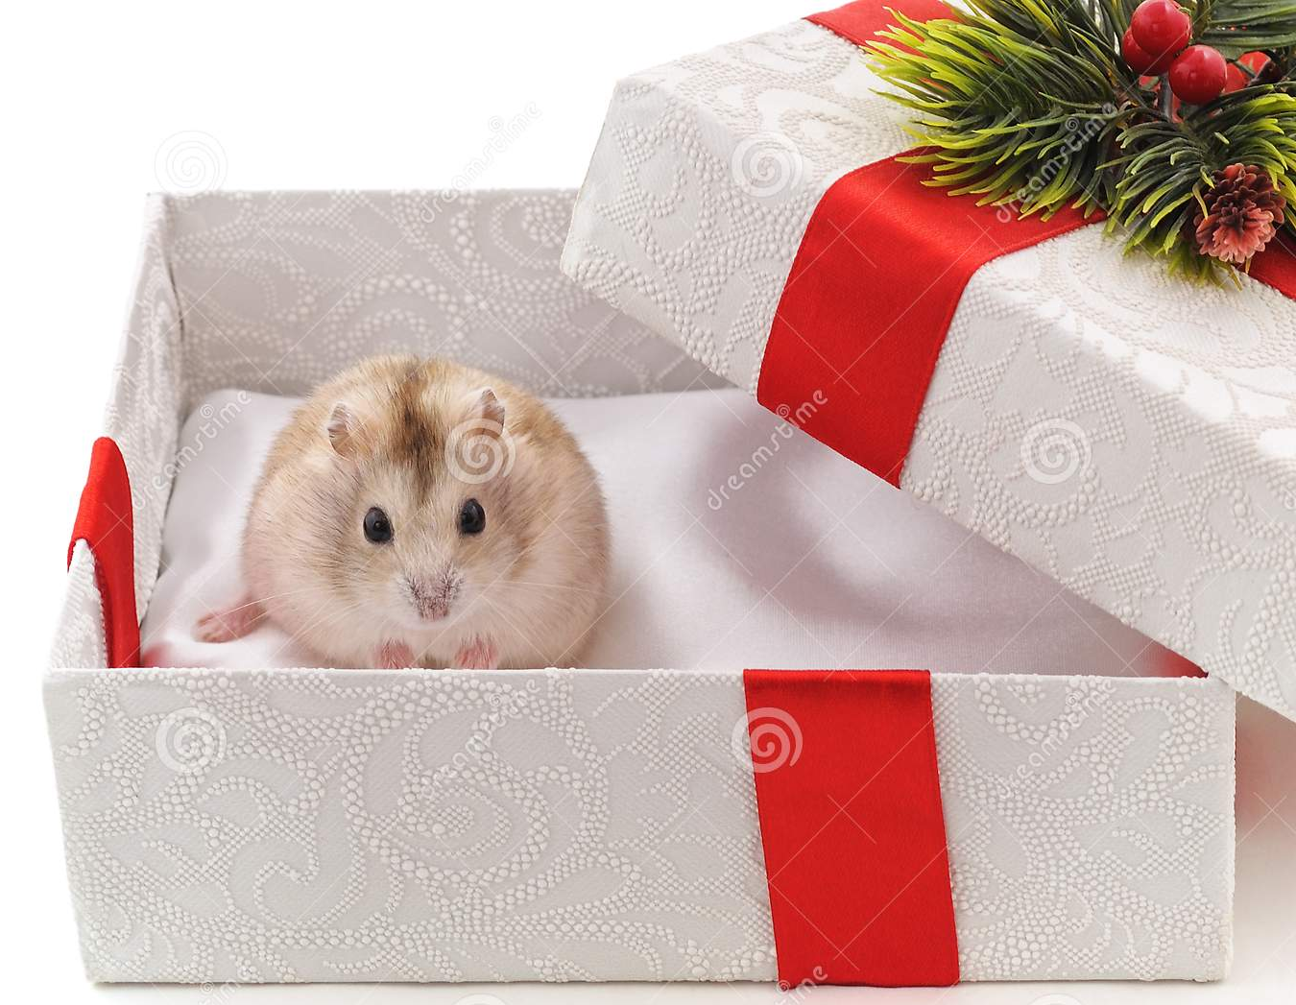

Why does mum say: “Oh,no!”?
The cake is a mess.
2. It’s not granny’s cake.
There’s a mouse in the box.
Watch the video and check.
IrinaPapakhina

Slide 7
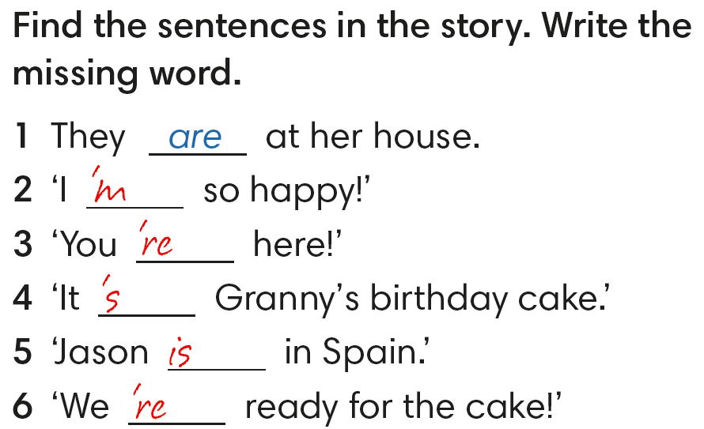
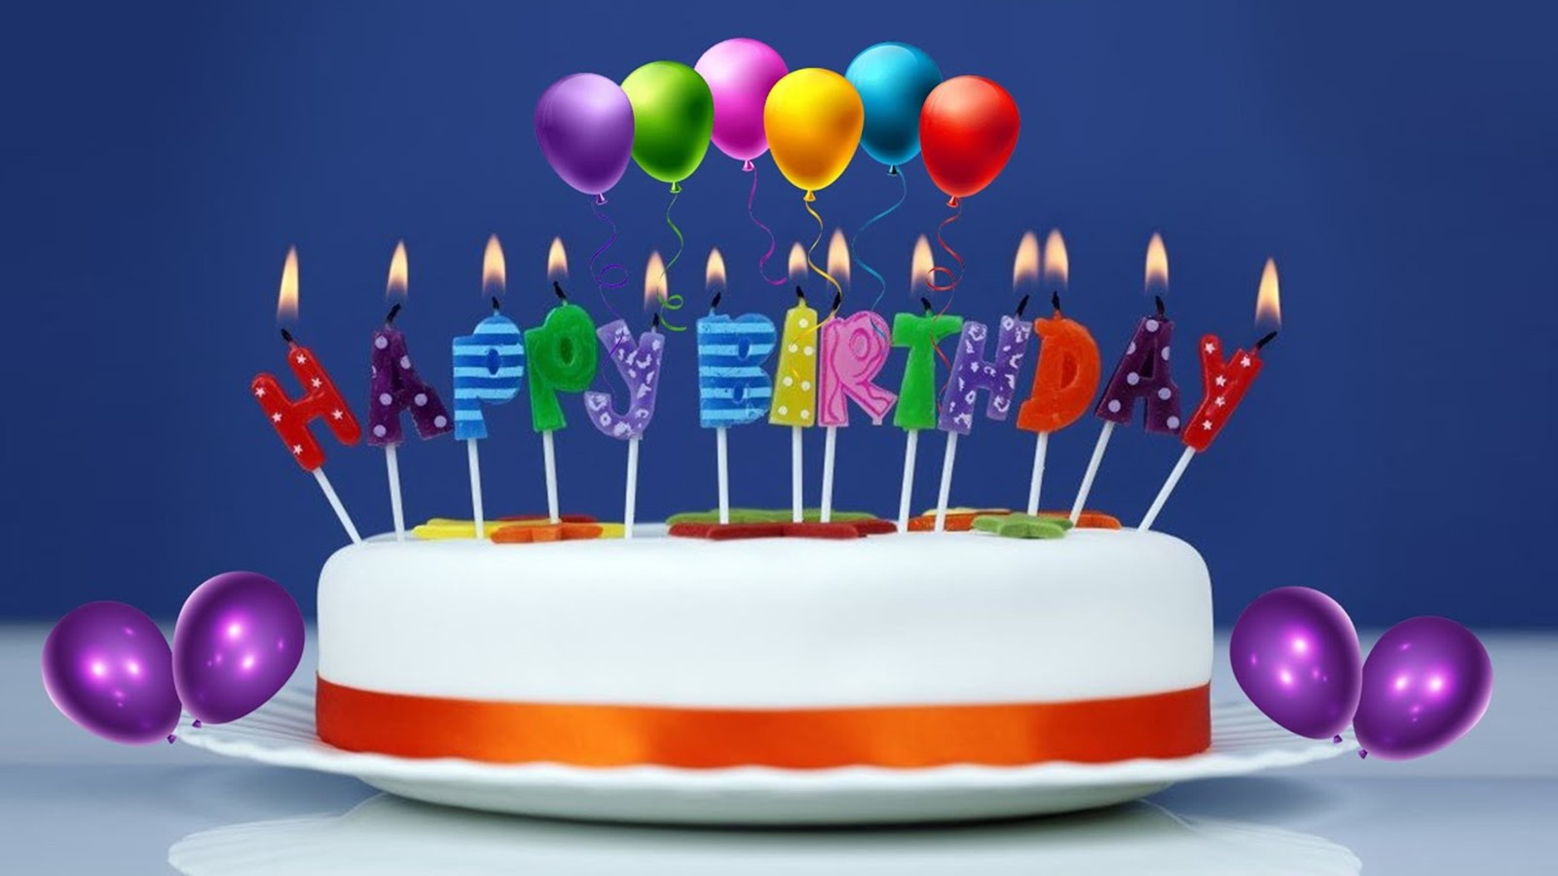
IrinaPapakhina

Slide 8
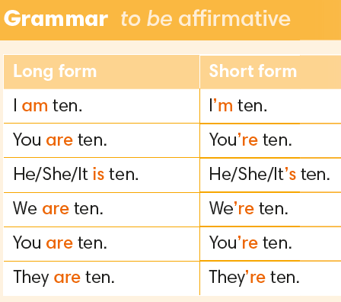
IrinaPapakhina

Slide 9
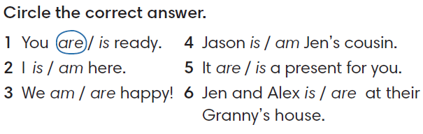
IrinaPapakhina

Slide 10
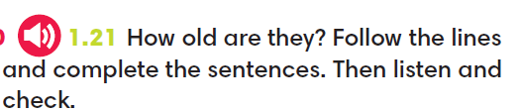
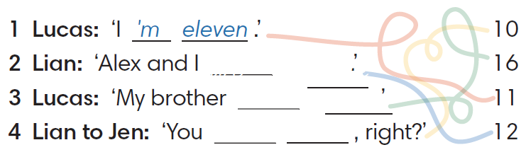
are
twelve
is
sixteen
are
ten
IrinaPapakhina

Slide 11
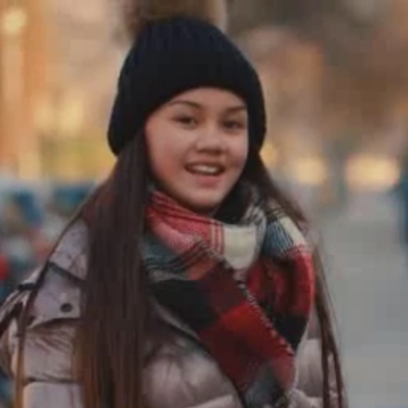
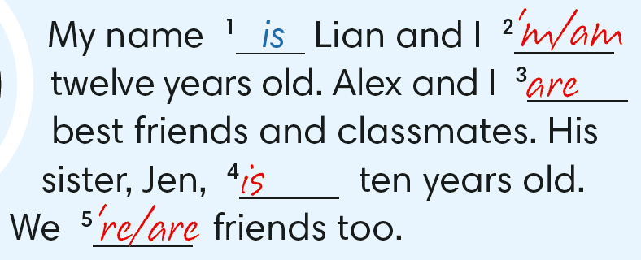
IrinaPapakhina

Slide 12
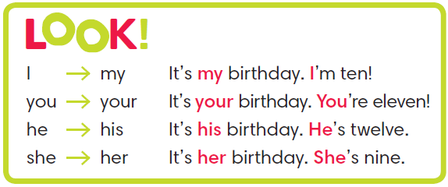
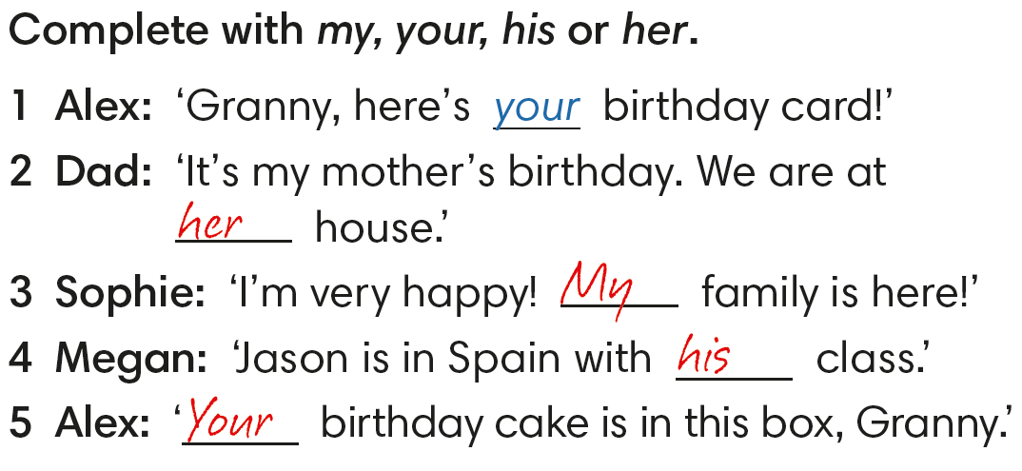
IrinaPapakhina

Slide 13
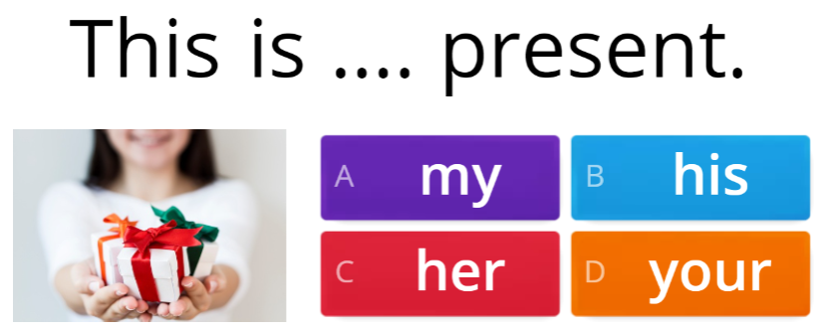
IrinaPapakhina

Slide 14
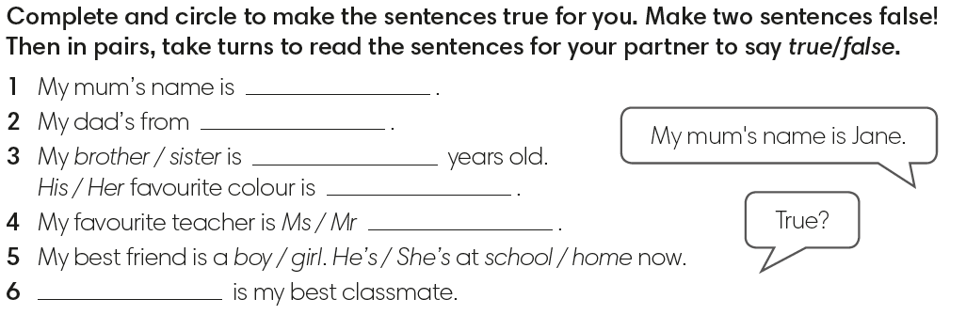
IrinaPapakhina

Slide 15
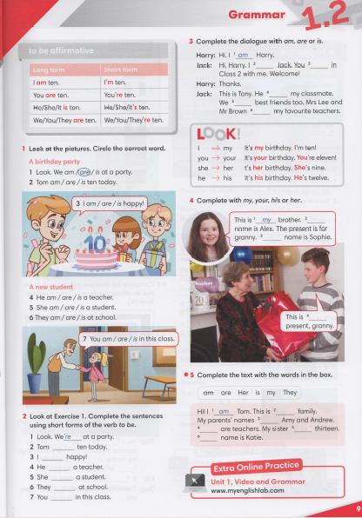


IrinaPapakhina

Slide 16
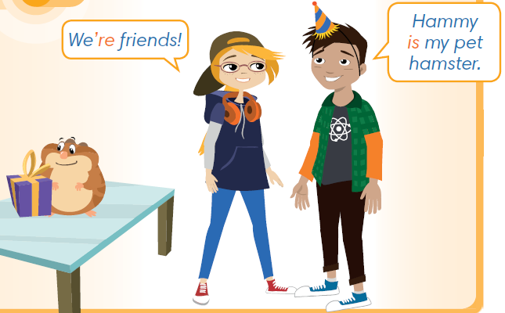

Look at the picture.
What’s the hamster’s name?
Is he the boy’s or the girl’s pet?
Watch the video.
What are their names.
How old is the boy?
IrinaPapakhina

Slide 17
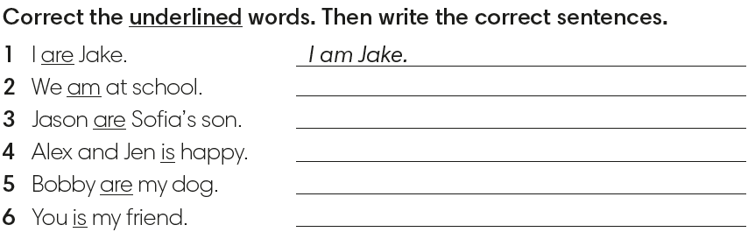
We are at school.
Jason is Sofia’s son.
Alex and Jen are happy.
Bobby is my dog.
You are my friend.
IrinaPapakhina

Slide 18
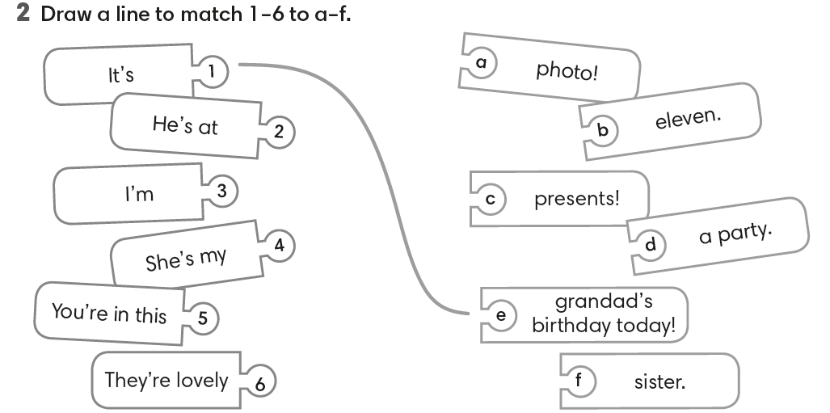
IrinaPapakhina

Slide 19
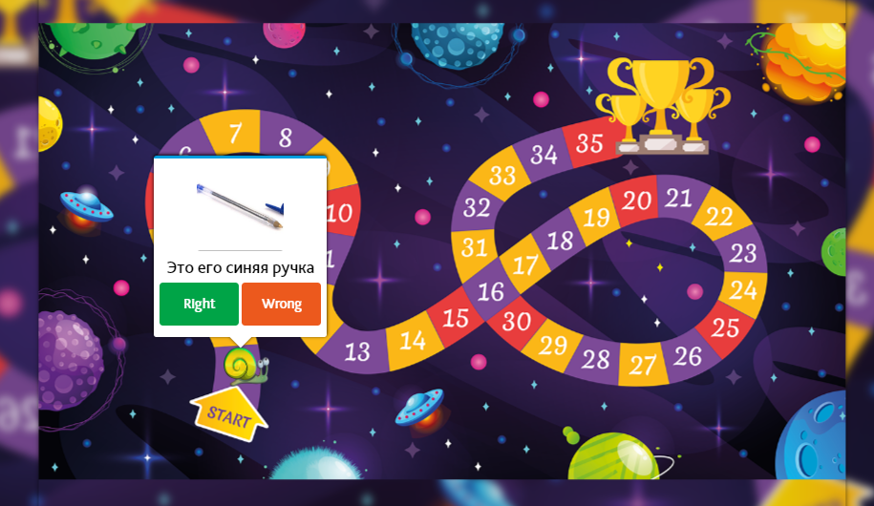
IrinaPapakhina

