Slide 1
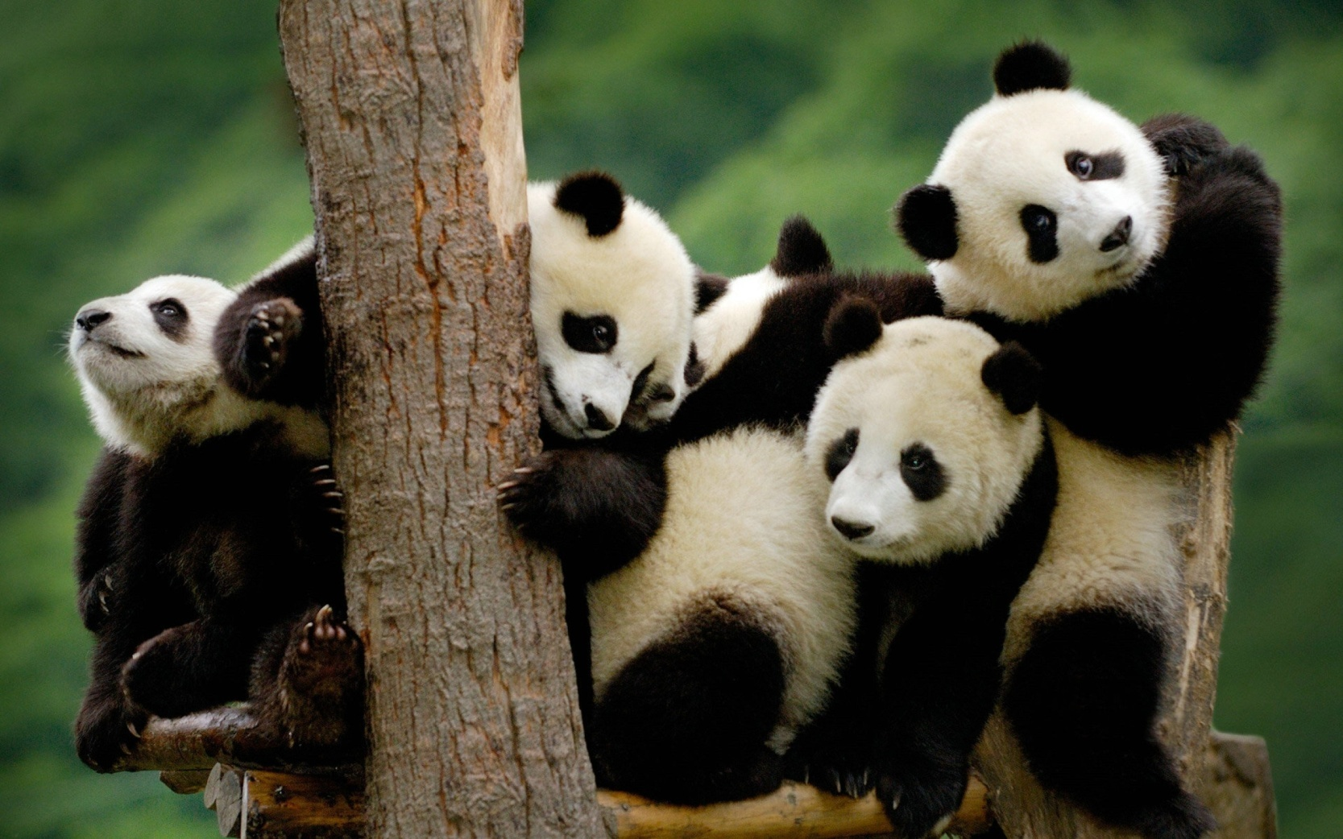
pandas?

Slide 2

bears?

Slide 3
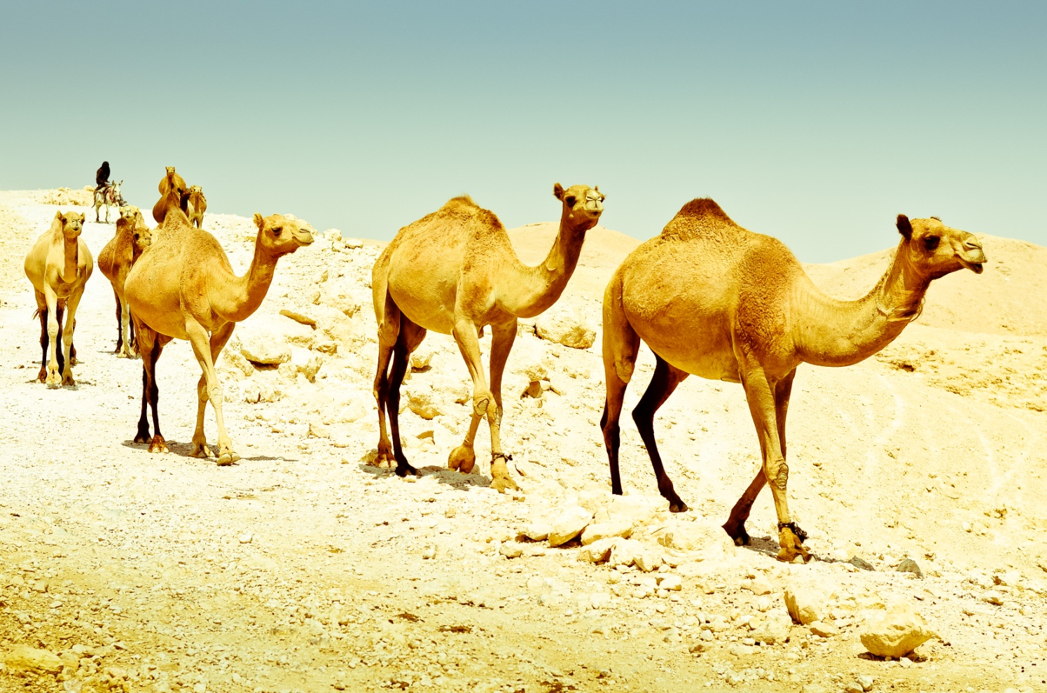
camels?

Slide 4

crocodiles?

Slide 5
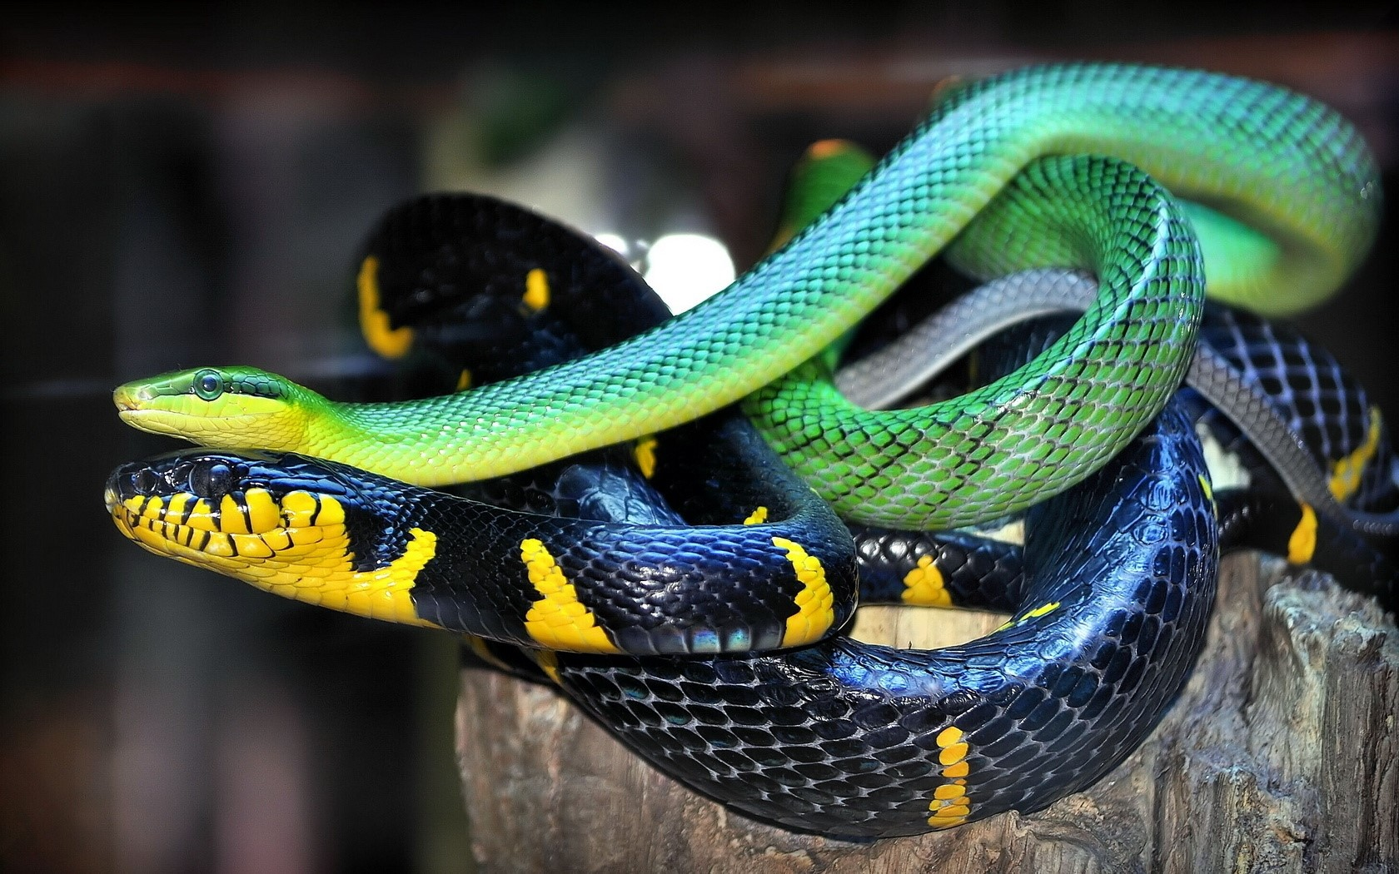
snakes?

Slide 6
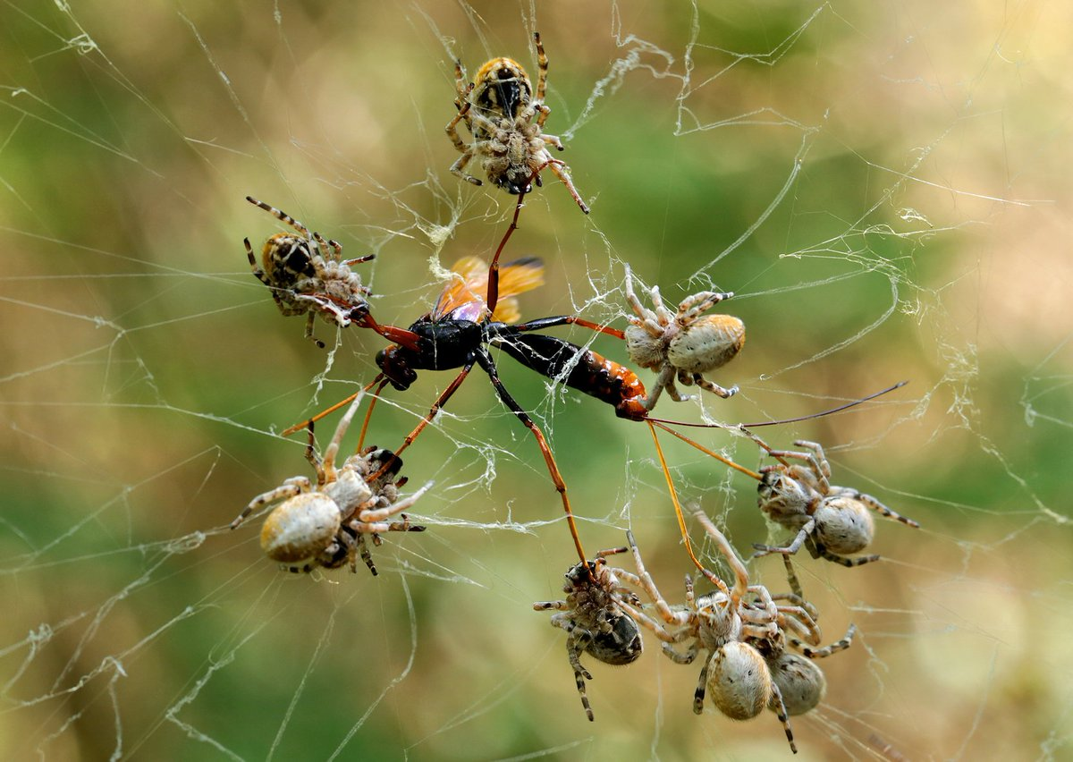
spiders?

Slide 7

kangaroos?

Slide 8
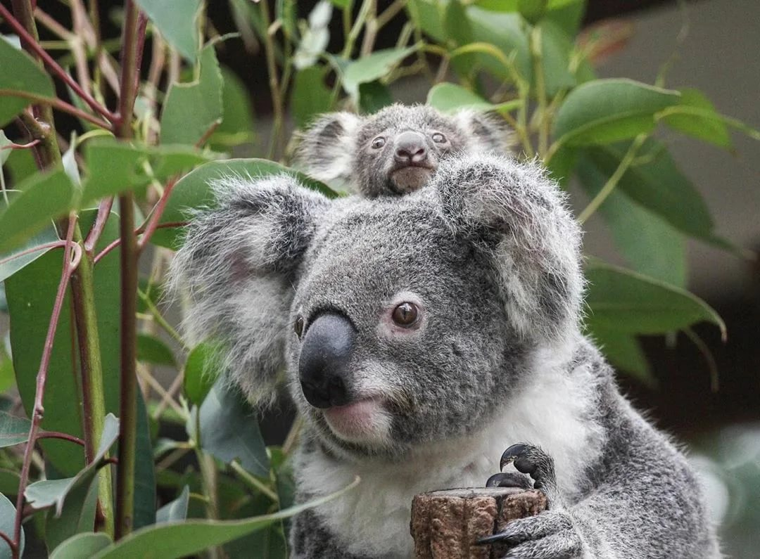
koalas?

Slide 9
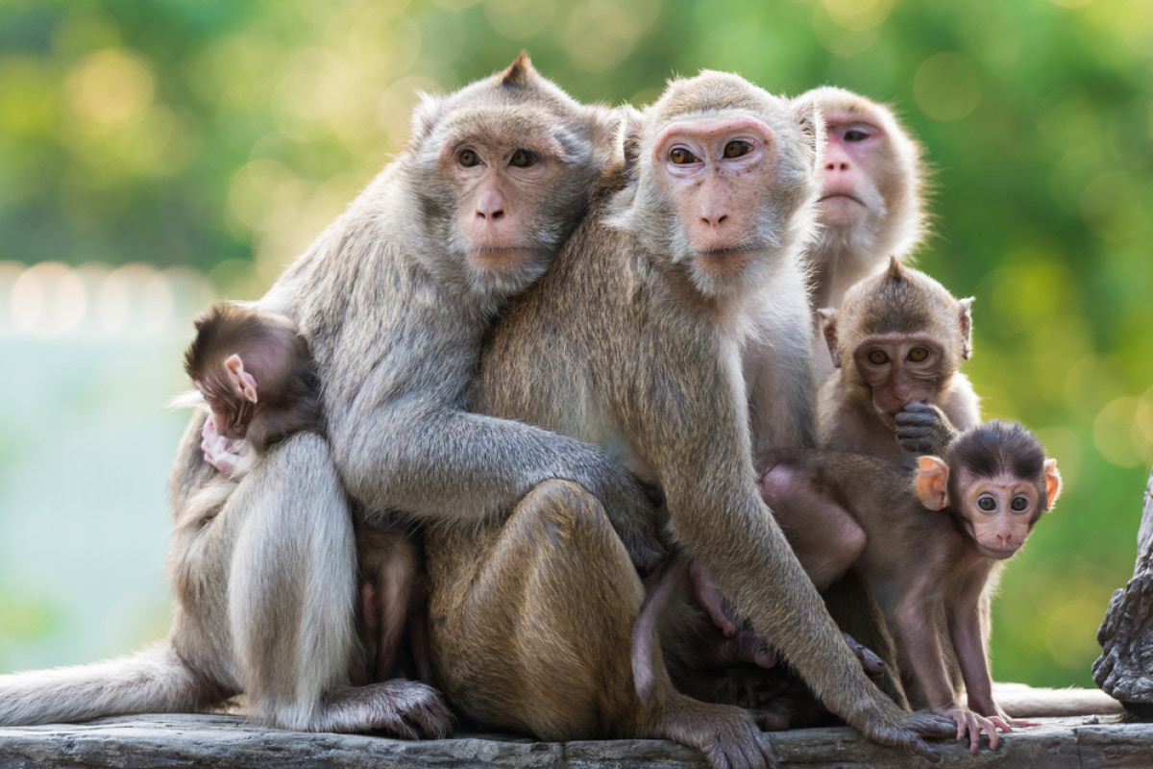
monkeys?

Slide 10

dogs?

Slide 11

cats?

Slide 12

elephants?

Slide 13

zebras?

Slide 14
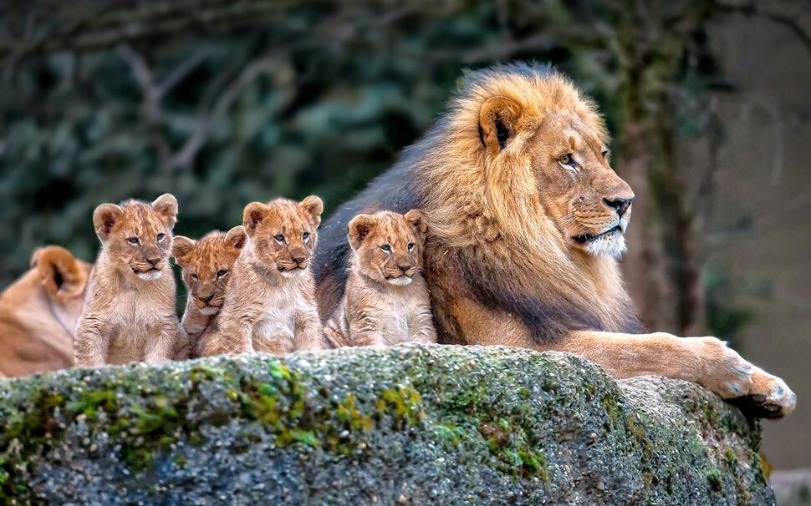
lions?

Slide 15
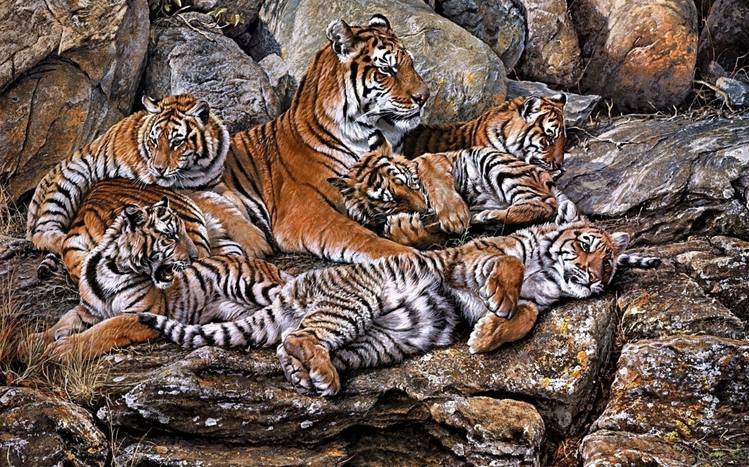
tigers?

Slide 16
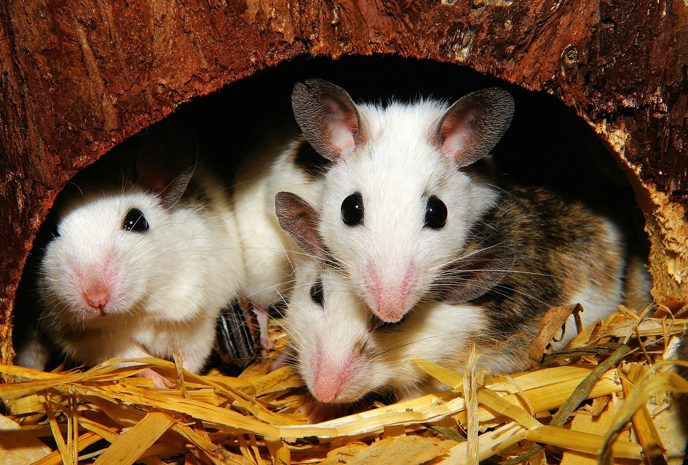
mice?

Slide 17

wolves?

Slide 18
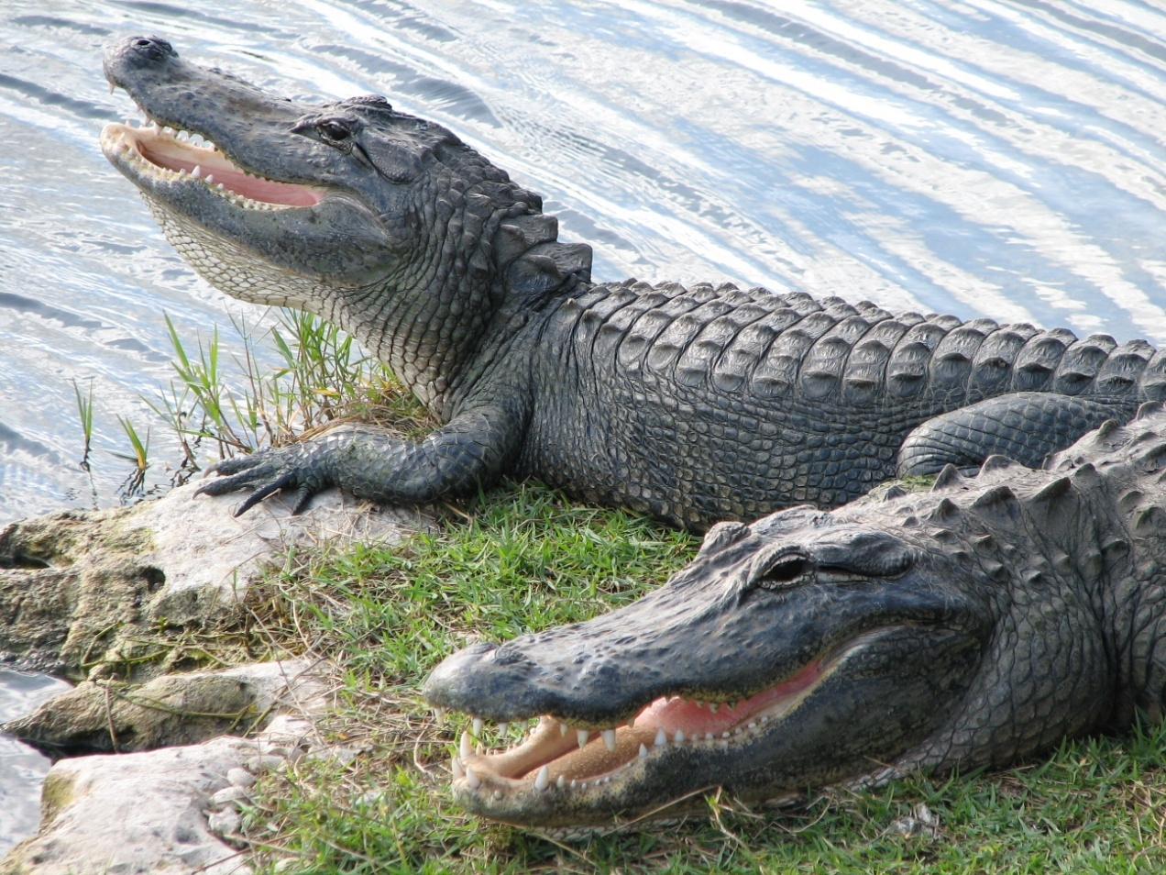
alligators?

Slide 19
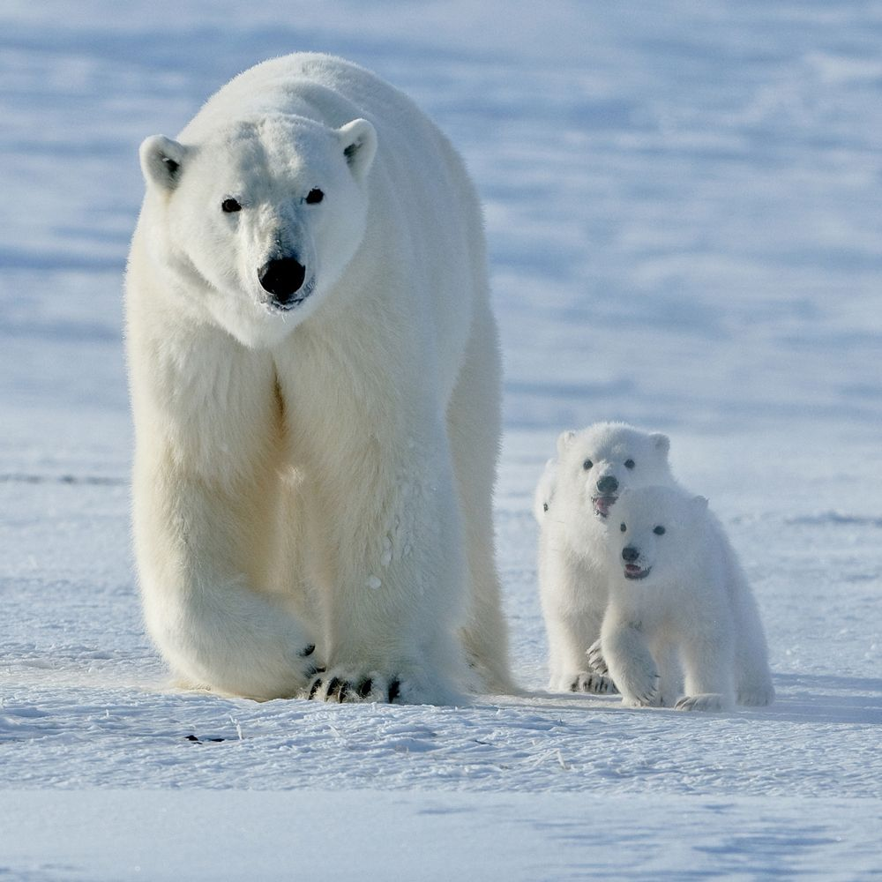
polar bears?

Slide 20
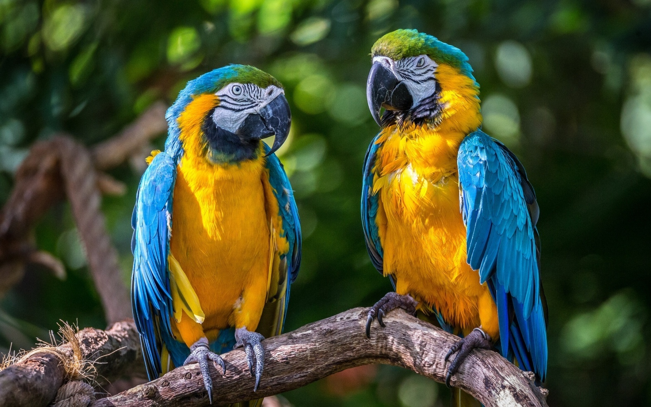
parrots?

