Slide 1


you/ Would / like / beans / some?

Slide 2
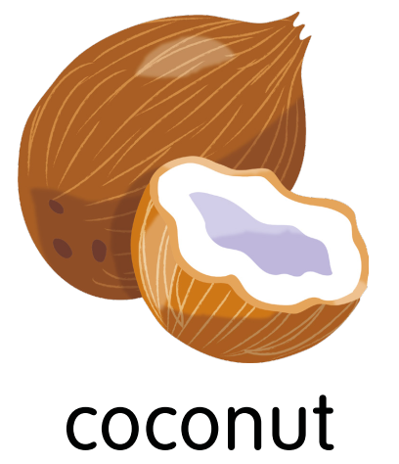

like / Would / a / coconut / you?

Slide 3

some / you / like / Would / grapes/ ?

Slide 4
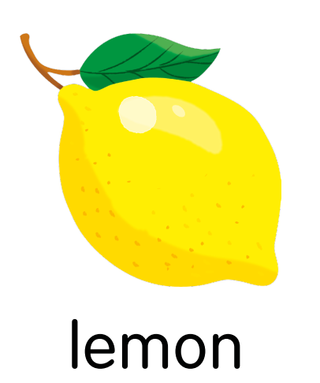
you/ like / lemon / a / Would/?

Slide 5
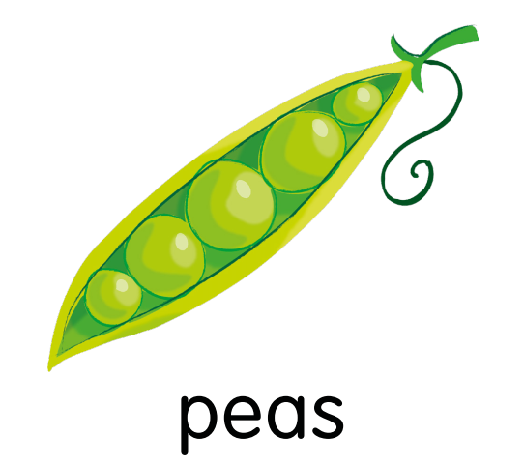
peas / some/ Would / you / like/?

Slide 6

a / Would / like / pepper/ you/?

Slide 7
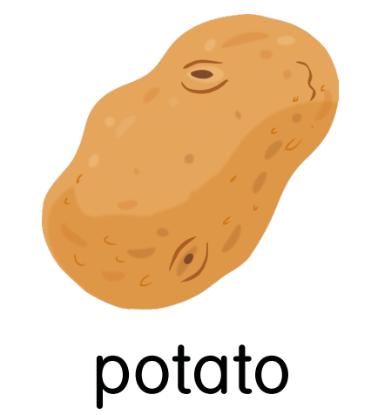
potato/ like / you / Would / a?

Slide 8

like / you/ a / watermelon/ Would/?

Slide 9

you/ strawberry / like / Would / a/?

Slide 10
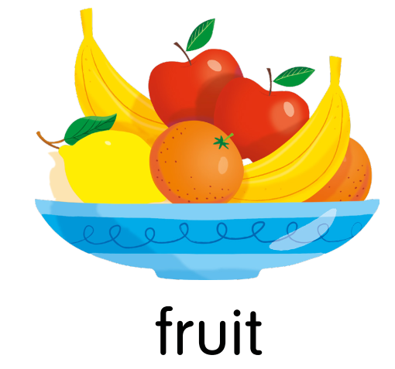
Would / fruit / some/ like / you/?

Slide 11
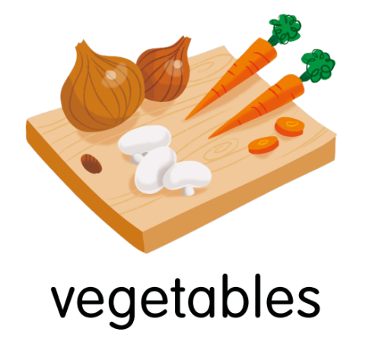
you/ vegetables/ some/ like/ Would/?

Slide 12

an / like/ Would / you / apple/?

Slide 13
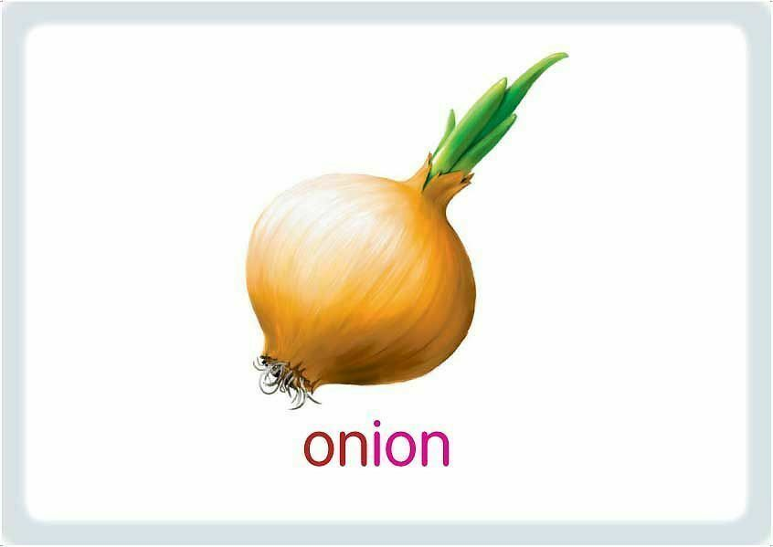
onion/ an/ like / Would / you/?

Slide 14
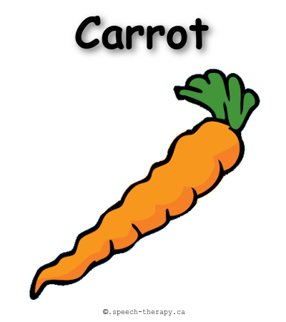
carrot/Would / like / you / a/?

