Slide 1
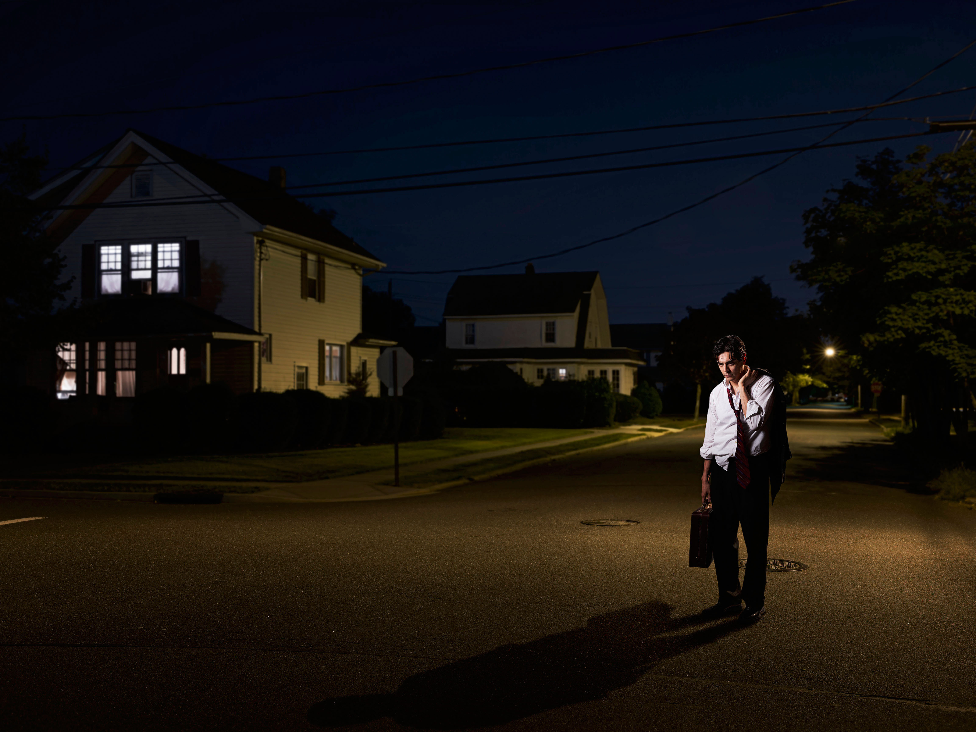
Mike ____ (come) home late yesterday.

Slide 2

We ___ (go) travelling around the world last year.

Slide 3
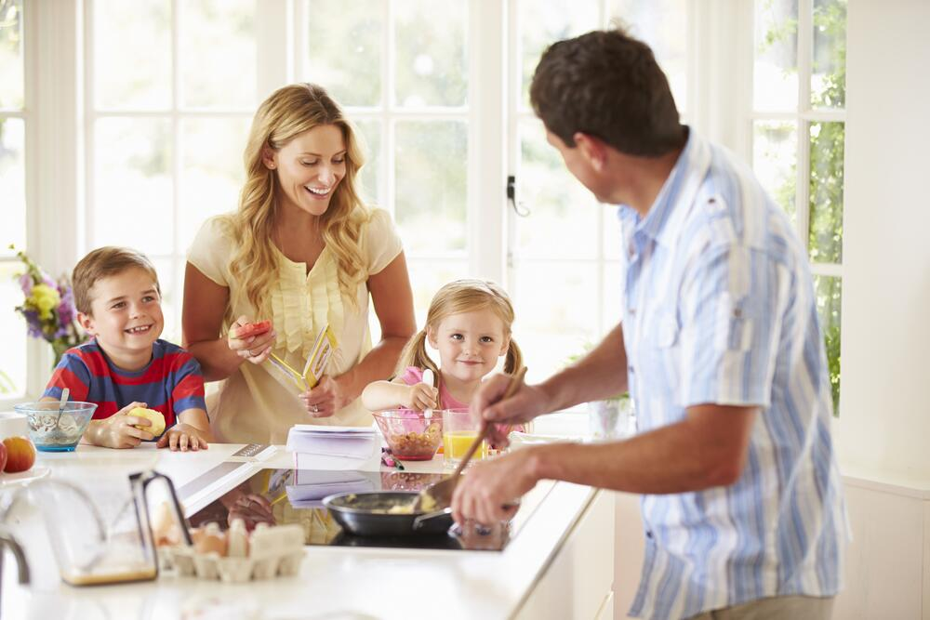
They ___ (have) breakfast at 8 yesterday.

Slide 4
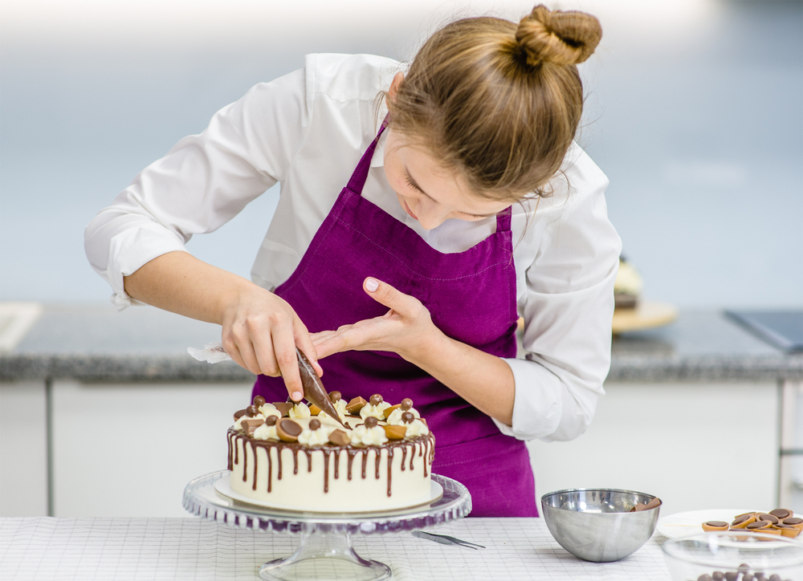
Mum ___ (make) a cake for my birthday.

Slide 5
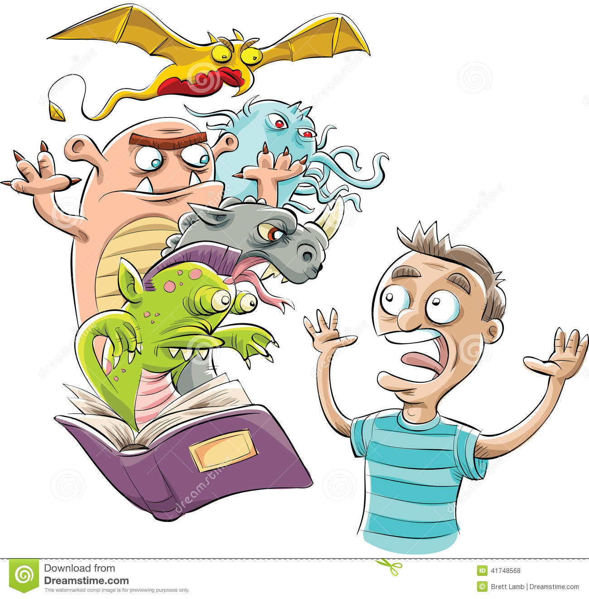
Sam ___ (read) a horror story last night.

Slide 6
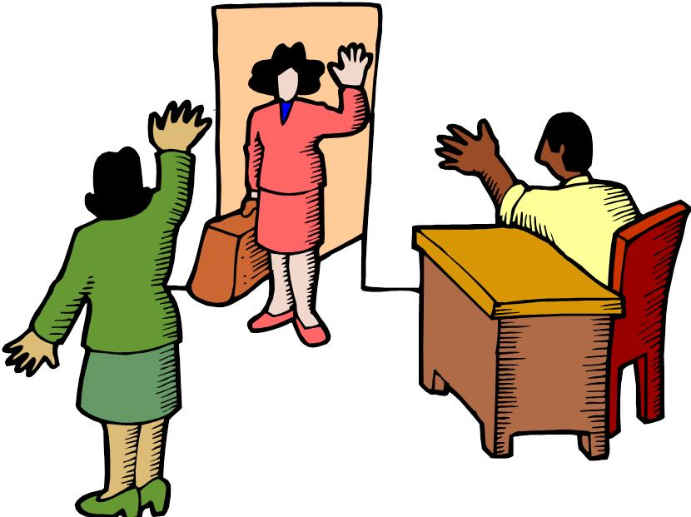
Linda ___ (say) goodbye and __ (go) home.

Slide 7
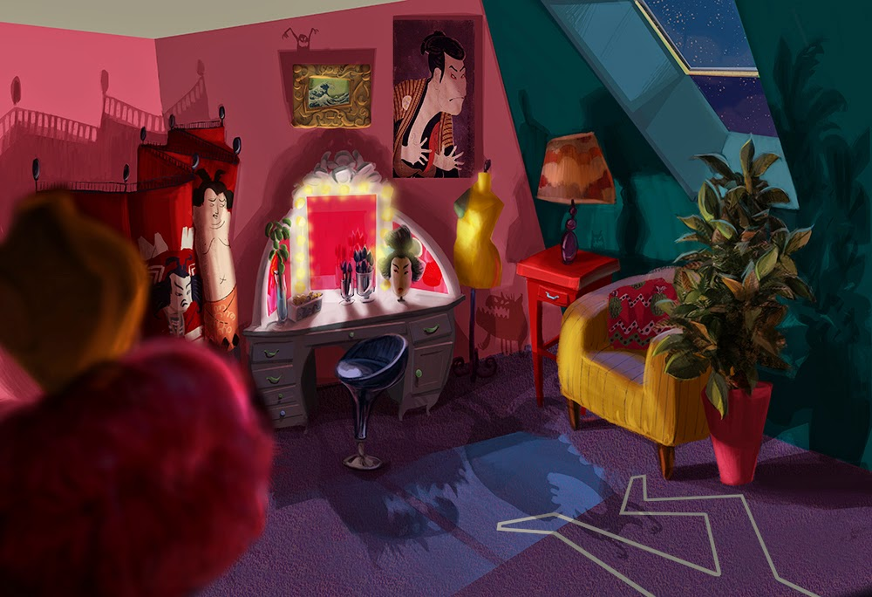
I ___ (see) a monster in my room last night.

Slide 8
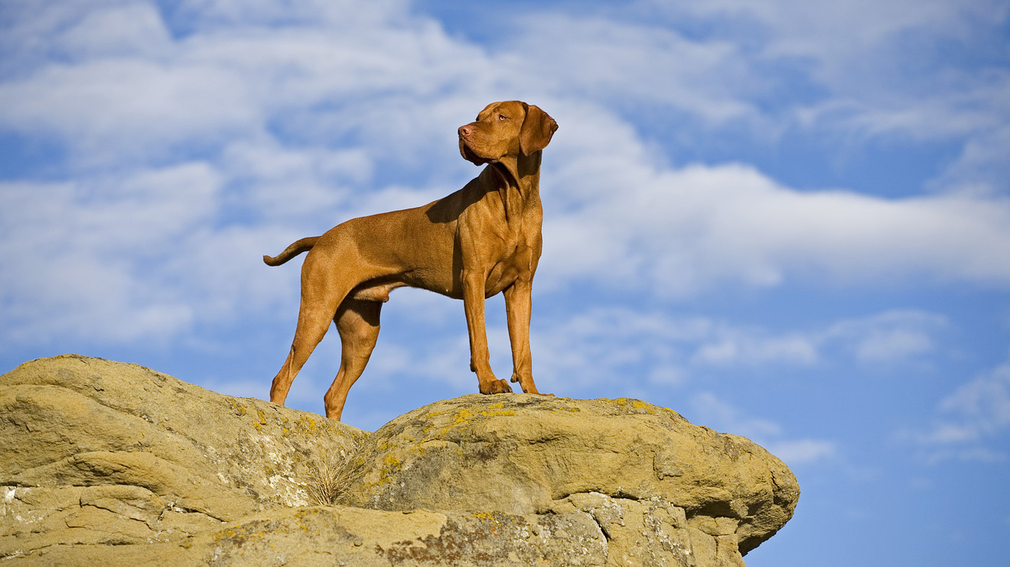
My dog ___ (stand) on the rock.

Slide 9
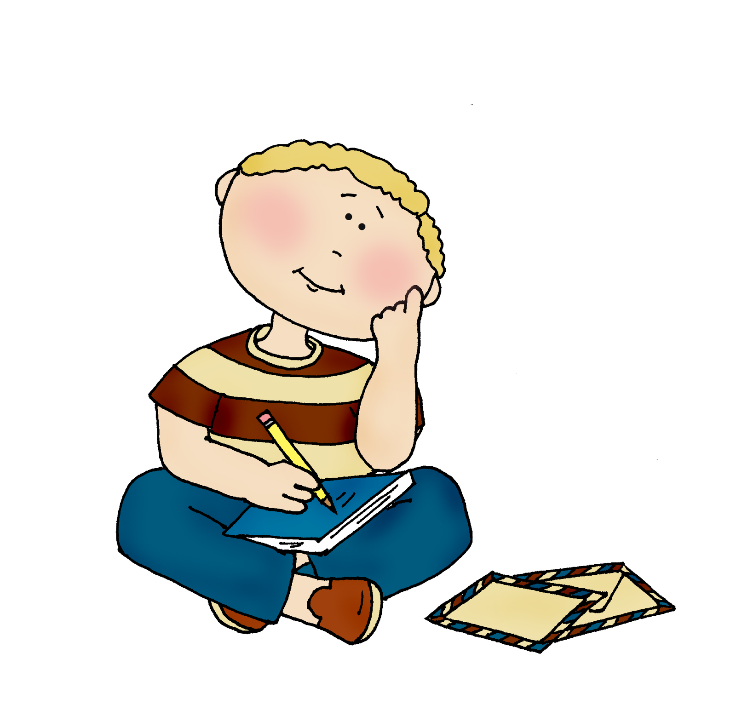
He ___ (think) about his friends.

Slide 10
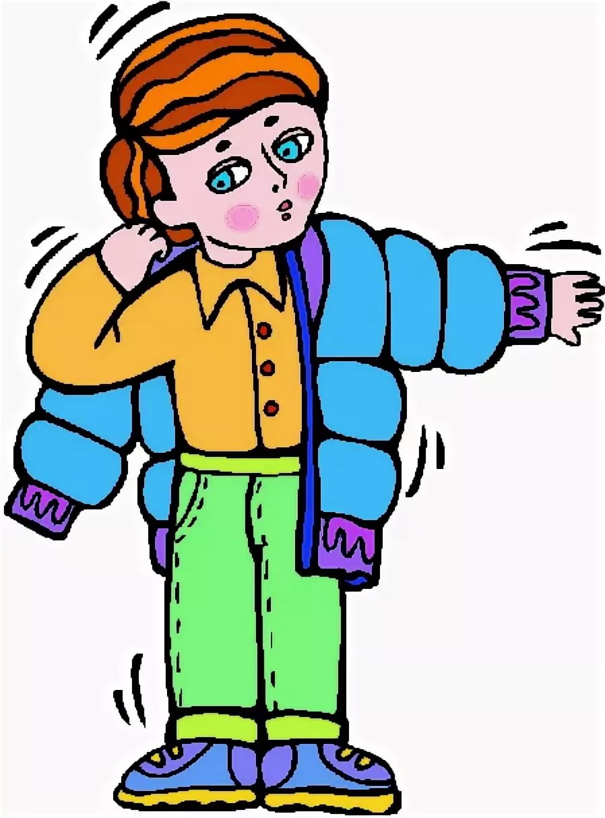
He ___ (wear) a coat because it was cold.

Slide 11
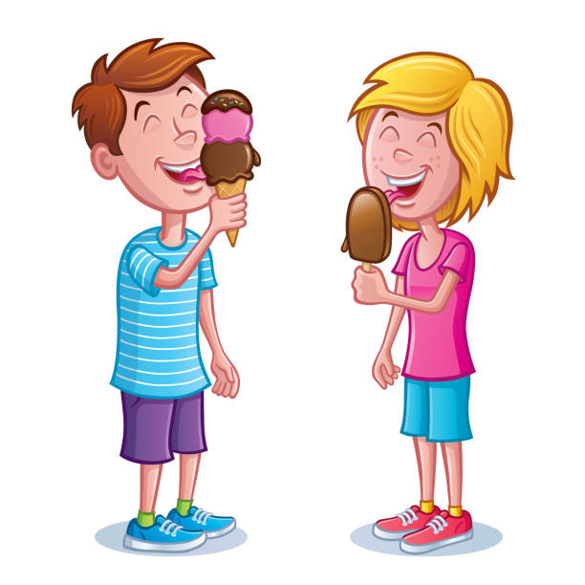
We ___ (eat) ice cream last weekend.

Slide 12
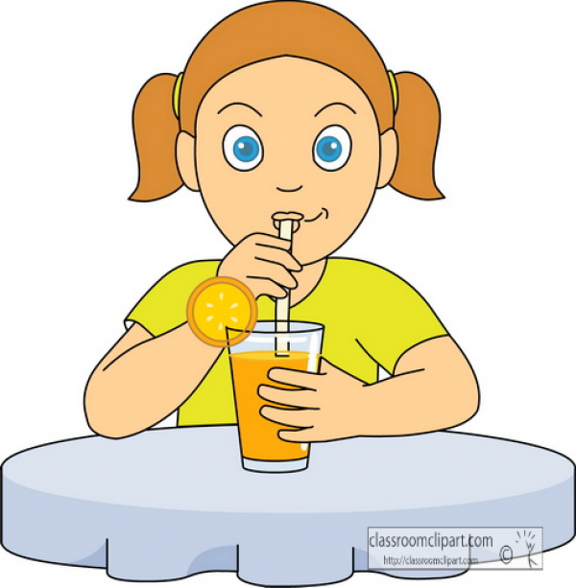
She ___ (drink) lemonade at the party.

