Slide 1

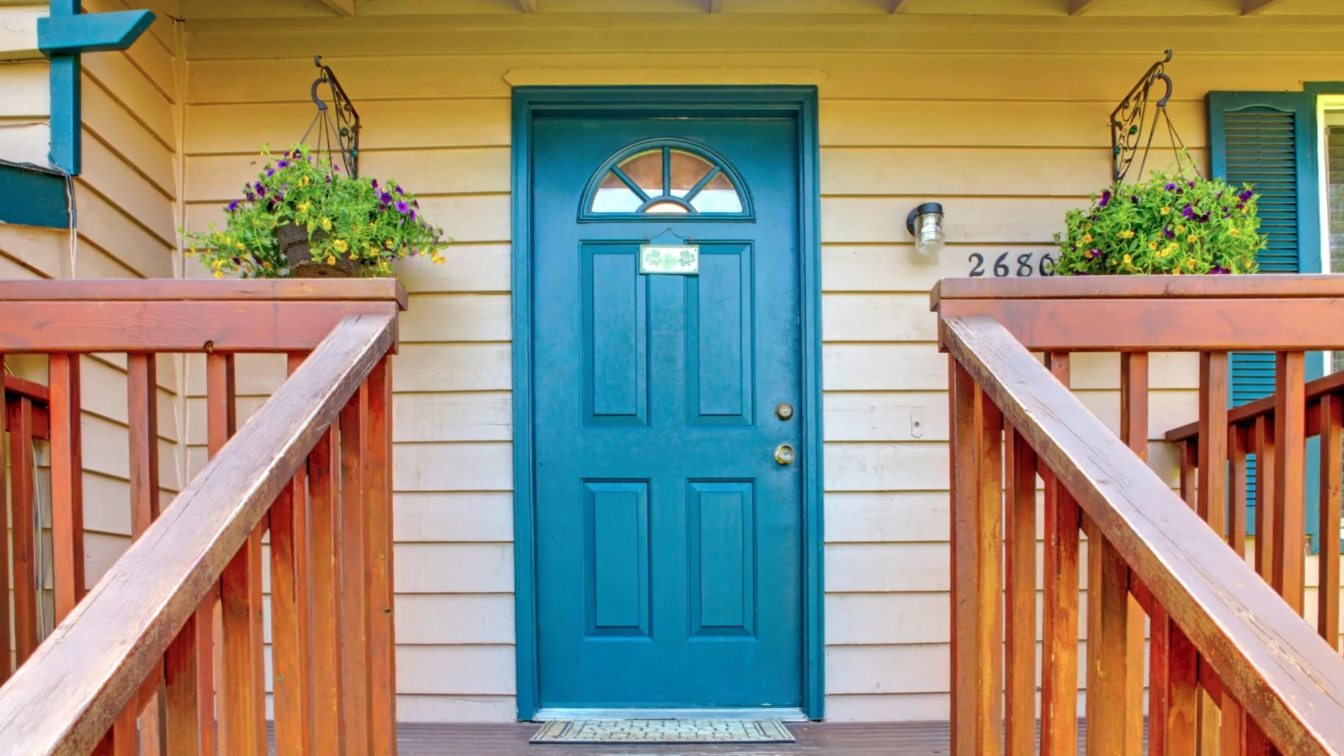


What is your name? How old are you? What food do you like? Have you got a pet?
Count from 12 to 31 Spell your name Name 10 colours in English
Name 5 school objects in English
Answer the questions to start new course:

Slide 2
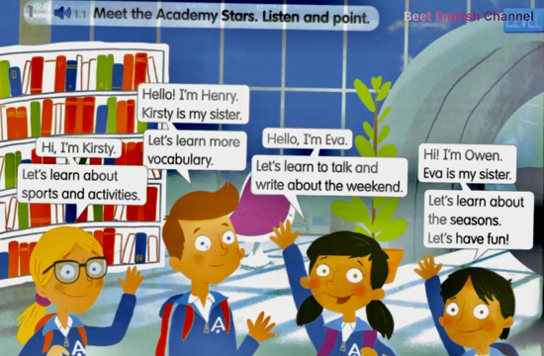

Slide 3

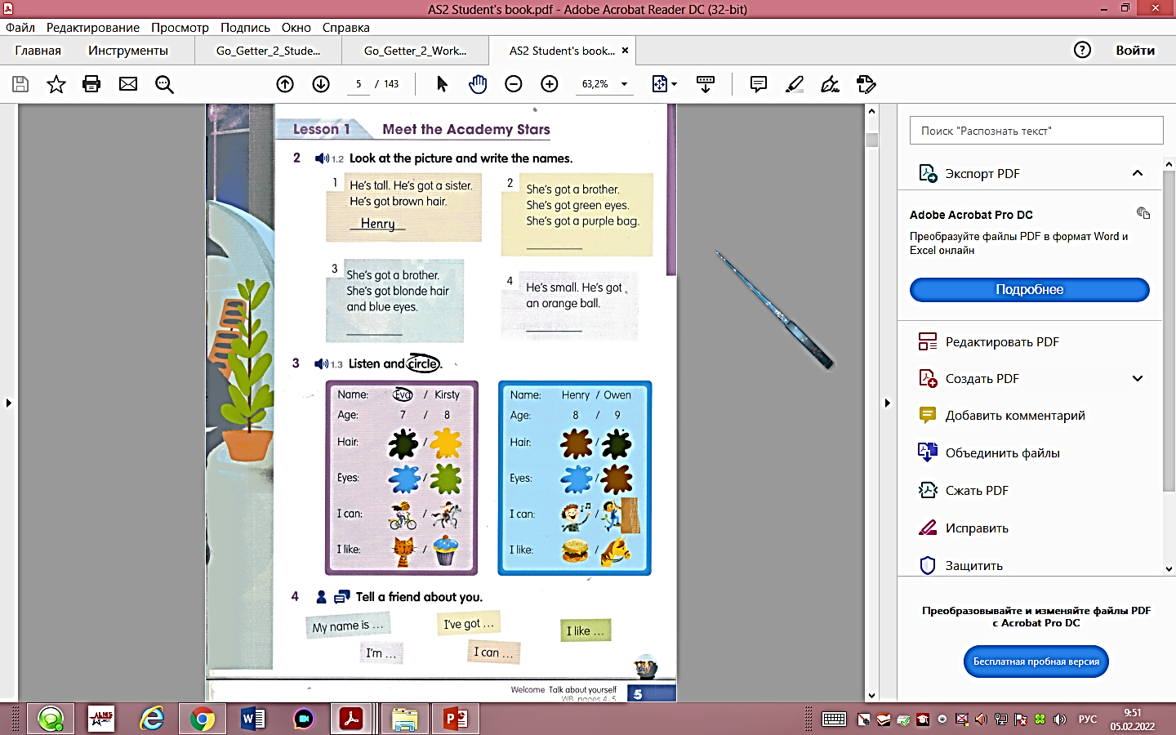
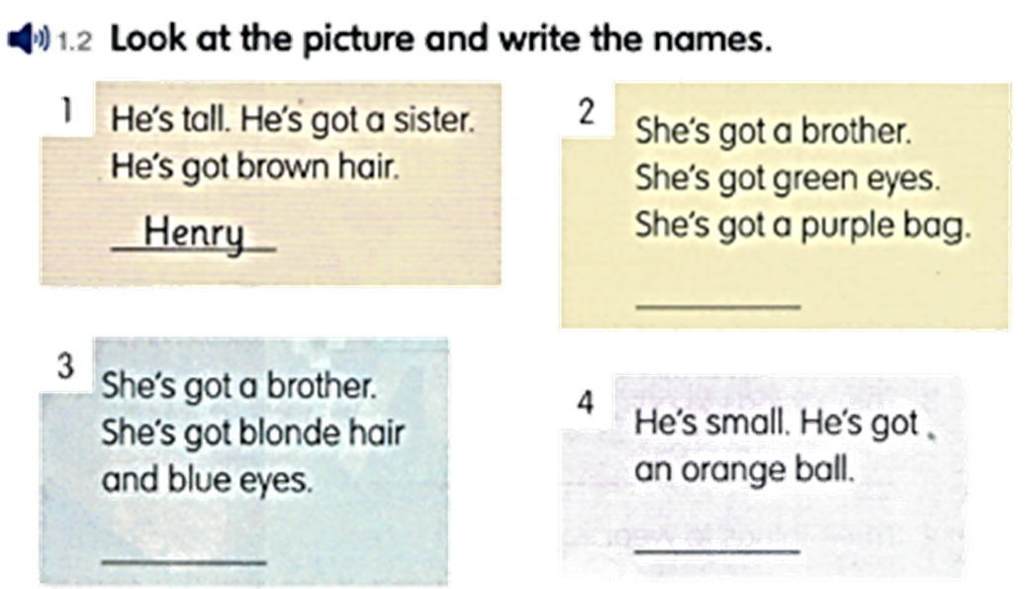
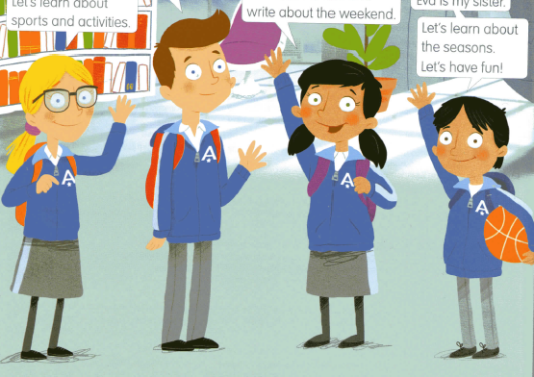
Look at the picture and write their names:
Eva
Kirsty
Owen

Slide 4





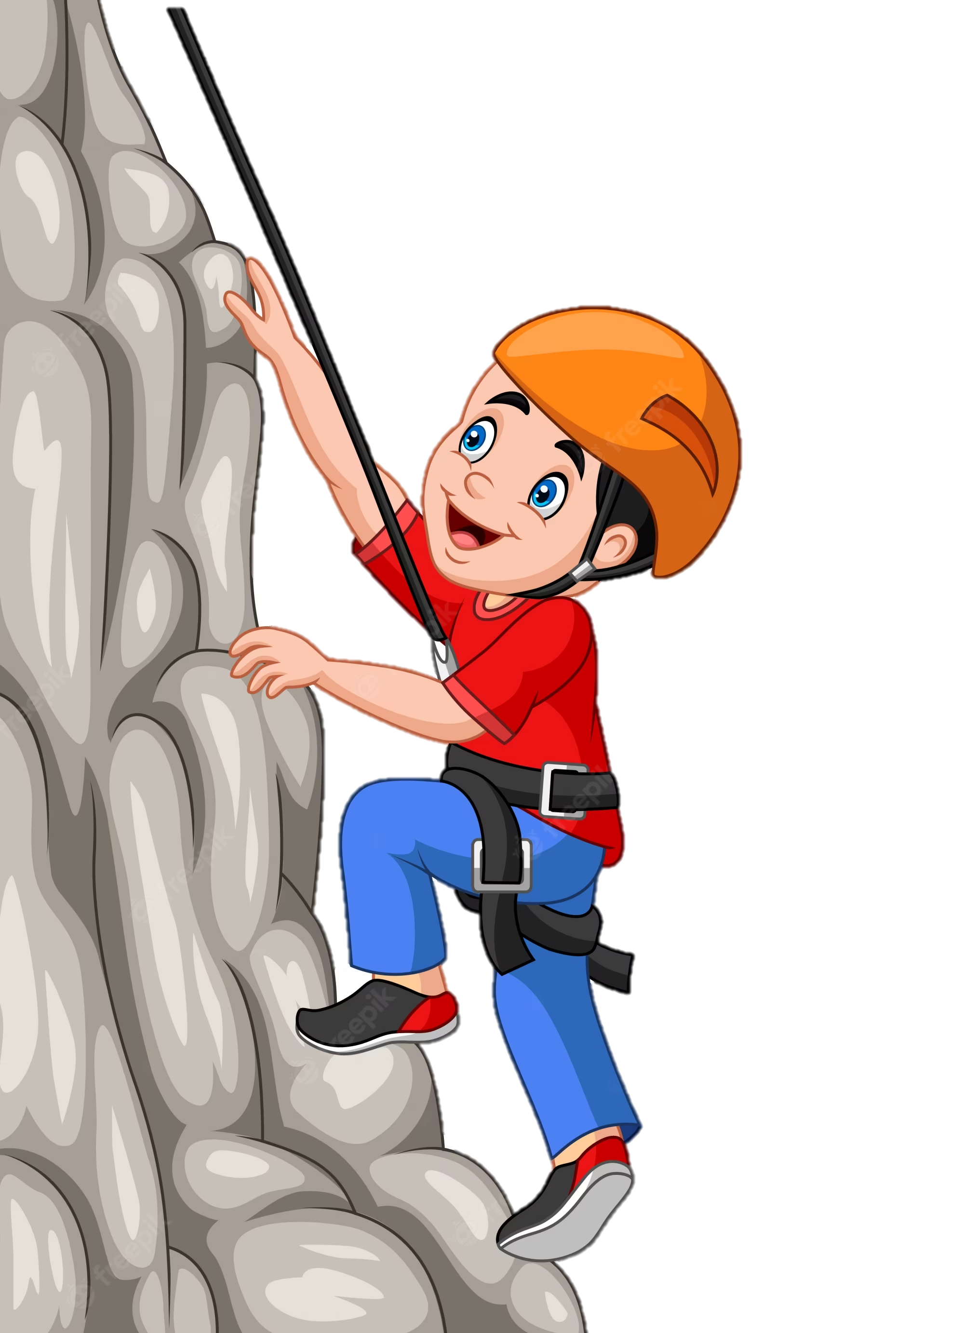
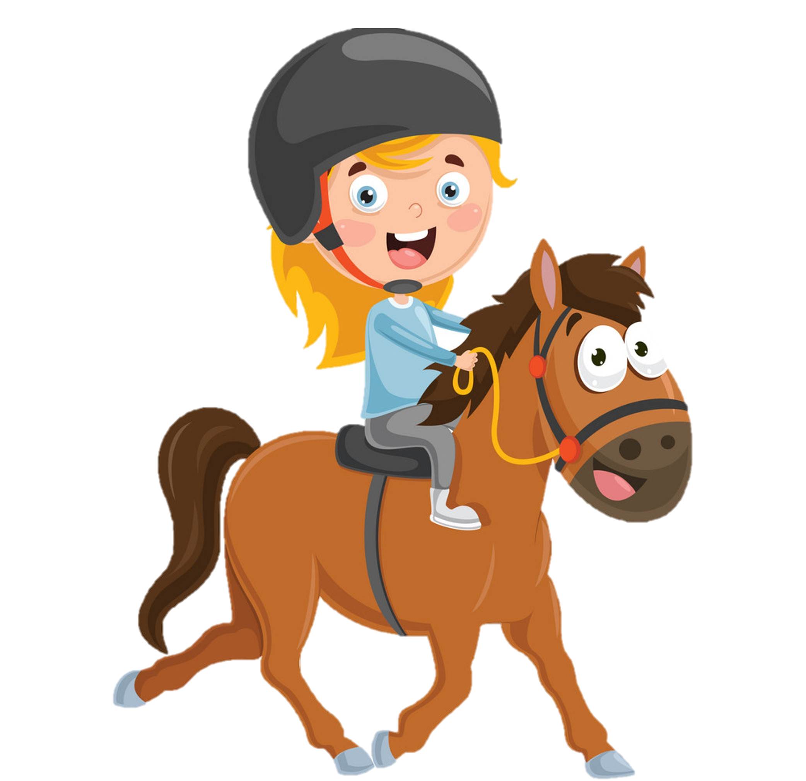
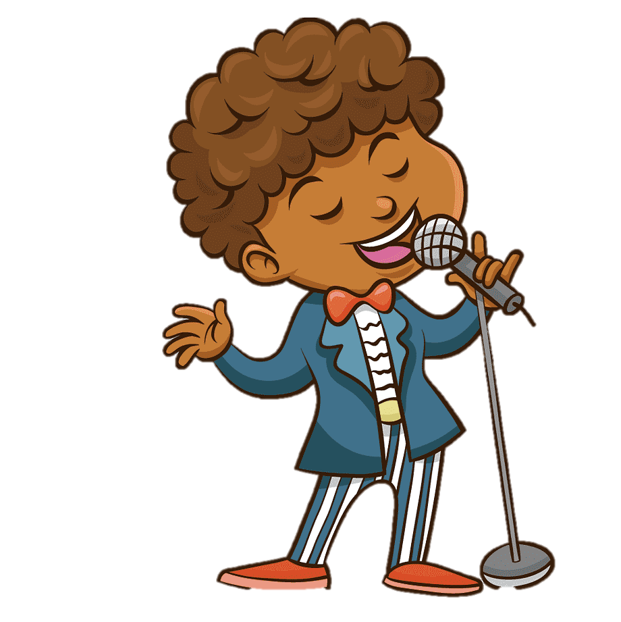
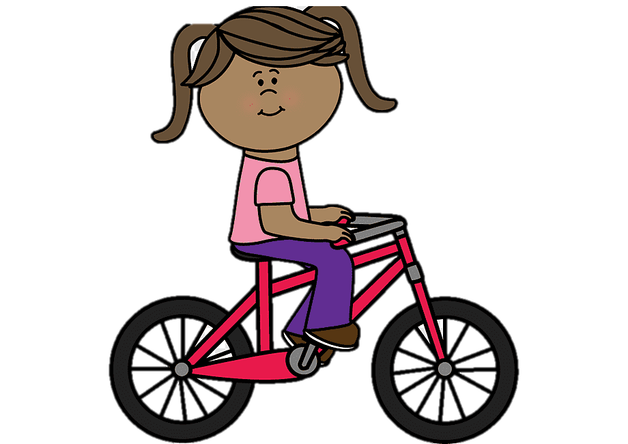
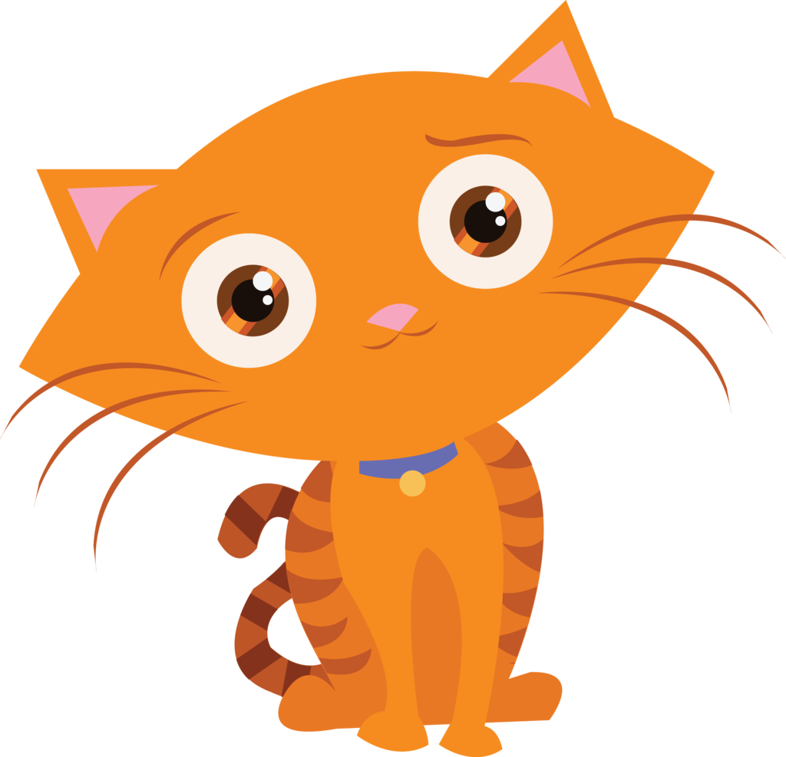


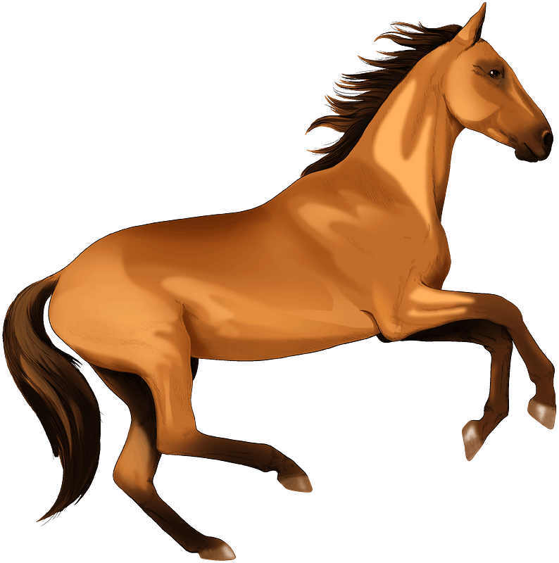
Listen and circle
Name: Eva/Kirsty
Age: 7/8
Hair:
Eyes:
I can
I like
Name: Eva/Kirsty
Age: 7/8
Hair:
Eyes:
I can
I like

Slide 5


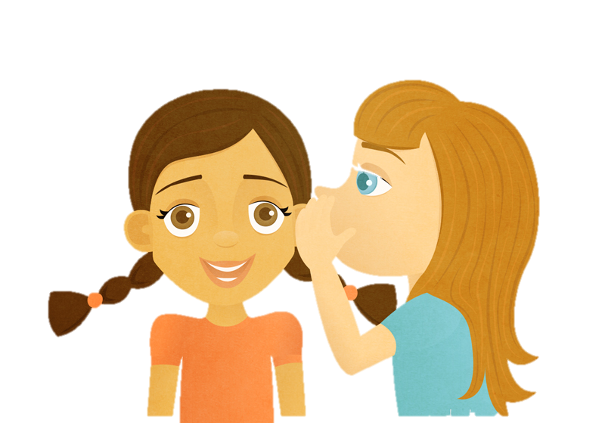



Tell a friend about you.

Slide 6
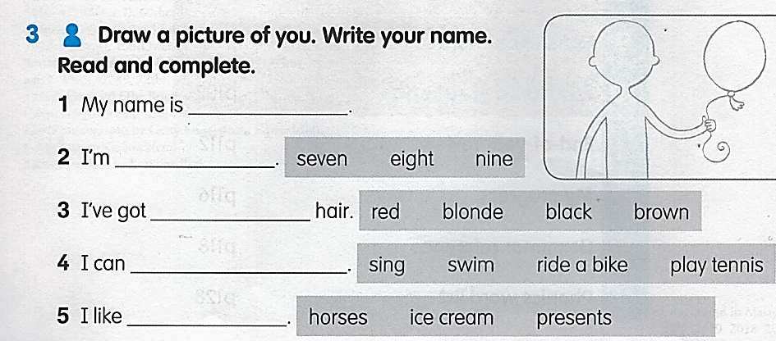


Slide 7
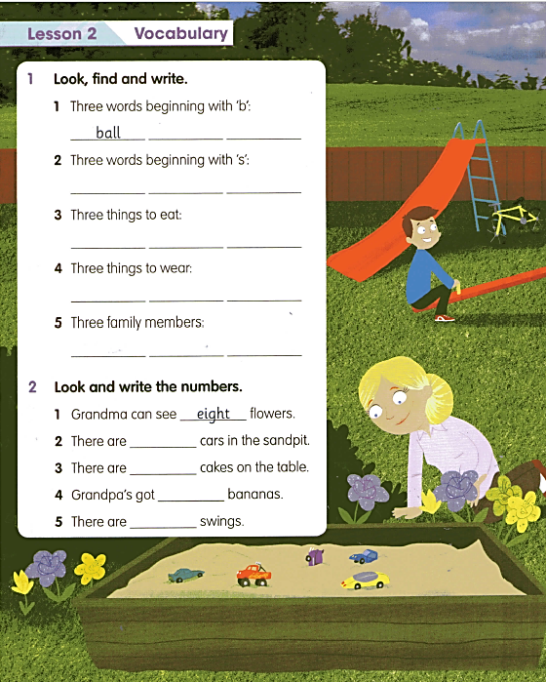
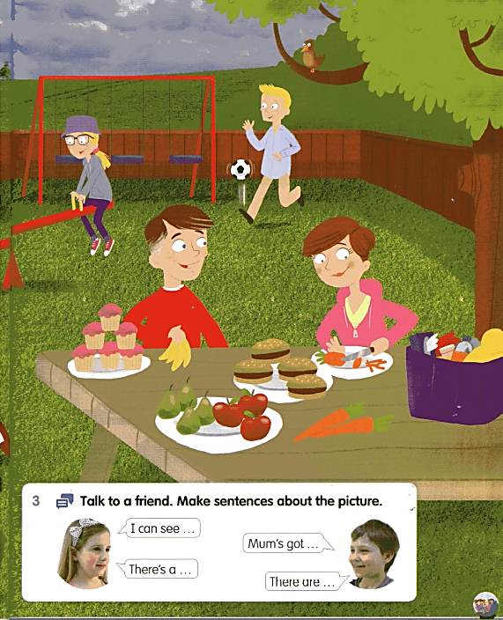
burger
bird
sandpit
swing
slide
apple
pear
carrot
hat
shirt
jacket
brother
mother
grandma
five
six
four
three

Slide 8
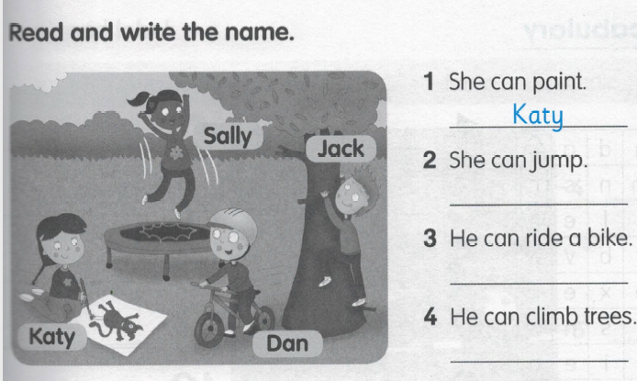
Sally
Dan
Jack

Slide 9
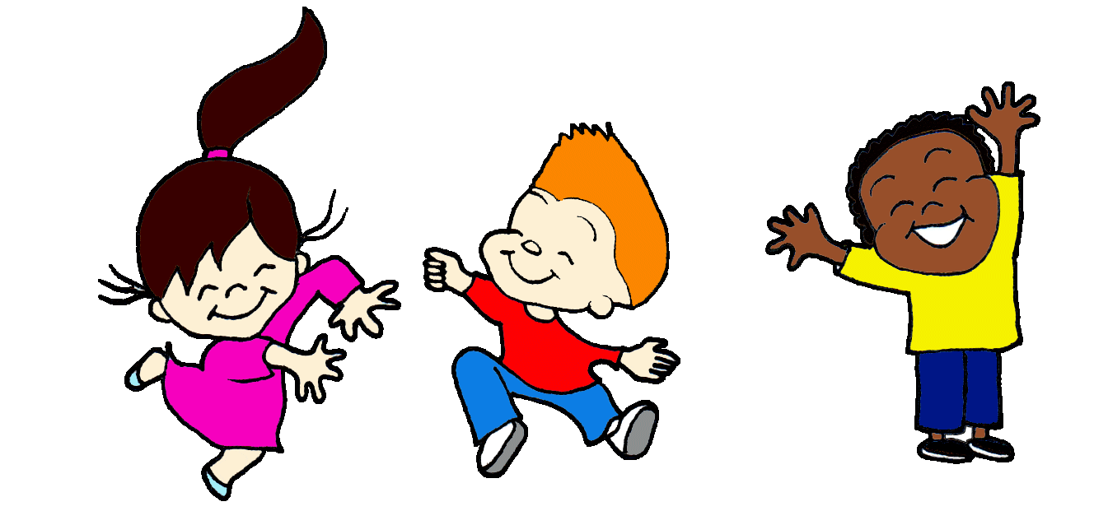

What about you? Read and circle.
Can you jump? Yes, I can./No, I can’t.
Can you paint? Yes, I can./No, I can’t.
Can you ride a bike? Yes, I can./No, I can’t.
Can you climb trees? Yes, I can./No, I can’t.

Slide 10
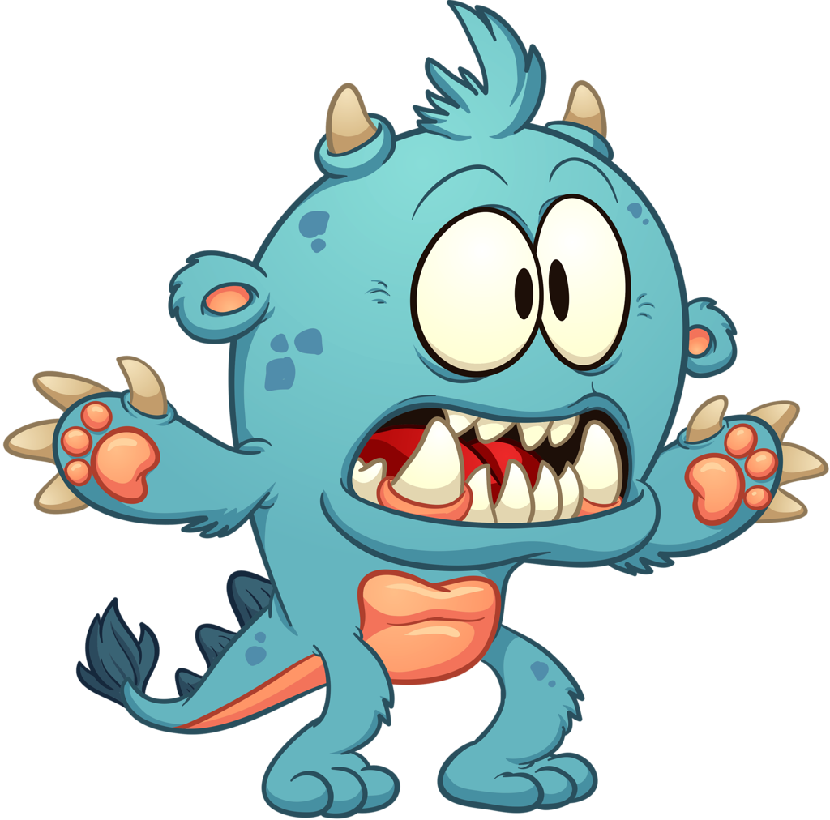
leg
tail
Find the body parts
eye
ear
arm

