Slide 1





IrinaPapakhina

Slide 2

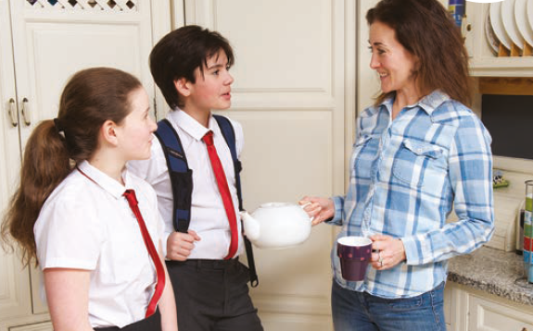

Who can you see in the photo?
Where are they?
Why are they there?
4. Watch the video and check your answers .
IrinaPapakhina

Slide 3

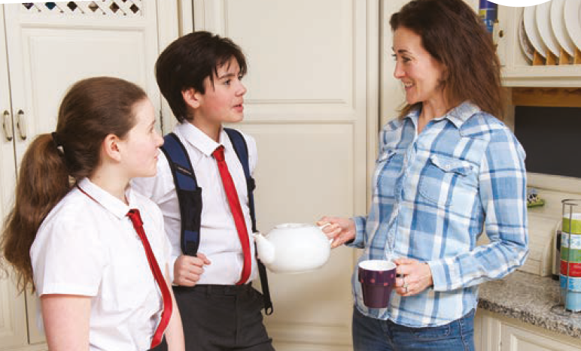
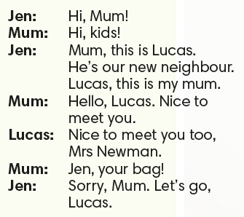
What is Jen’s family name?
IrinaPapakhina

Slide 4
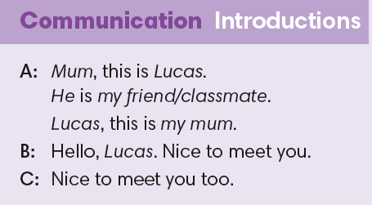
IrinaPapakhina

Slide 5
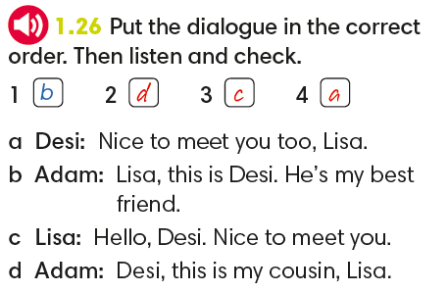
IrinaPapakhina

Slide 6
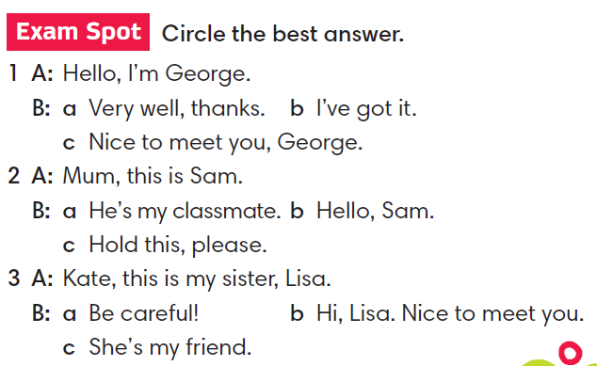
IrinaPapakhina

Slide 7
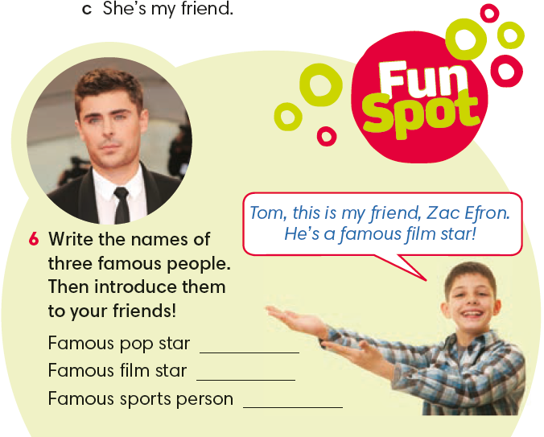
IrinaPapakhina

Slide 8
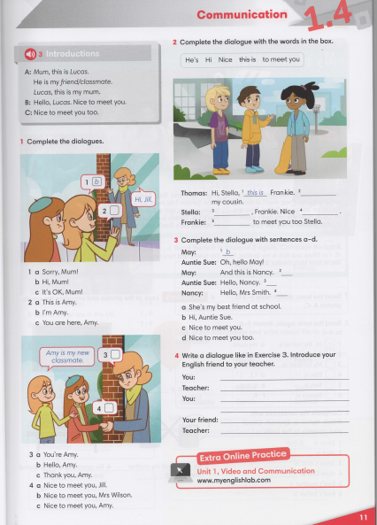


IrinaPapakhina

Slide 9
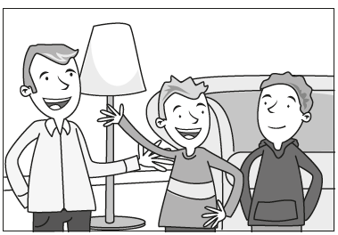
Read the sentences. Who are the people in the pitcher?
Put the sentences in the correct order to make a dialogue.
Dialogue 1
Jonas: Nice to meet you too, Mr. Smith.
Dad: Hello, Jonas. Nice to meet you.
Dave: Dad, this is Jonas. He is my classmate. Jonas, this is my dad.
IrinaPapakhina

Slide 10
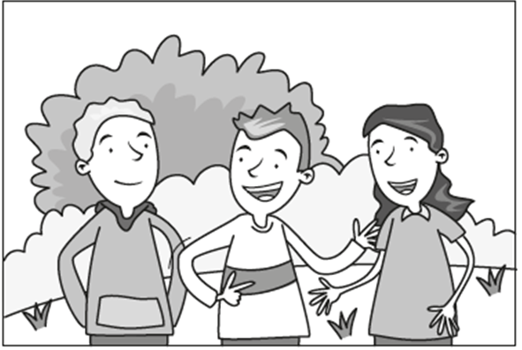
Read the sentences. Who are the people in the pitcher?
Put the sentences in the correct order to make a dialogue.
Dialogue 2
Anna: Nice to meet you, Mark.
Robbie: Mark, this is Ann. She’s my cousin.
Mark: I’m Robbie’s classmate. Nice to meet you.
IrinaPapakhina

Slide 11

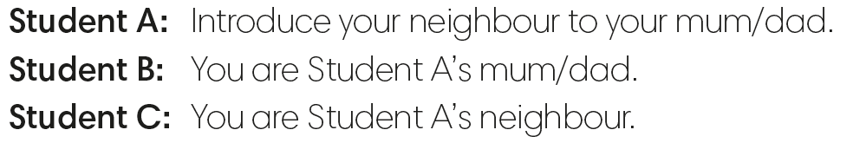
Dave: Dad, this is Jonas. He is my classmate.
Jonas, this is my dad.
Robbie: Mark, this is Ann. She’s my cousin.
Mark: I’m Robbie’s classmate. Nice to meet you.
Dad: Hello, Jonas. Nice to meet you.
Anna: Nice to meet you, Mark.
Jonas: Nice to meet you too, Mr. Smith.
IrinaPapakhina

Slide 12

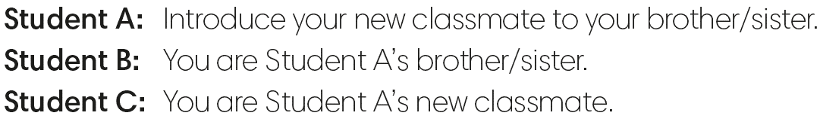
Dave: Dad, this is Jonas. He is my classmate.
Jonas, this is my dad.
Robbie: Mark, this is Ann. She’s my cousin.
Mark: I’m Robbie’s classmate. Nice to meet you.
Dad: Hello, Jonas. Nice to meet you.
Anna: Nice to meet you, Mark.
Jonas: Nice to meet you too, Mr. Smith.
IrinaPapakhina

Slide 13

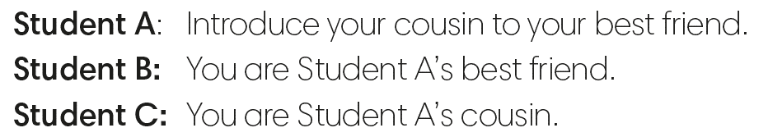
Dave: Dad, this is Jonas. He is my classmate.
Jonas, this is my dad.
Robbie: Mark, this is Ann. She’s my cousin.
Mark: I’m Robbie’s classmate. Nice to meet you.
Dad: Hello, Jonas. Nice to meet you.
Anna: Nice to meet you, Mark.
Jonas: Nice to meet you too, Mr. Smith.
IrinaPapakhina

