Slide 1
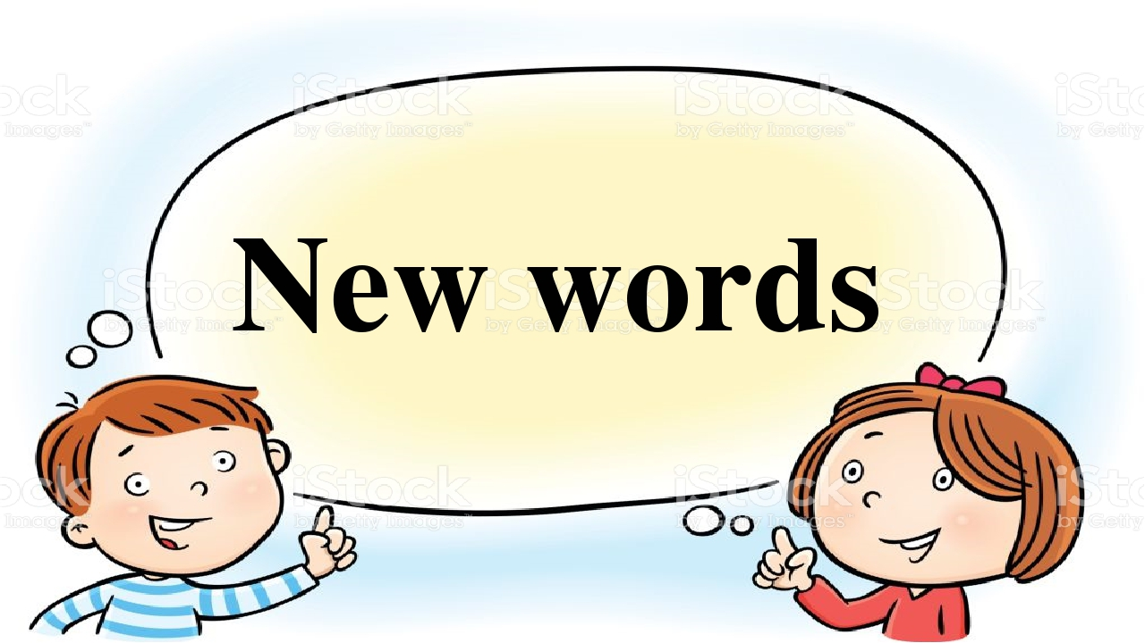
Do they learn the new words?
Yes, they do. No, they don’t.

Slide 2
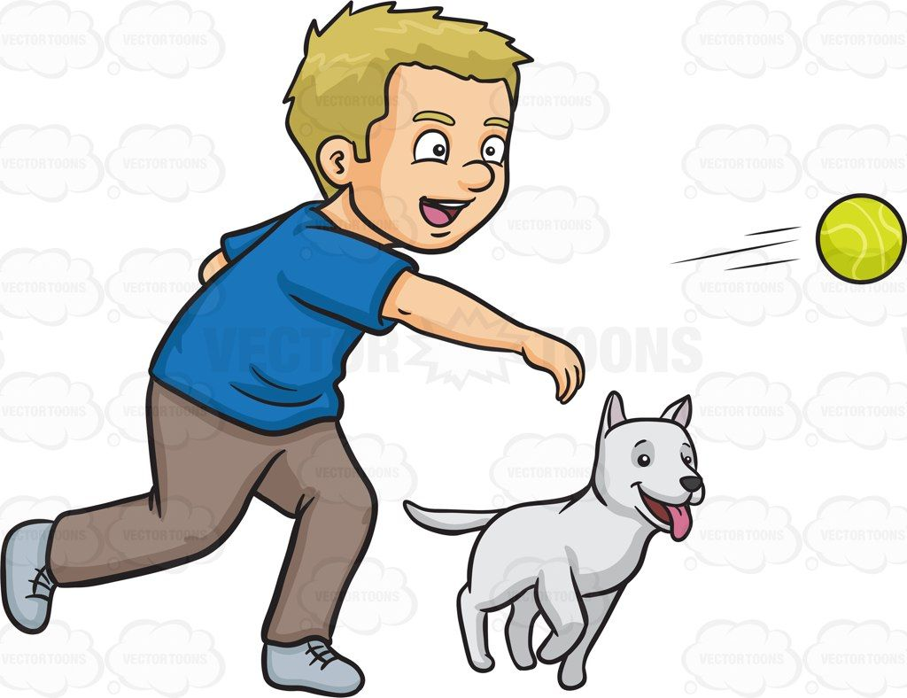
Do you learn the new words?
Yes, I do. No, I don’t.

Slide 3
Do you throw the ball?
Yes, I do. No, I don’t.

Slide 4
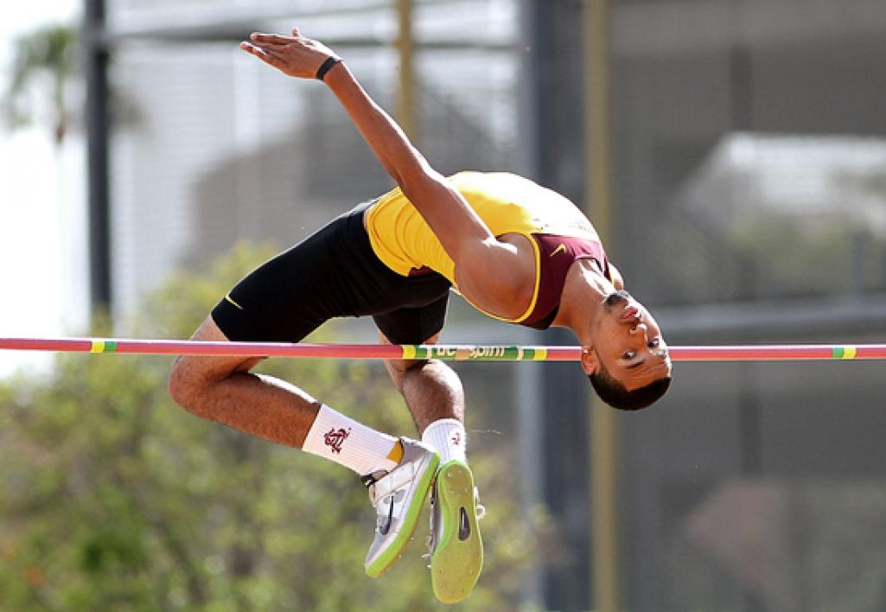
Do you jump high?
Yes, I do. No, I don’t.

Slide 5
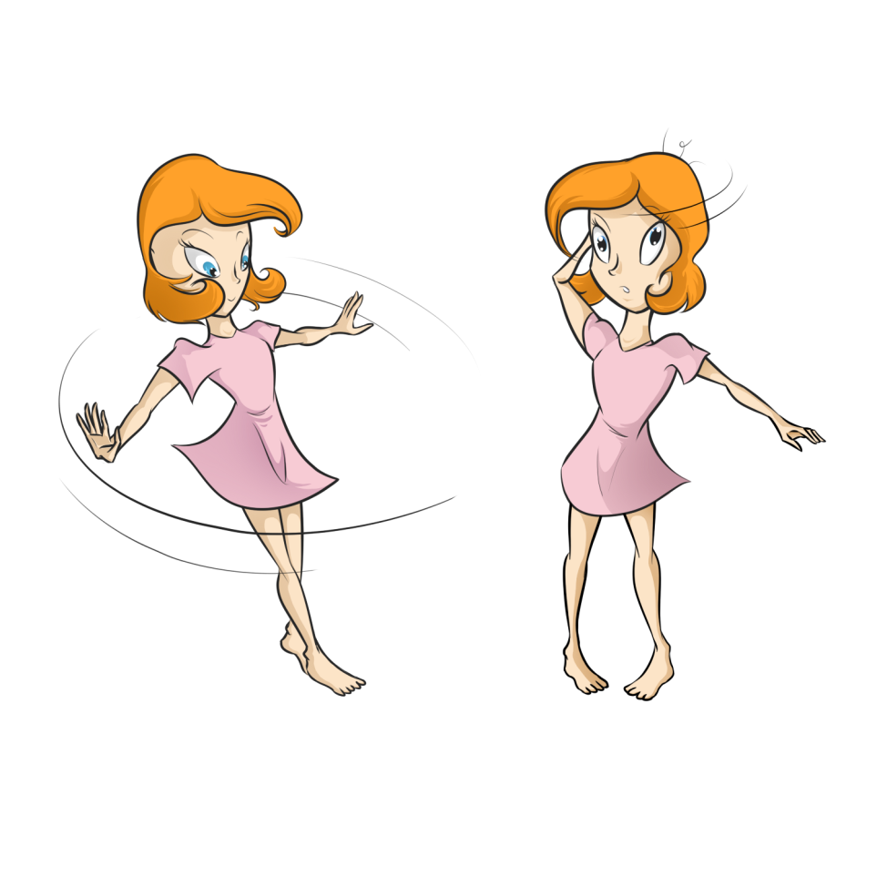
Do you turn around?
Yes, I do. No, I don’t.

Slide 6
Do you jump high?
Yes, I do. No, I don’t.

Slide 7
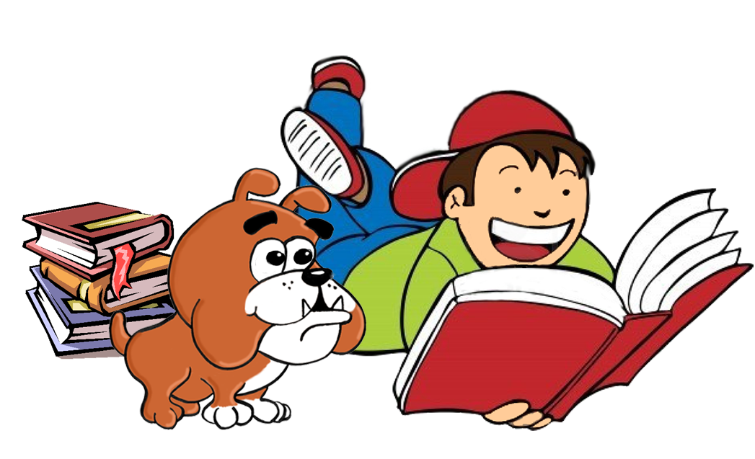
Do they turn around?
Yes, they do. No, they don’t.

Slide 8
Do they read books?
Yes, they do. No, they don’t.

Slide 9
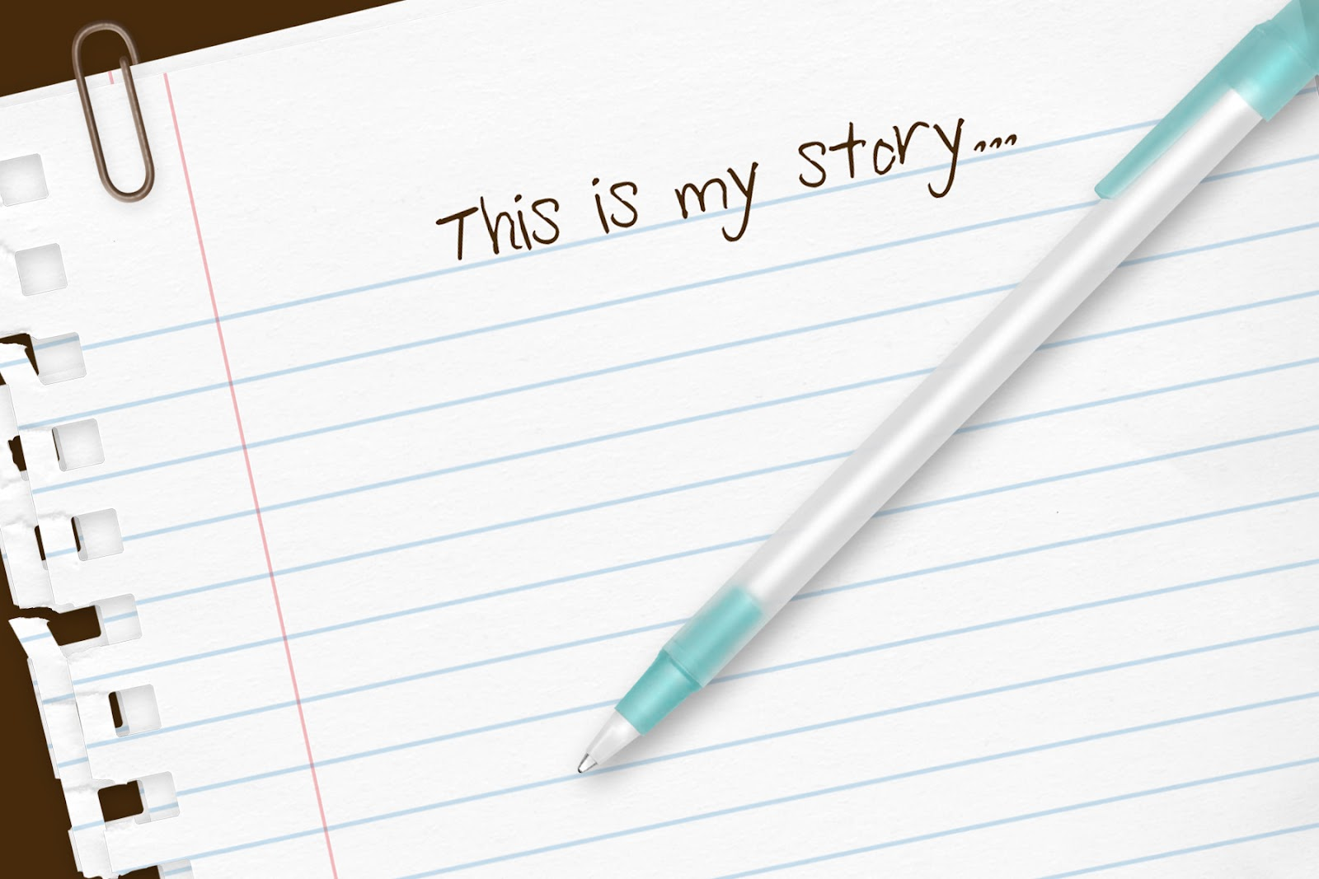
Do they read books?
Yes, they do. No, they don’t.

Slide 10
Do they write a story?
Yes, they do. No, they don’t.

Slide 11
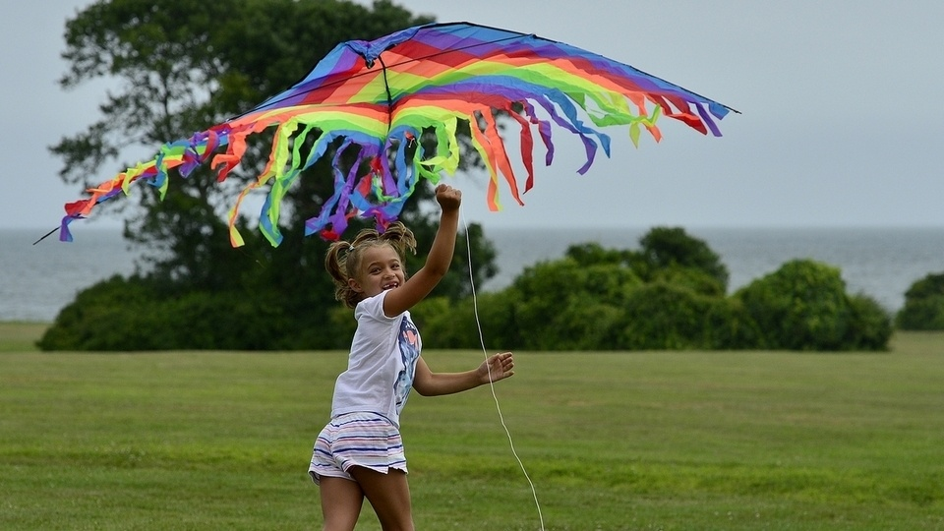
Do you write a story?
Yes, I do. No, I don’t.

Slide 12
Do you fly a kite?
Yes, I do. No, I don’t.

Slide 13
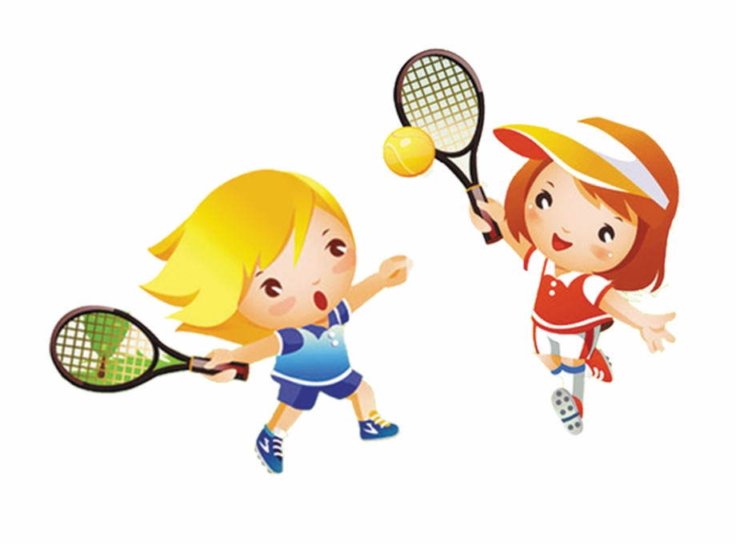
Do they play tennis?
Yes, they do. No, they don’t.

Slide 14
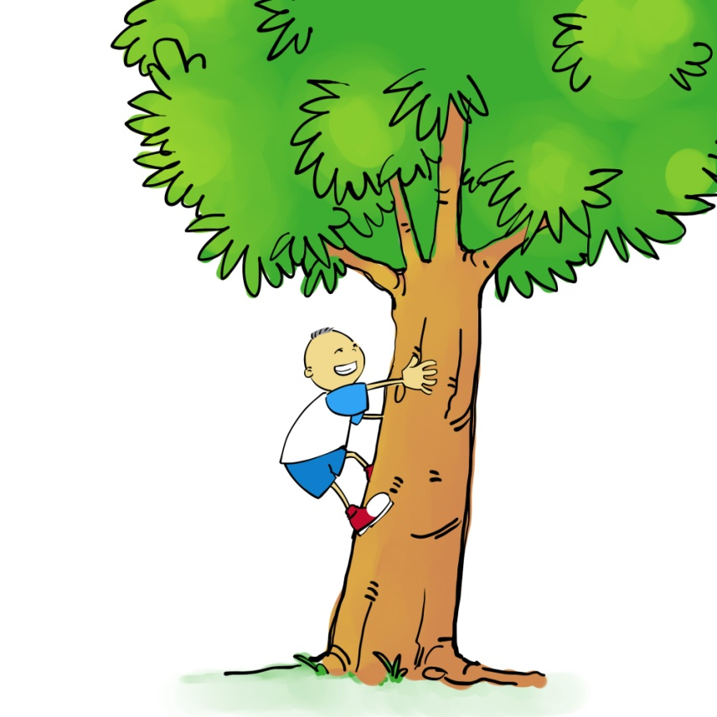
Do you play tennis?
Yes, I do. No, I don’t.

Slide 15
Do you climb a tree?
Yes, I do. No, I don’t.

