Slide 1
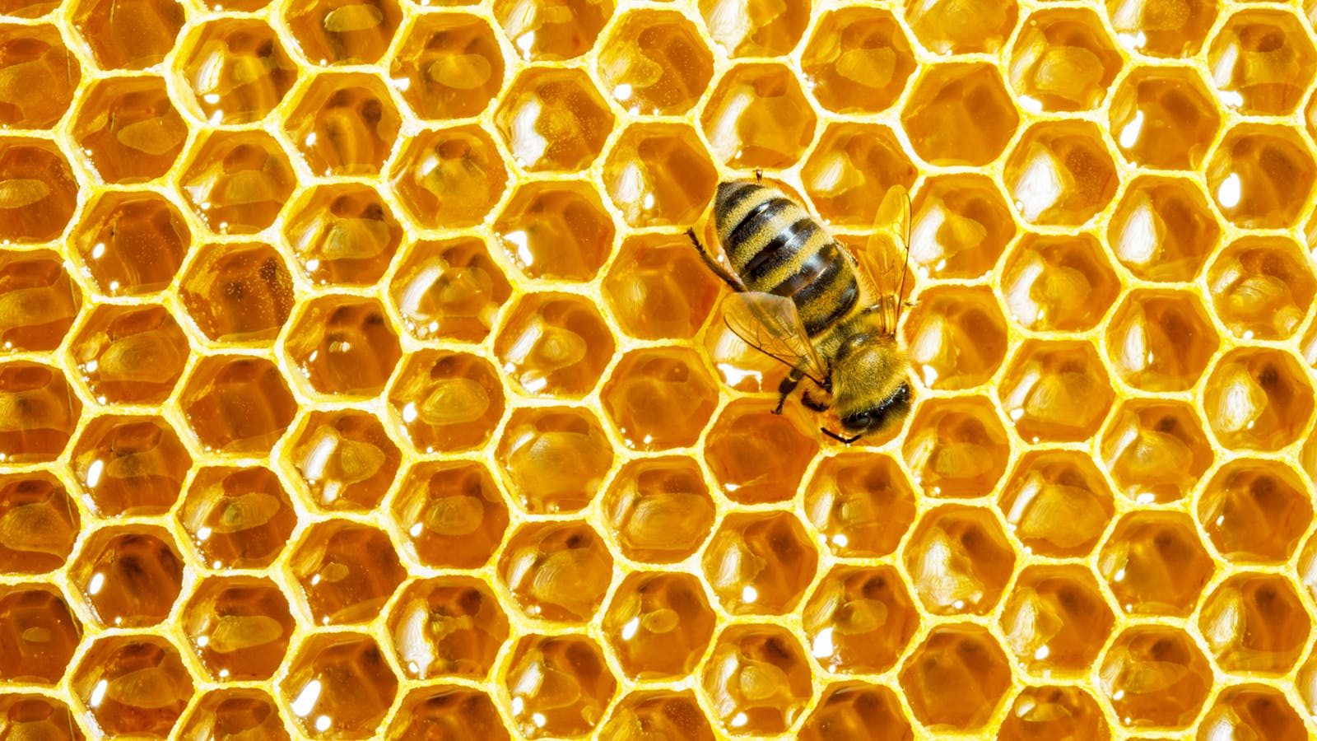


Complete the sentence. Use the Present Continuous.
in football
NEXT
I am playing football in the park.
play
the football
is
playing
in the park.
am
football
I
played
on the park.

Slide 2
Complete the sentence. Use the Present Continuous.
NEXT
He isn’t eating a banana.
ate
pears.
aren’t
eat
apple.
isn’t
a
He
eating
banana.

Slide 3
listen
in
You are listening to the radio.
listening
the radio.
are
to
NEXT
am
teacher.
You
Complete the sentence. Use the Present Continuous.

Slide 4
Complete the sentence. Use the Present Continuous.
bike
NEXT
Are you riding a bike now?
ride
a bik
she
riding
now?
you
a bike
Are
rideing
yesterday?

Slide 5
Complete the sentence. Use the Present Continuous.
NEXT
We aren’t taking a photo.
take
photo.
isn’t
takeing
foto.
aren’t
a
We
taking

Slide 6
drive
car
I’m not driving a car at the moment.
driving
at the moment.
‘m not
a car
Great job!
isn’t
every day.
I
Complete the sentence. Use the Present Continuous.

