Slide 1

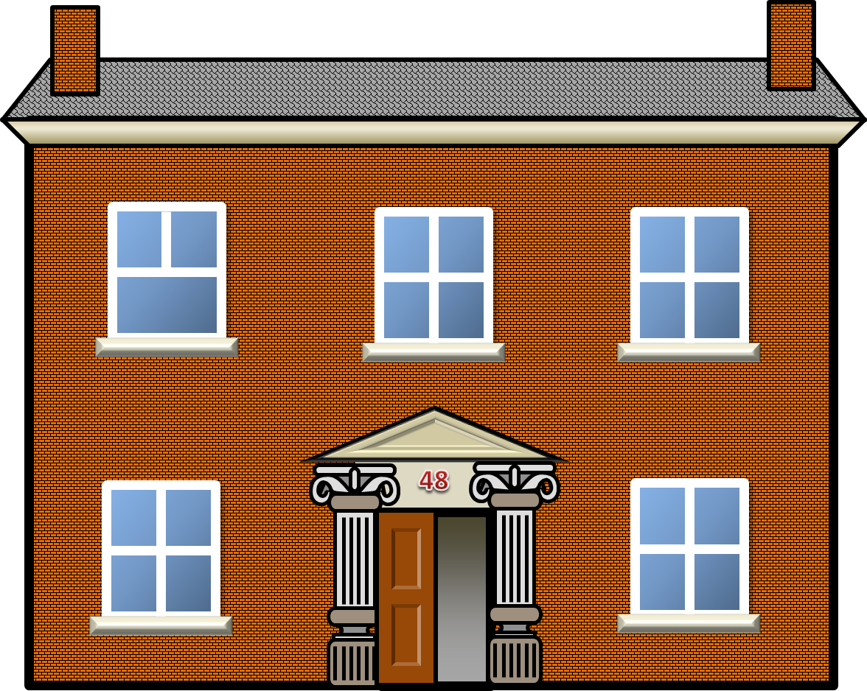



PAST CONTINUOUS
What were the neighbours doing yesterday evening?

Slide 2
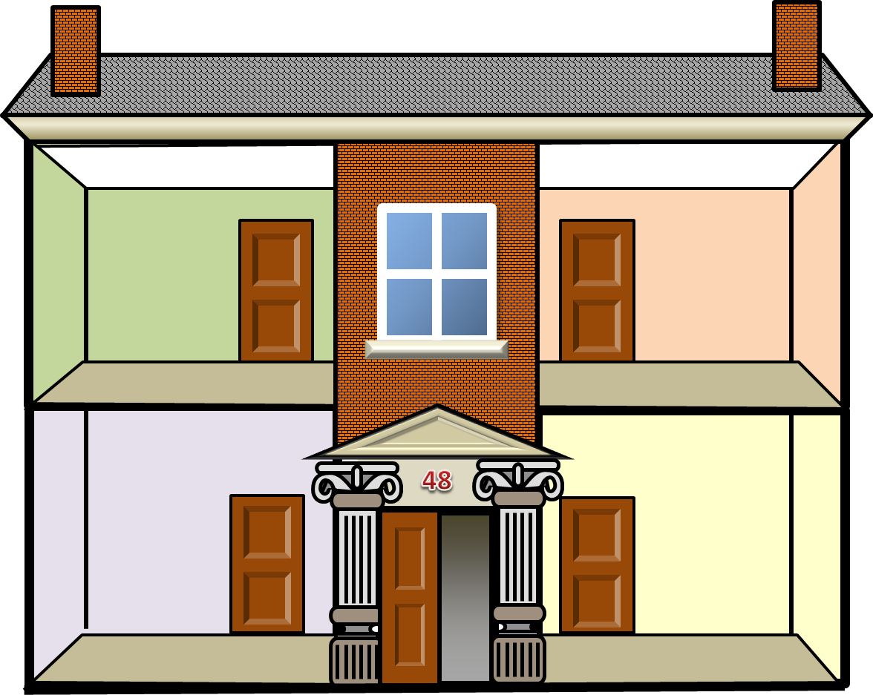
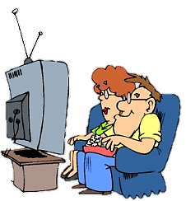
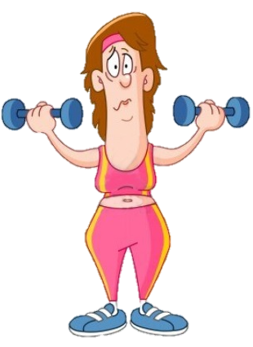

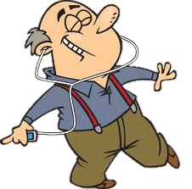
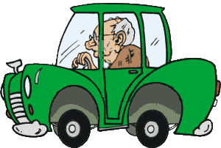
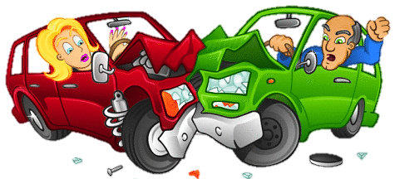

What was Mr. Smith doing when the car crash happened?
He was reading the newspaper.
Miss White
The Grahams
Mr Smith
Mr Lean

Slide 3
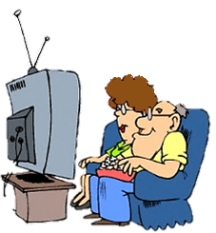

What were the Grahams doing while Mr Smith was reading the newspaper?
They were watching TV.
Miss White
The Grahams
Mr Smith
Mr Lean

Slide 4
What was Miss White doing when the car crash happened?
She was doing fitness.
Miss White
The Grahams
Mr Smith
Mr Lean

Slide 5
What was Mr Lean doing while Miss White was doing fitness?
He was listening to music and dancing.
Miss White
The Grahams
Mr Smith
Mr Lean

Slide 6
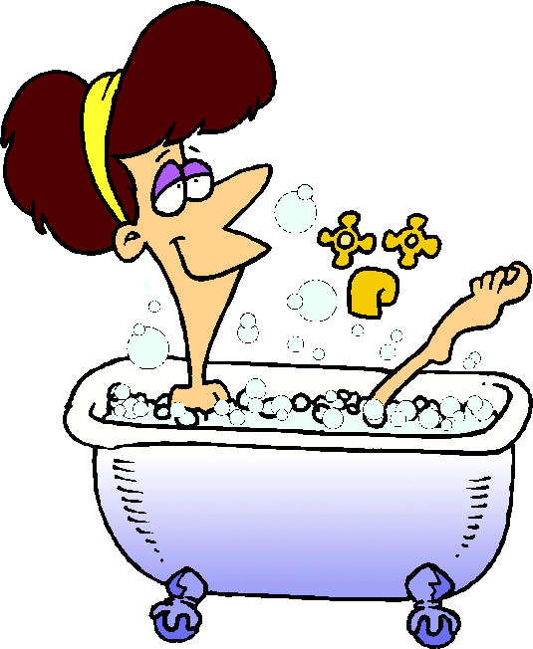
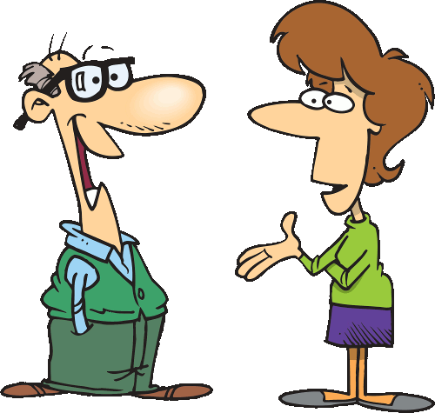
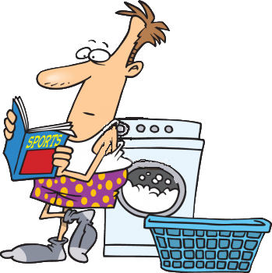
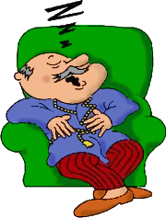

What was Miss White doing when the police arrived?
She was having a bath.
Miss White
The Grahams
Mr Smith
Mr Lean

Slide 7
What were the Grahams doing while Miss White was having a bath?
They were talking.
Miss White
The Grahams
Mr Smith
Mr Lean

Slide 8
What was Mr Smith doing when the police arrived?
He was washing his clothes.
Miss White
The Grahams
Mr Smith
Mr Lean

Slide 9
What was Mr Lean doing while Mr Smith was washing his clothes?
He was taking a nap.
Miss White
The Grahams
Mr Smith
Mr Lean

Slide 10

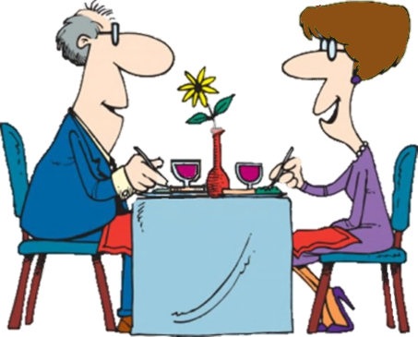
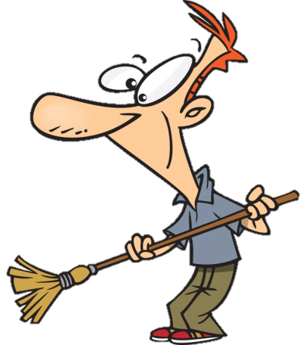
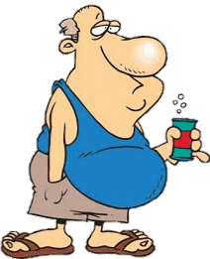


What was Mr Smith doing when the tow truck arrived?
He was sweeping the floor.
Miss White
The Grahams
Mr Smith
Mr Lean

Slide 11

What was Mr Lean doing while Mr Smith was sweeping the floor?
He was drinking soda.
Miss White
The Grahams
Mr Smith
Mr Lean

Slide 12
What was Miss White doing when the tow truck arrived?
She was using her computer.
Miss White
The Grahams
Mr Smith
Mr Lean

Slide 13
What were the Grahams doing while Miss White was using her computer?
They were having dinner.
Miss White
The Grahams
Mr Smith
Mr Lean

Slide 14



Complete the sentences with the correct option
when
Mr. Smith was reading the newspaper _________ the car crash happened
when
while
wrong
right
NEXT

Slide 15
while
Mr. Lean was listening to music_________ the Grahams were watching TV
when
while
wrong
right
NEXT

Slide 16
while
Miss White was doing fitness_________ Mr Smith was reading the paper
when
while
wrong
right
NEXT

Slide 17
when
Mr. Lean was taking a nap_________ the car crash happened
when
while
wrong
right
NEXT

Slide 18
when
The Grahams were having dinner_________ the tow truck arrived
when
while
wrong
right
NEXT

Slide 19
while
Miss White was having a bath_________ Mr Smith was washing his clothes
when
while
wrong
right
NEXT

Slide 20
when
The Grahams were talking ________ the police arrived
when
while
wrong
right
NEXT

Slide 21
when
Mr Smith was washing his clothes ________ the police arrived
when
while
wrong
right
NEXT

Slide 22
while
Mr Lean was drinking soda_________ Mr Smith was sweeping the floor
when
while
wrong
right
NEXT

Slide 23


