Slide 1

1. I / listen to music.

Slide 2
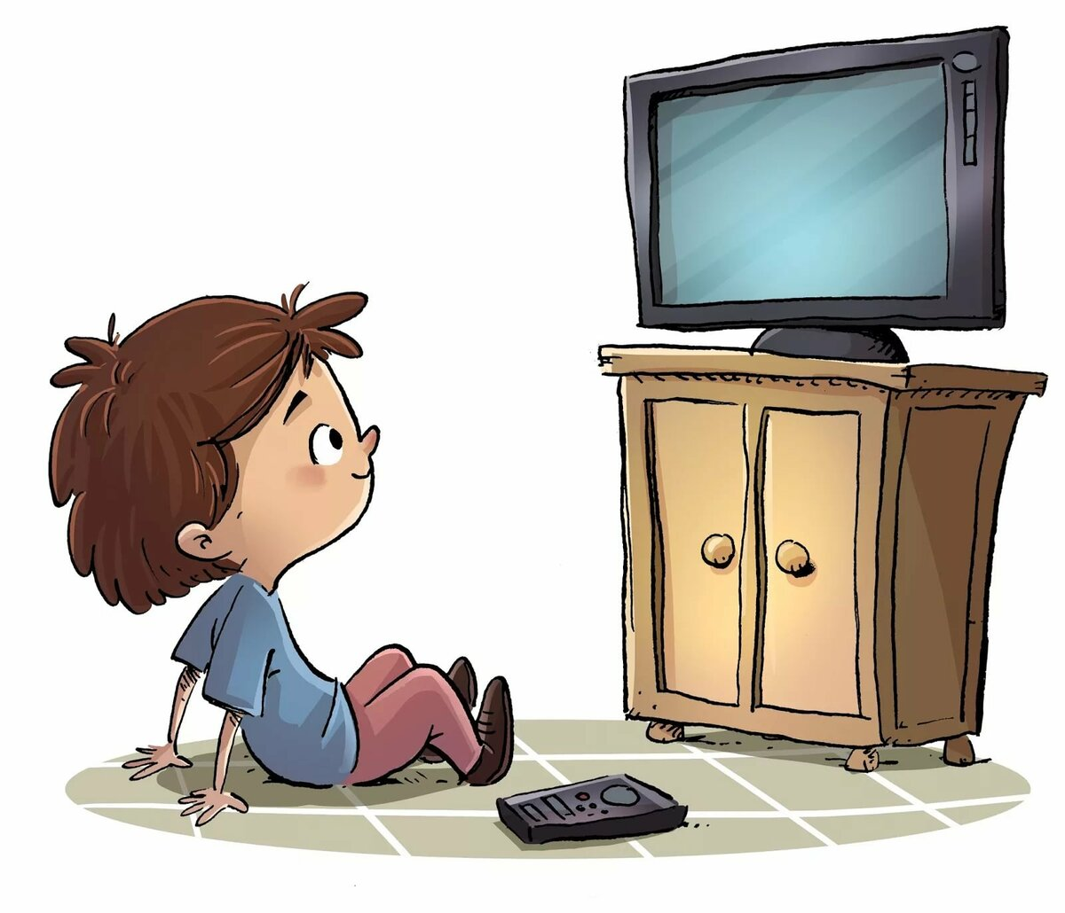
2. He / watch TV.

Slide 3
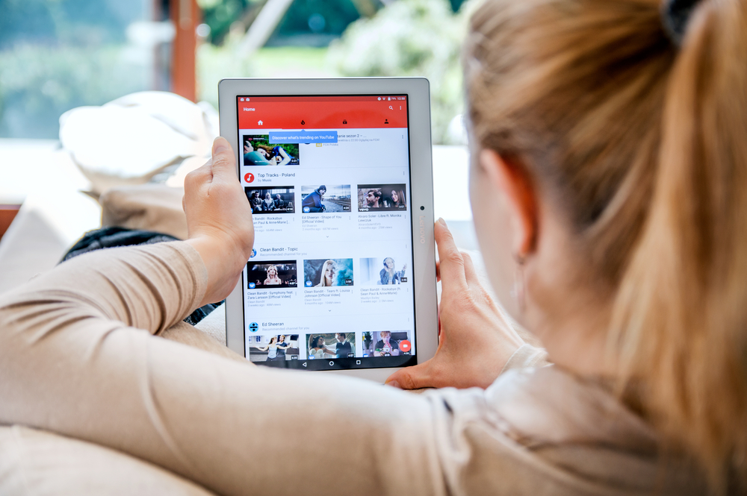
3. She / watch videos.

Slide 4
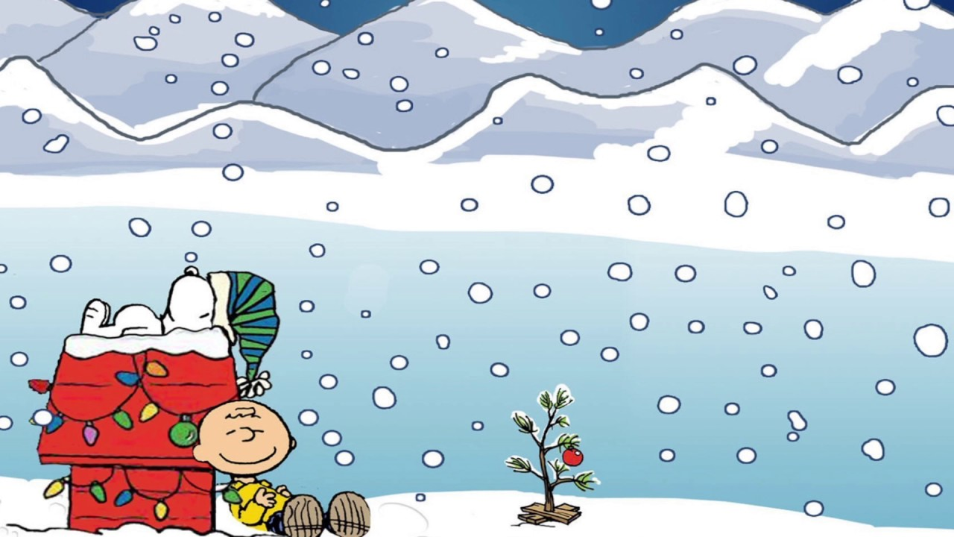
4. It / snow.

Slide 5
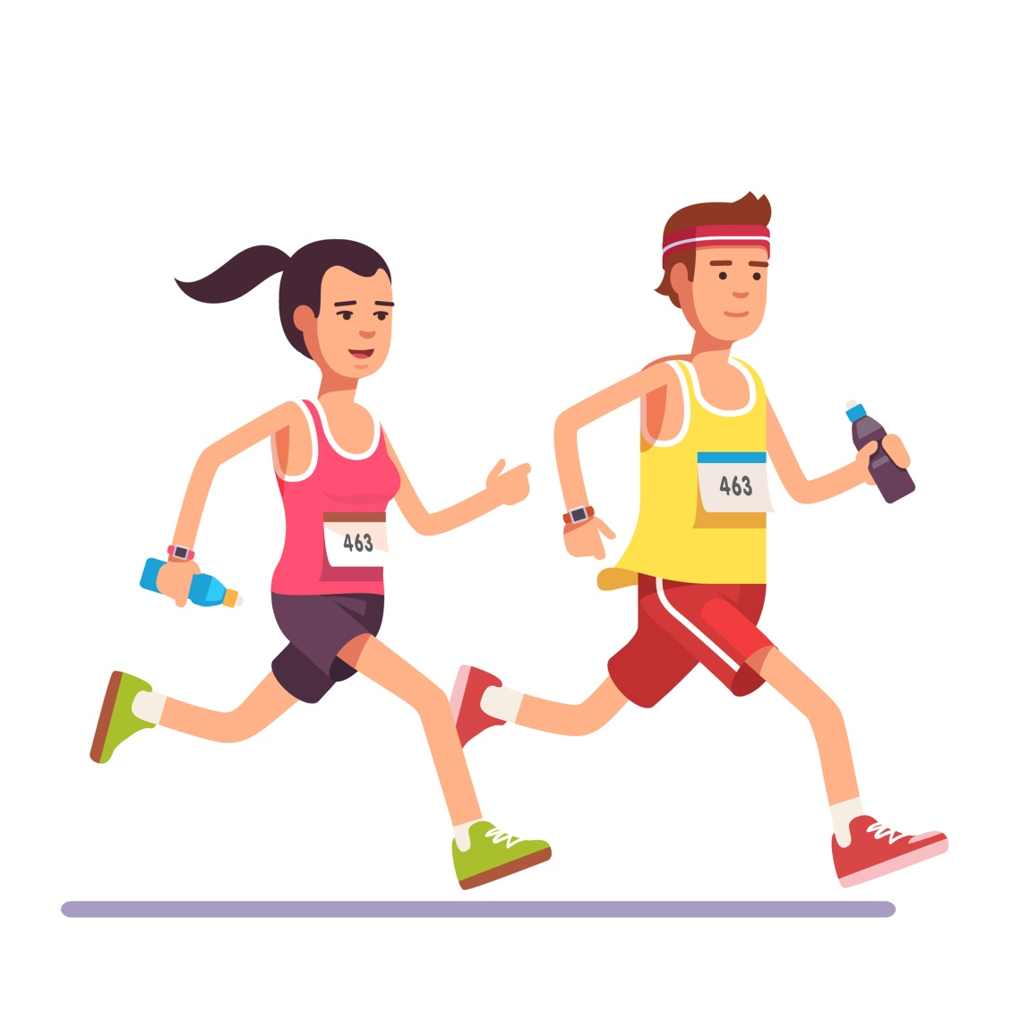
5. We / run.

Slide 6
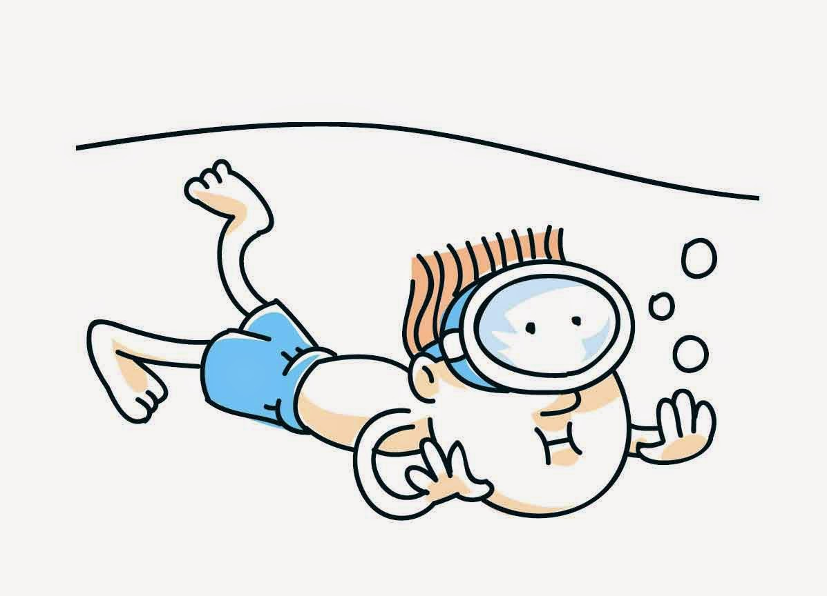
6. You / swim in the sea.

Slide 7
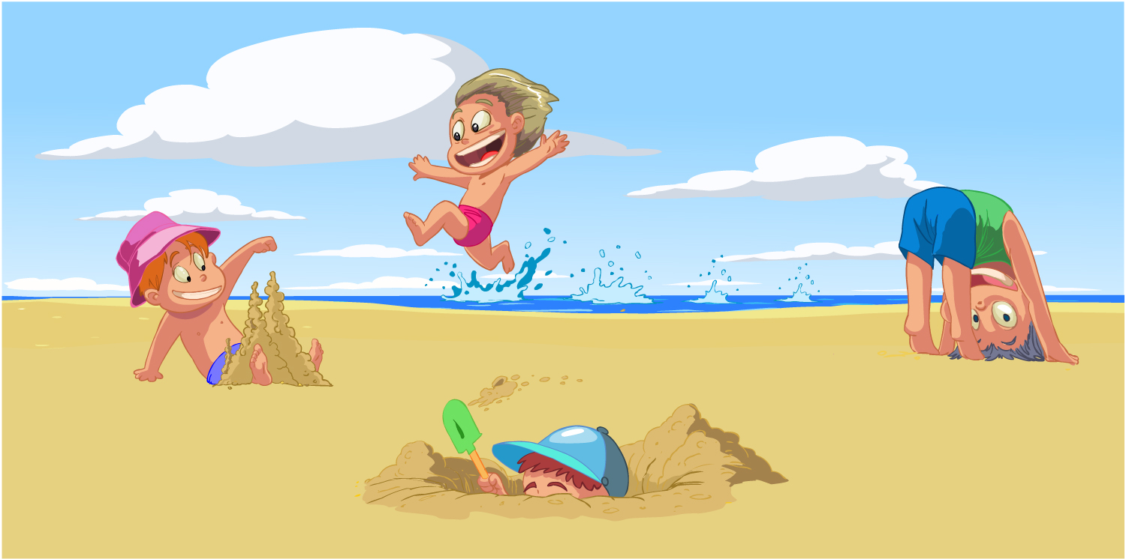
7. They / play on the beach.

