Slide 1

JERRY’S DOOR
By Artem Morozov
START
© Artem Morozov, 2020

Slide 2
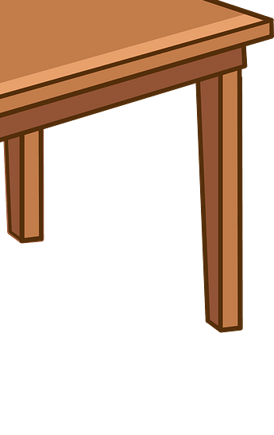

What is this?
CHECK
A table!

Slide 3

What is this?
CHECK
A fridge!

Slide 4
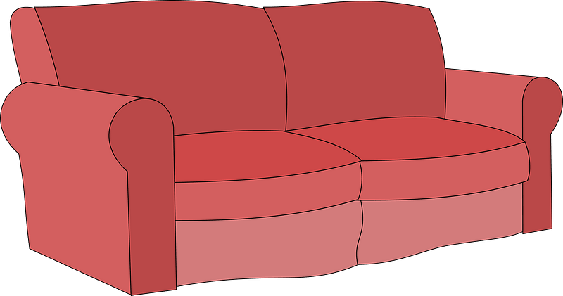
What is this?
CHECK
A sofa!

Slide 5
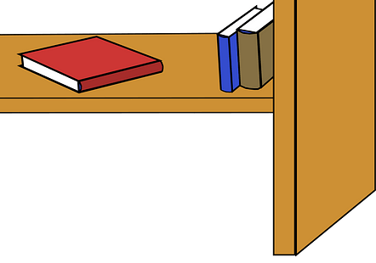
What is this?
CHECK
A bookcase!

Slide 6

What is this?
CHECK
A bed!

Slide 7

What is this?
CHECK
A fireplace!

Slide 8

What is this?
CHECK
A mat

Slide 9

What is this?
CHECK
A lamp!

Slide 10
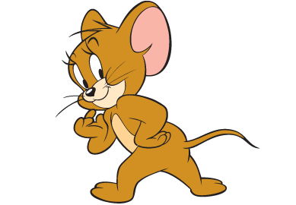
Well done!

