Slide 1
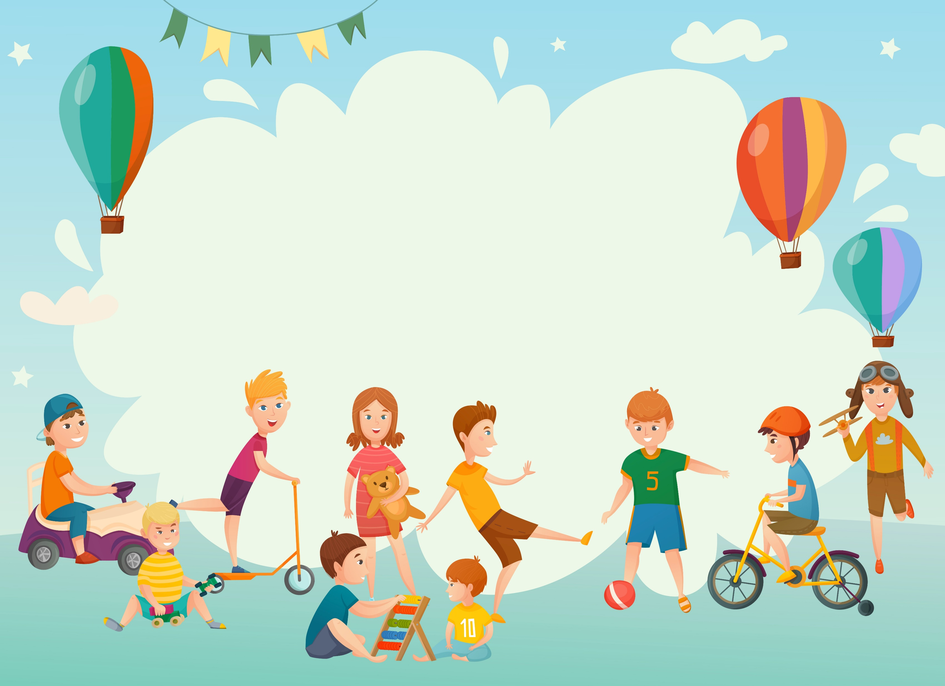


IrinaPapakhinac

Slide 2


1. What can we read?
2. What can we cook?
3. What can we fix?
4. What can we play?
5. Where can we skateboard?
6. Where can we swim?
IrinaPapakhinac

Slide 3

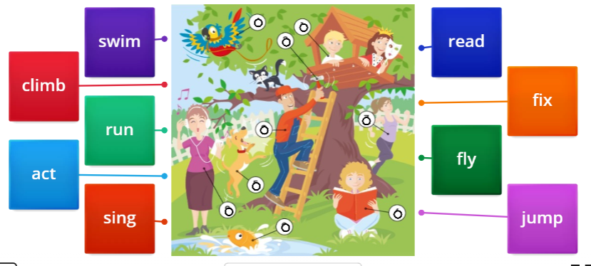
IrinaPapakhinac

Slide 4

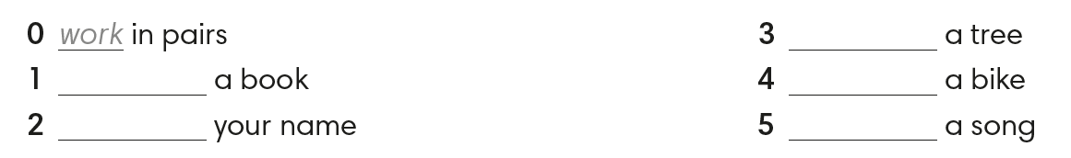
read
work
write
cook
sing
climb
ride
IrinaPapakhinac

Slide 5
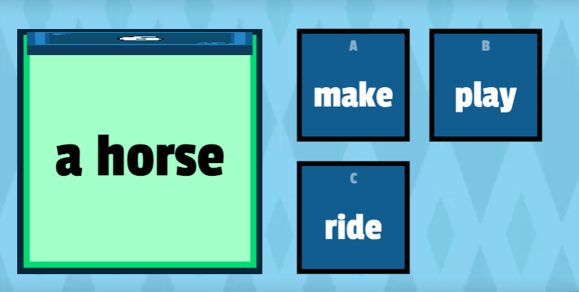
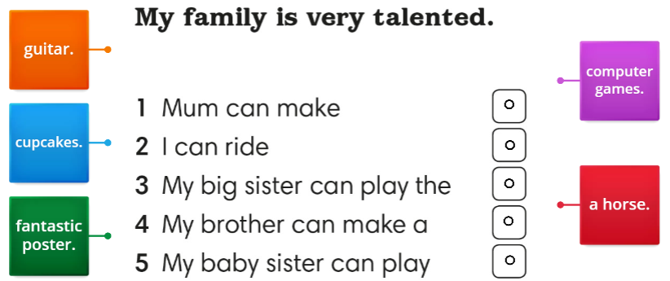
IrinaPapakhinac

Slide 6







Make sentences with these verbs.
ex: We can make cupcakes at home.
make
climb
fix
read
play
swim
draw
ride
cook
IrinaPapakhinac

Slide 7
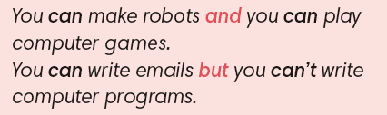
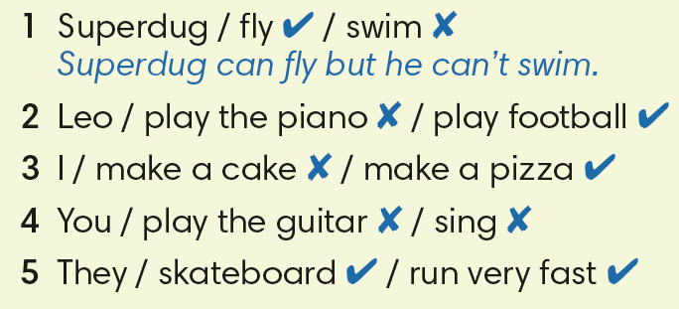
Make sentences with can or can’t and and or but.
2. Leo can play the piano but he can’t play football.
3. I can’t make a cake but I can make a pizza.
4. You can’t play the guitar and you can’t sing.
5. They can skateboard and they can run very fast.
IrinaPapakhinac

Slide 8


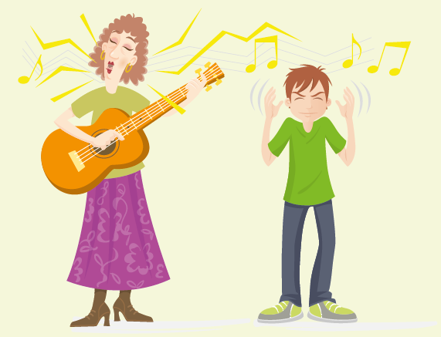

IrinaPapakhinac

Slide 9
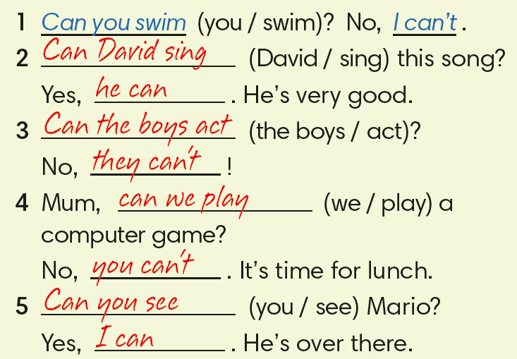
IrinaPapakhinac

Slide 10
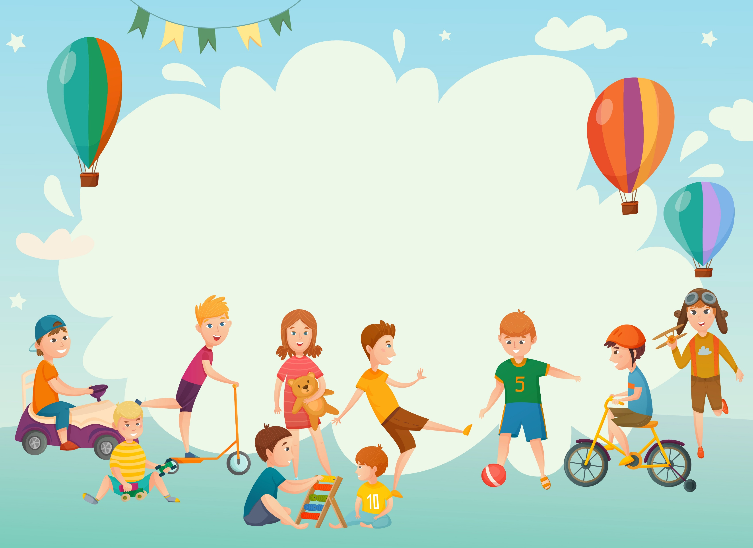
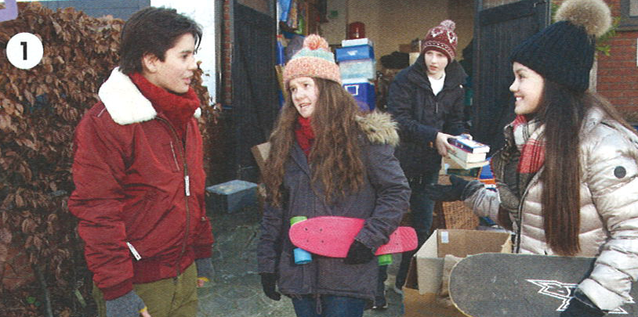
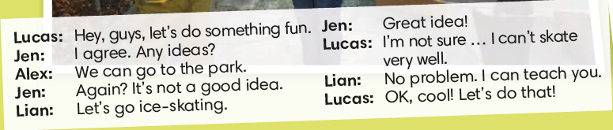
IrinaPapakhinac

Slide 11
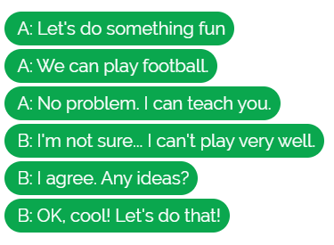
Put the dialogue in the correct order.
IrinaPapakhinac

Slide 12
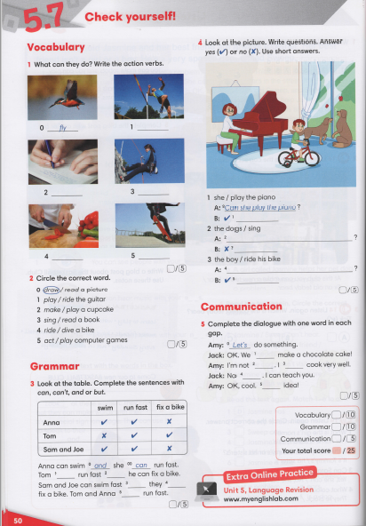
IrinaPapakhinac

Slide 13
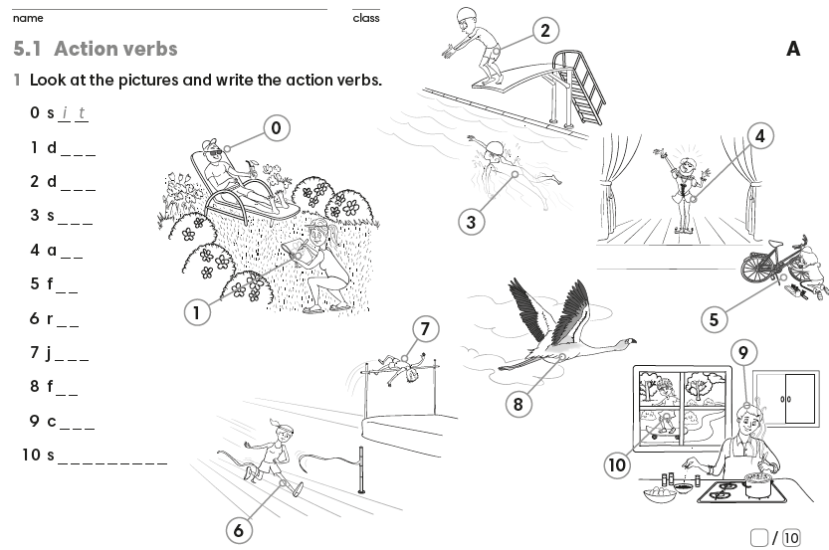
Guess the words.
IrinaPapakhinac

Slide 14
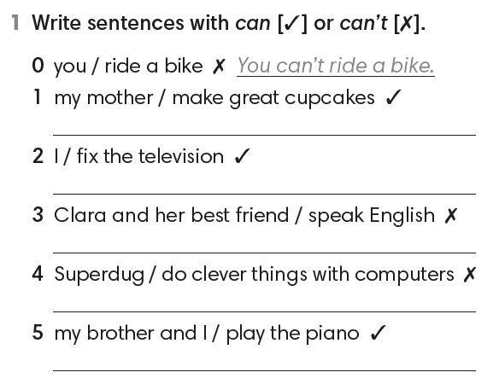
My mother can make great cupcakes.
I can fix the television.
Clara and her best friend can’t speak English.
Superdug can’t do clever things with computers.
My brother and I can play the piano.
IrinaPapakhinac

Slide 15
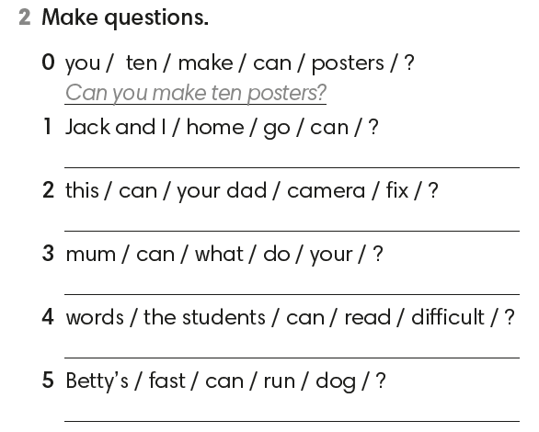

Can Jack and I go home?
Can your dad fix this camera?
What can you mum do?
Can the students read difficult words?
Can Betty’s dog run fast?
IrinaPapakhinac

Slide 16
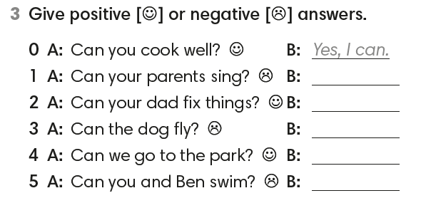
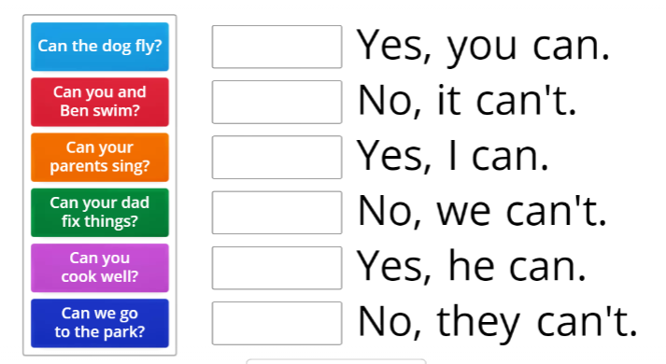
No, they can’t.
Yes, he can.
No, it can’t.
Yes, you can.
No, we can’t.
IrinaPapakhinac

