Slide 1




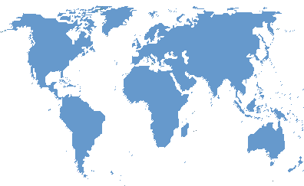






Some English Speaking Countries

Slide 2
England

Slide 3

Wales

Slide 4
Scotland

Slide 5

Great Britain
GB

Slide 6

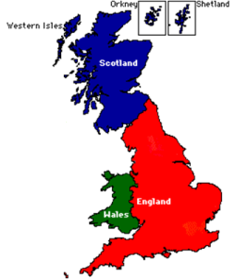
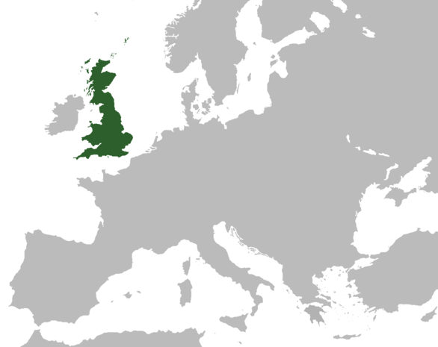
England
Scotland
Wales
Great Britain

Slide 7
England

Slide 8
Wales

Slide 9
Scotland

Slide 10

Northern Ireland

Slide 11
The United Kingdom
UK

Slide 12
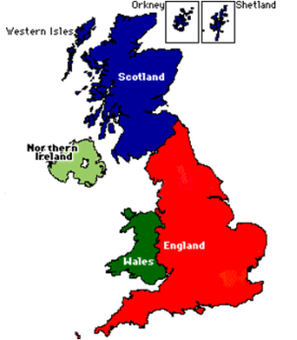
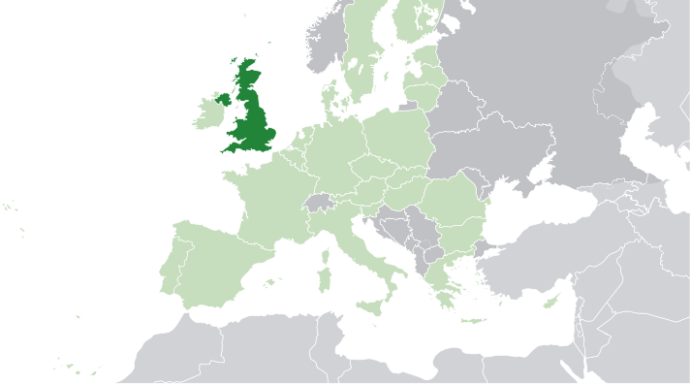
England
Scotland
Wales
Northern
Ireland
The United Kingdom

Slide 13
England

Slide 14
Wales

Slide 15
Scotland

Slide 16
Northern Ireland

Slide 17
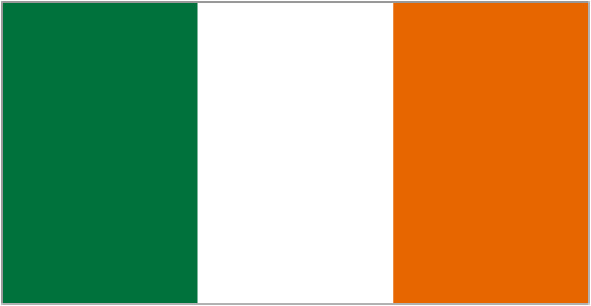
Ireland

Slide 18

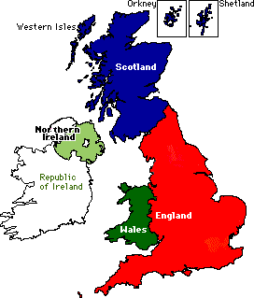
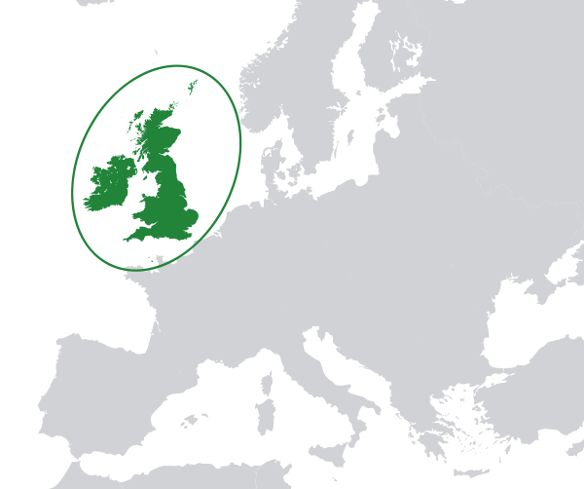
England
Scotland
Wales
Northern
Ireland
The Republic of Ireland
The British Isles

Slide 19

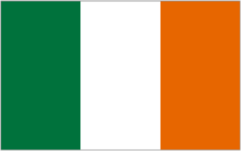

United Kingdom

Slide 20

The United States
Of America
(usa)

Slide 21
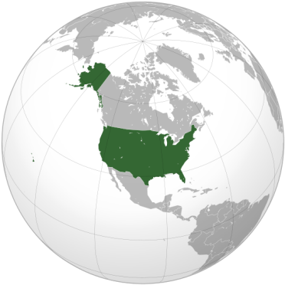
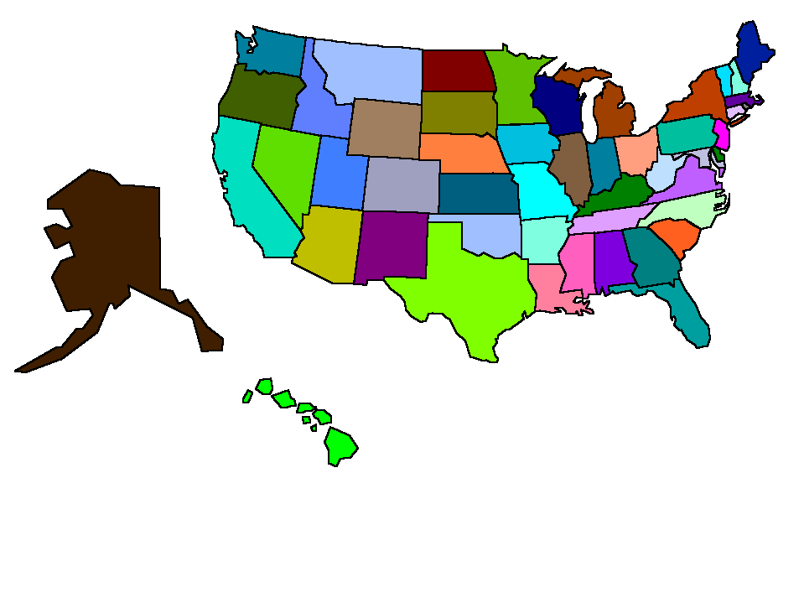
USA
48 states
Alaska
Hawaii

Slide 22
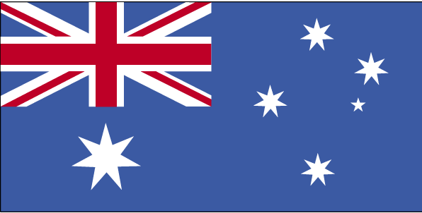
Australia

Slide 23
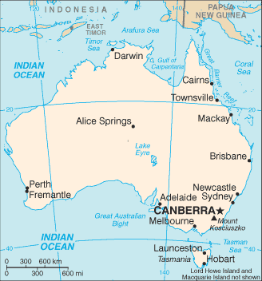
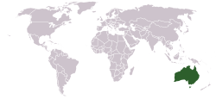
Australia

Slide 24

New Zealand

Slide 25
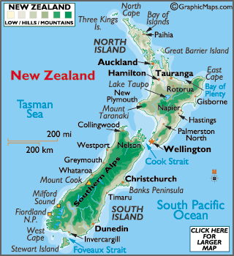
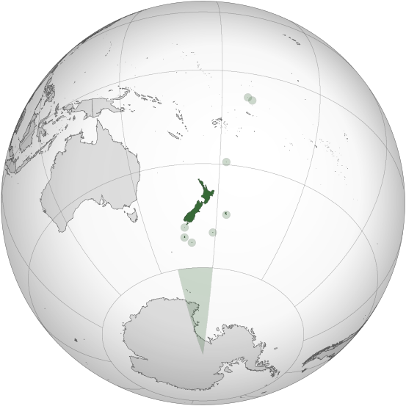
NEW
ZEALAND

Slide 26

Canada

Slide 27
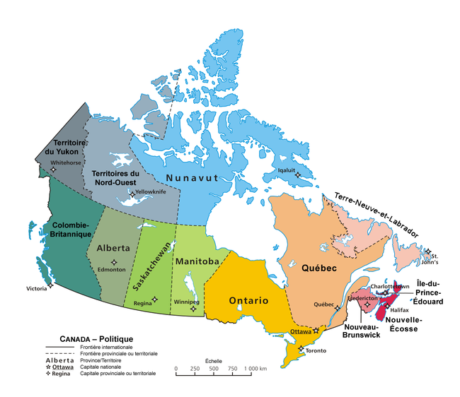
CANADA
10 provinces
and
3 territories

Slide 28
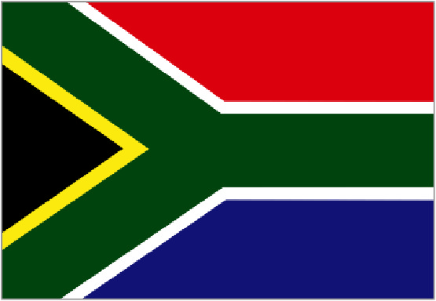
South Africa

Slide 29
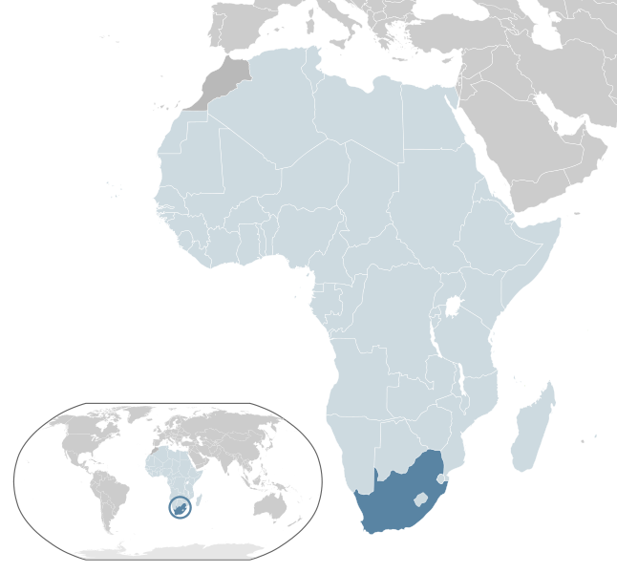
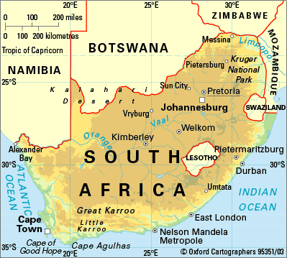
South Africa

Slide 30
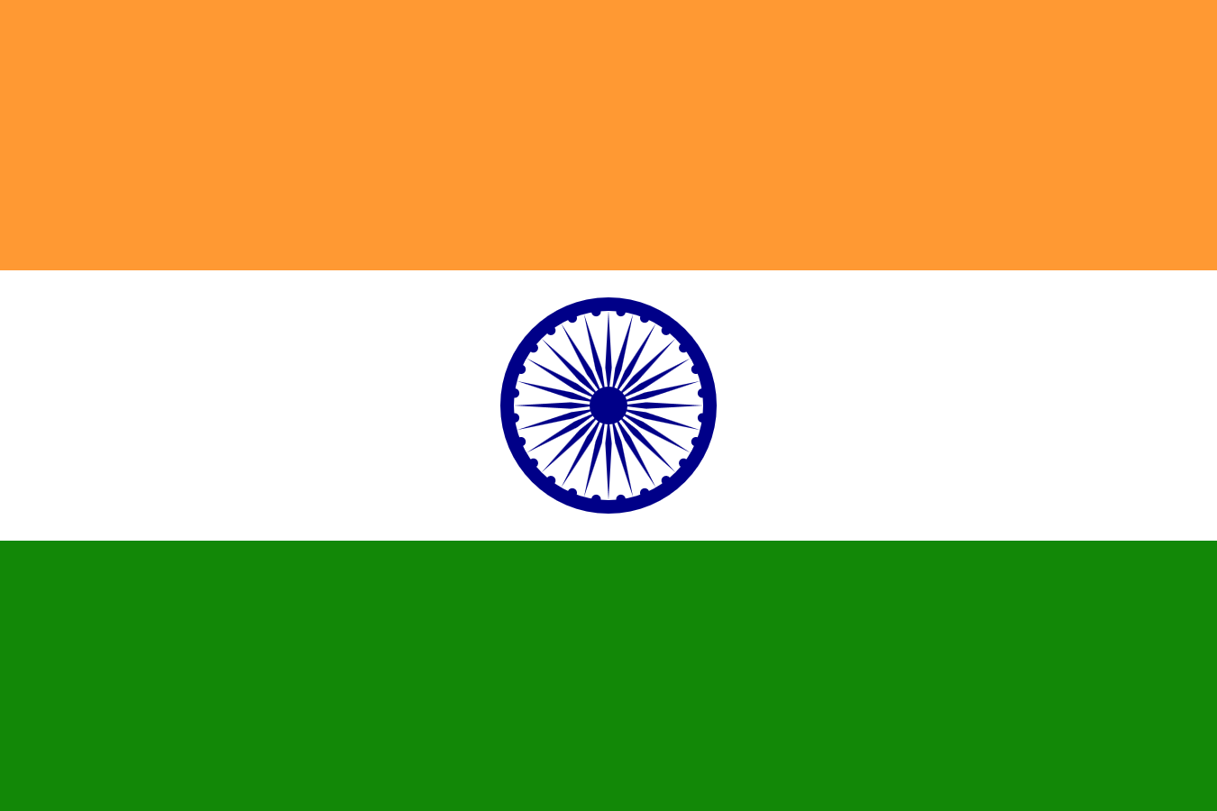
India

Slide 31
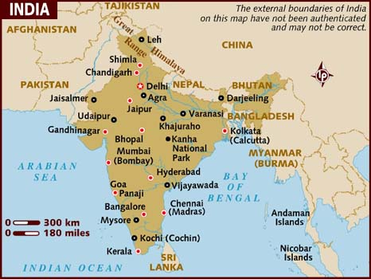
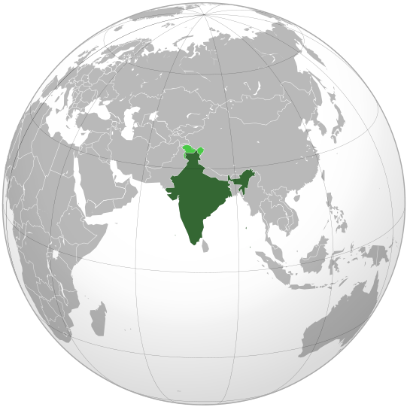
India

