Slide 1
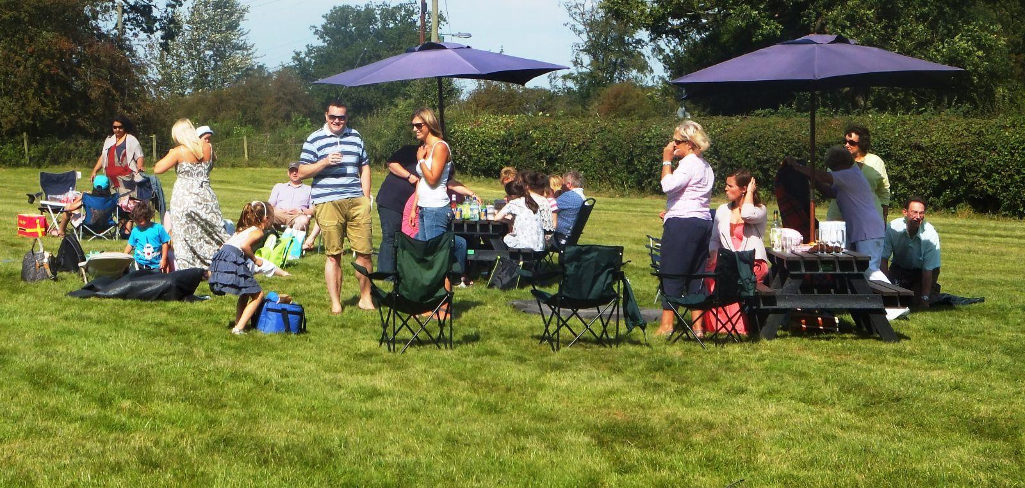
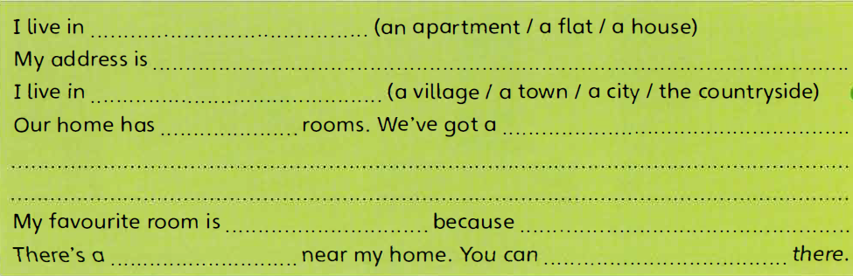

Slide 2

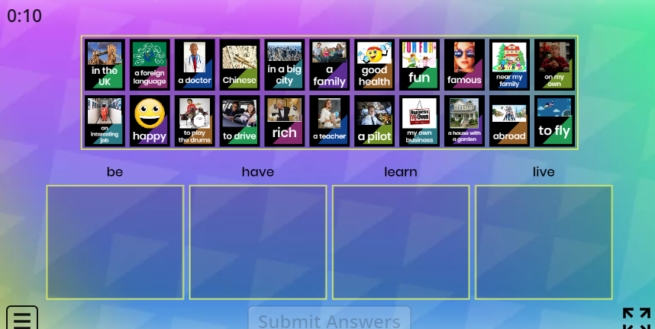

Slide 3








I will / won’t … when I grow up.
be rich
be famous
have a family
have
an interesting job
have
my own business
speak
a foreign language
learn to drive
live abroad
live on my own

Slide 4

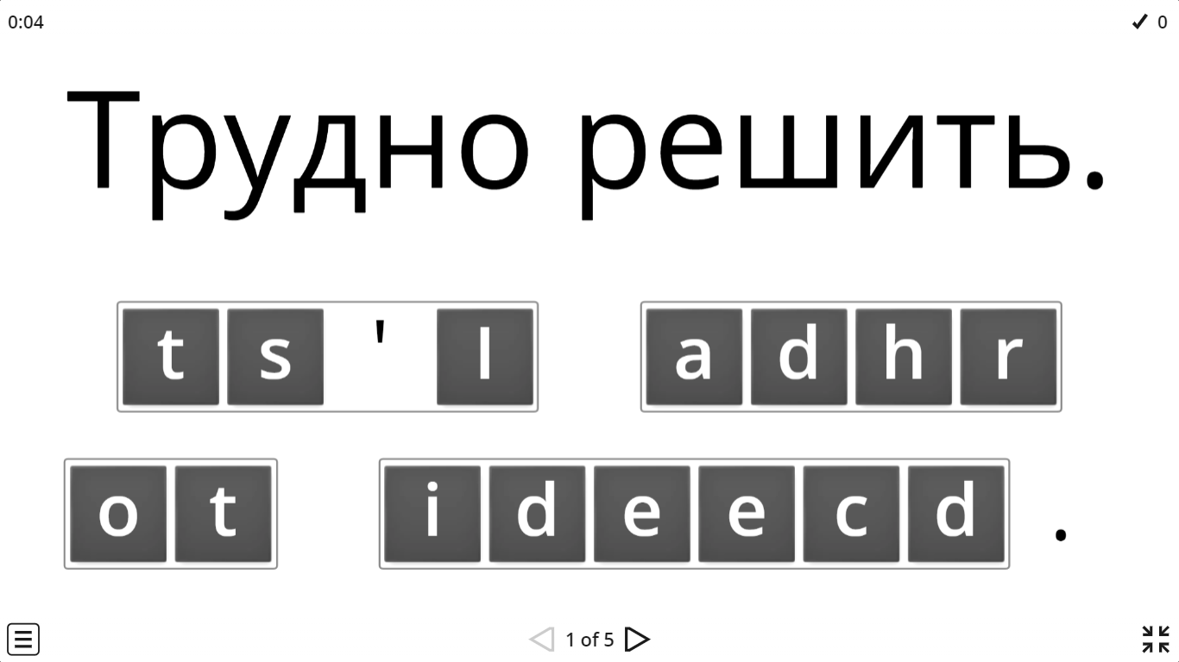
IrinaPapakhina

Slide 5
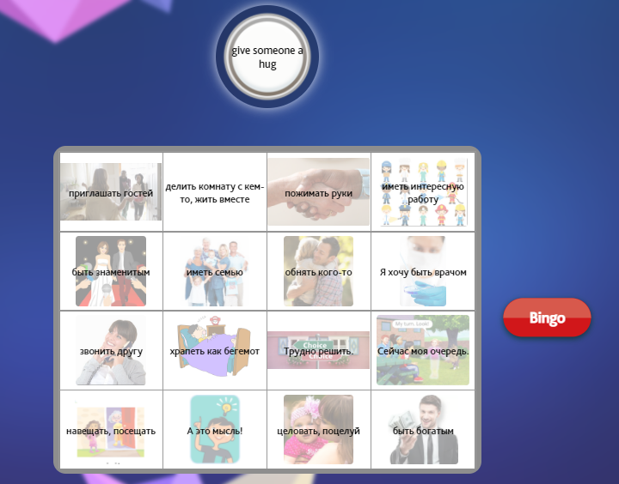
IrinaPapakhina

Slide 6
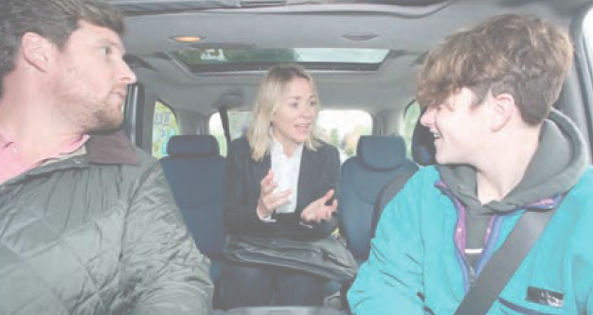
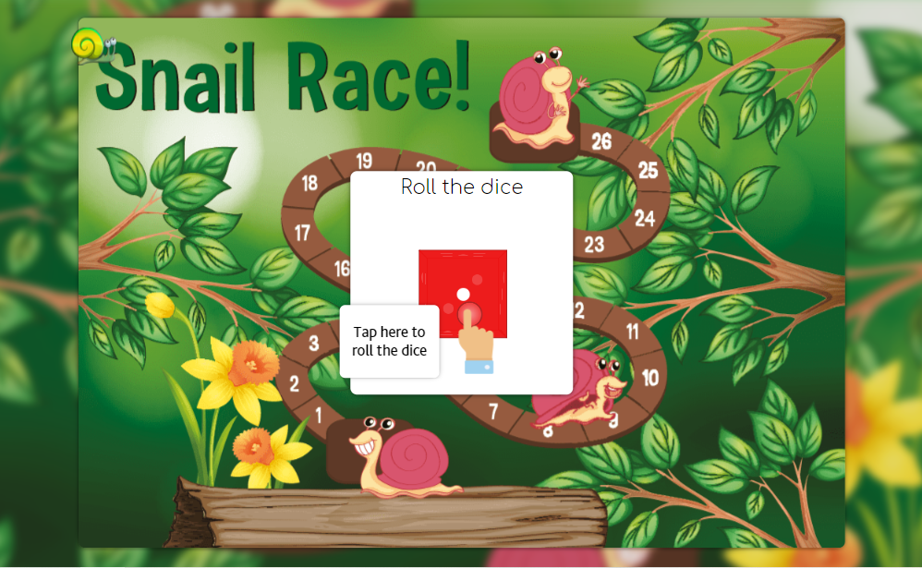
IrinaPapakhina

Slide 7

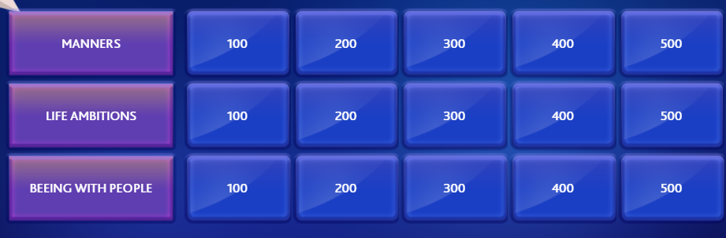

IrinaPapakhina

Slide 8


Slide 9
