Slide 1
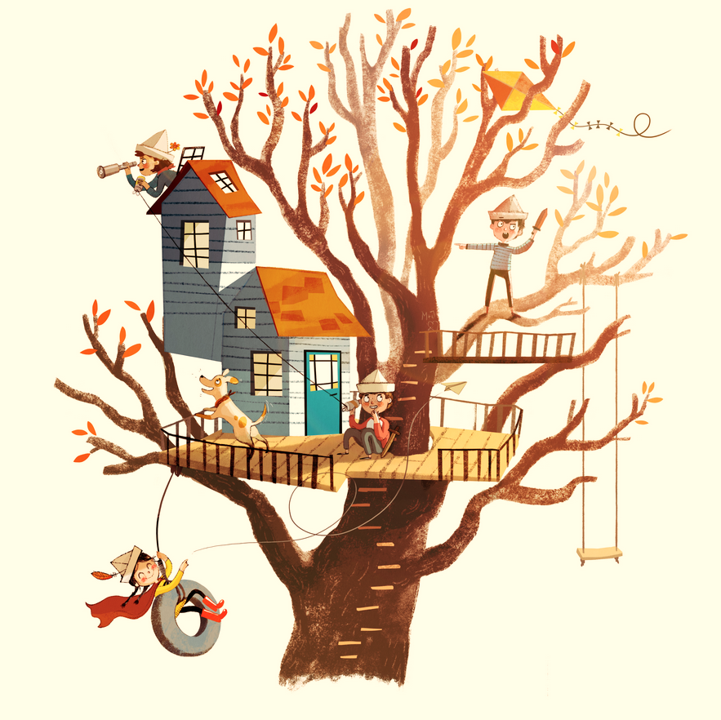


IrinaPapakhinac

Slide 2

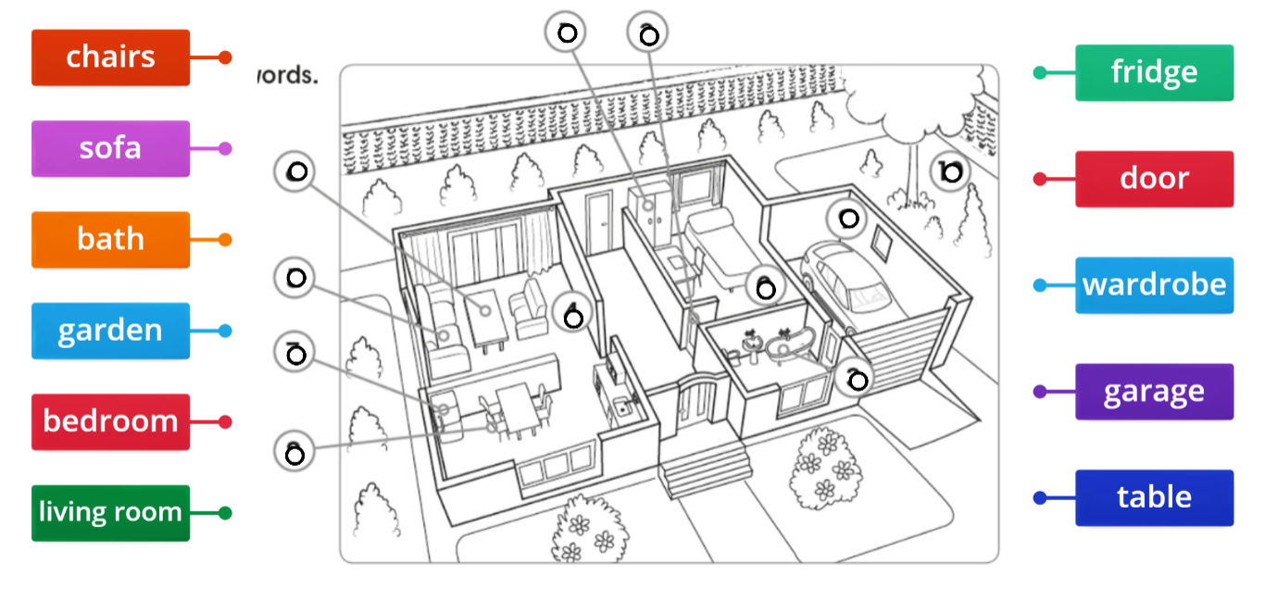
IrinaPapakhinac

Slide 3
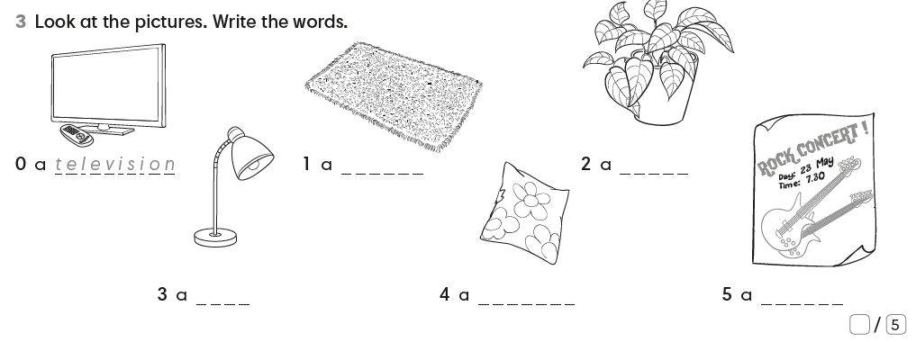
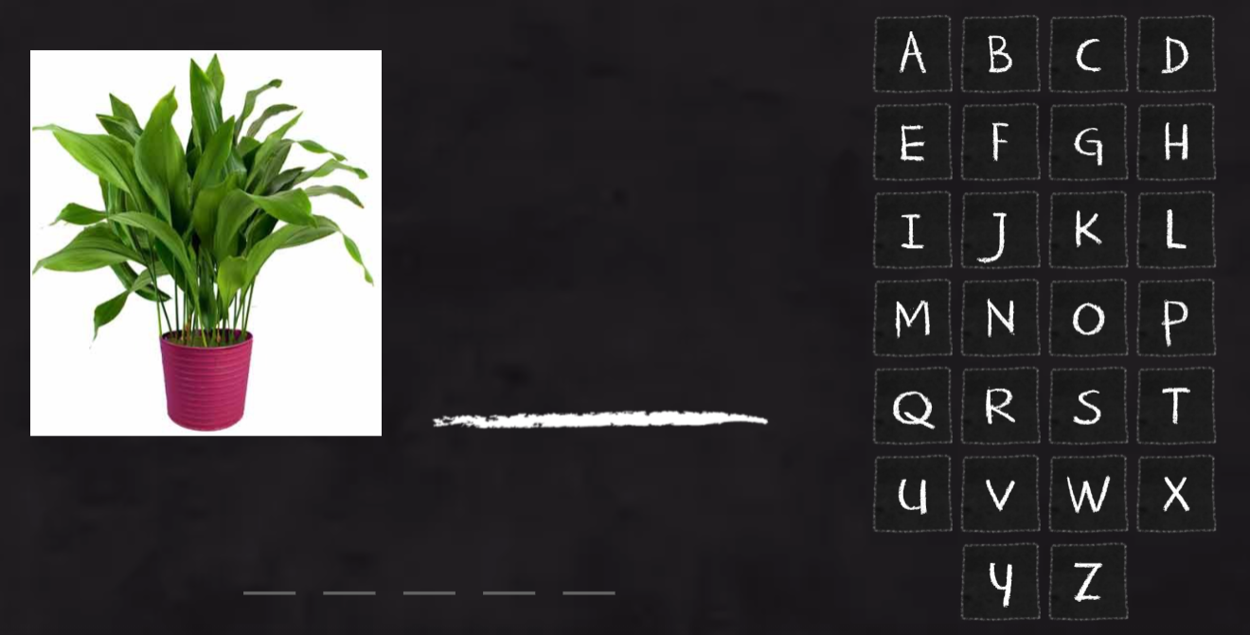
carpet
plant
lamp
cushion
poster
IrinaPapakhinac

Slide 4
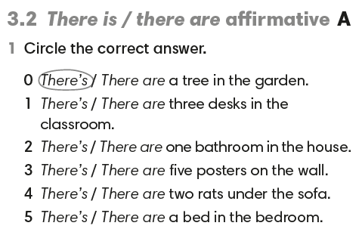
IrinaPapakhinac

Slide 5
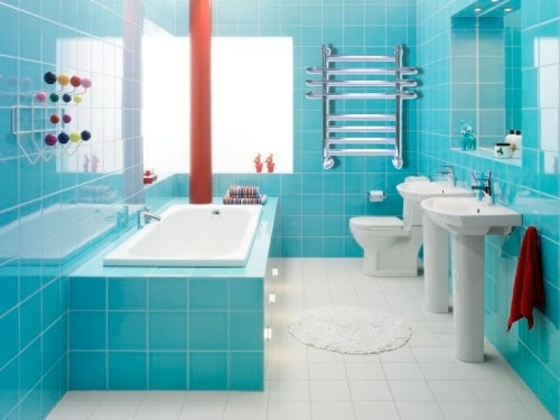
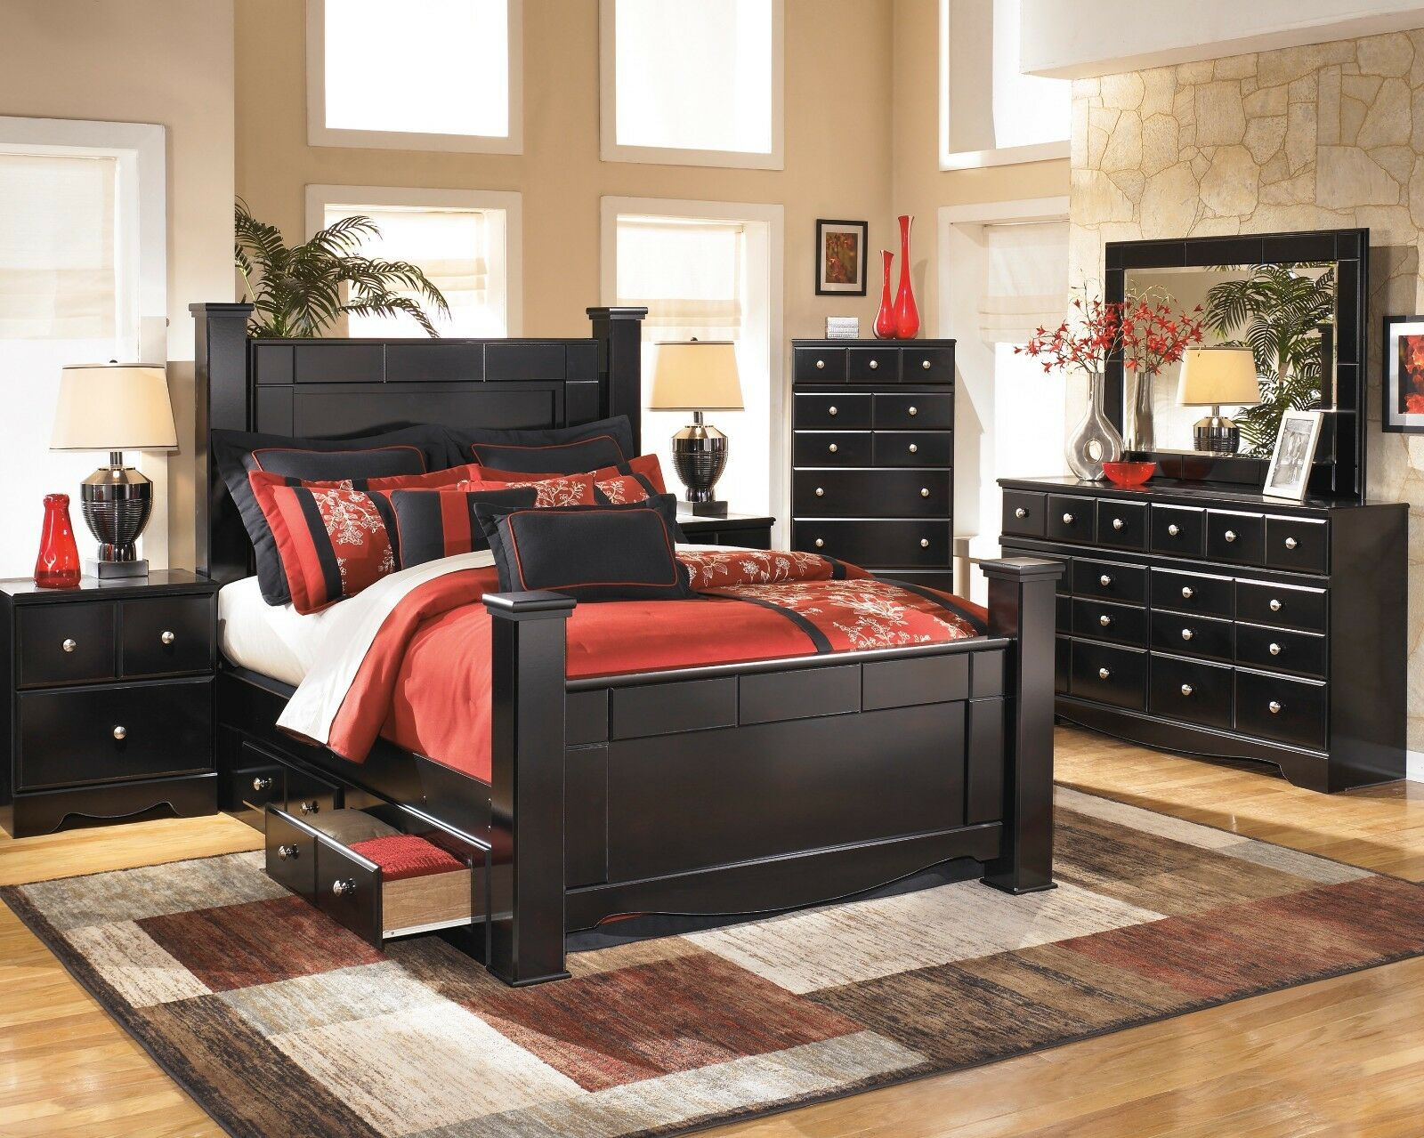
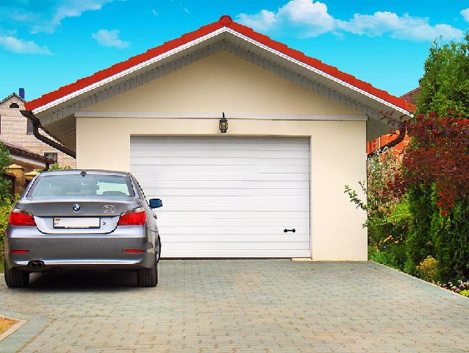
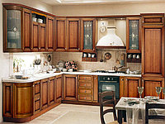
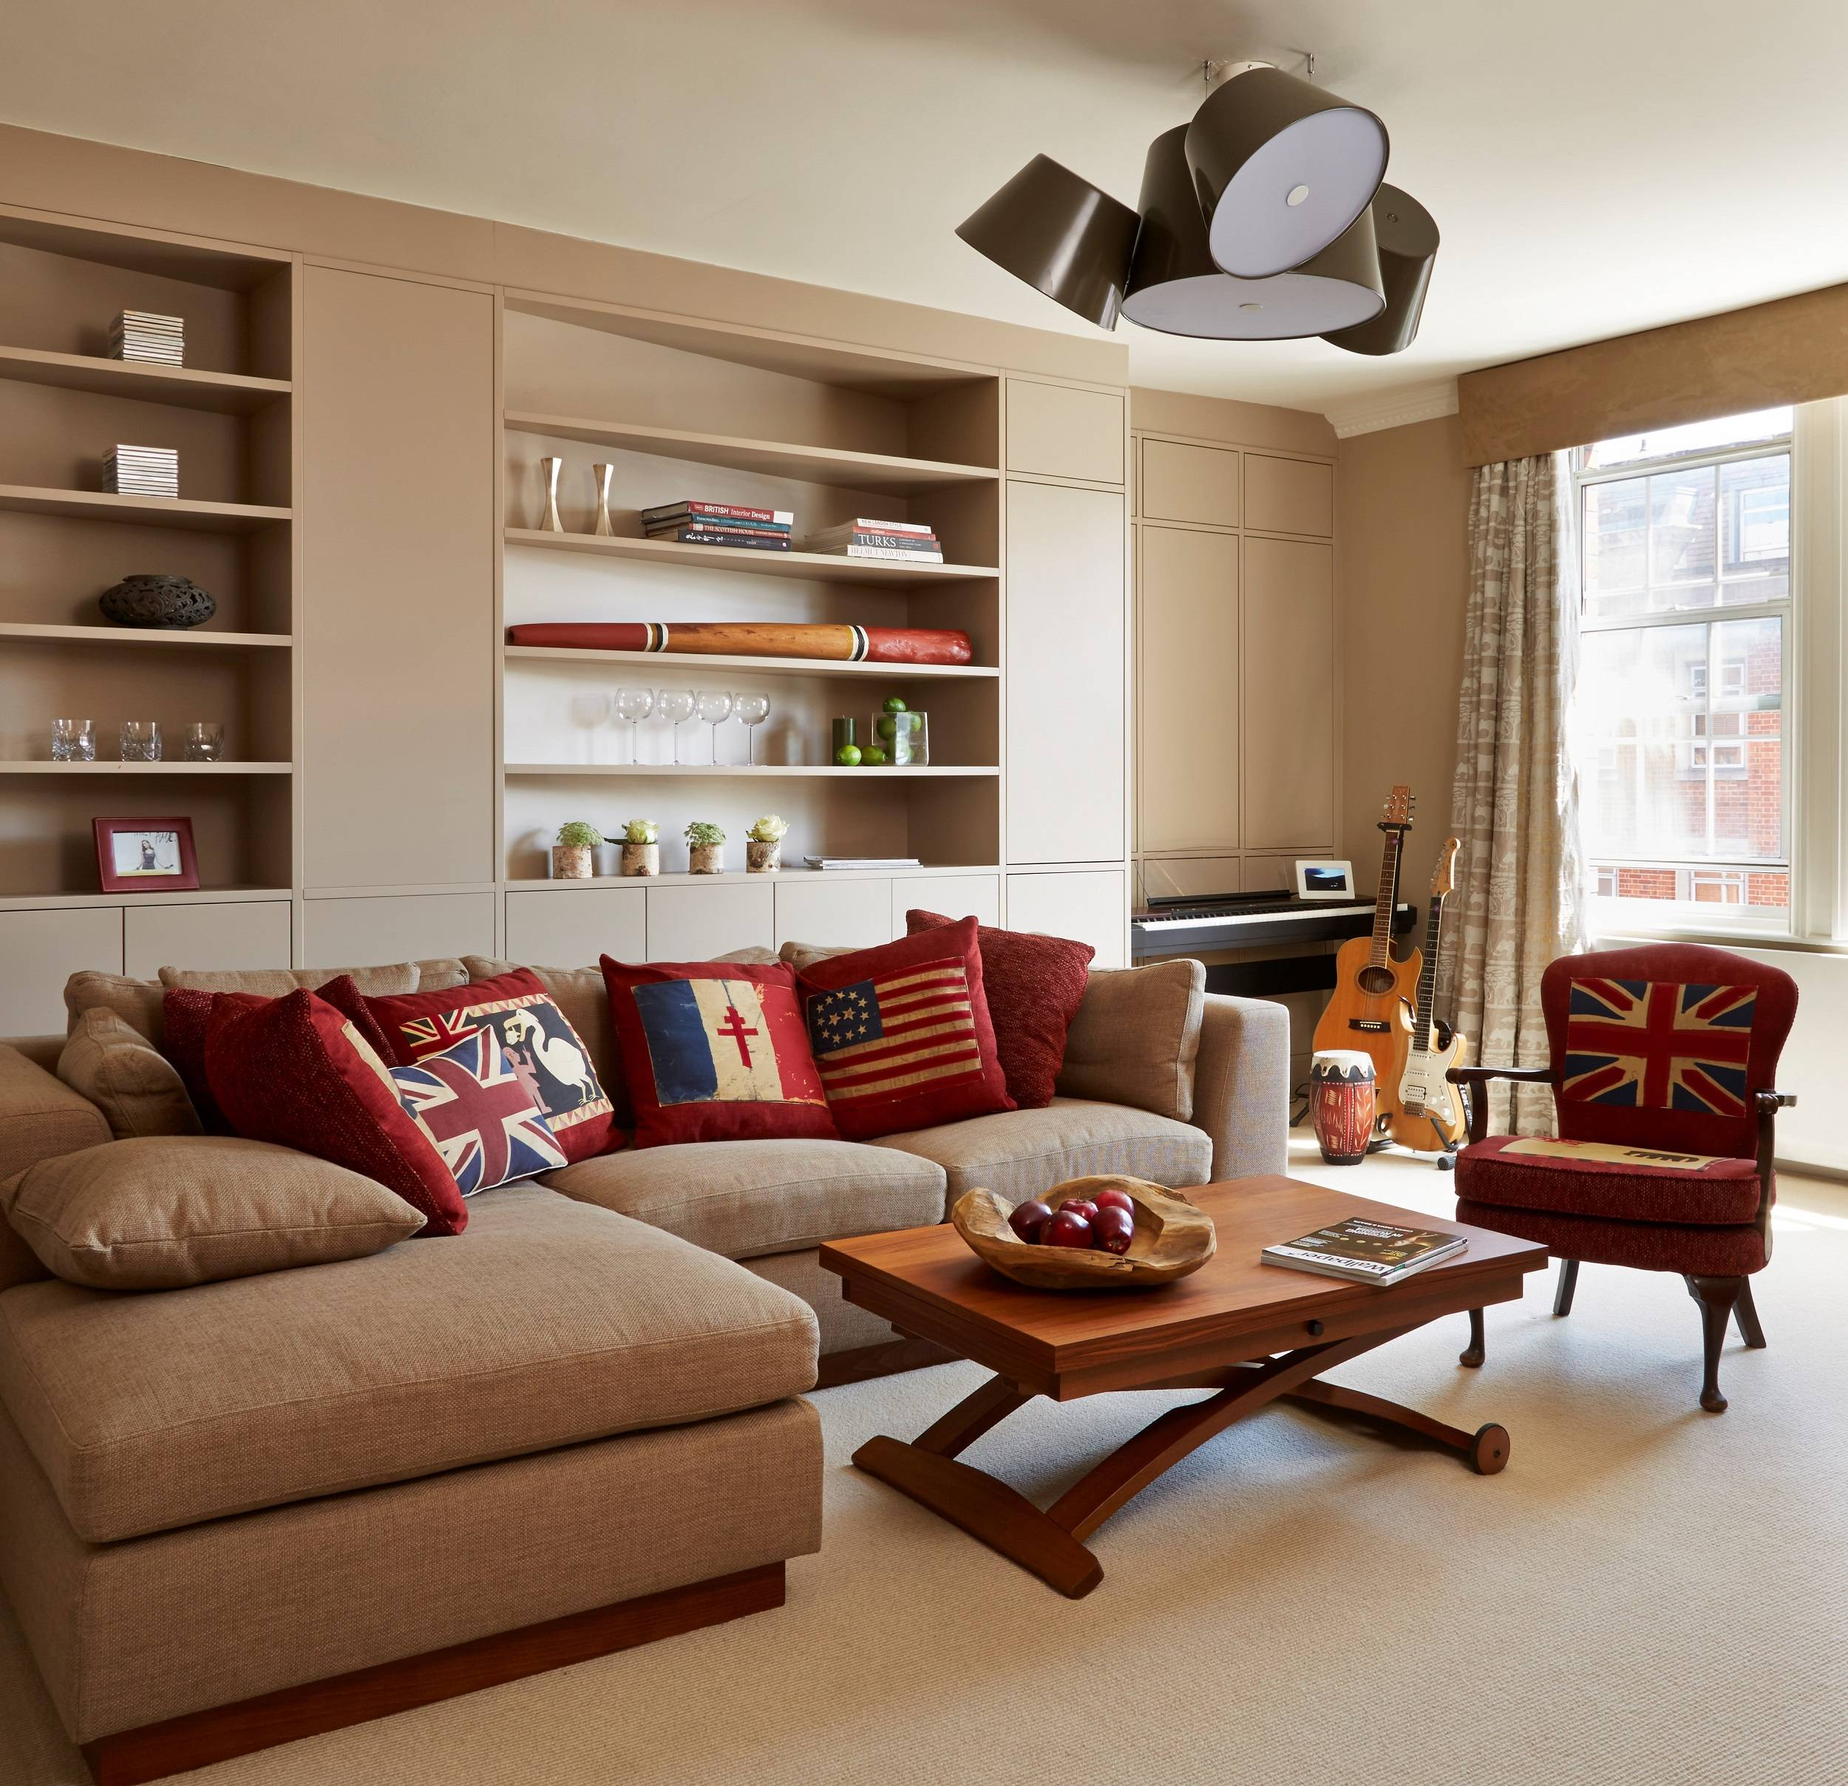
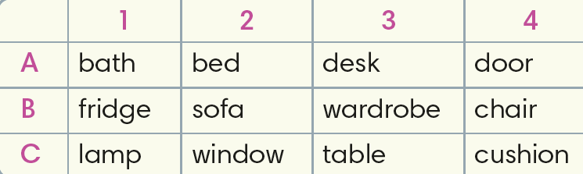
1. Name the rooms.
2. Choose a square.
Say where this things are in you in house.
3B There is a wardrobe in my parents’ bedroom.
IrinaPapakhinac

Slide 6
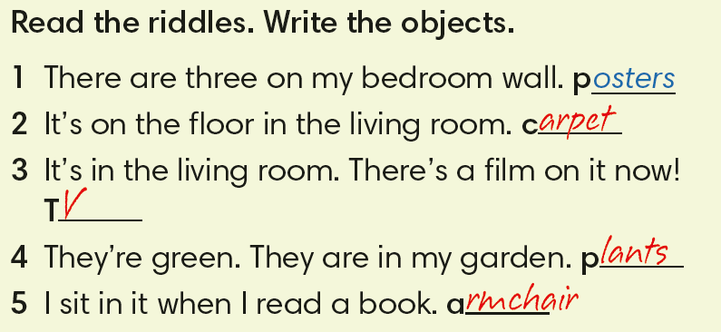
IrinaPapakhinac

Slide 7
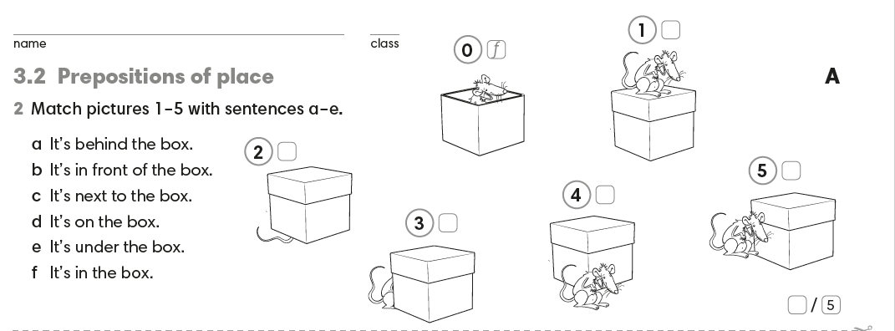
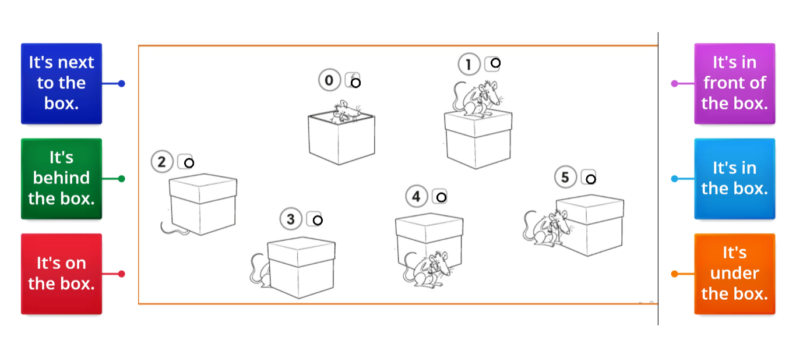
IrinaPapakhinac

Slide 8
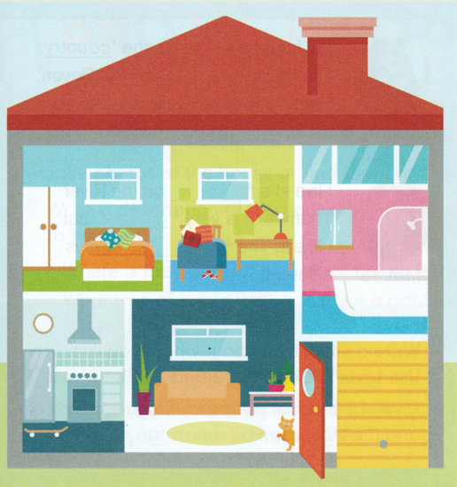
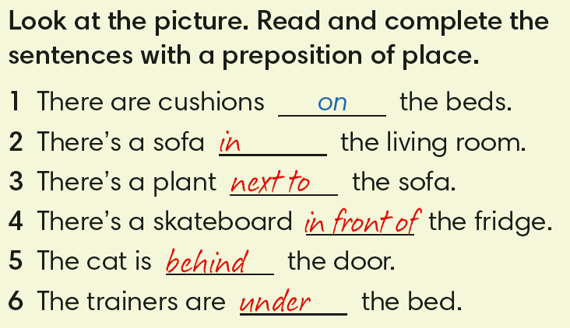
IrinaPapakhinac

Slide 9
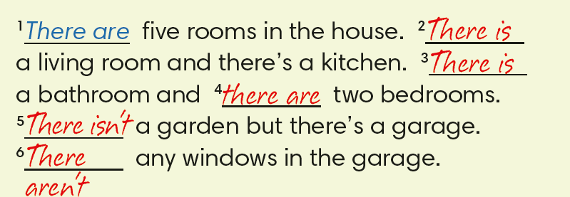
Look at the picture. Complete the text with
there is, there isn’t, there are, there aren’t.
IrinaPapakhinac

Slide 10
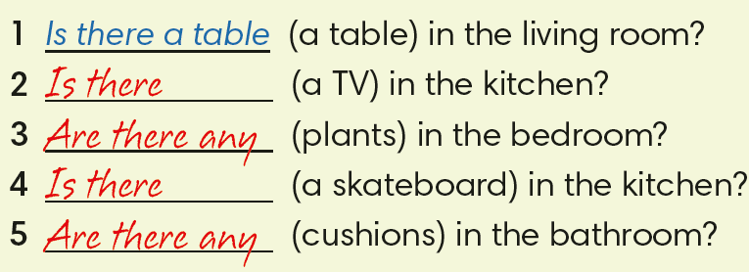
Look at the picture. Complete the question with
there is, there isn’t, there are, there aren’t
and the words in brackets.
Yes, there is.
No, there isn’t.
No, there aren’t.
Yes, there is.
No, there aren’t
IrinaPapakhinac

Slide 11
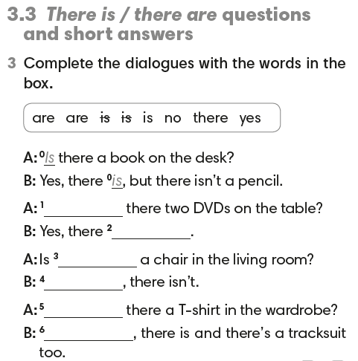
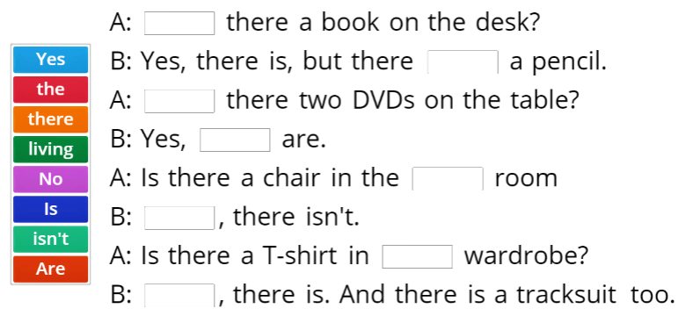
IrinaPapakhinac

Slide 12

IrinaPapakhinac

Slide 13
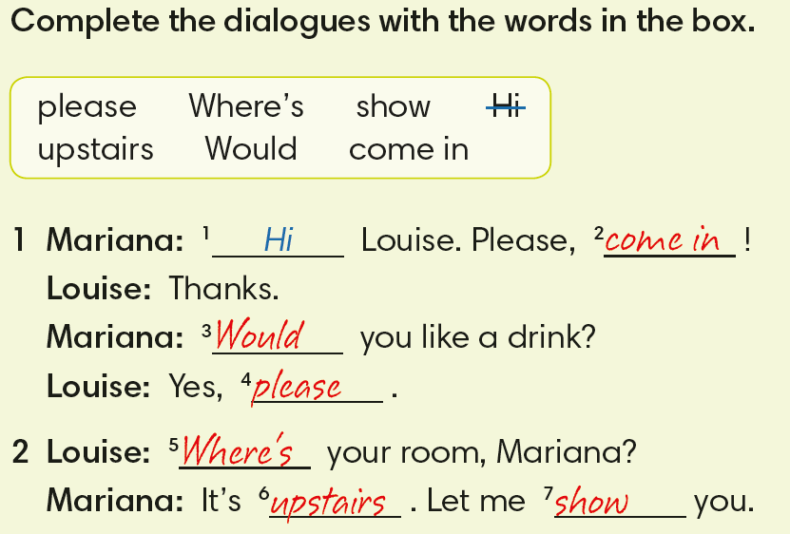
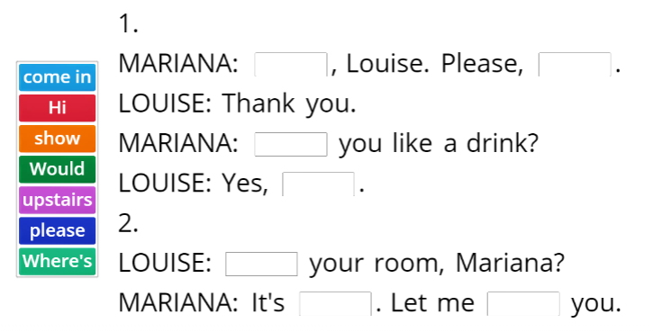
IrinaPapakhinac

Slide 14

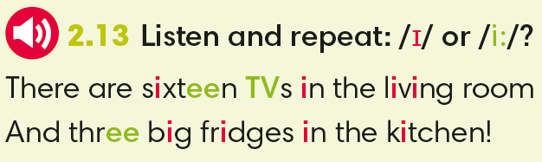
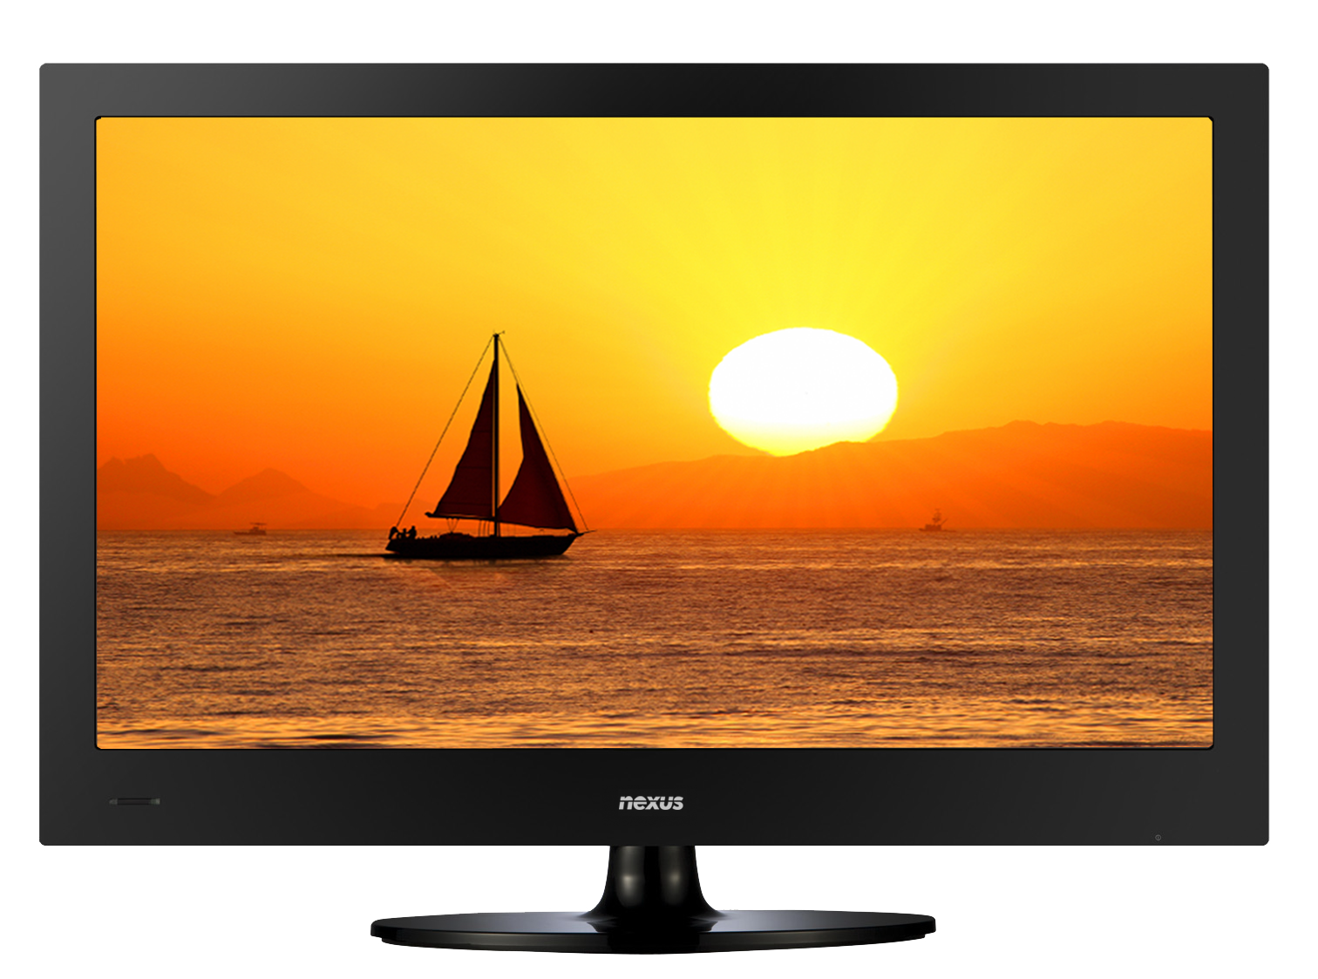
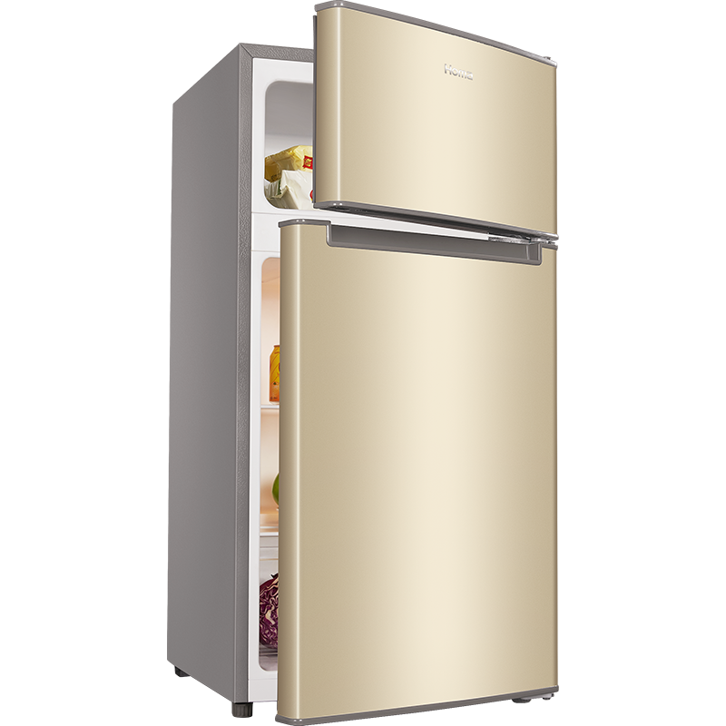
Read the sentences again and circle the correct answer.
There are 6 / 16 / 60 TVs in the living room.
And 3 / 13 / 30 big fridges in the kitchen.
IrinaPapakhinac

Slide 15
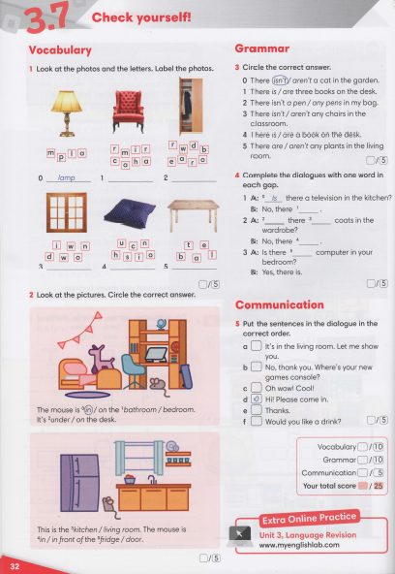
IrinaPapakhinac

