Slide 1
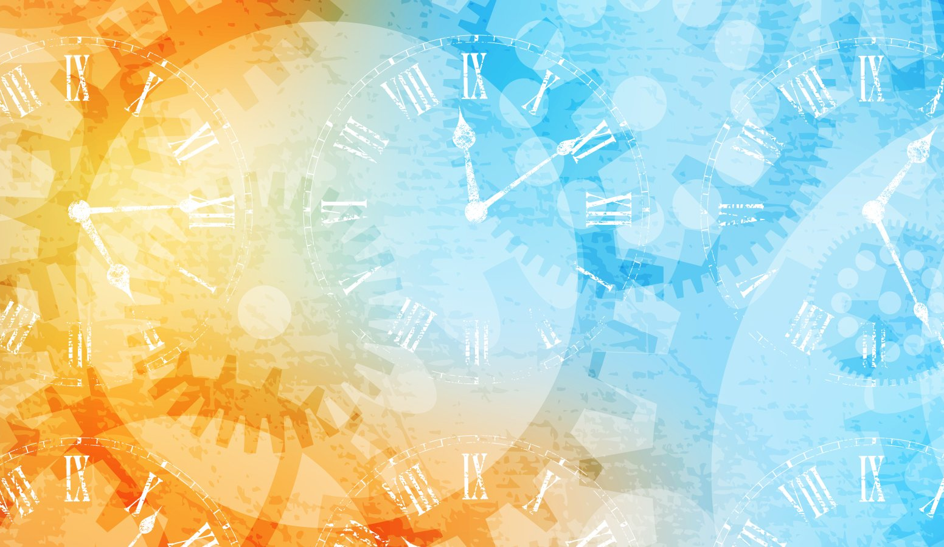


IrinaPapakhinac

Slide 2

IrinaPapakhinac

Slide 3
HOURS
0
It’s … o’clock.
5
12
5
1
2
3
11
1
4
5
6
10
10
10
2
7
8
9
10
11
12
1/4
9
3
1/4
MINUTES
8
4
1
2
3
20
20
4
5
6
7
5
6
7
8
9
25
25
1/2
10
11
12
IrinaPapakhinac
Notes:
O’clock

Slide 4
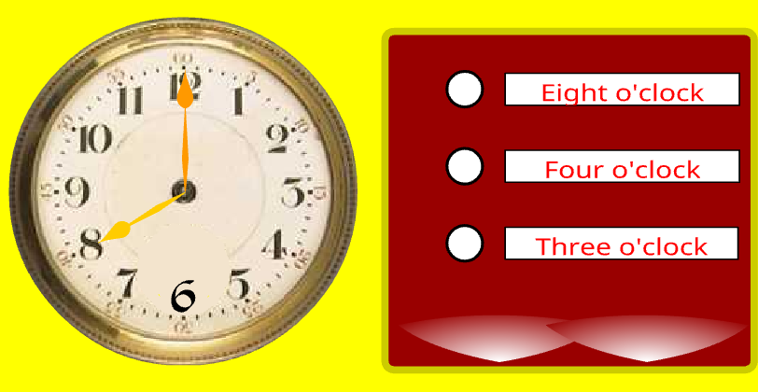
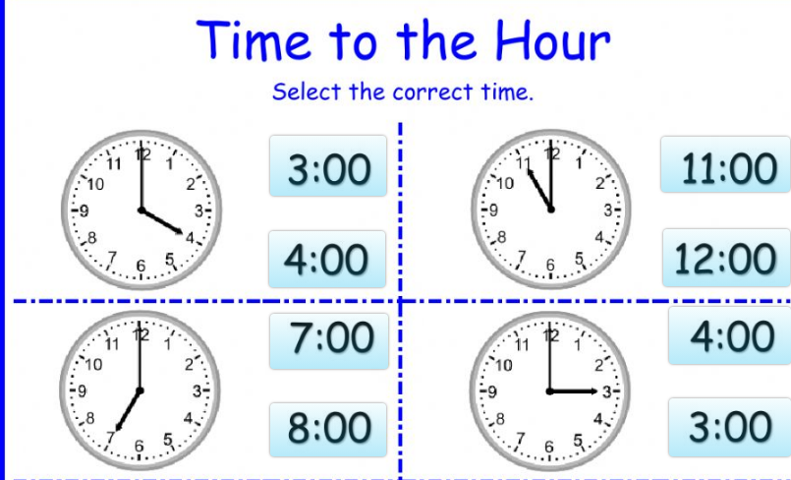
IrinaPapakhinac

Slide 5
HOURS
0
5
12
5
1
2
3
11
1
4
5
6
10
10
10
2
7
8
9
10
11
12
1/4
9
3
1/4
MINUTES
8
4
1
2
3
20
20
4
5
6
7
5
6
7
8
9
25
25
1/2
10
11
12
It’s half past … .
IrinaPapakhinac

Slide 6
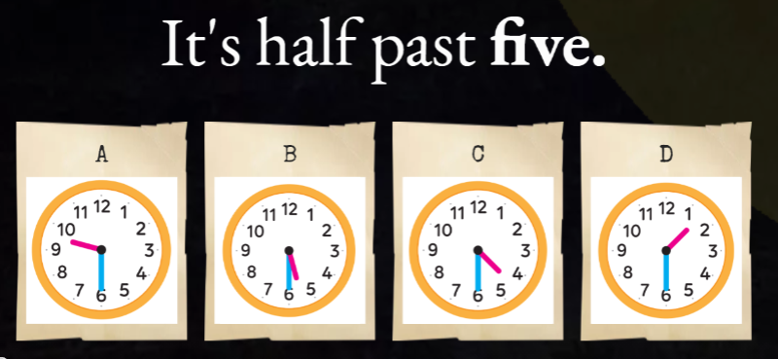
IrinaPapakhinac

Slide 7
HOURS
0
It’s … o’clock.
5
12
5
1
2
3
11
1
4
5
6
10
10
10
2
7
8
9
10
11
12
1/4
9
3
1/4
MINUTES
8
4
1
2
3
20
20
4
5
6
7
5
6
7
8
9
25
25
1/2
It’s half past … .
10
11
12
IrinaPapakhinac

Slide 8
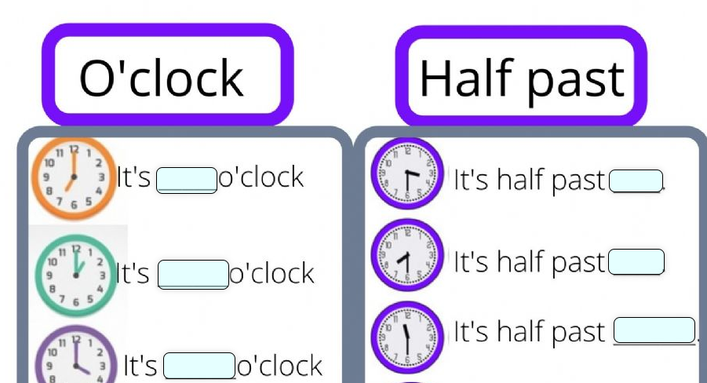
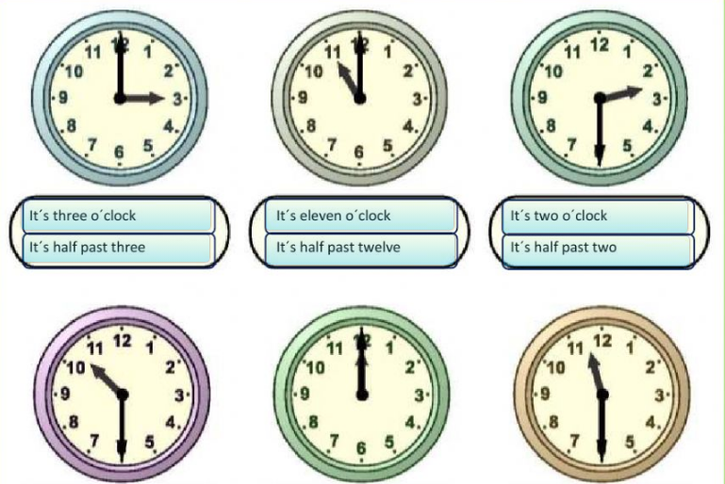
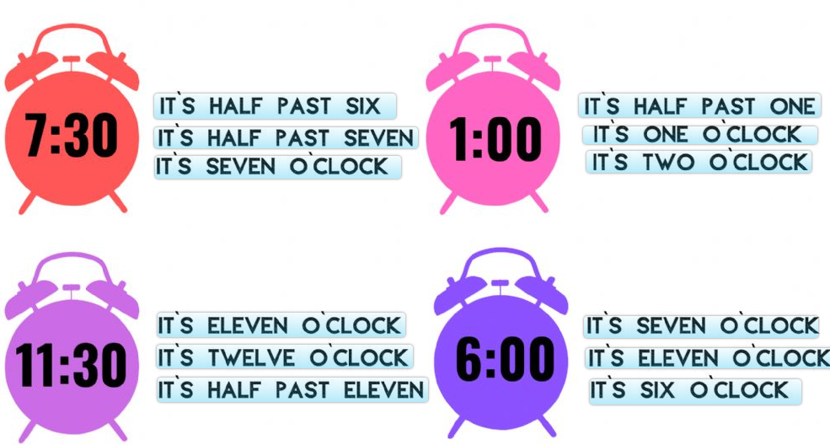
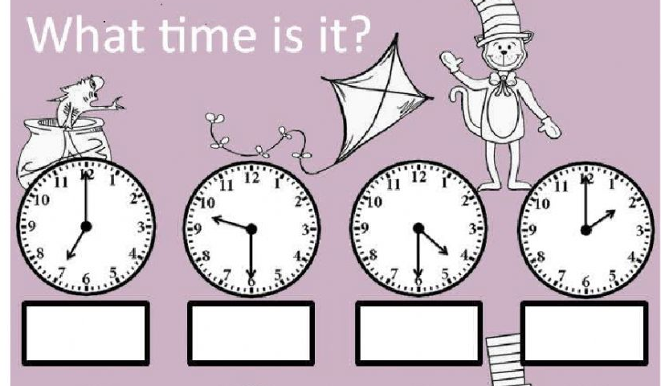
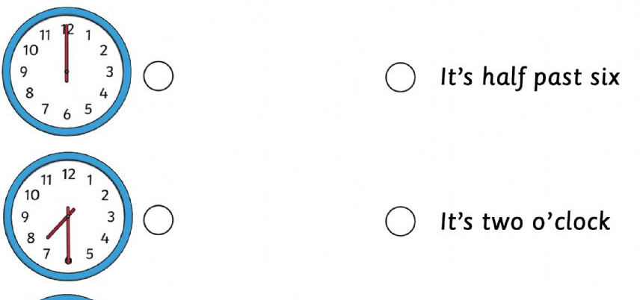
IrinaPapakhinac

Slide 9
HOURS
0
5
12
5
1
2
3
11
1
4
5
6
10
10
10
2
7
8
9
10
11
12
1/4
9
3
1/4
It’s quarter past … .
MINUTES
8
4
1
2
3
20
20
4
5
6
7
5
6
7
8
9
25
25
1/2
10
11
12
IrinaPapakhinac

Slide 10
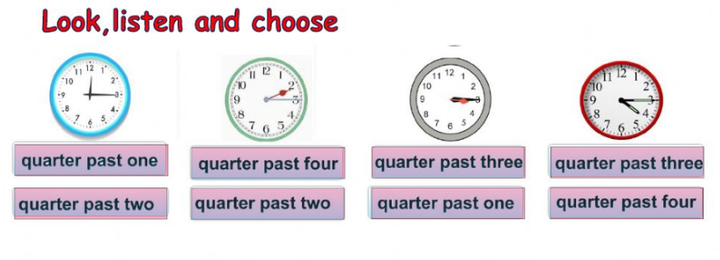
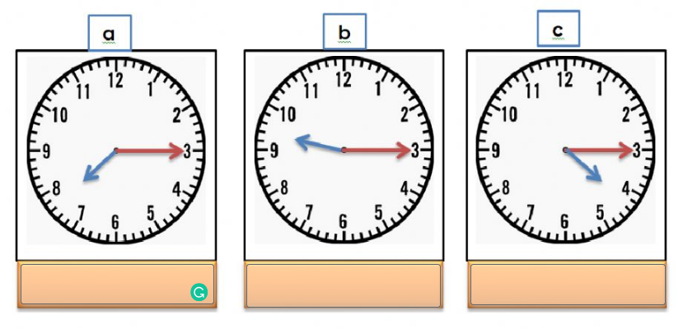
IrinaPapakhinac

Slide 11
HOURS
It’s … o’clock .
0
5
12
5
1
2
3
11
1
4
5
6
10
10
10
2
7
8
9
10
11
12
1/4
9
3
1/4
It’s quarter past … .
MINUTES
8
4
1
2
3
20
20
4
5
6
7
5
6
7
8
9
25
25
1/2
It’s half past … .
10
11
12
IrinaPapakhinac

Slide 12
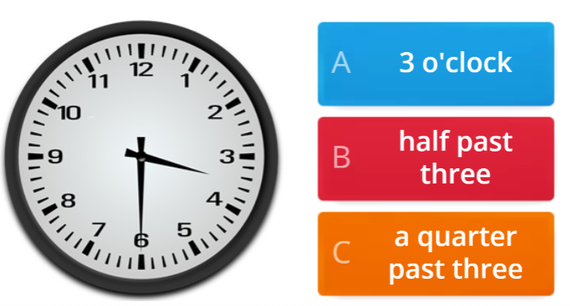
IrinaPapakhinac

Slide 13
HOURS
0
5
12
5
1
2
3
11
1
4
5
6
10
10
10
2
7
8
9
10
11
12
1/4
9
3
1/4
It’s quarter to … .
MINUTES
8
4
1
2
3
20
20
4
5
6
7
5
6
7
8
9
25
25
1/2
10
11
12
IrinaPapakhinac

Slide 14
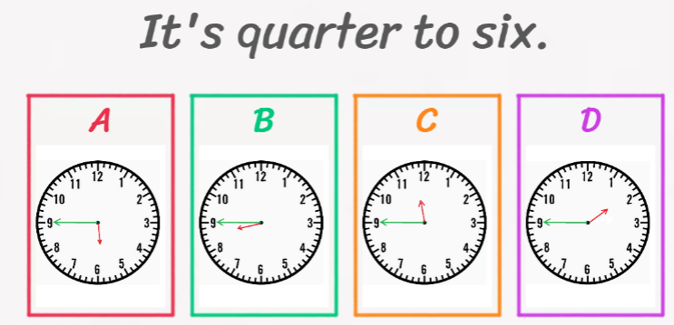
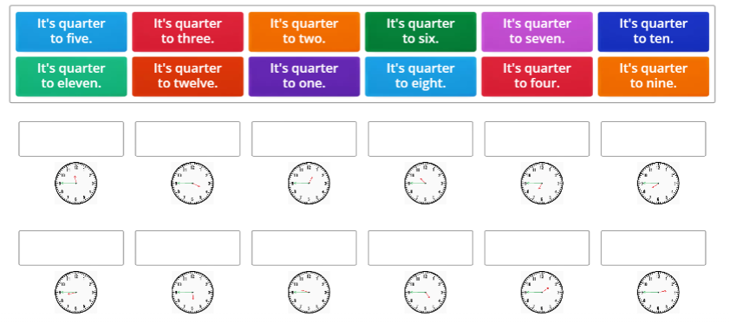
IrinaPapakhinac

Slide 15
HOURS
0
5
12
5
1
2
3
11
1
4
5
6
10
10
10
2
7
8
9
10
11
12
1/4
9
3
1/4
It’s quarter to ….
It’s quarter past … .
MINUTES
8
4
1
2
3
20
20
4
5
6
7
5
6
7
8
9
25
25
1/2
10
11
12
IrinaPapakhinac

Slide 16
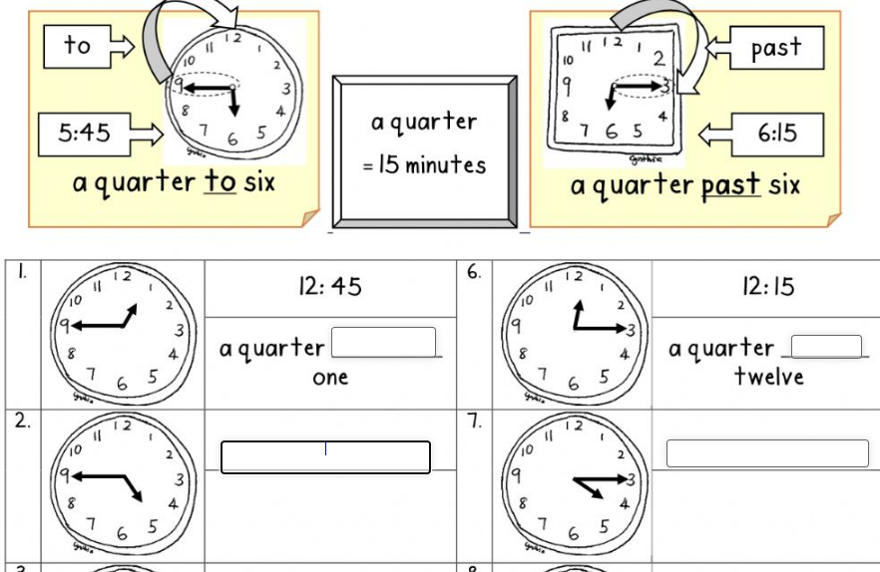
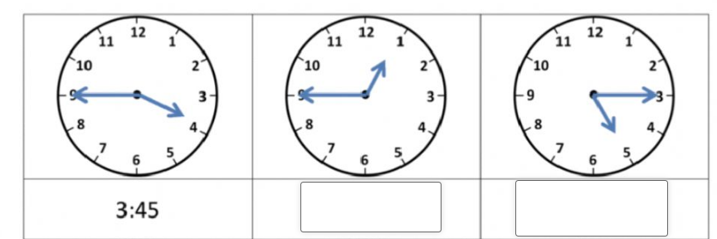
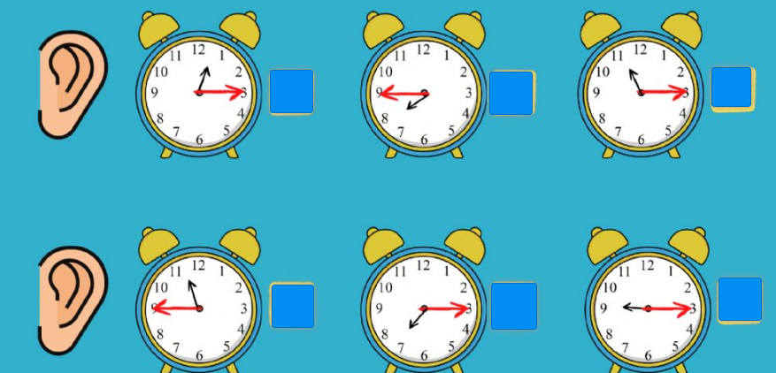
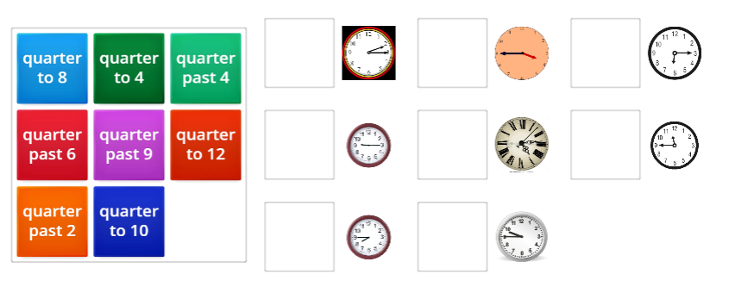
IrinaPapakhinac

Slide 17
HOURS
0
It’s … o’clock .
5
12
5
1
2
3
11
1
4
5
6
10
10
10
2
7
8
9
10
11
12
1/4
9
3
1/4
It’s quarter to ….
It’s quarter past … .
MINUTES
8
4
1
2
3
20
20
4
5
6
7
5
6
7
8
9
25
25
1/2
It’s half past … .
10
11
12
IrinaPapakhinac

Slide 18
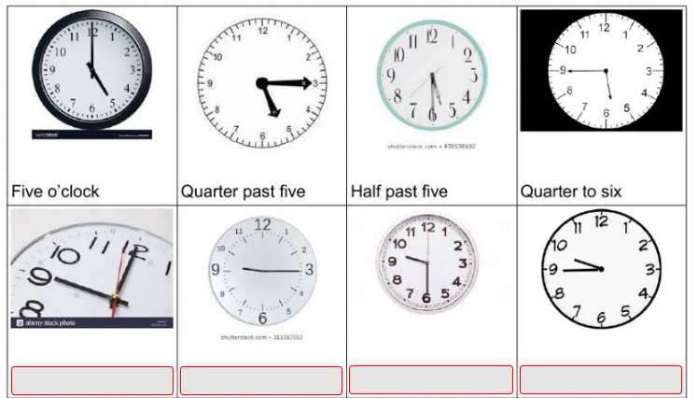
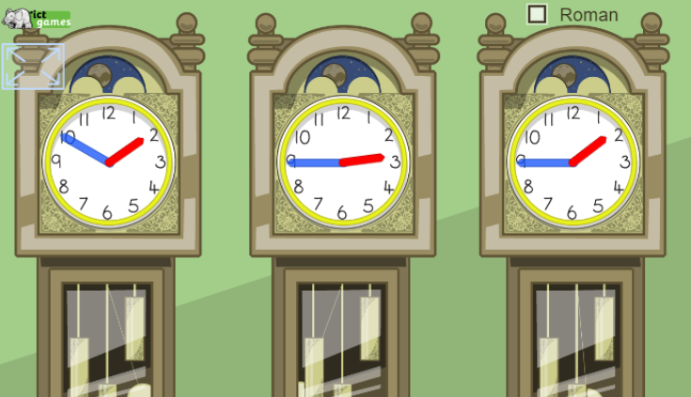
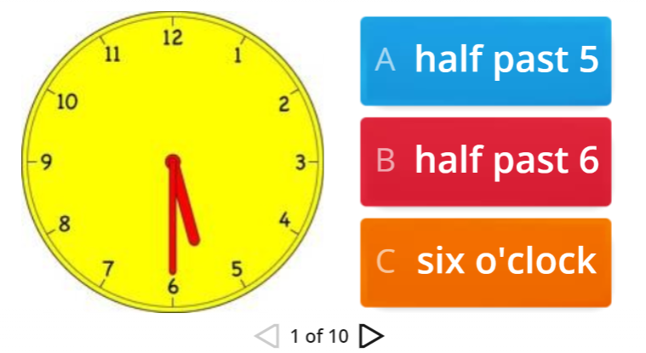
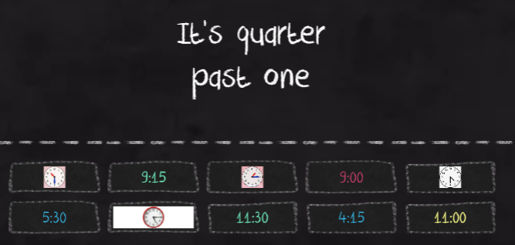
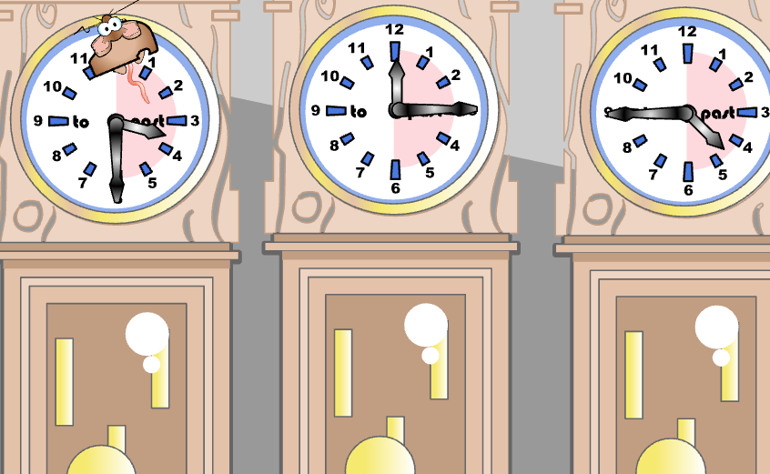
IrinaPapakhinac

Slide 19
HOURS
0
5
12
5
It’s five past … .
1
2
3
11
1
4
5
6
10
10
It’s ten past … .
10
2
7
8
9
10
11
12
1/4
9
3
1/4
It’s quarter past … .
MINUTES
8
4
1
2
3
20
20
It’s twenty past … .
4
5
6
7
5
6
7
8
9
25
25
It’s twenty-five past … .
1/2
10
11
12
It’s half past … .
IrinaPapakhinac

Slide 20
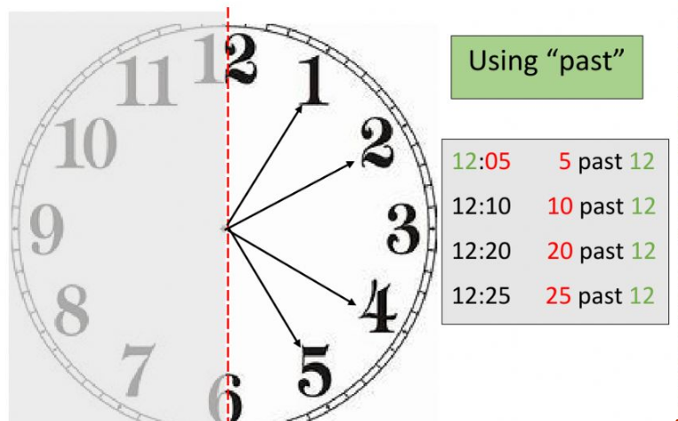
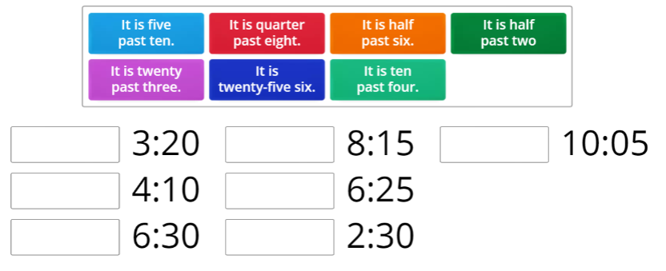
IrinaPapakhinac

Slide 21
HOURS
0
5
12
5
1
2
3
It’s five to … .
11
1
4
5
6
10
10
It’s ten to … .
10
2
7
8
9
10
11
12
1/4
9
3
1/4
It’s quarter to … .
MINUTES
8
4
1
2
3
It’s twenty to … .
20
20
4
5
6
7
5
6
7
8
9
25
25
It’s twenty-five to … .
1/2
10
11
12
IrinaPapakhinac

Slide 22
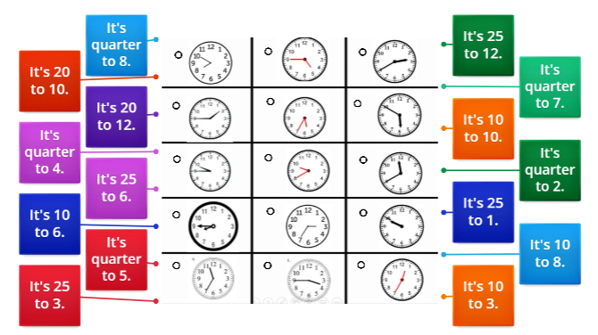
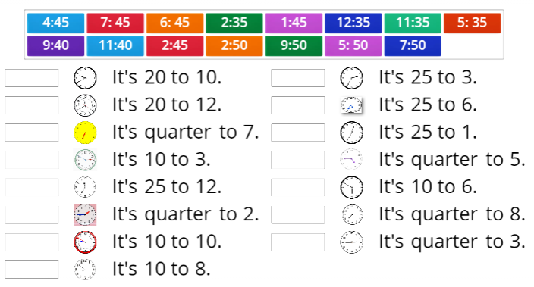
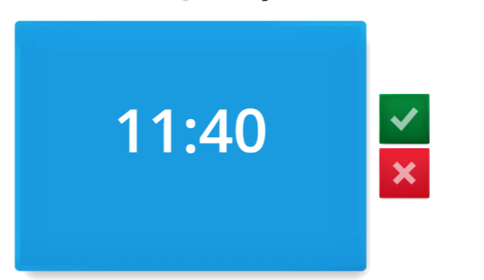
IrinaPapakhinac

Slide 23
HOURS
0
It’s … o’clock .
5
12
5
It’s five past … .
1
2
3
It’s five to … .
11
1
4
5
6
10
10
It’s ten past … .
It’s ten to … .
10
2
7
8
9
10
11
12
1/4
9
3
1/4
It’s quarter past … .
It’s quarter to … .
MINUTES
8
4
1
2
3
It’s twenty to … .
20
20
It’s twenty past … .
4
5
6
7
5
6
7
8
9
25
25
It’s twenty-five past … .
It’s twenty-five to … .
1/2
10
11
12
It’s half past … .
IrinaPapakhinac

Slide 24
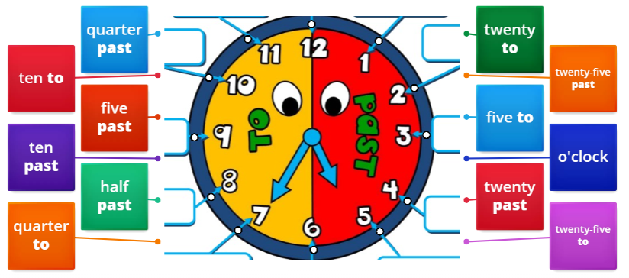
IrinaPapakhinac

Slide 25
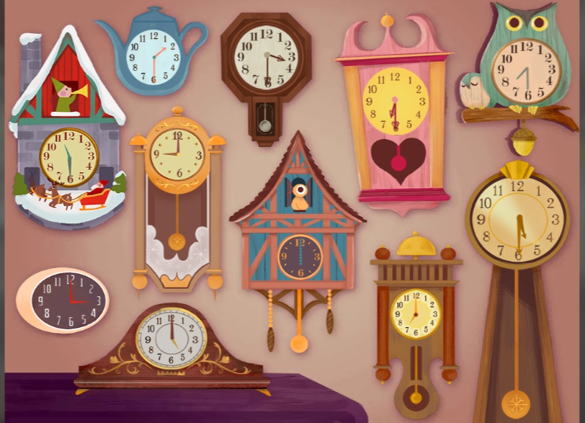
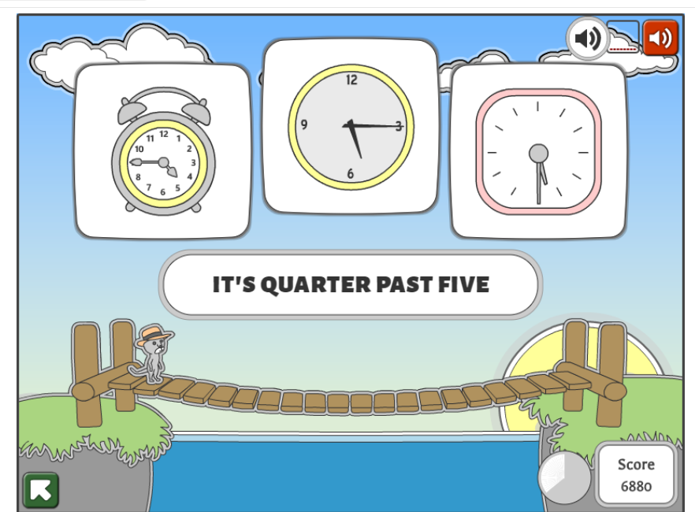
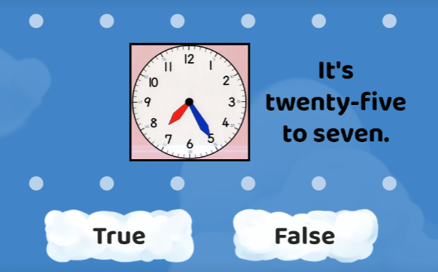
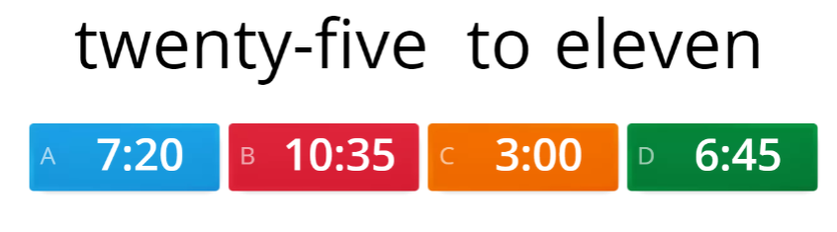
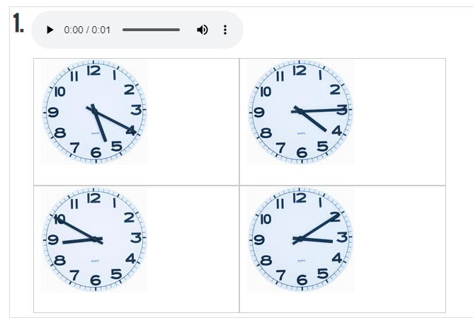
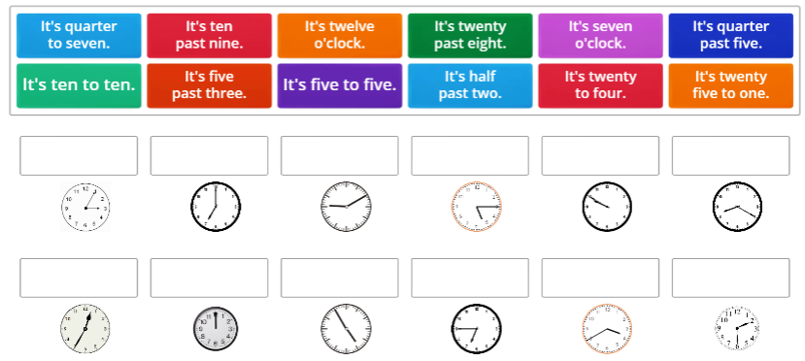
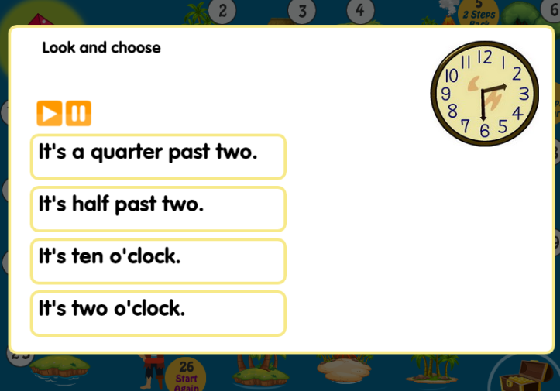
IrinaPapakhinac

Slide 26
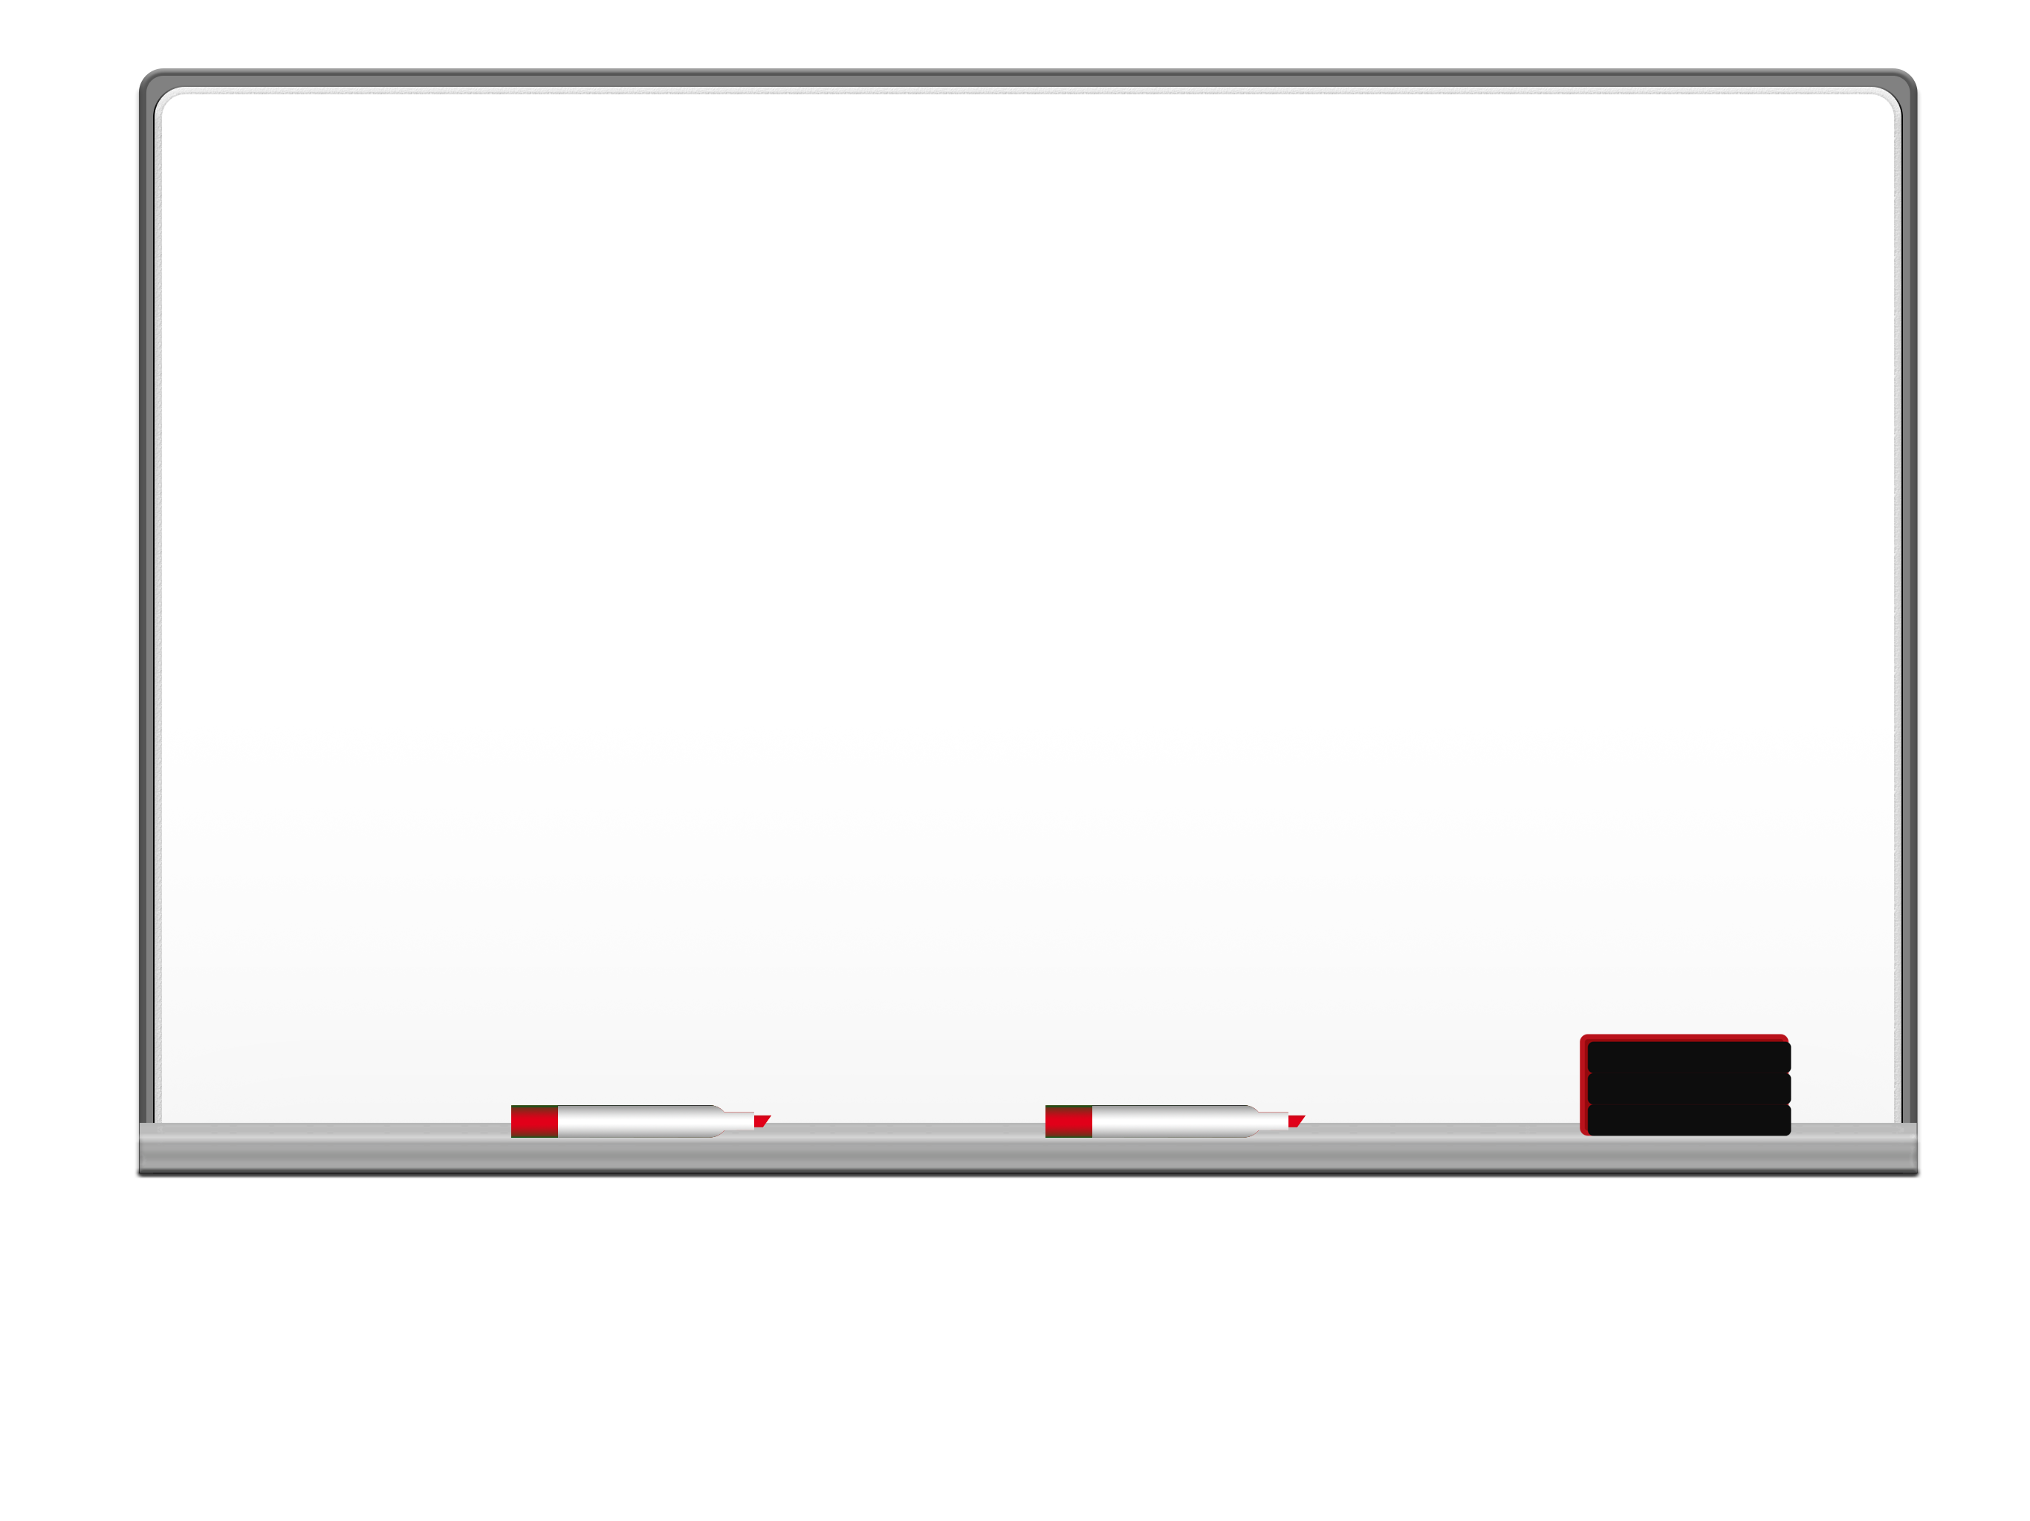
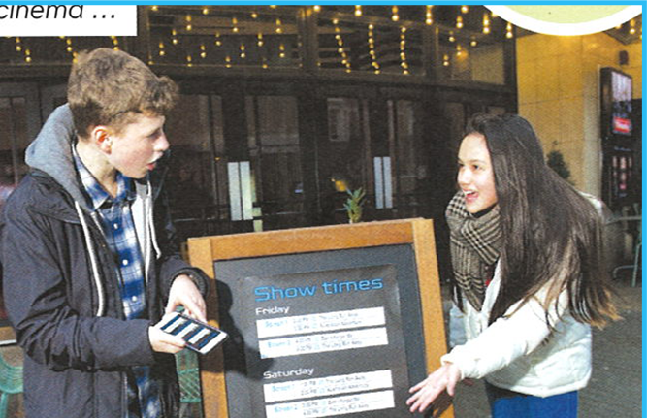
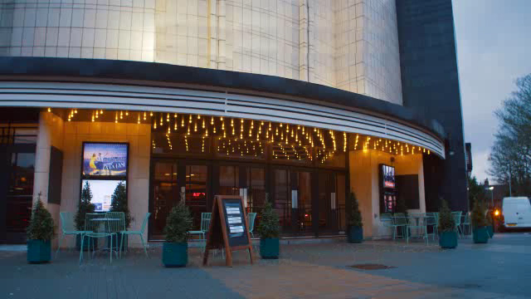
Watch the video and say
what time the film is on.
IrinaPapakhinac

Slide 27

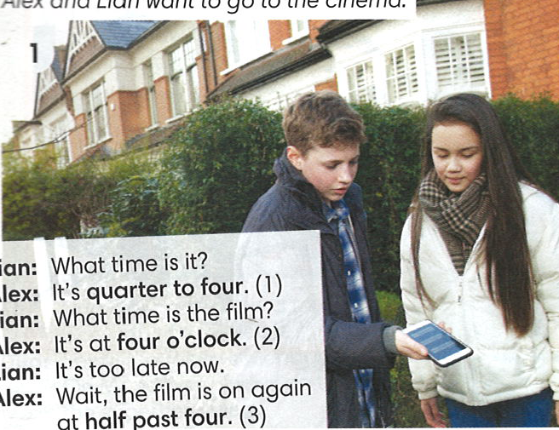
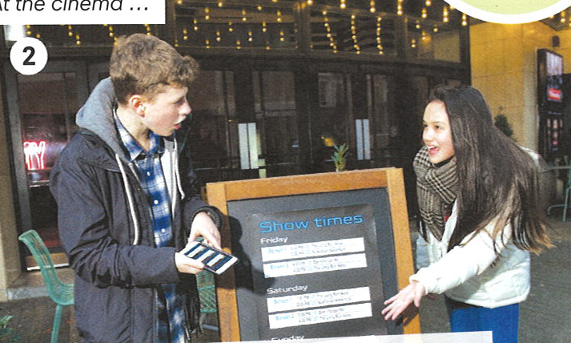
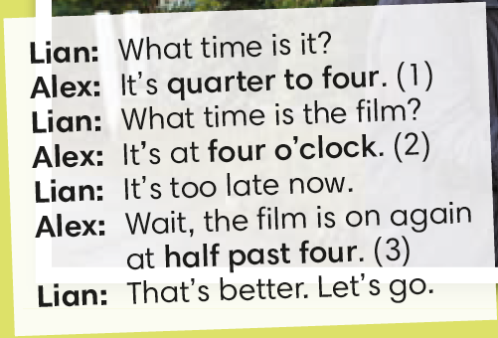
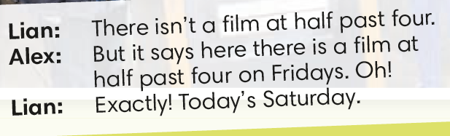
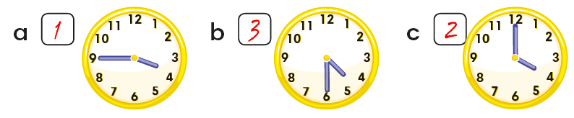
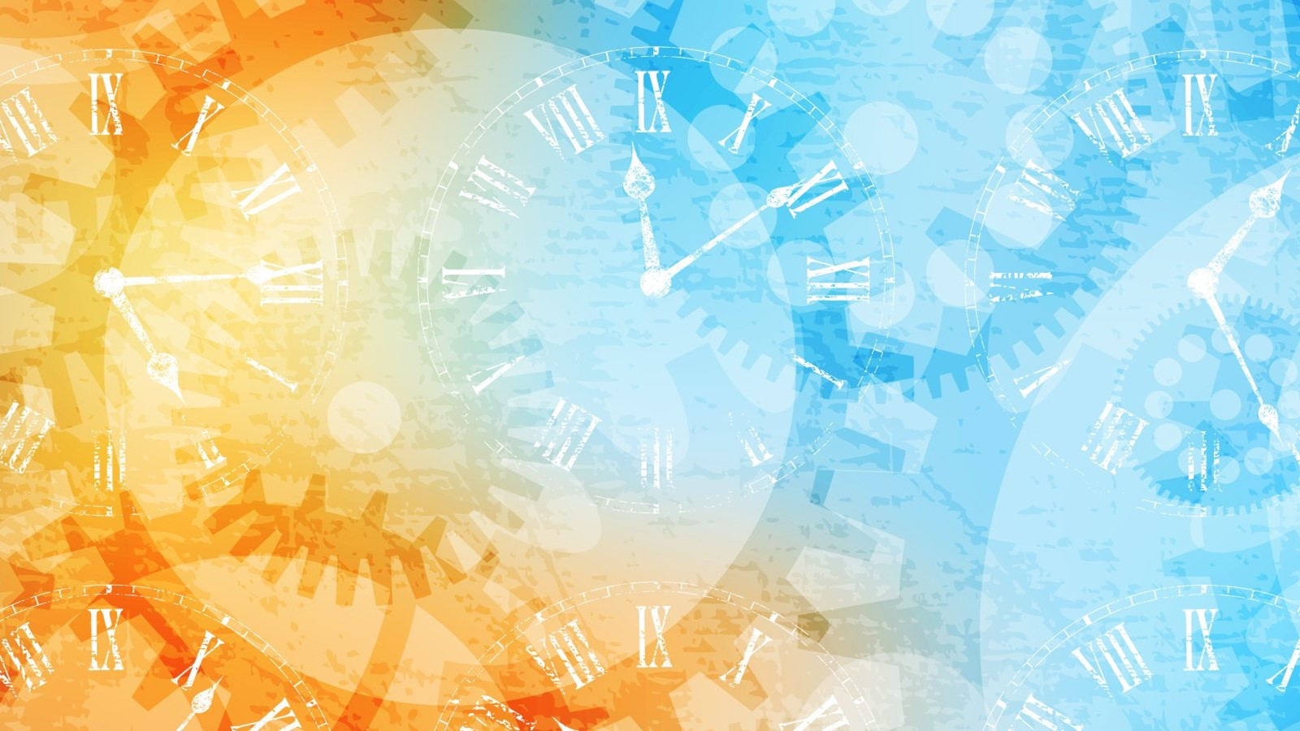
Match the times in the dialogue (1-3) with the clocks (a-c).
IrinaPapakhinac

Slide 28
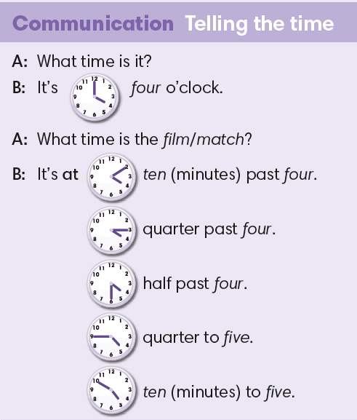
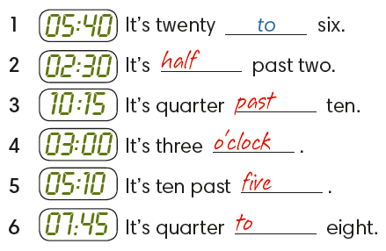
IrinaPapakhinac

Slide 29
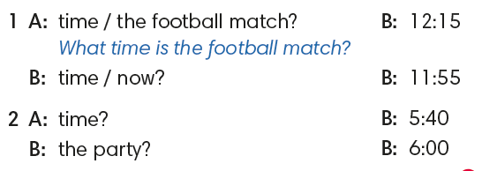
Make dialogues.
IrinaPapakhinac

Slide 30
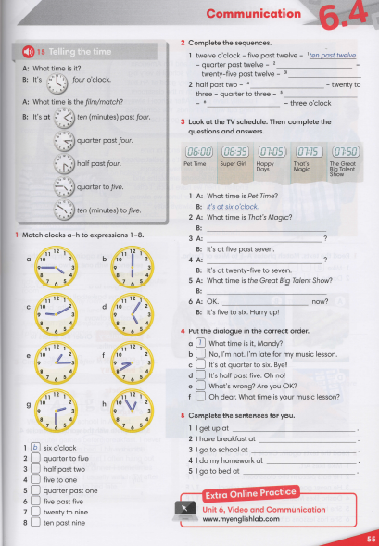


IrinaPapakhinac

Slide 31
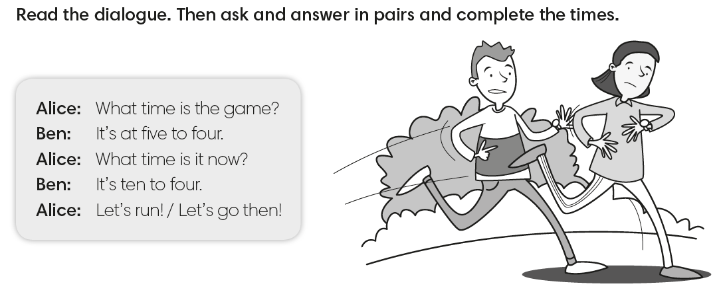

IrinaPapakhinac

Slide 32

IrinaPapakhinac

