Slide 1
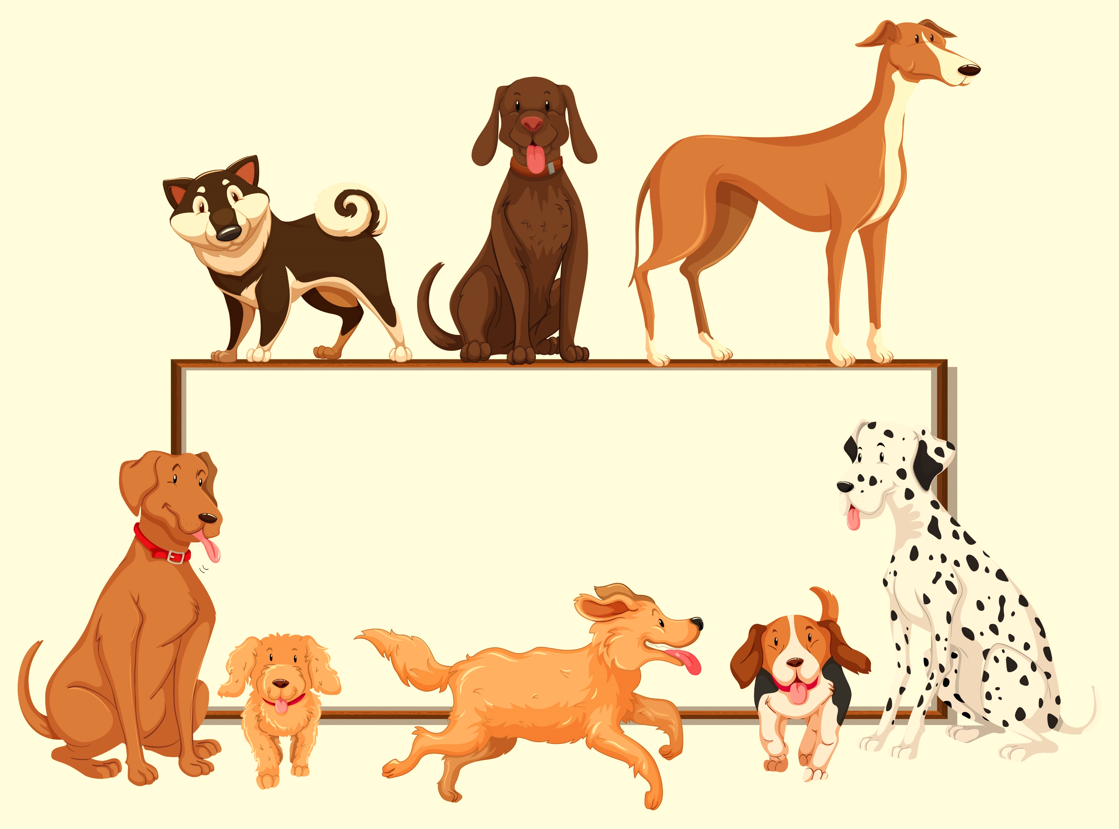




Slide 2

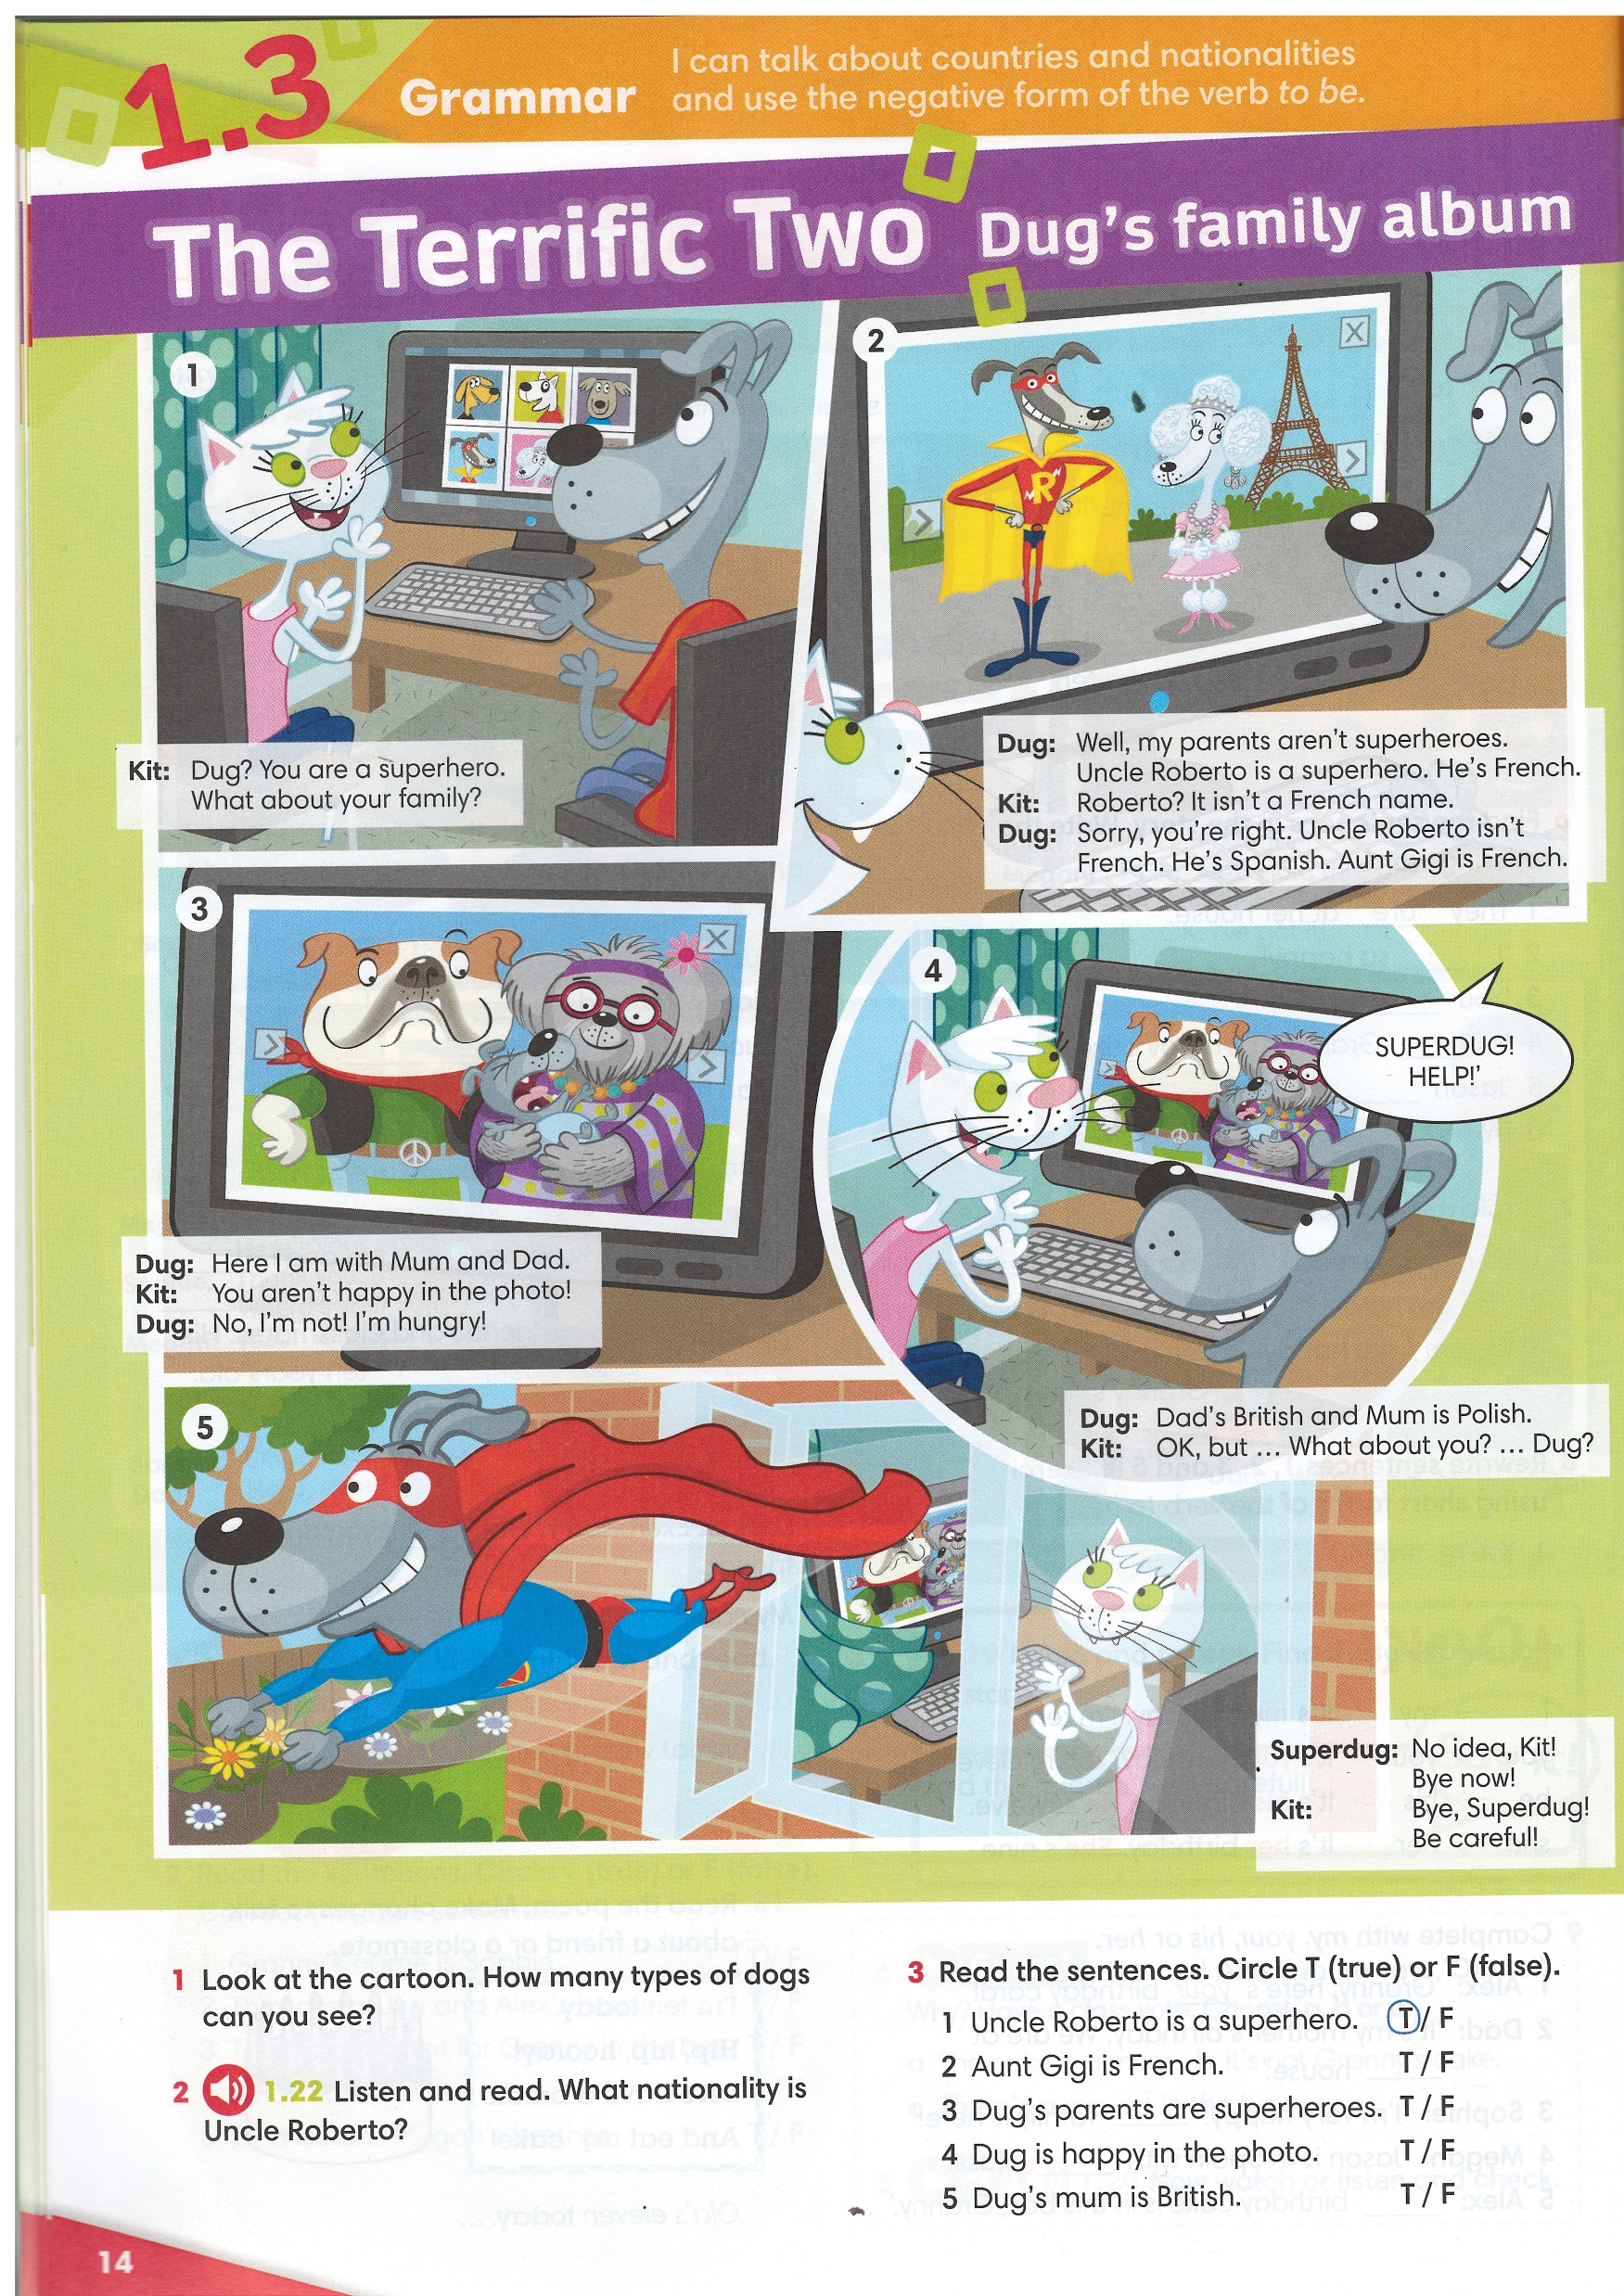

Look at the photos from Dug’s family album.
Can you see Dug’s parents? Are they superheroes?
Can you see a superhero? Is he Dug’s brother, cousin, uncle or grandad?
Listen and check your answers.
IrinaPapakhina

Slide 3

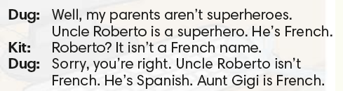
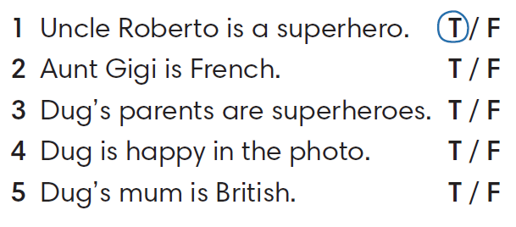



IrinaPapakhina

Slide 4
Complete the sentences.
aren’t
Well, my parents ________ superheroes.
It ________ a French name.
Uncle Roberto ________ French.
You ________ happy in the photo.
isn’t
isn’t
aren’t
IrinaPapakhina

Slide 5
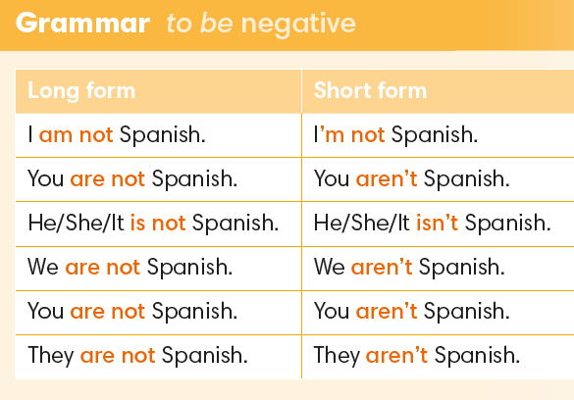
IrinaPapakhina

Slide 6
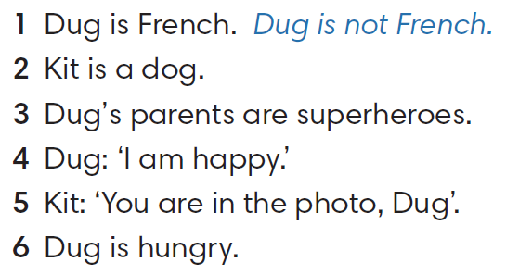
2. Kit is not a dog. / Kit isn’t a dog.
3. Dug’s parents are not superheroes. / They aren’t superheroes.
4. Dug: “I am not happy.” / I’m not happy”.
5. Kit: “You are not in the photo, Dug”. / You aren’t in the photo, Dug”.
6. Dug is not hungry. / Dug isn’t hungry.
IrinaPapakhina

Slide 7
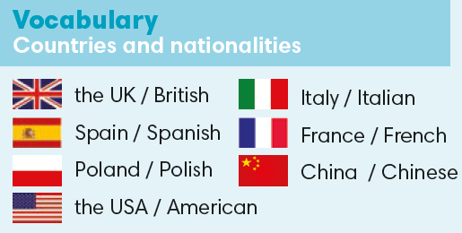
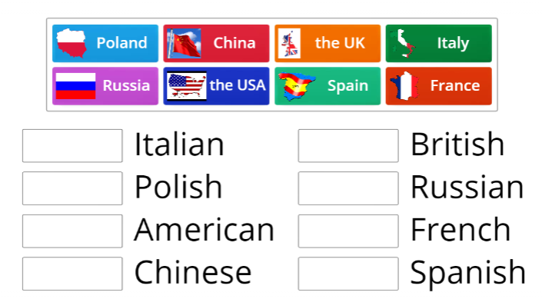
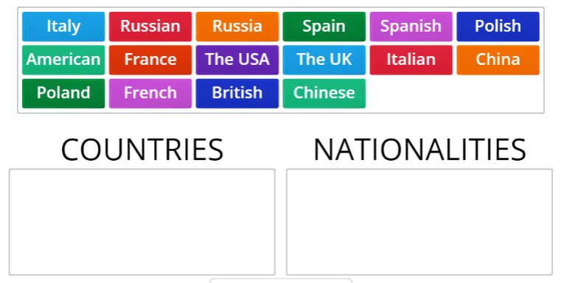

IrinaPapakhina

Slide 8
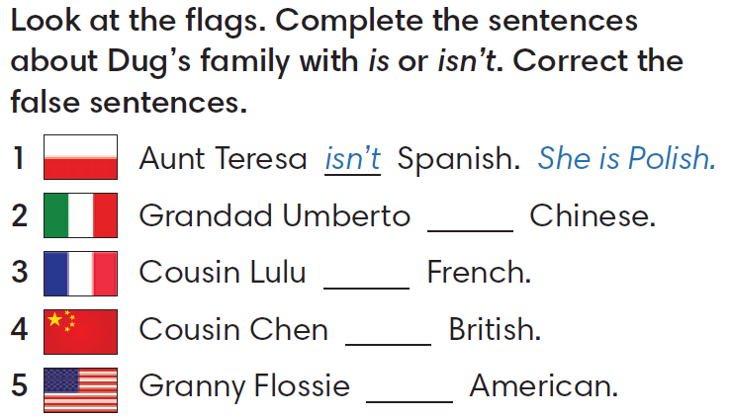
isn’t
He is Italian.
isn’t
isn’t
He is Chinese.
is
IrinaPapakhina

Slide 9
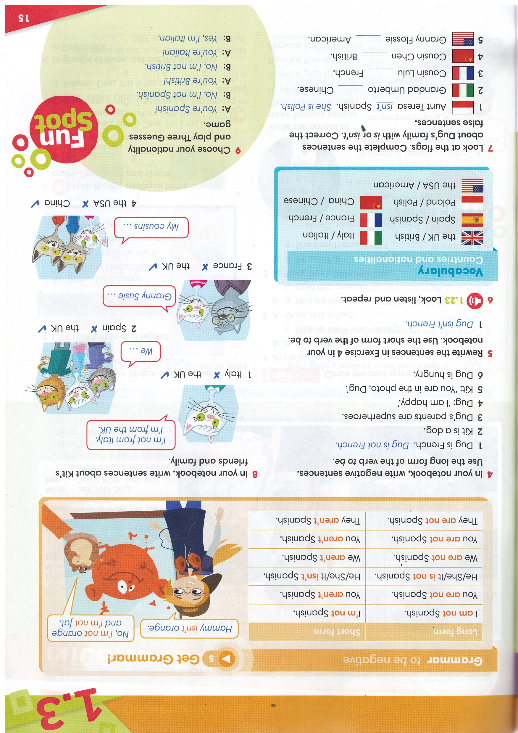
2. We aren’t from Spain. We are from the UK.
3. Granny Susie isn’t from France. She is from the UK.
4. My cousins aren’t from the USA. They are from China.
IrinaPapakhina

Slide 10
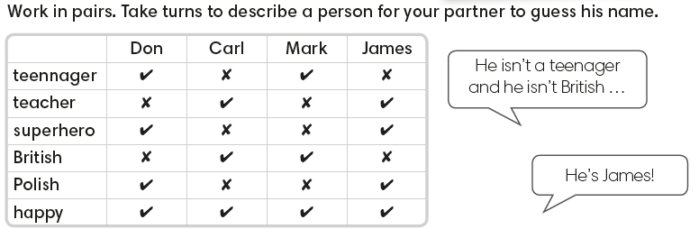
IrinaPapakhina

Slide 11
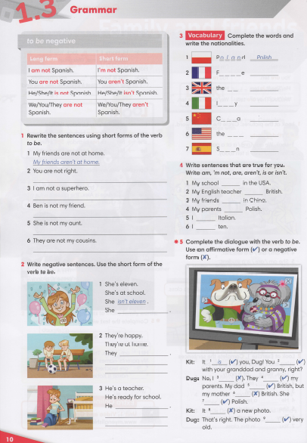


IrinaPapakhina

Slide 12
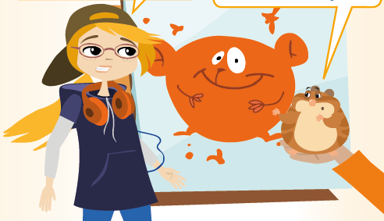

What is it?
Watch the video
and check your answer.
IrinaPapakhina

Slide 13
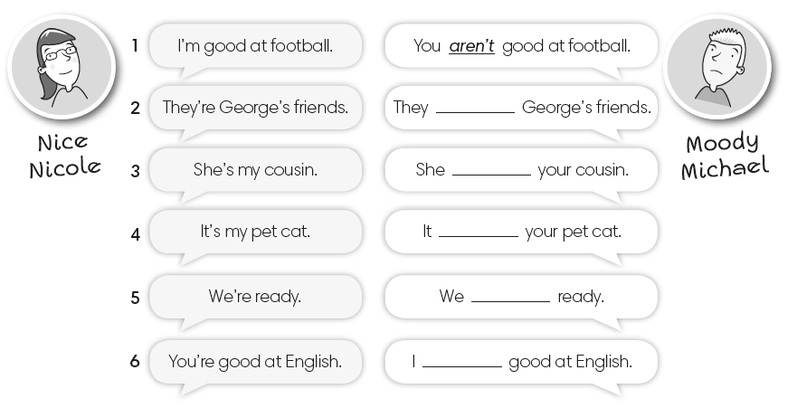
IrinaPapakhina

Slide 14
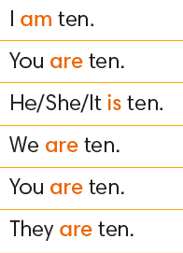
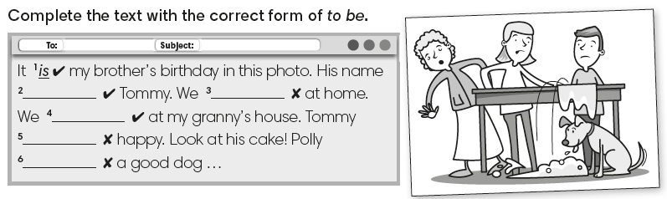
IrinaPapakhina

Slide 15
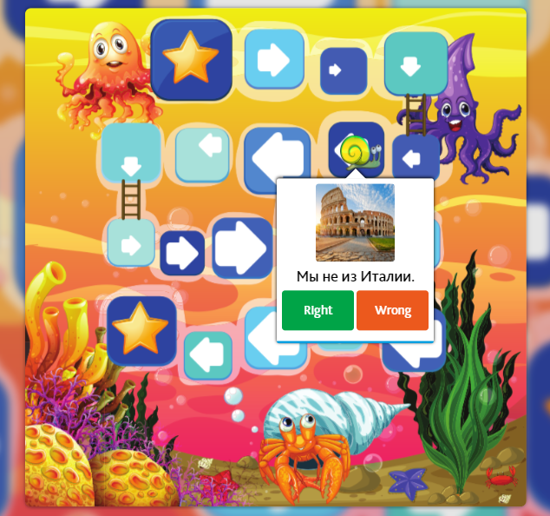
IrinaPapakhina

