Slide 1

PRIMARY FOUR
WAS / WERE

Slide 2
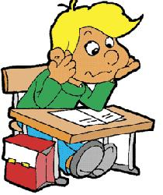

WAS/WERE
POSITIVE & NEGATIVE FORM
I
He
She
It
We
You
They
was/wasn’t at school yesterday.
were/weren’t at the beach last week.

Slide 3

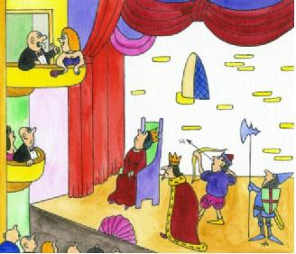
QUESTION FORM
I
He
She
It
We
You
They
Yes, she was.
No,she wasn’t.
Was
hungry?
at the theatre last weekend?
Were
Yes, we were.
No,we weren’t.

Slide 4

I __________ at home yesterday.
were
wasn’t
weren’t
I __________ at school.
was
wasn’t
were
I __________ happy, because
was
wasn’t
were
My friends __________ at school.
was
were
weren’t

Slide 5
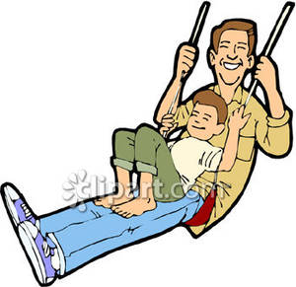
Tom __________ in the playground last week.
was
wasn’t
were
He __________ with his dad.
was
wasn’t
were
Tom’s mum __________ in the playground.
was
wasn’t
were
He __________ on the swing.
wasn’t
was
weren’t

Slide 6

Sally and Tom __________ in the ZOO last weekend.
was
wasn’t
were
There __________ elephants in the ZOO.
was
were
weren’t
They __________ huge.
was
were
weren’t
But the children _________ scared.
was
were
weren’t

Slide 7
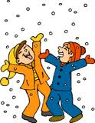
Yesterday it __________ snowy.
was
wasn’t
were
It __________ hot, but
was
wasn’t
were
the boys __________ sad.
were
weren’t
wasn’t
They __________ happy.
were
was
weren’t
The children __________ in the garden.
was
weren’t
were

Slide 8

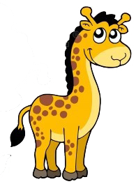
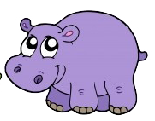



I was in the zoo yesterday.
I am in the museum now.

Slide 9


My friend is 6 years old now.
He was 5 years old last year.

Slide 10



The weather was rainy yesterday.
It is sunny today.

Slide 11


He was a student ten years ago.
He is a teacher now.

Slide 12
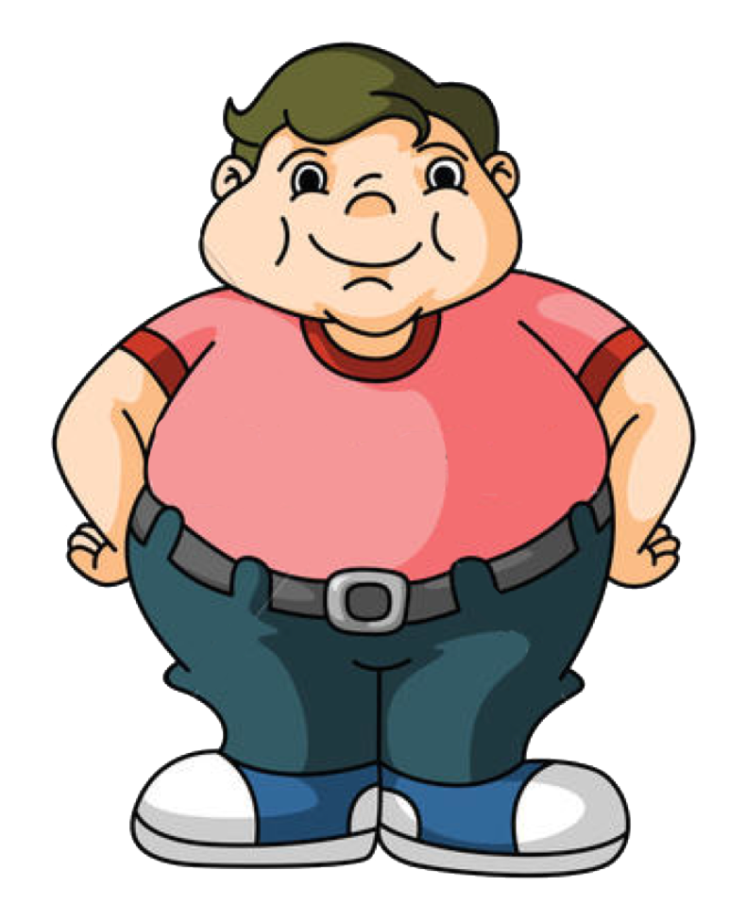
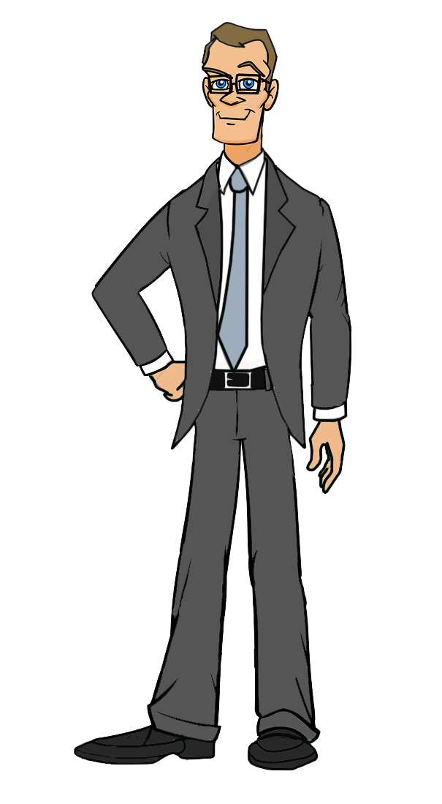
I was fat when I was young.
I am slim now.

