Slide 1





Slide 2


Hi, my name is Tom and this is Chammy, my pet.
Can you describe the following pictures?
Let’s have a look!

Slide 3


Slide 4
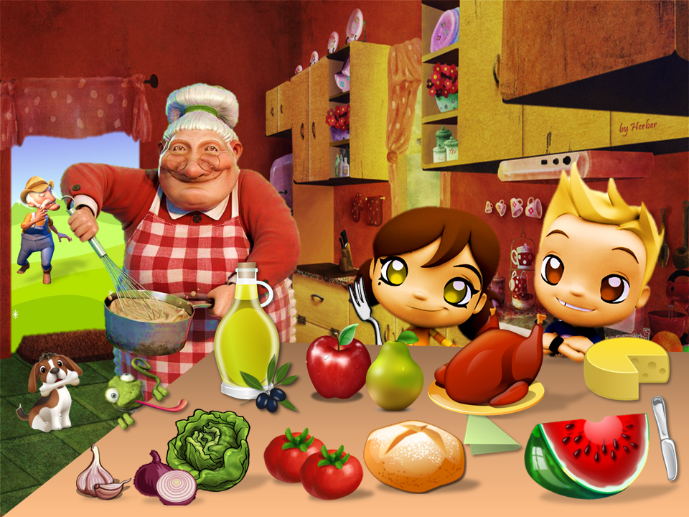


Slide 5
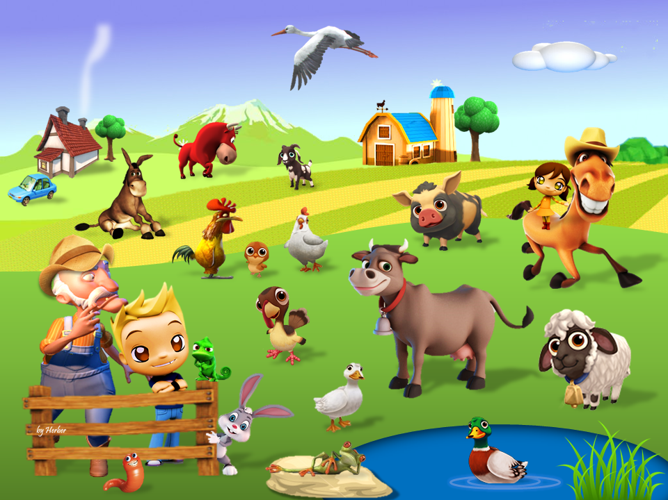

Slide 6


Slide 7
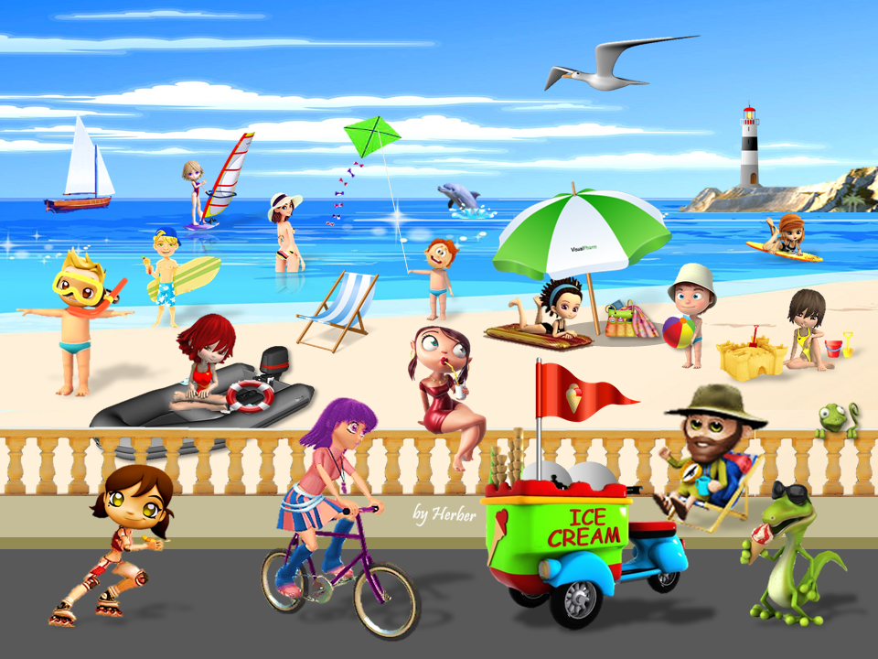

Slide 8


Slide 9



Slide 10


Slide 11
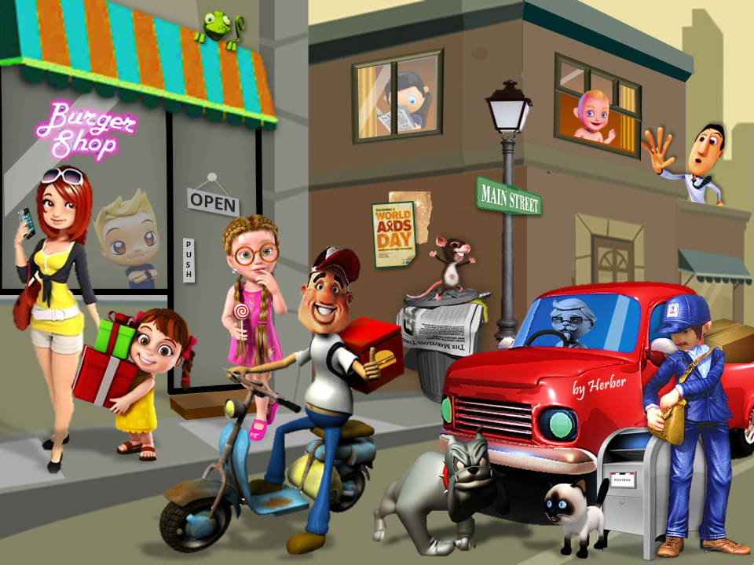

Slide 12
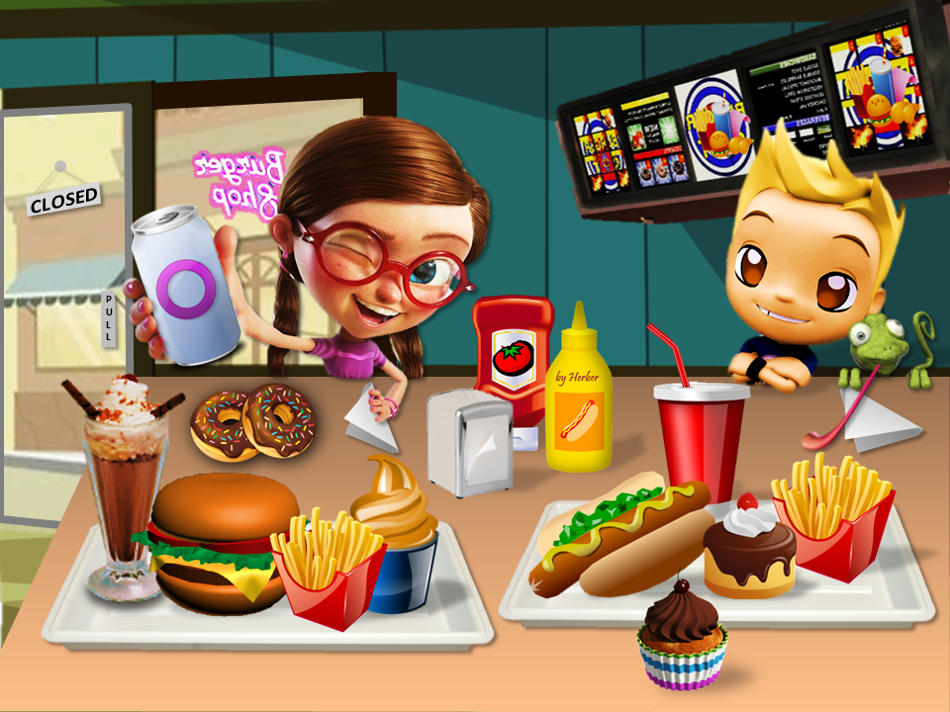

Slide 13



Slide 14


Slide 15
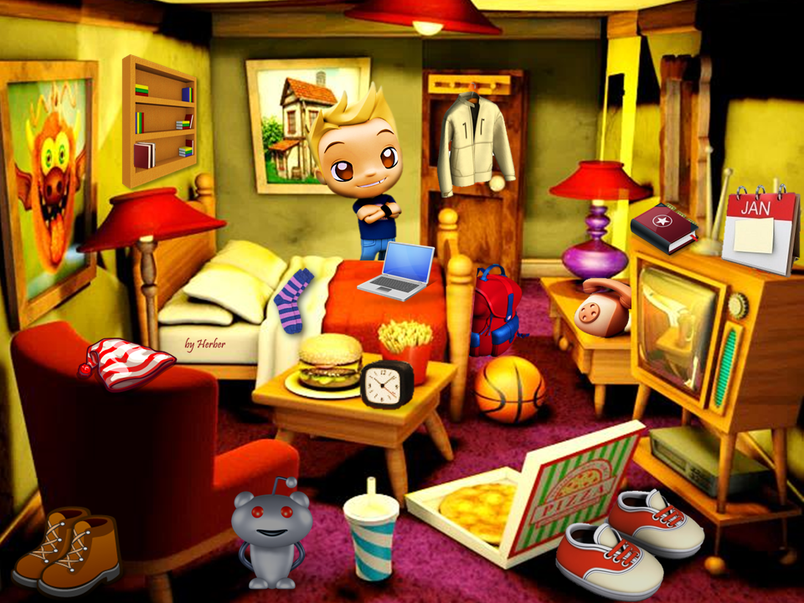




Slide 16
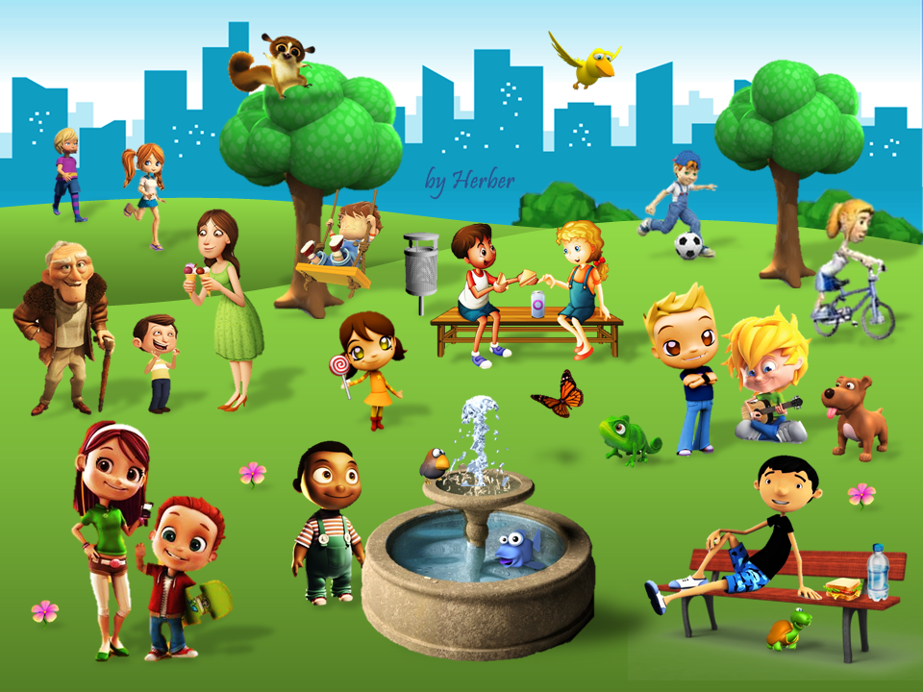

Slide 17
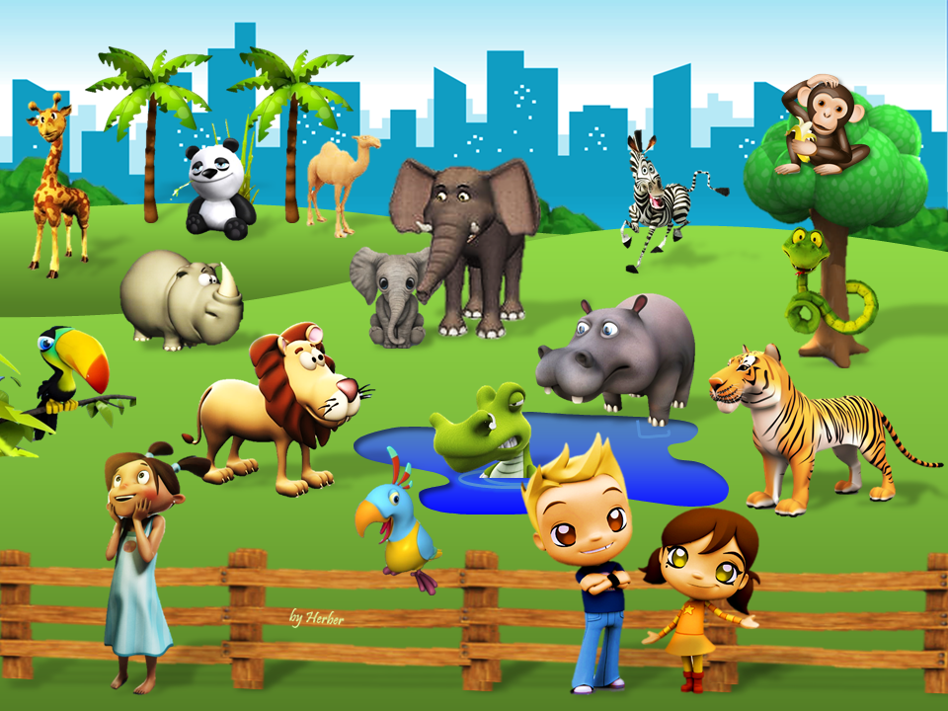


Slide 18
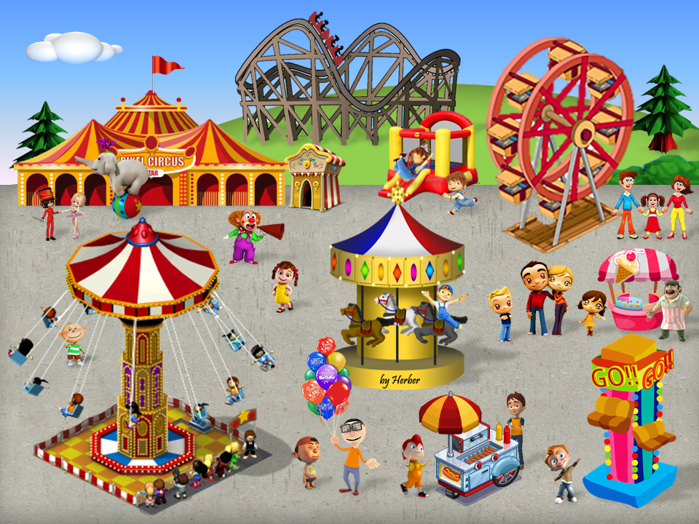

Slide 19
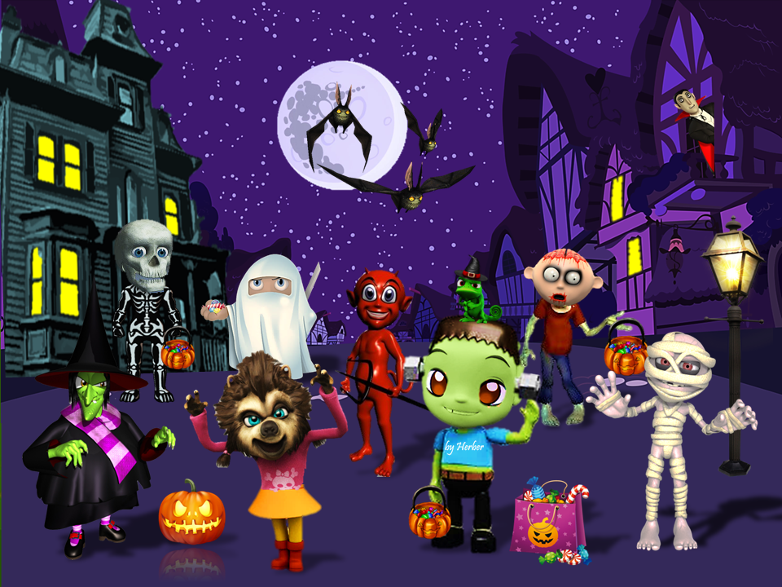


Slide 20


Slide 21


Slide 22


