Slide 1
What Can You Do?

Slide 2
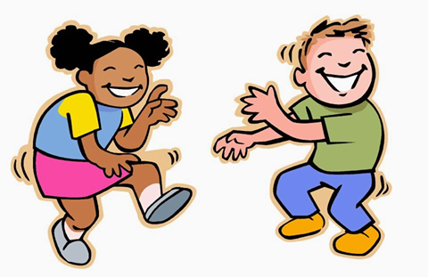
Dance

Slide 3
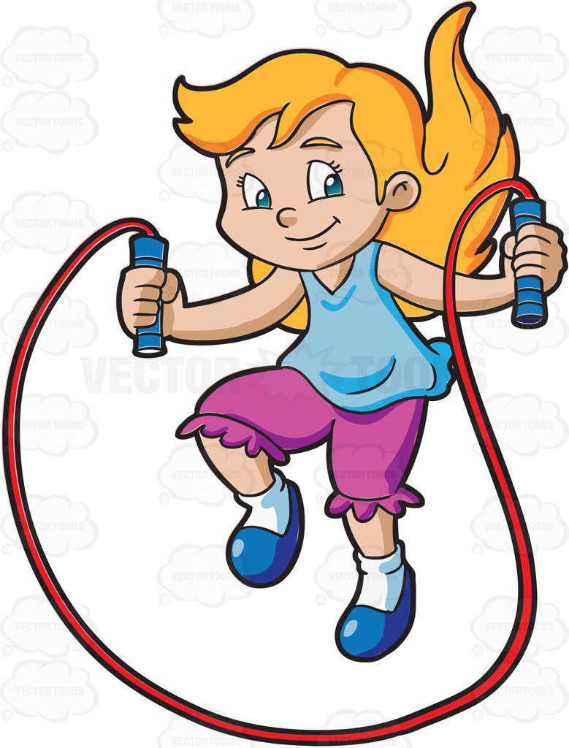
Skip

Slide 4

Swim

Slide 5
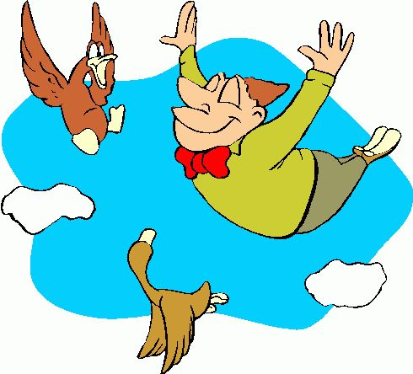
Fly

Slide 6
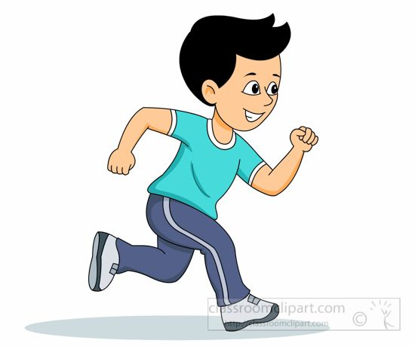
Run

Slide 7
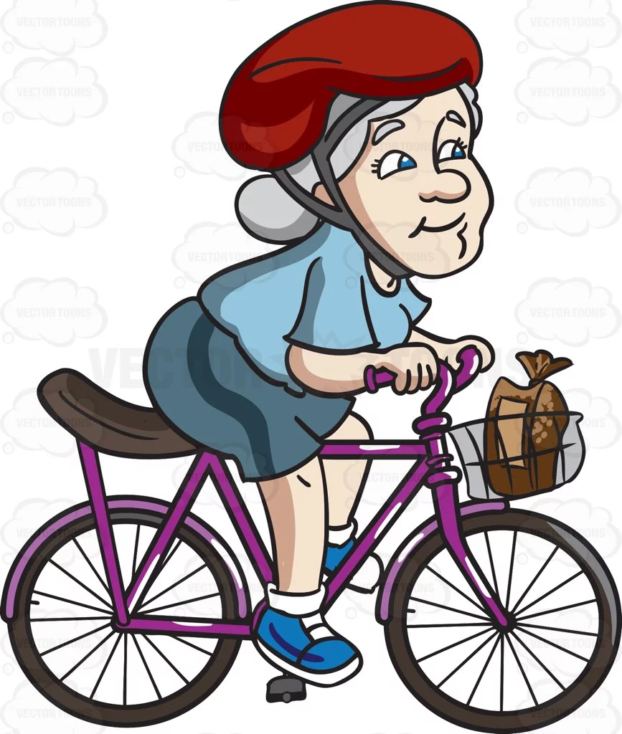
Ride a Bike

Slide 8

Read

Slide 9

Jump

Slide 10

Draw

Slide 11
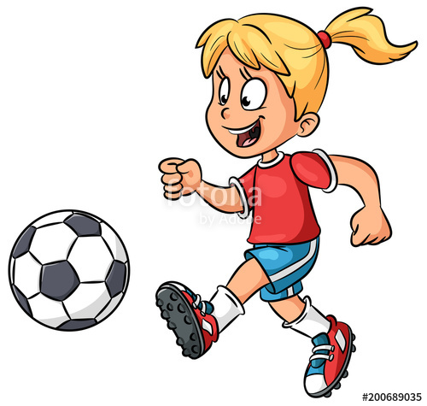
Play Football

Slide 12

Walk

Slide 13

Sing

Slide 14
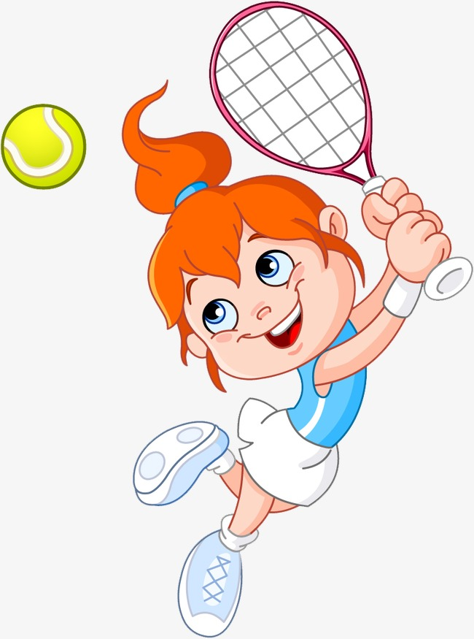
Play Tennis

Slide 15
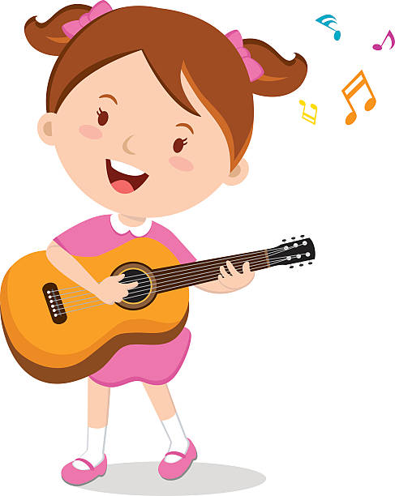
Play the Guitar

Slide 16


Slide 18
CAN
CAN’T

