Slide 1
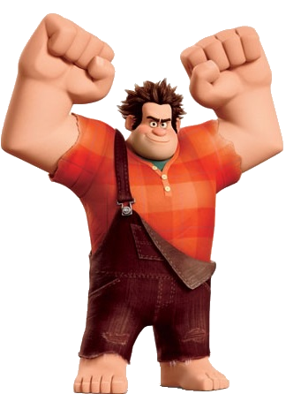

as … as
not so … as

Slide 2

Use as … as
Superman
Batman
serious
strict
Superman is as serious (strict) as Batman.

Slide 3
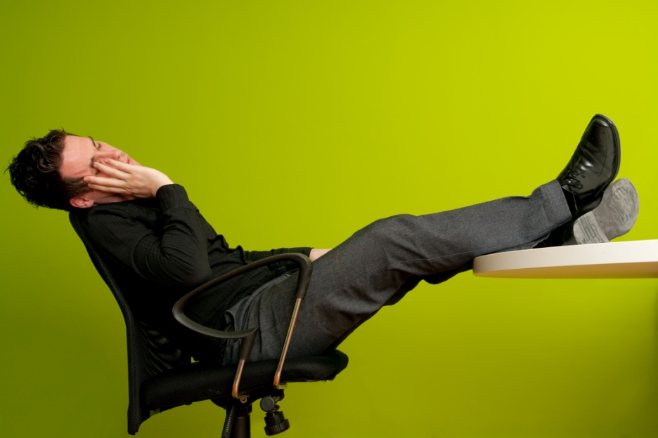
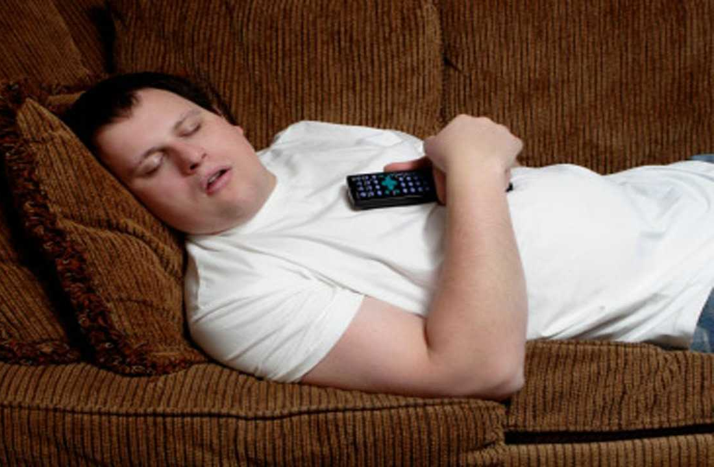
Use as … as
Robert
Sam
lazy
Robert is as lazy as Sam.

Slide 4
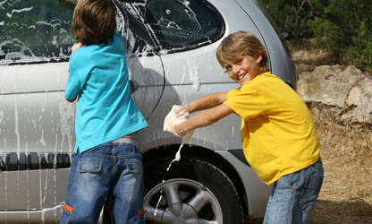
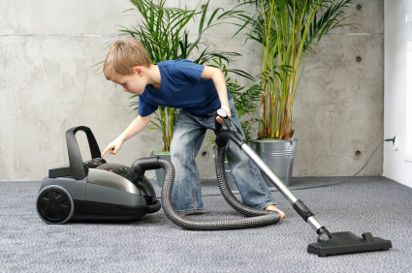
Use as … as
Peter and Frank
Ben
helpful
Peter and Frank are as helpful as Ben.

Slide 5
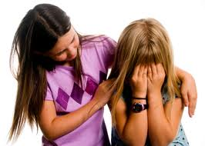
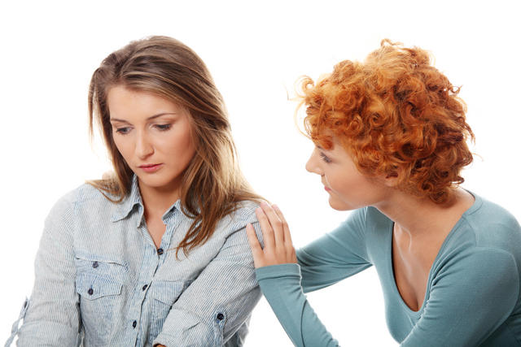
Use as … as
Diana
Stacy
caring
trustworthy
understanding
Diana is as caring as Stacy.

Slide 6
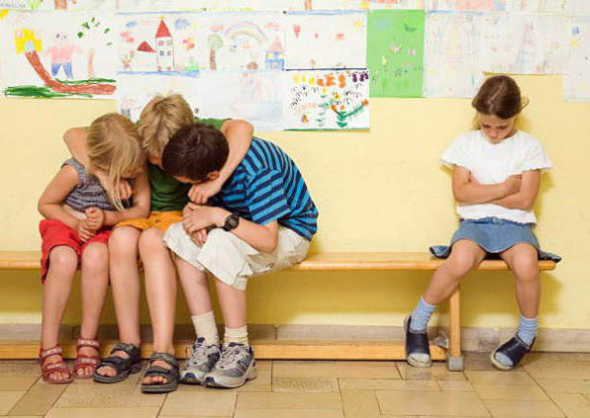
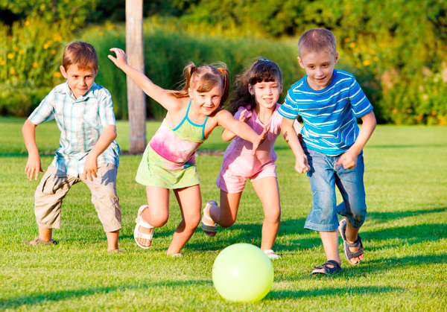
Use not so … as
Susan
sociable
John
outgoing
friendly
Susan is not so sociable as John.

Slide 7
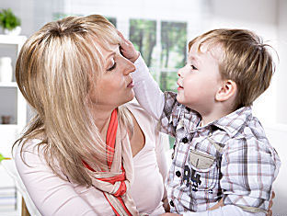
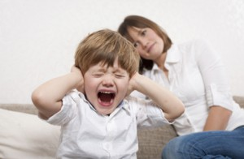
Use not so … as
Steve
Tom
complaining
Steve is not so complaining as Tom.

Slide 8
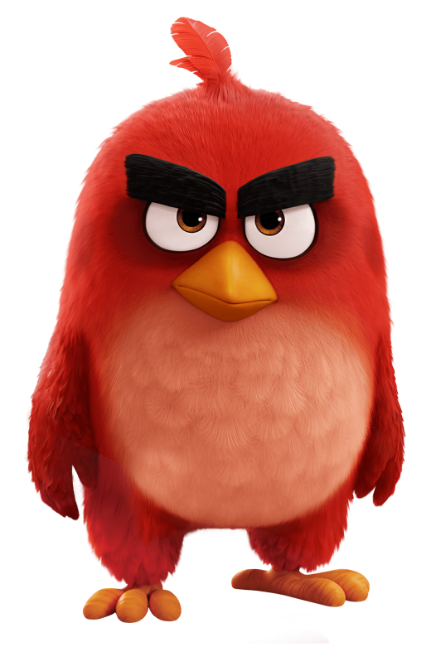
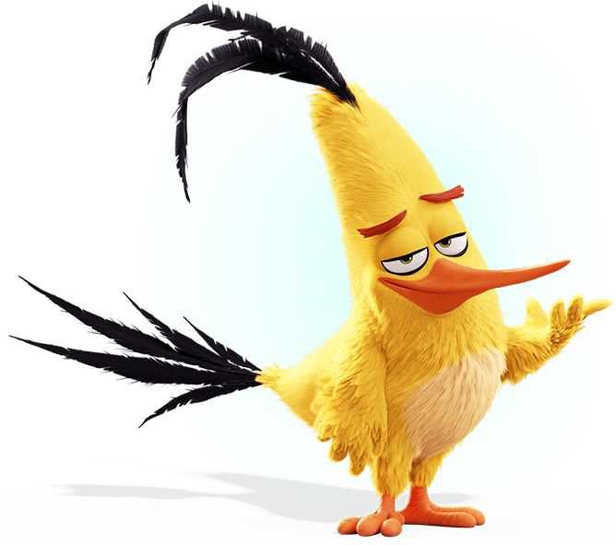
Use not so … as
Red
Chuck
chatty
sociable
Red is not so chatty as Chuck.

Slide 9
Use not so … as
?
?
amusing

